Slide 1
Denver Public Library and Brest Mediatheque –
A Sister City Partnership
Presented by
Nancy Bolt and Diane LaPierre

Slide 2
Denver Sister Cities International
10 Sister Cities around the World
Expand to Libraries?
YES!! From
  Brest, France
  Takayama, Japan

Slide 3
Denver, CO and Brest, FR
Second-oldest Sister City in the US
Started in 1948, after visit from Amanda Knecht, teacher at East High School
Her class raised $32,000 to help build Children’s wing of the Brest hospital and donated books to the hospital

Slide 4
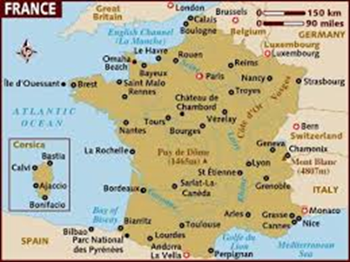

Slide 5
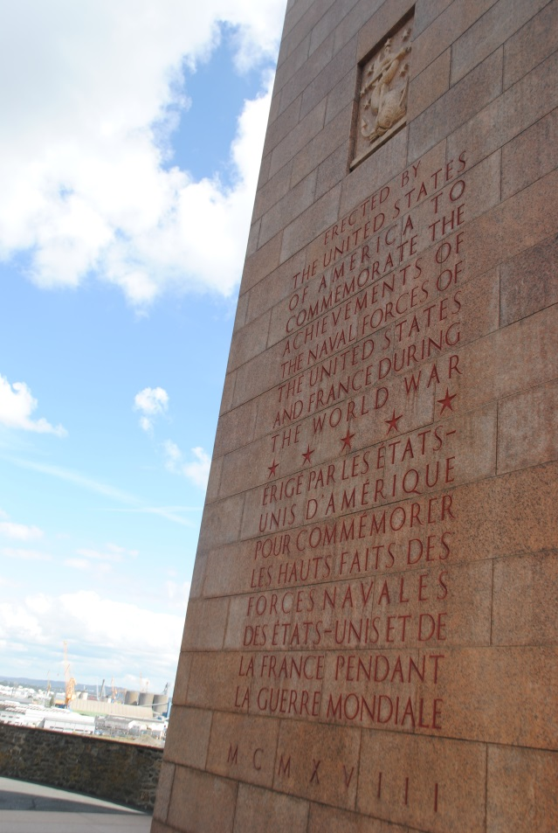
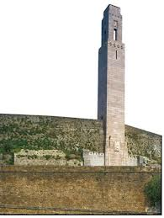
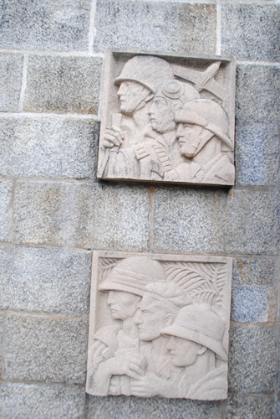
Brest, Franc

Slide 6
Erected by the United States of America to commemorate the achievements of the naval forces of the United States and France during the world war.

Slide 7
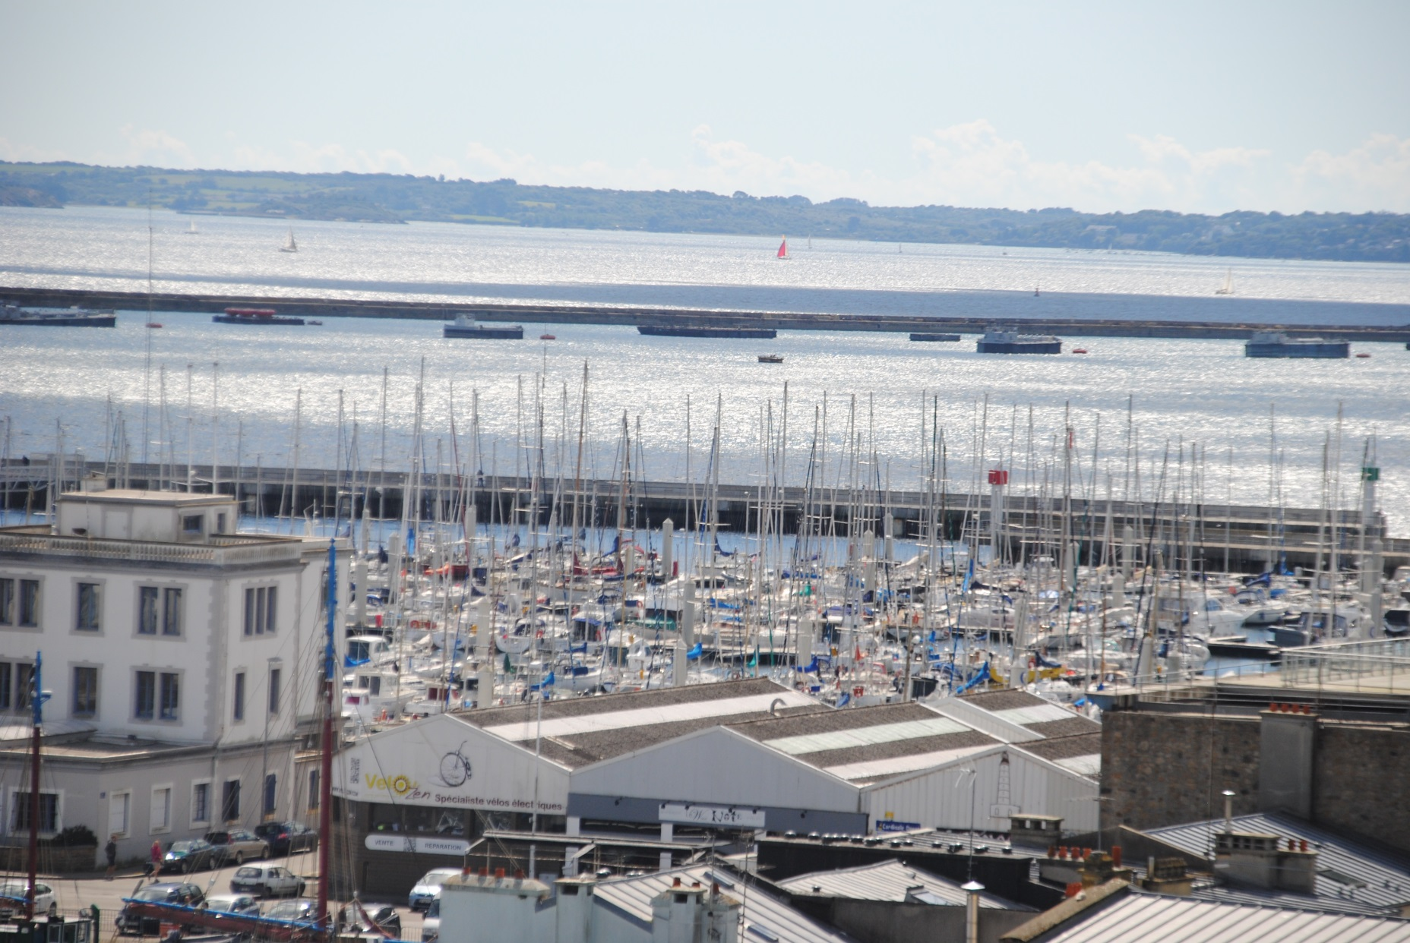

Slide 8
Nancy’s Visit to Brest
Representing the Library
  Nicolas Galaud, Director of Brest Public Libraries Network
  Bénédicte Jarry, Coordinator of the Capuchins Multimedia Library Project, Brest Public Libraries Network
Representing Brest City Government
  Julie Nuyts, Head, Office of International Division
  Vincent Birrien, Project Officer within the International Division
Representing the Brest/Denver Twinning Committee
  Armel Guyomard, Deputy President of Brest/Denver Twinning Committee
  Laurence Michelet, Member of Brest/Denver Twinning Committee

Slide 9
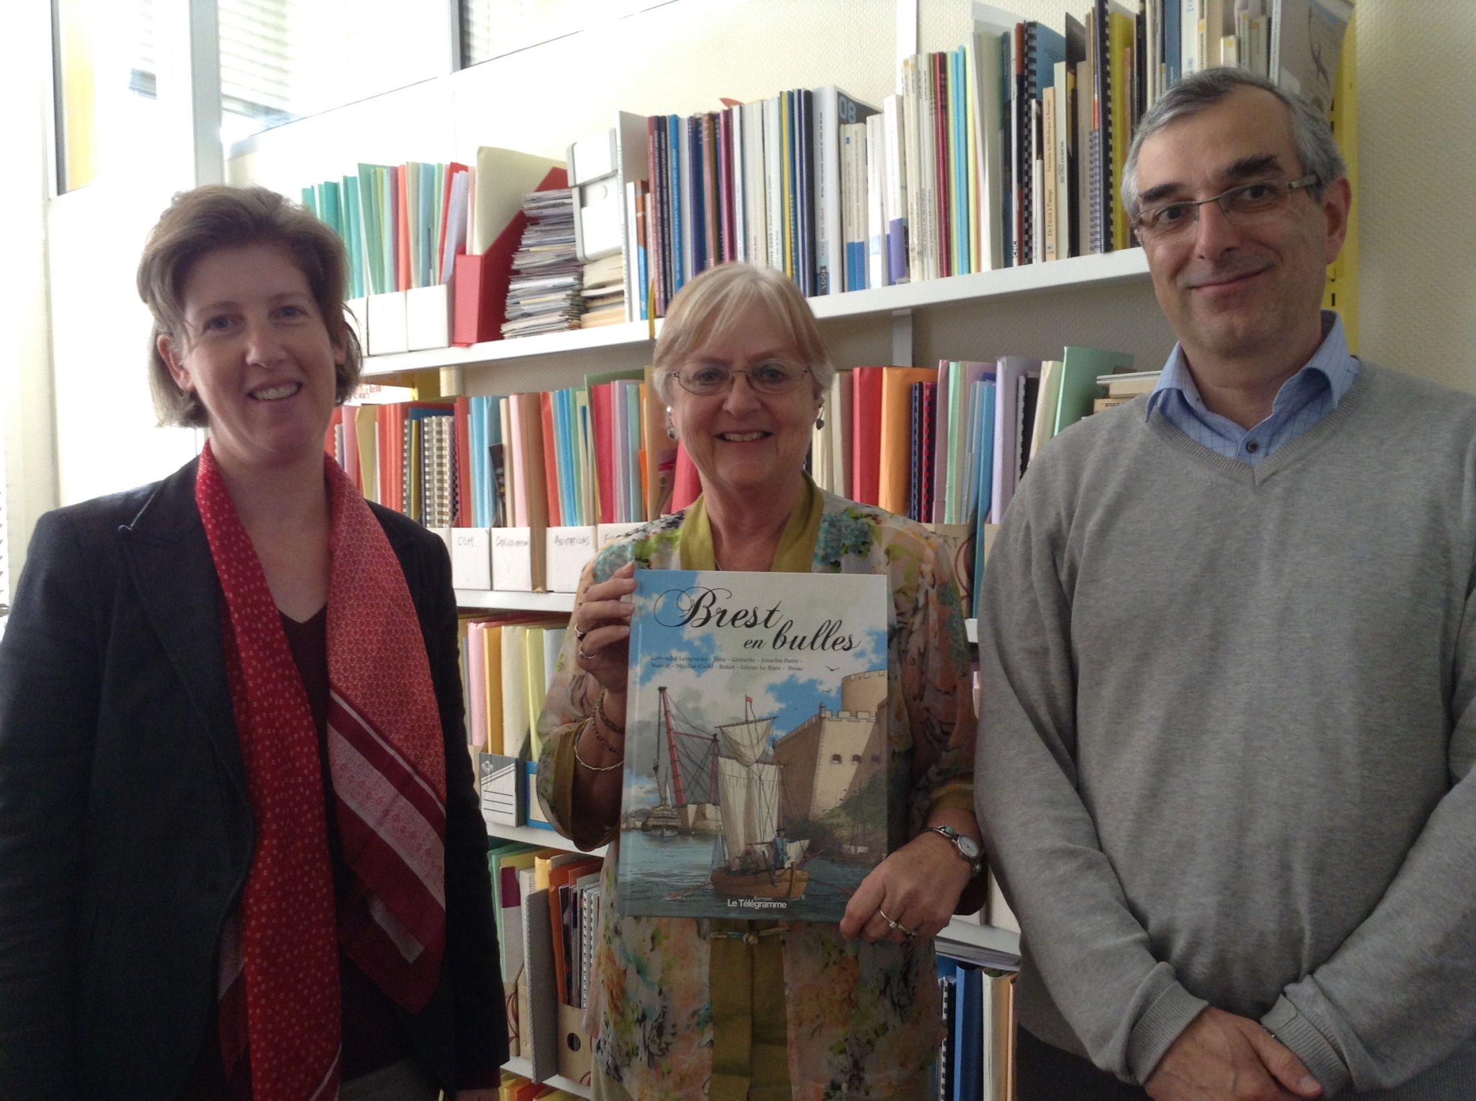

Slide 10
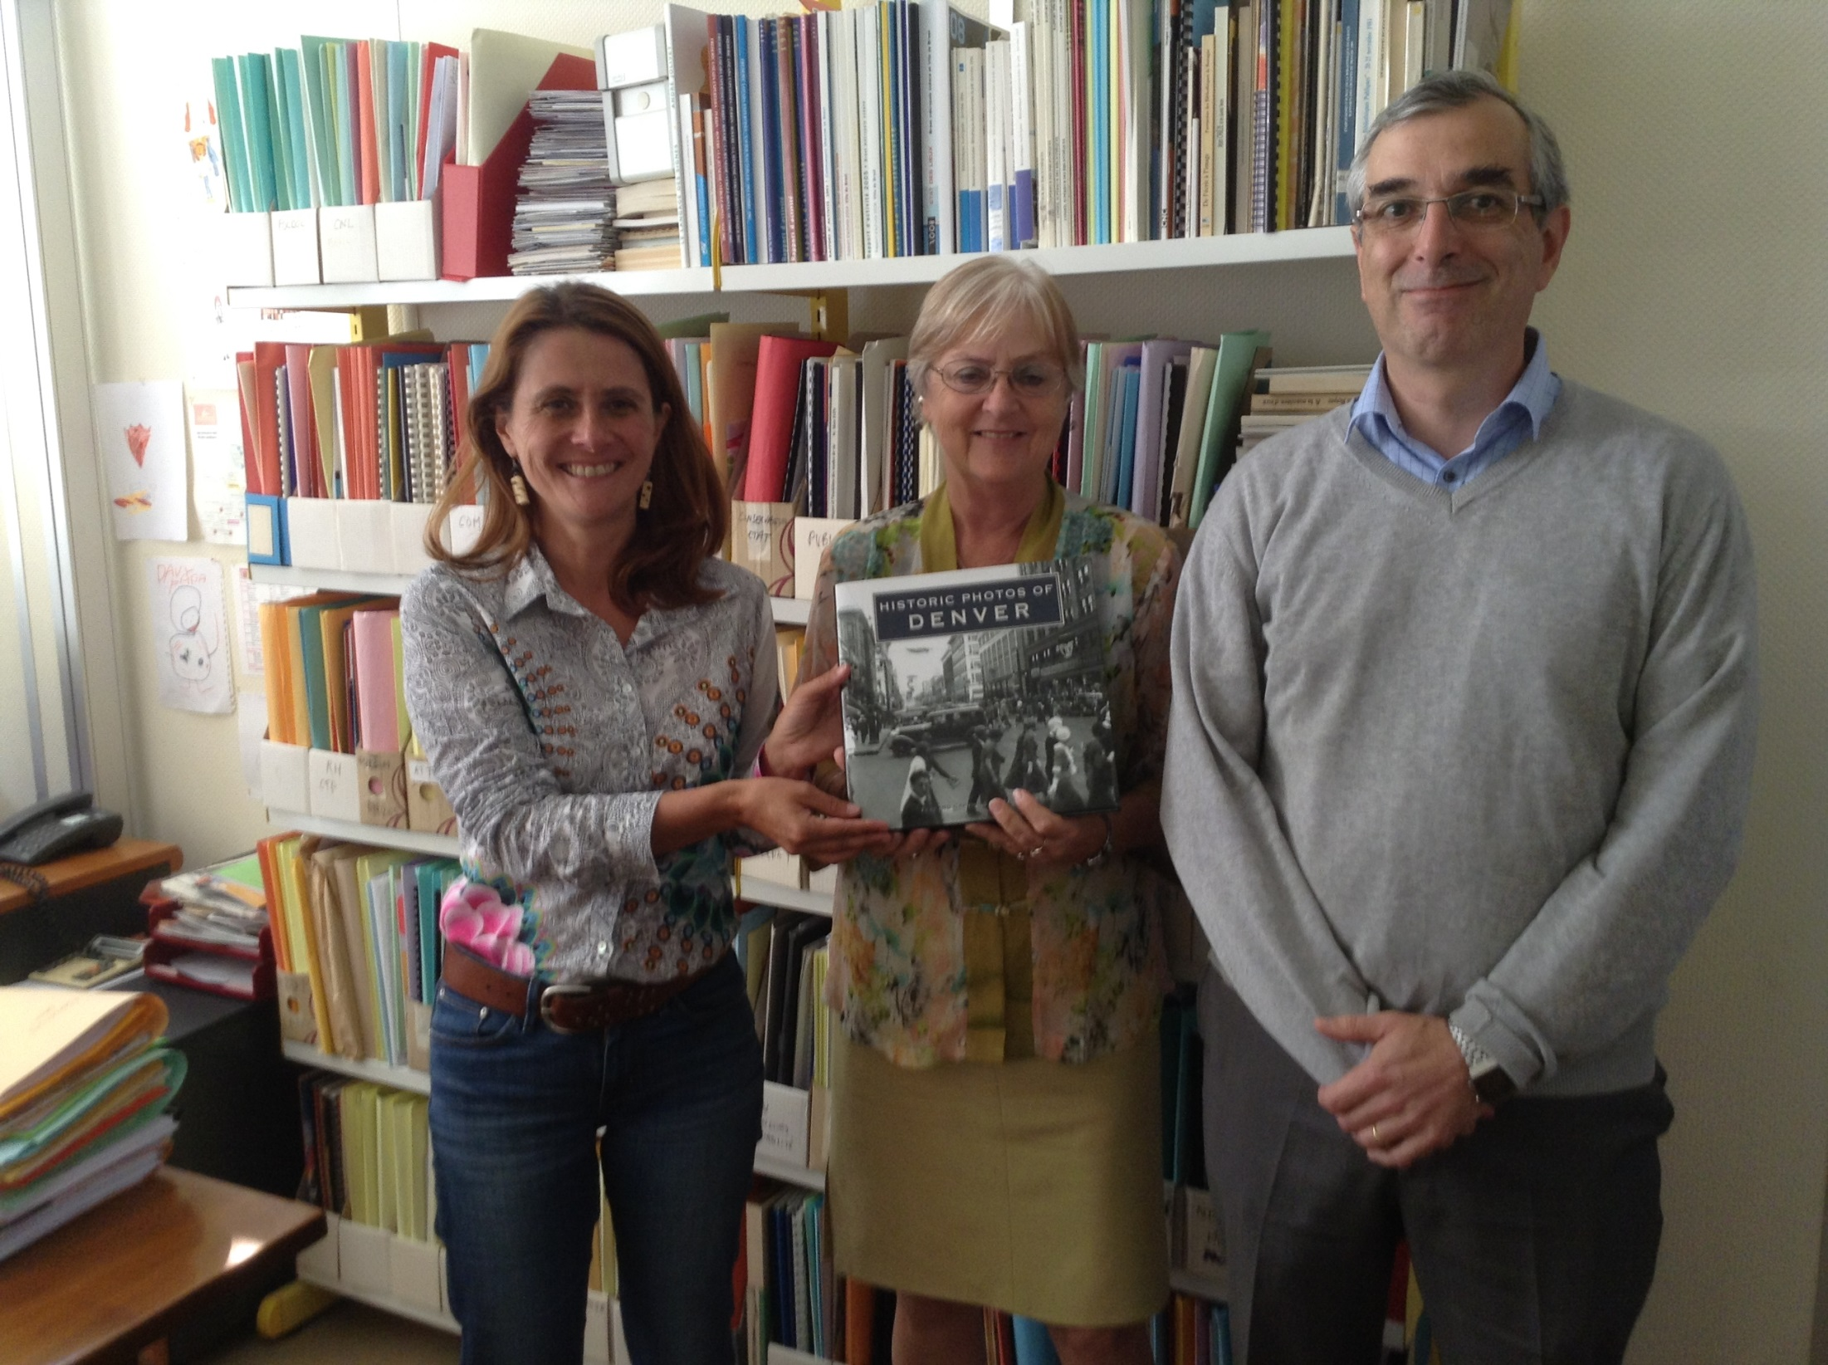

Slide 11
Brest Public Library
8 branches and main library
150,000 pop with 25,000 library cards
Circulate 1.3 million a year
Charges 17E (about $32) for a library card
Kids, students, disabled, poor are free
Book budget $519,000
140 employees
50 computers
300,000 books in closed stacks

Slide 12
Current Services – Programs
Libraries called Mediatheques
Media centered – eBook's and eReaders
Outreach to parks and events
Joint exhibits with museum
Sponsor concerts, record, and put on web
Book club for teens/local authors
Volunteers to visit homebound – bring to library

Slide 13
Current Services - Collections
Rare book collection with 8 incunabula
Historical children collections of 50,000 items with 10,000 between 15th and 19th century
Brest cultural information center
Large print – deliver to senior housing

Slide 14
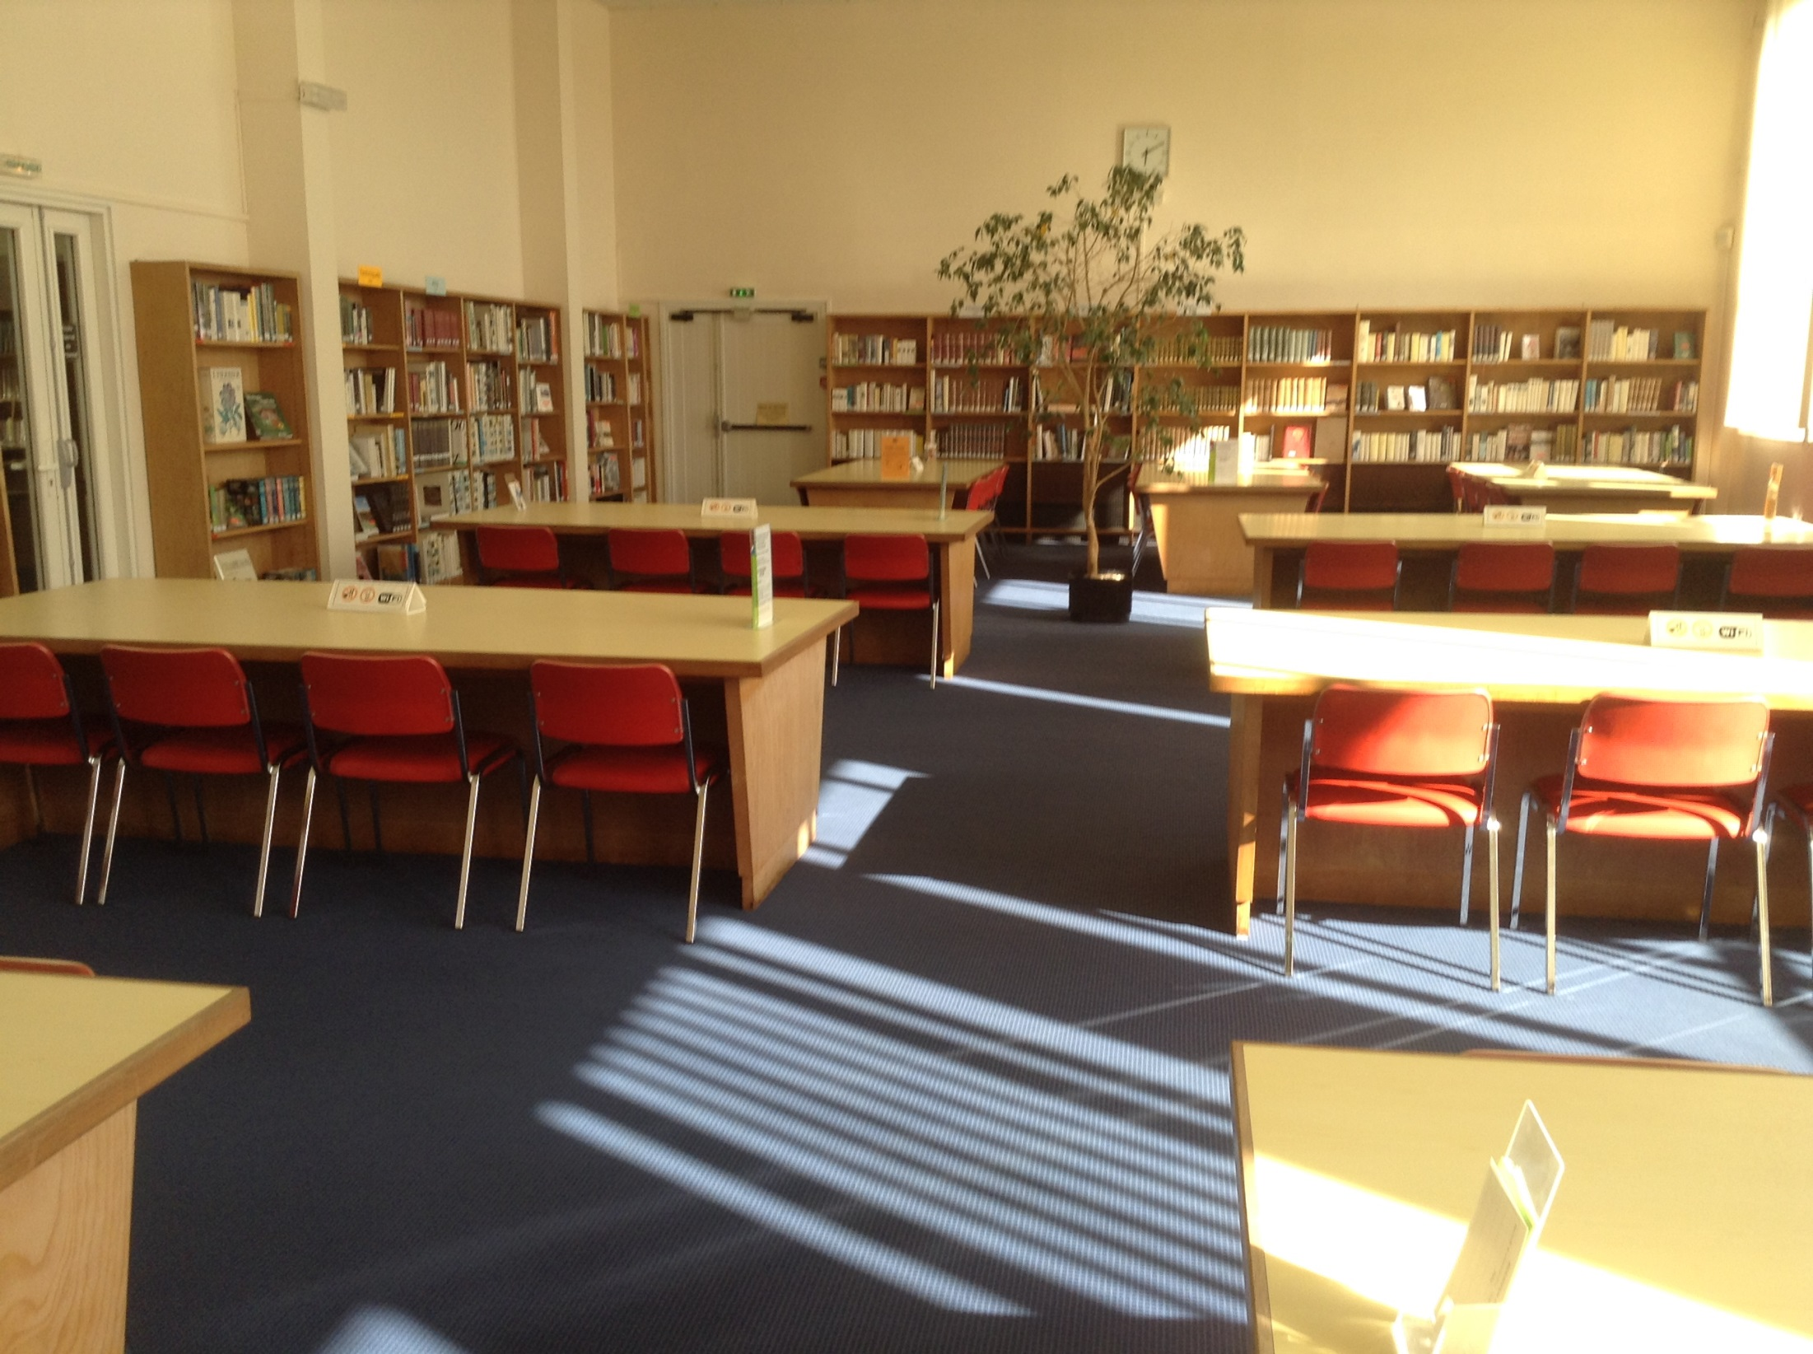

Slide 15
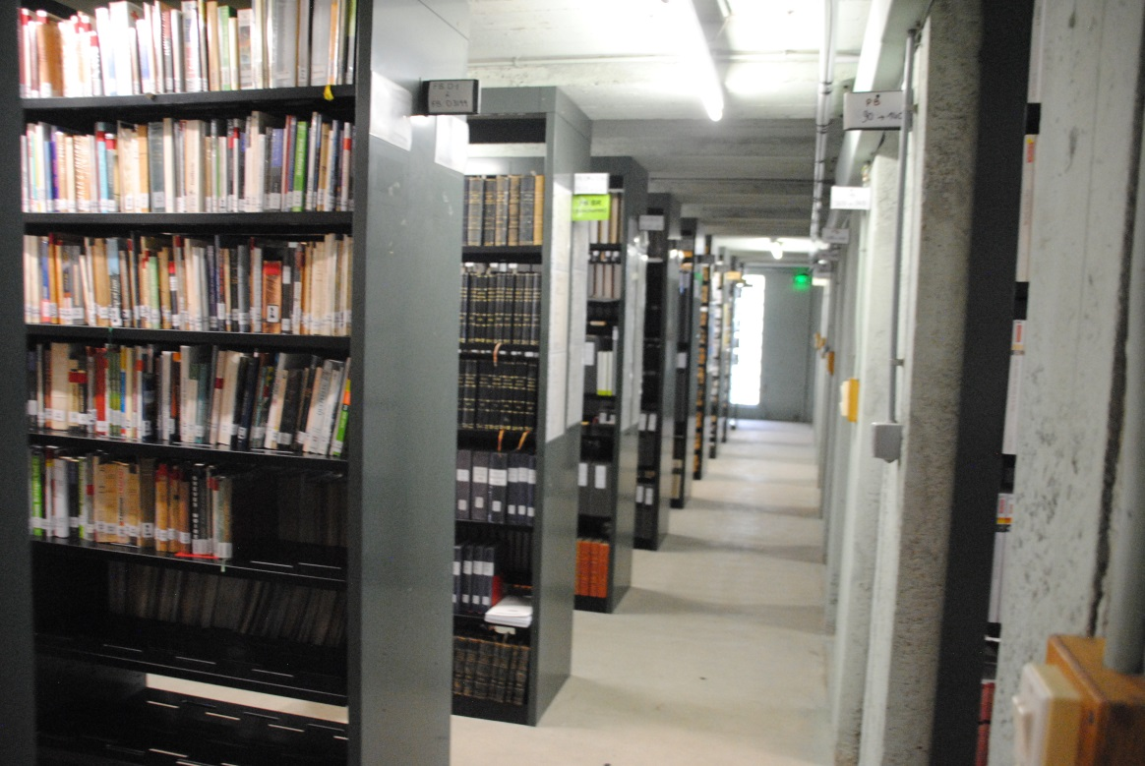
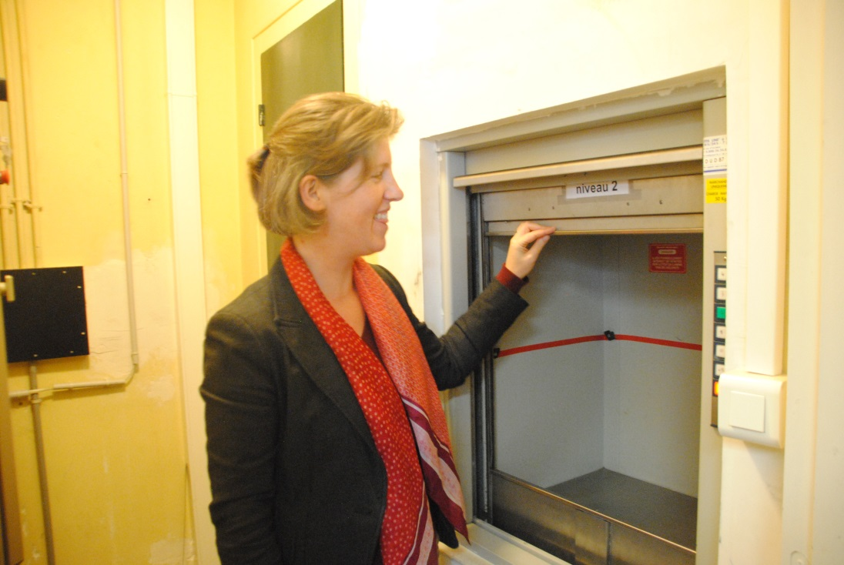

Slide 16
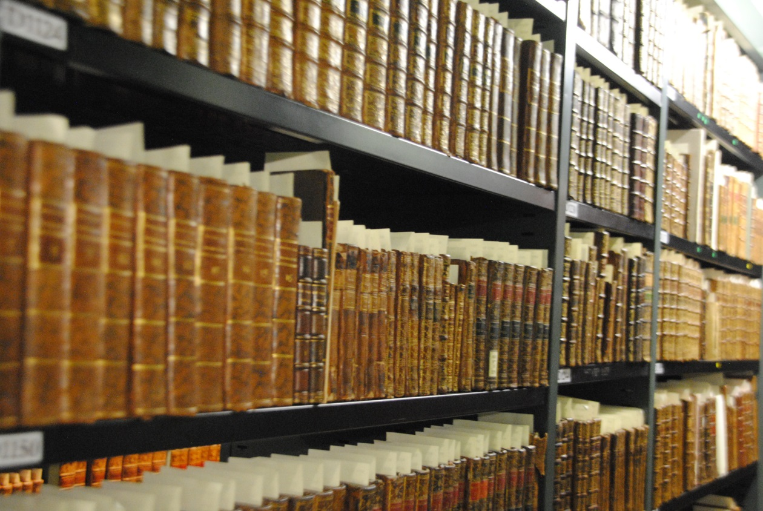
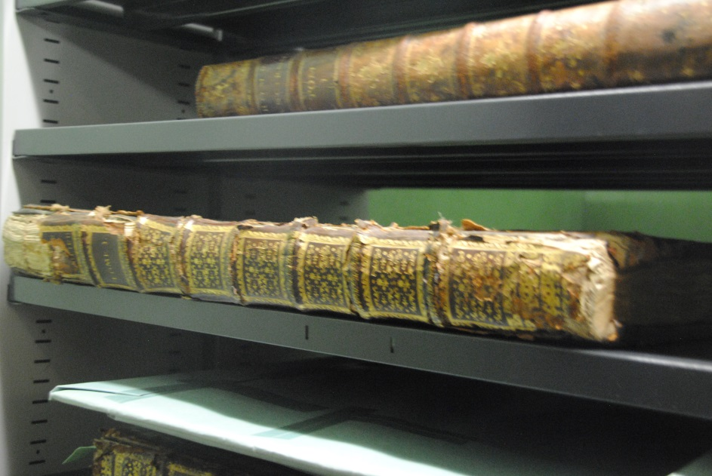

Slide 17
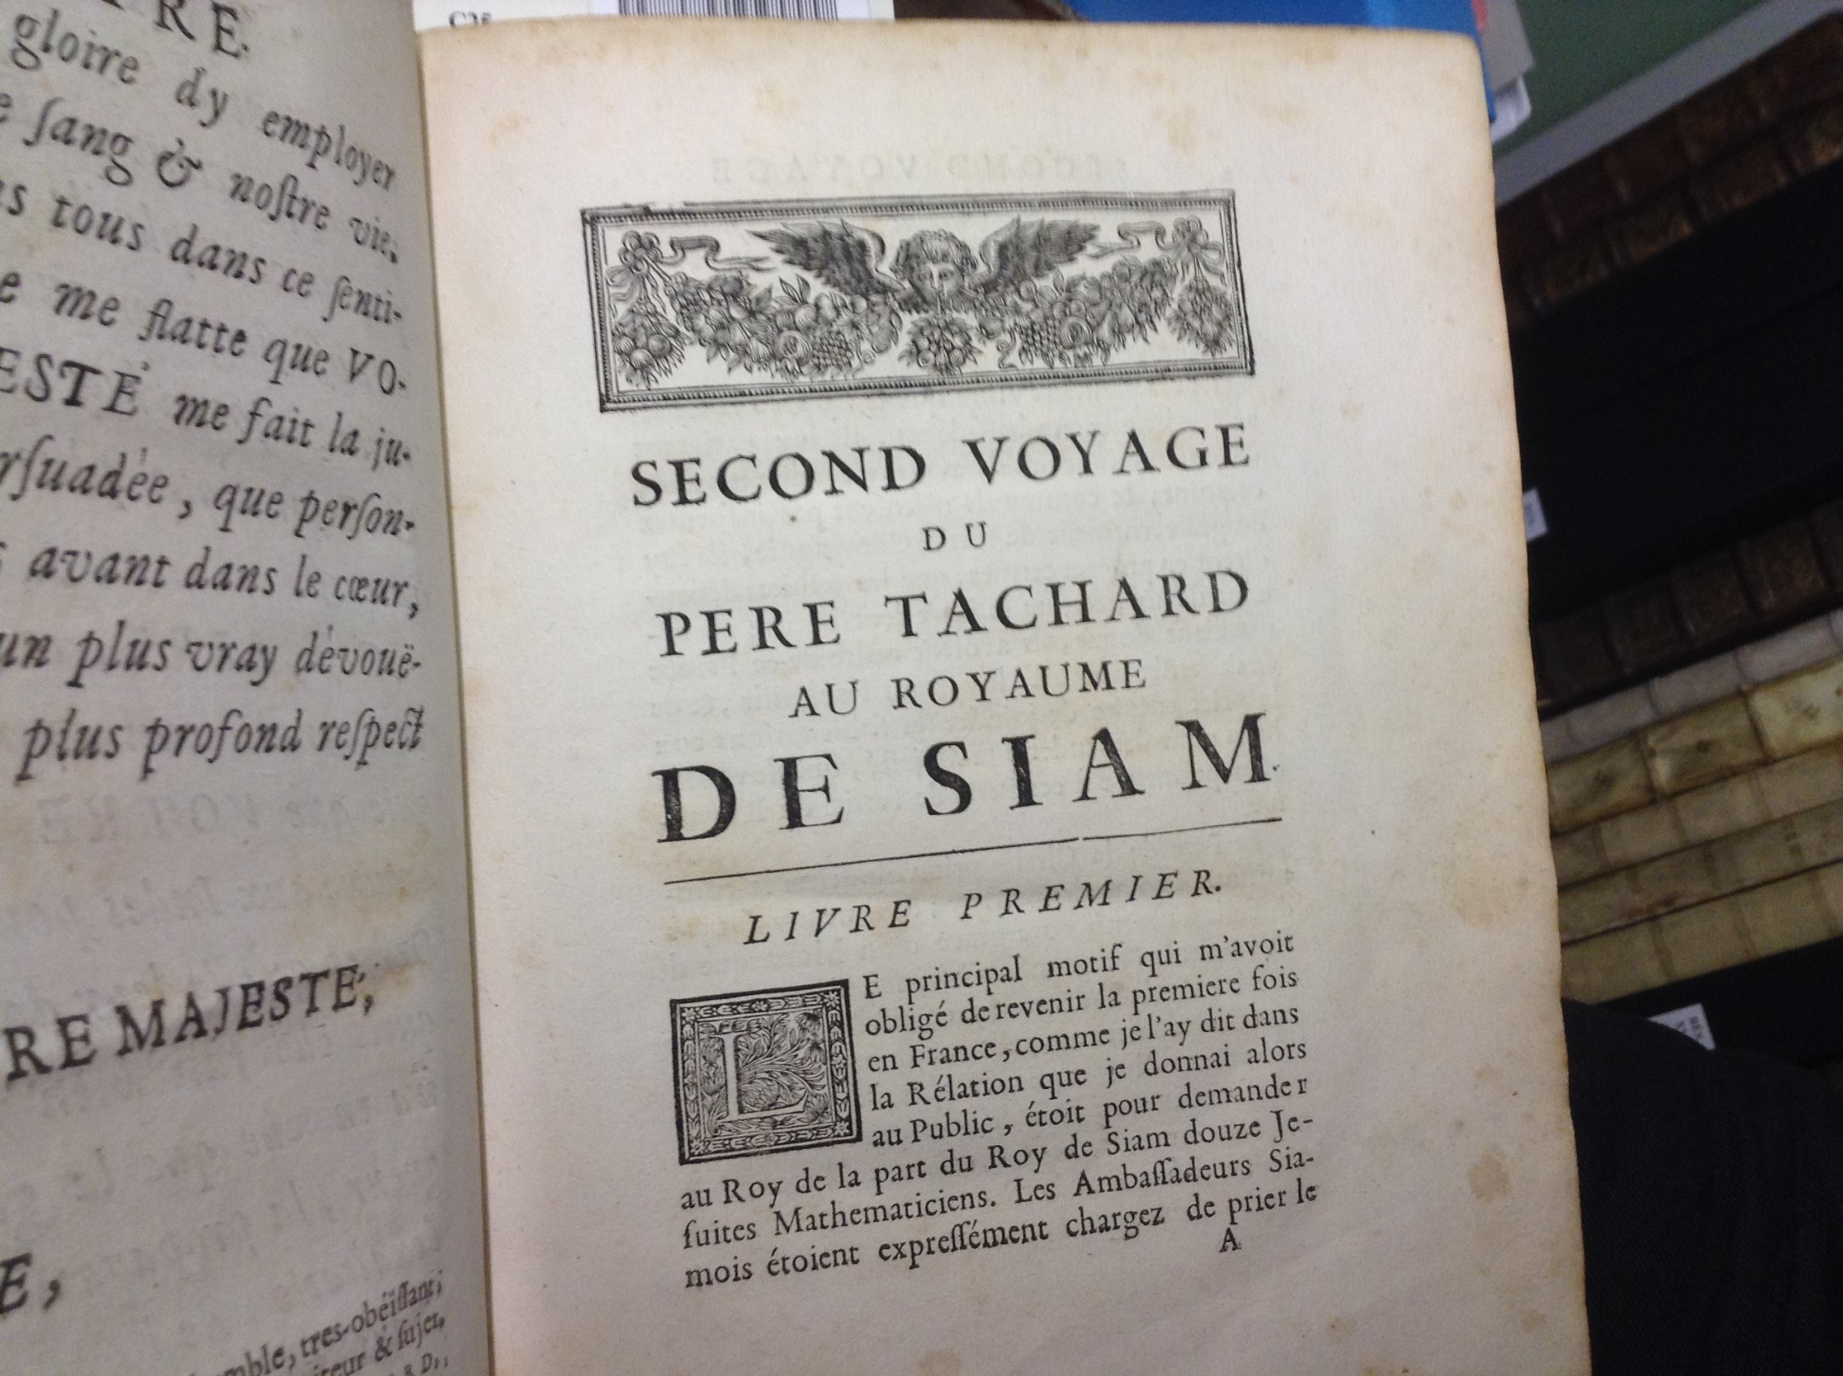

Slide 18
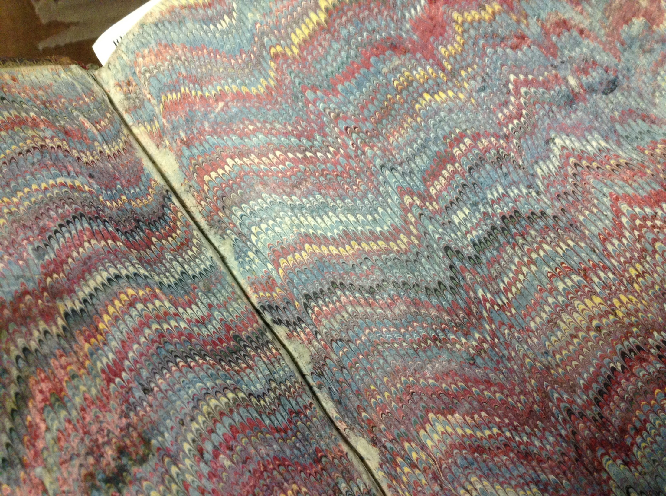

Slide 19
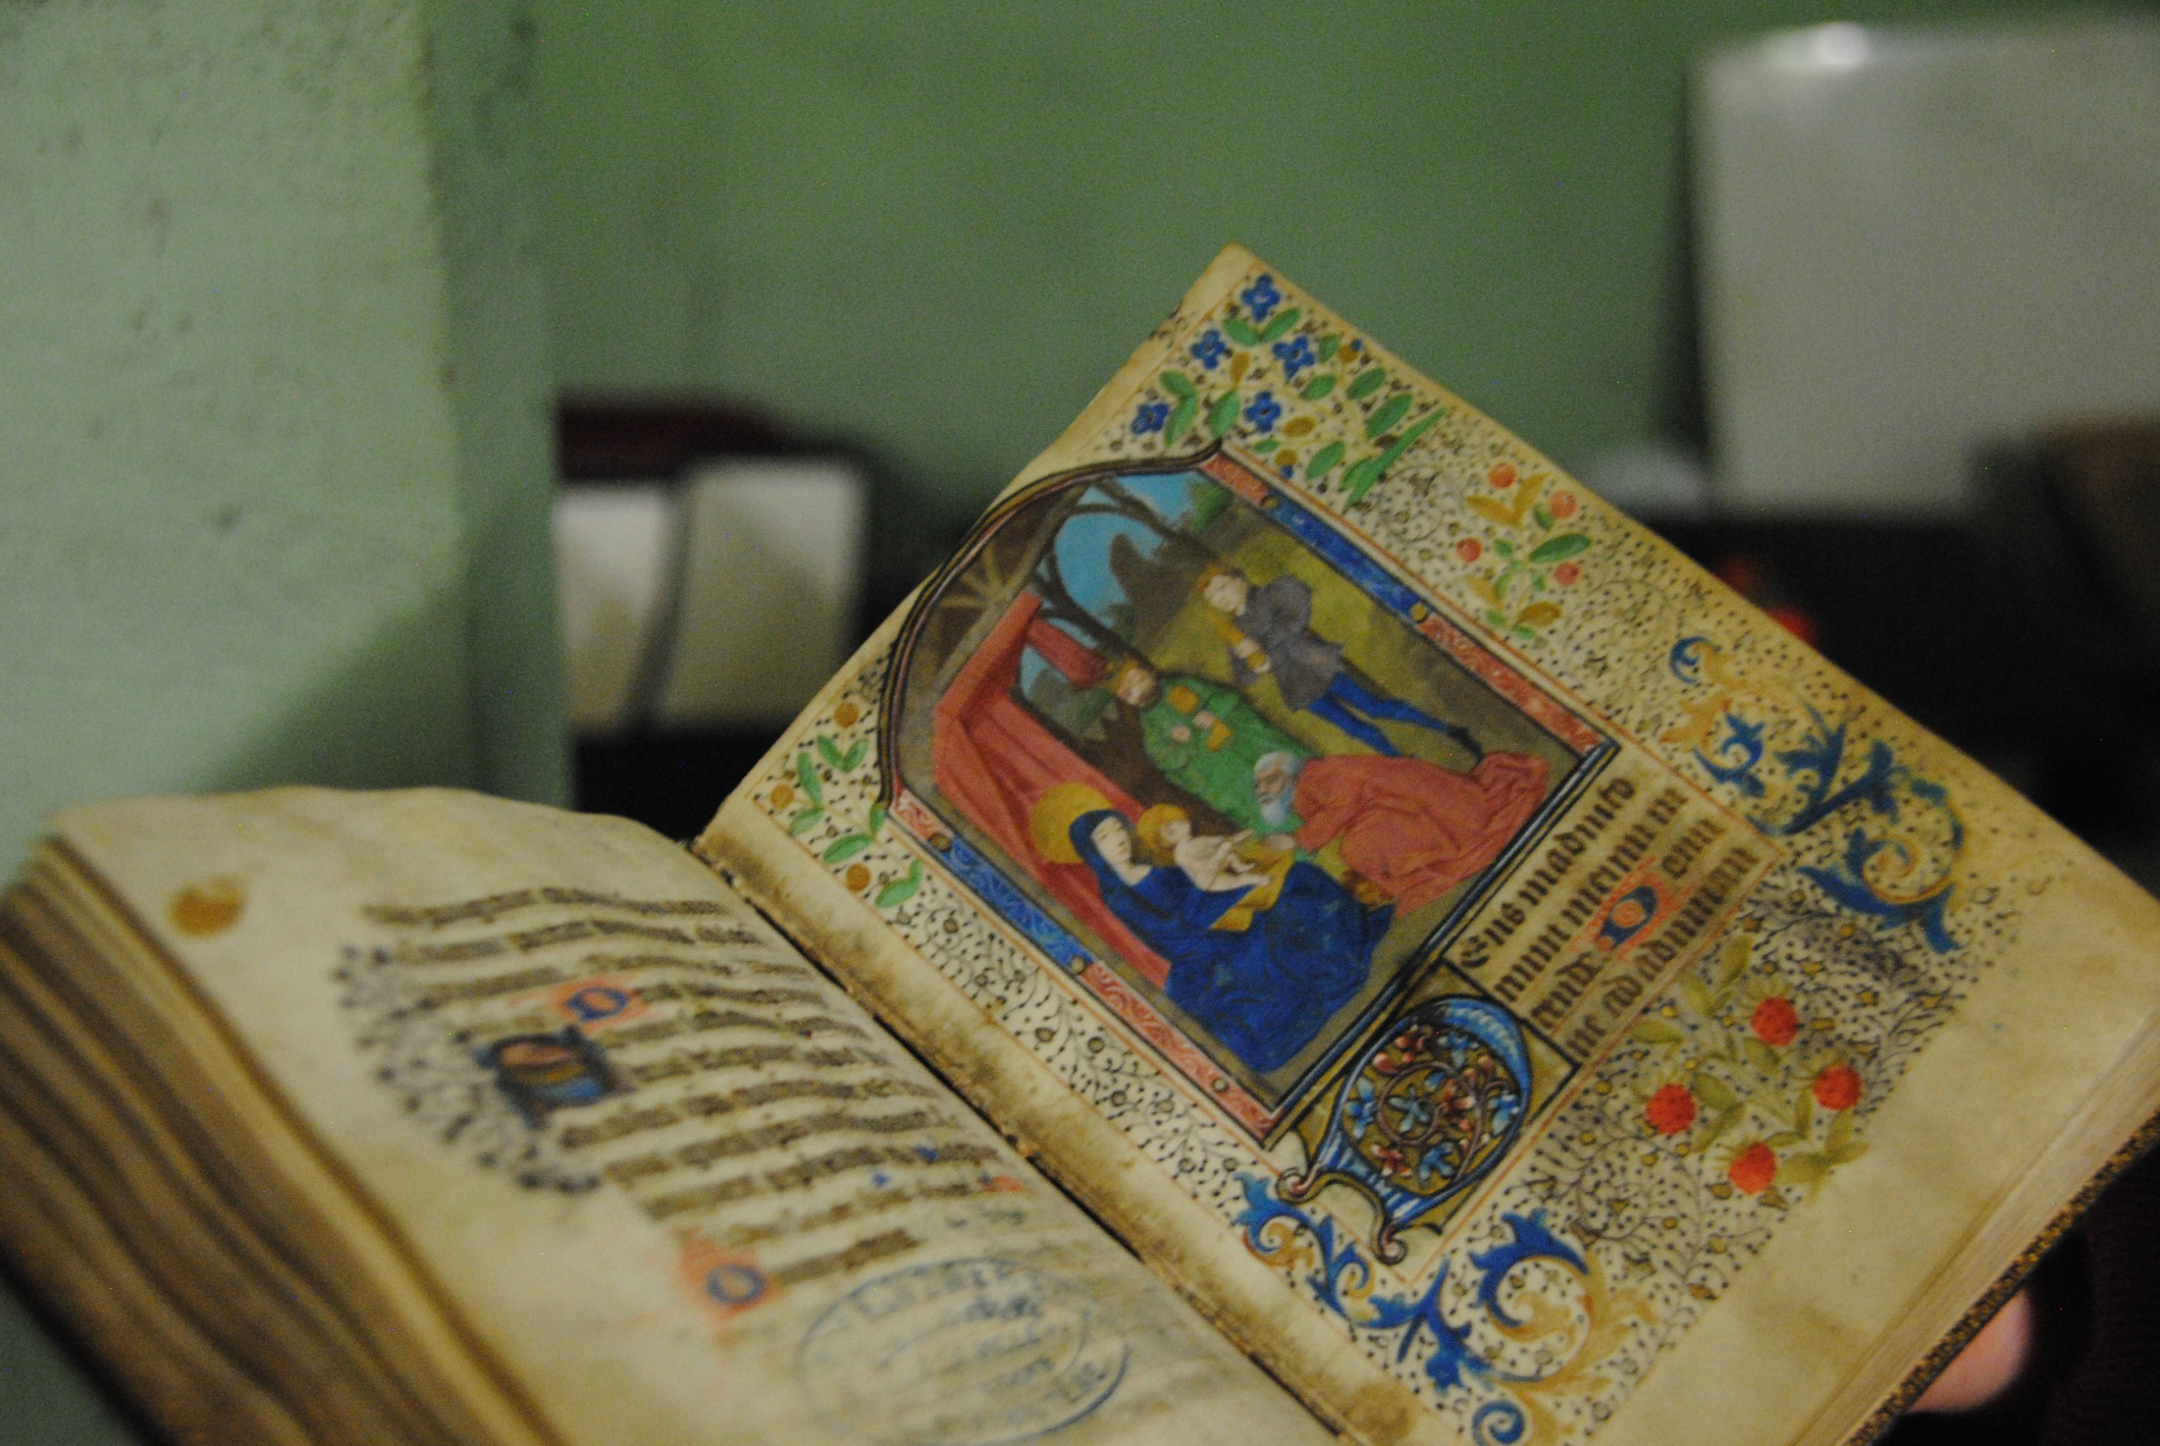

Slide 20
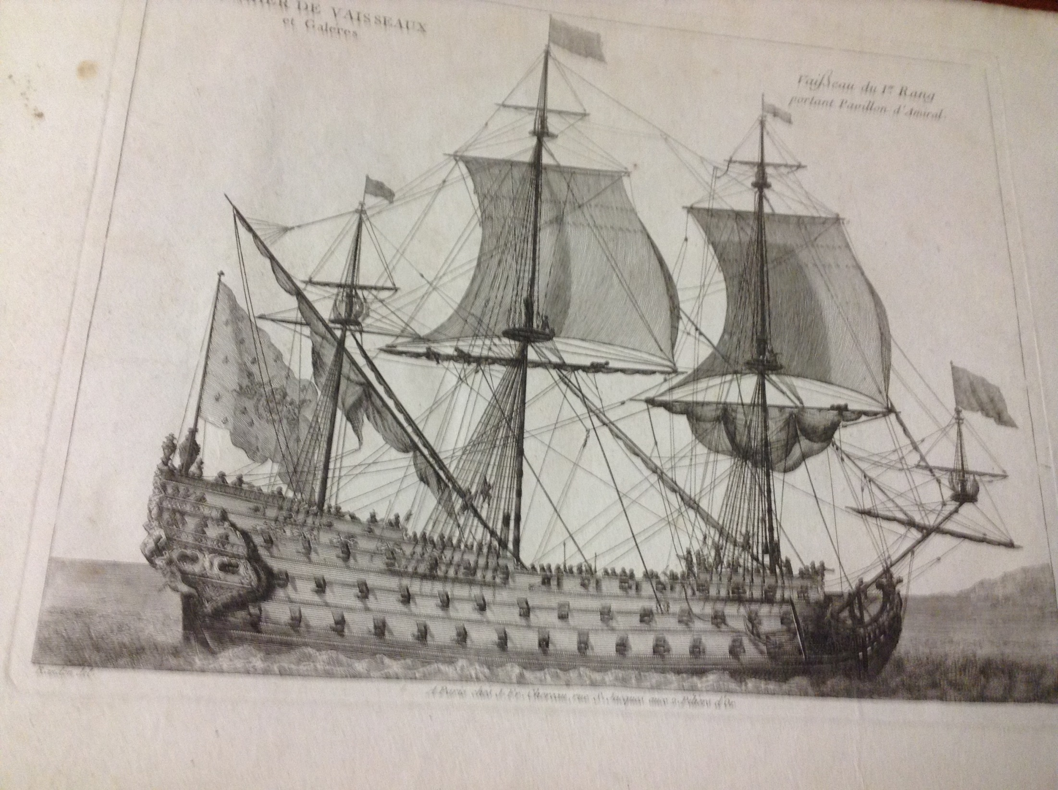

Slide 21
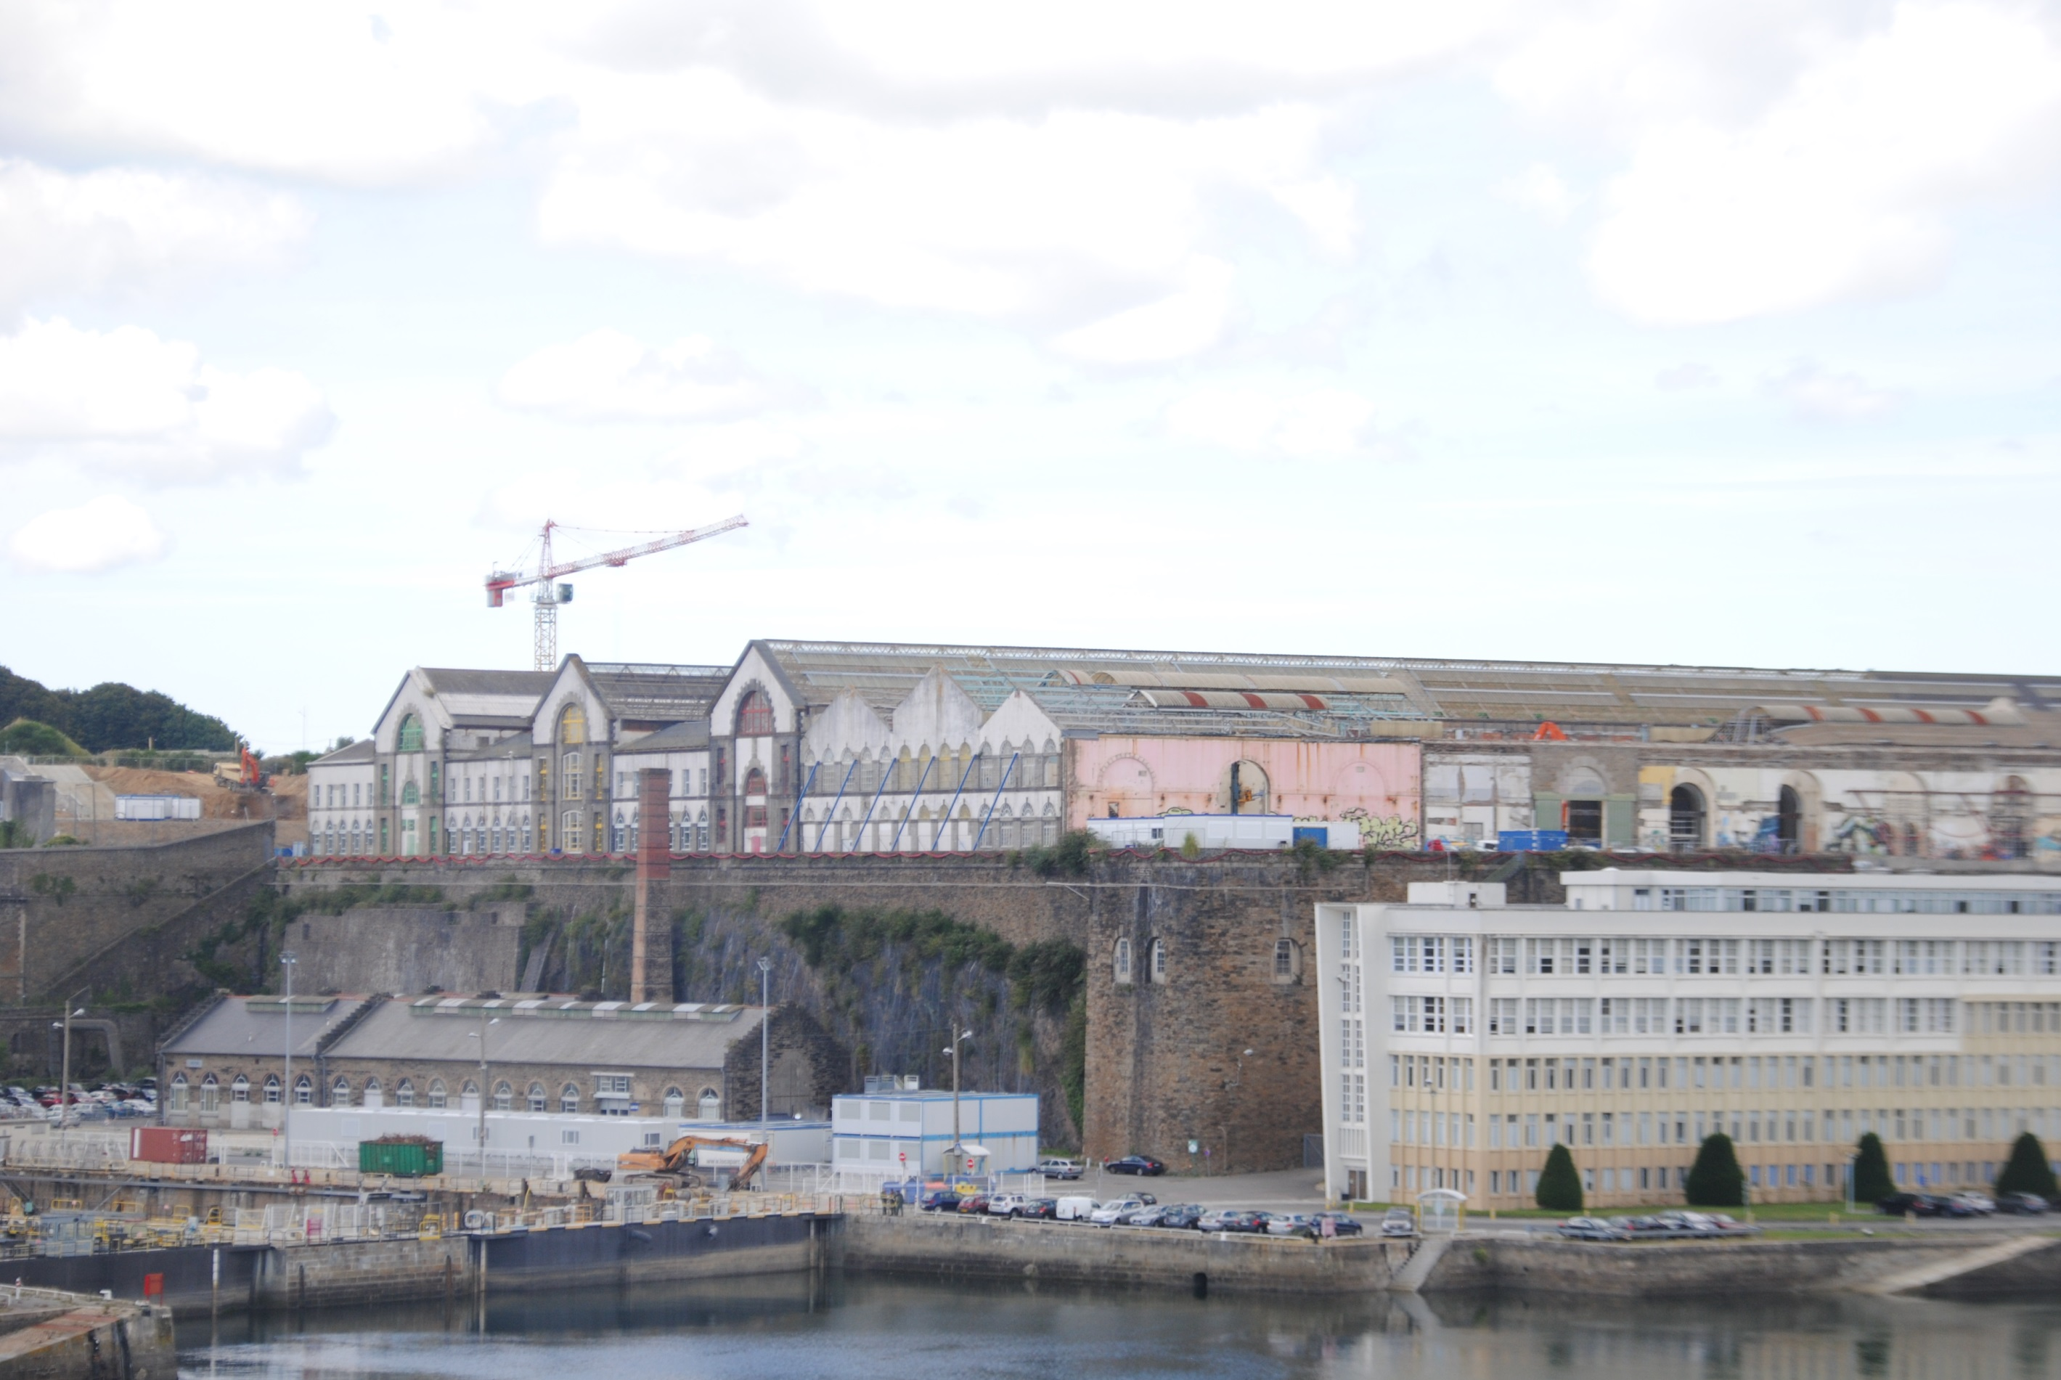
  New library part of cultural center
  “Change the image of the library”
  Expand all current services
  Heavy emphasis on media

Slide 22
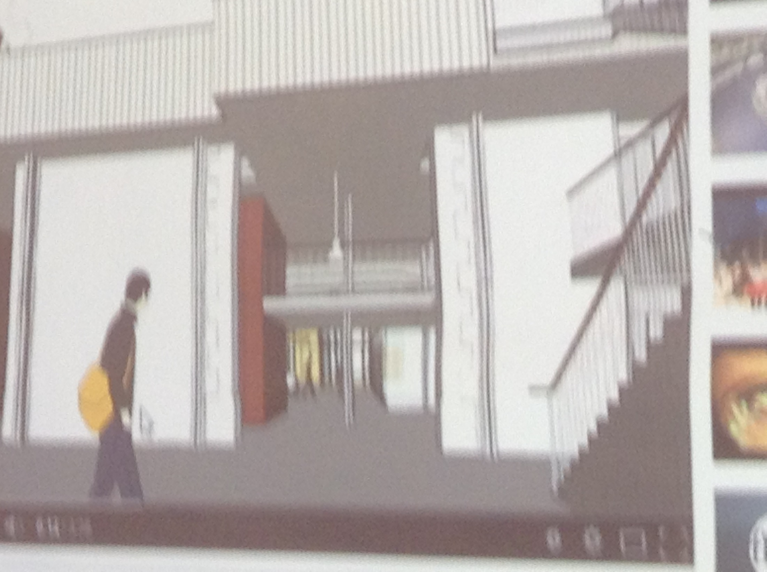

Slide 23
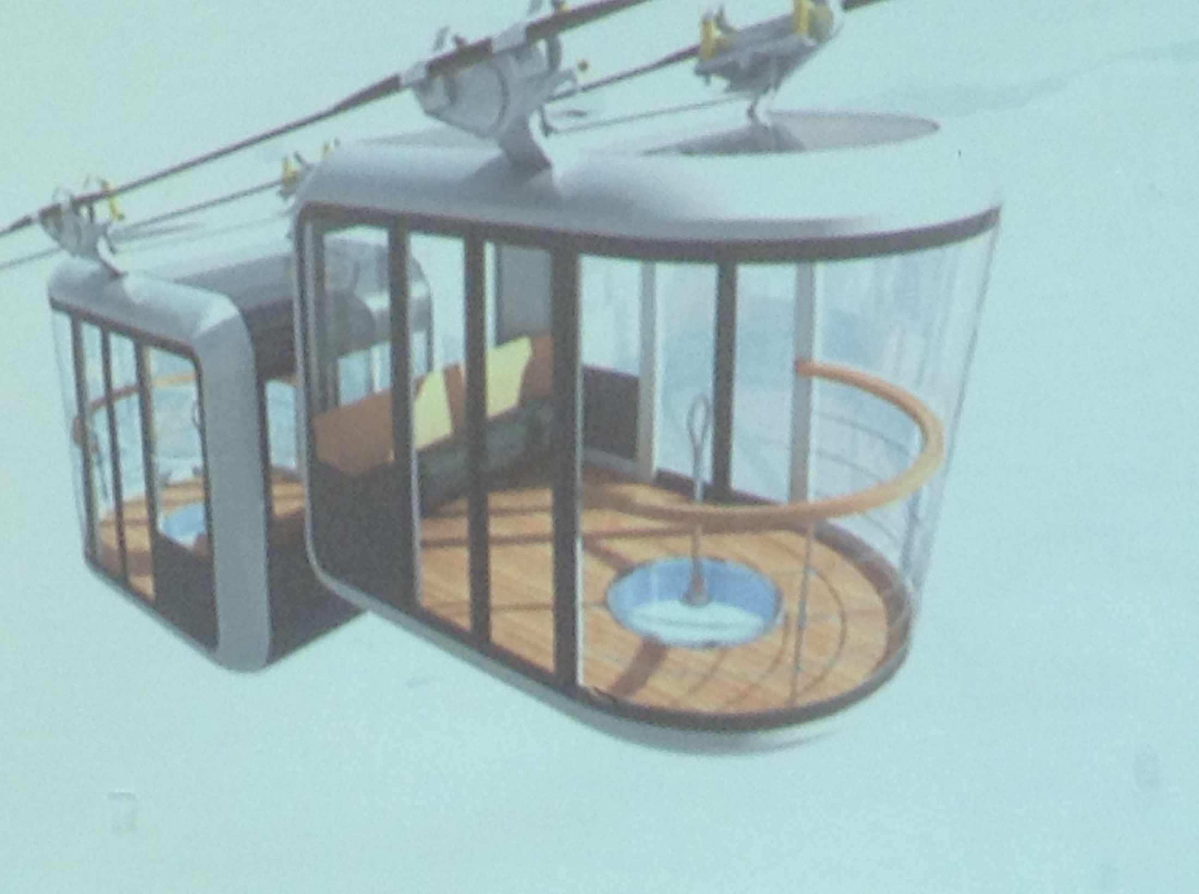

Slide 24
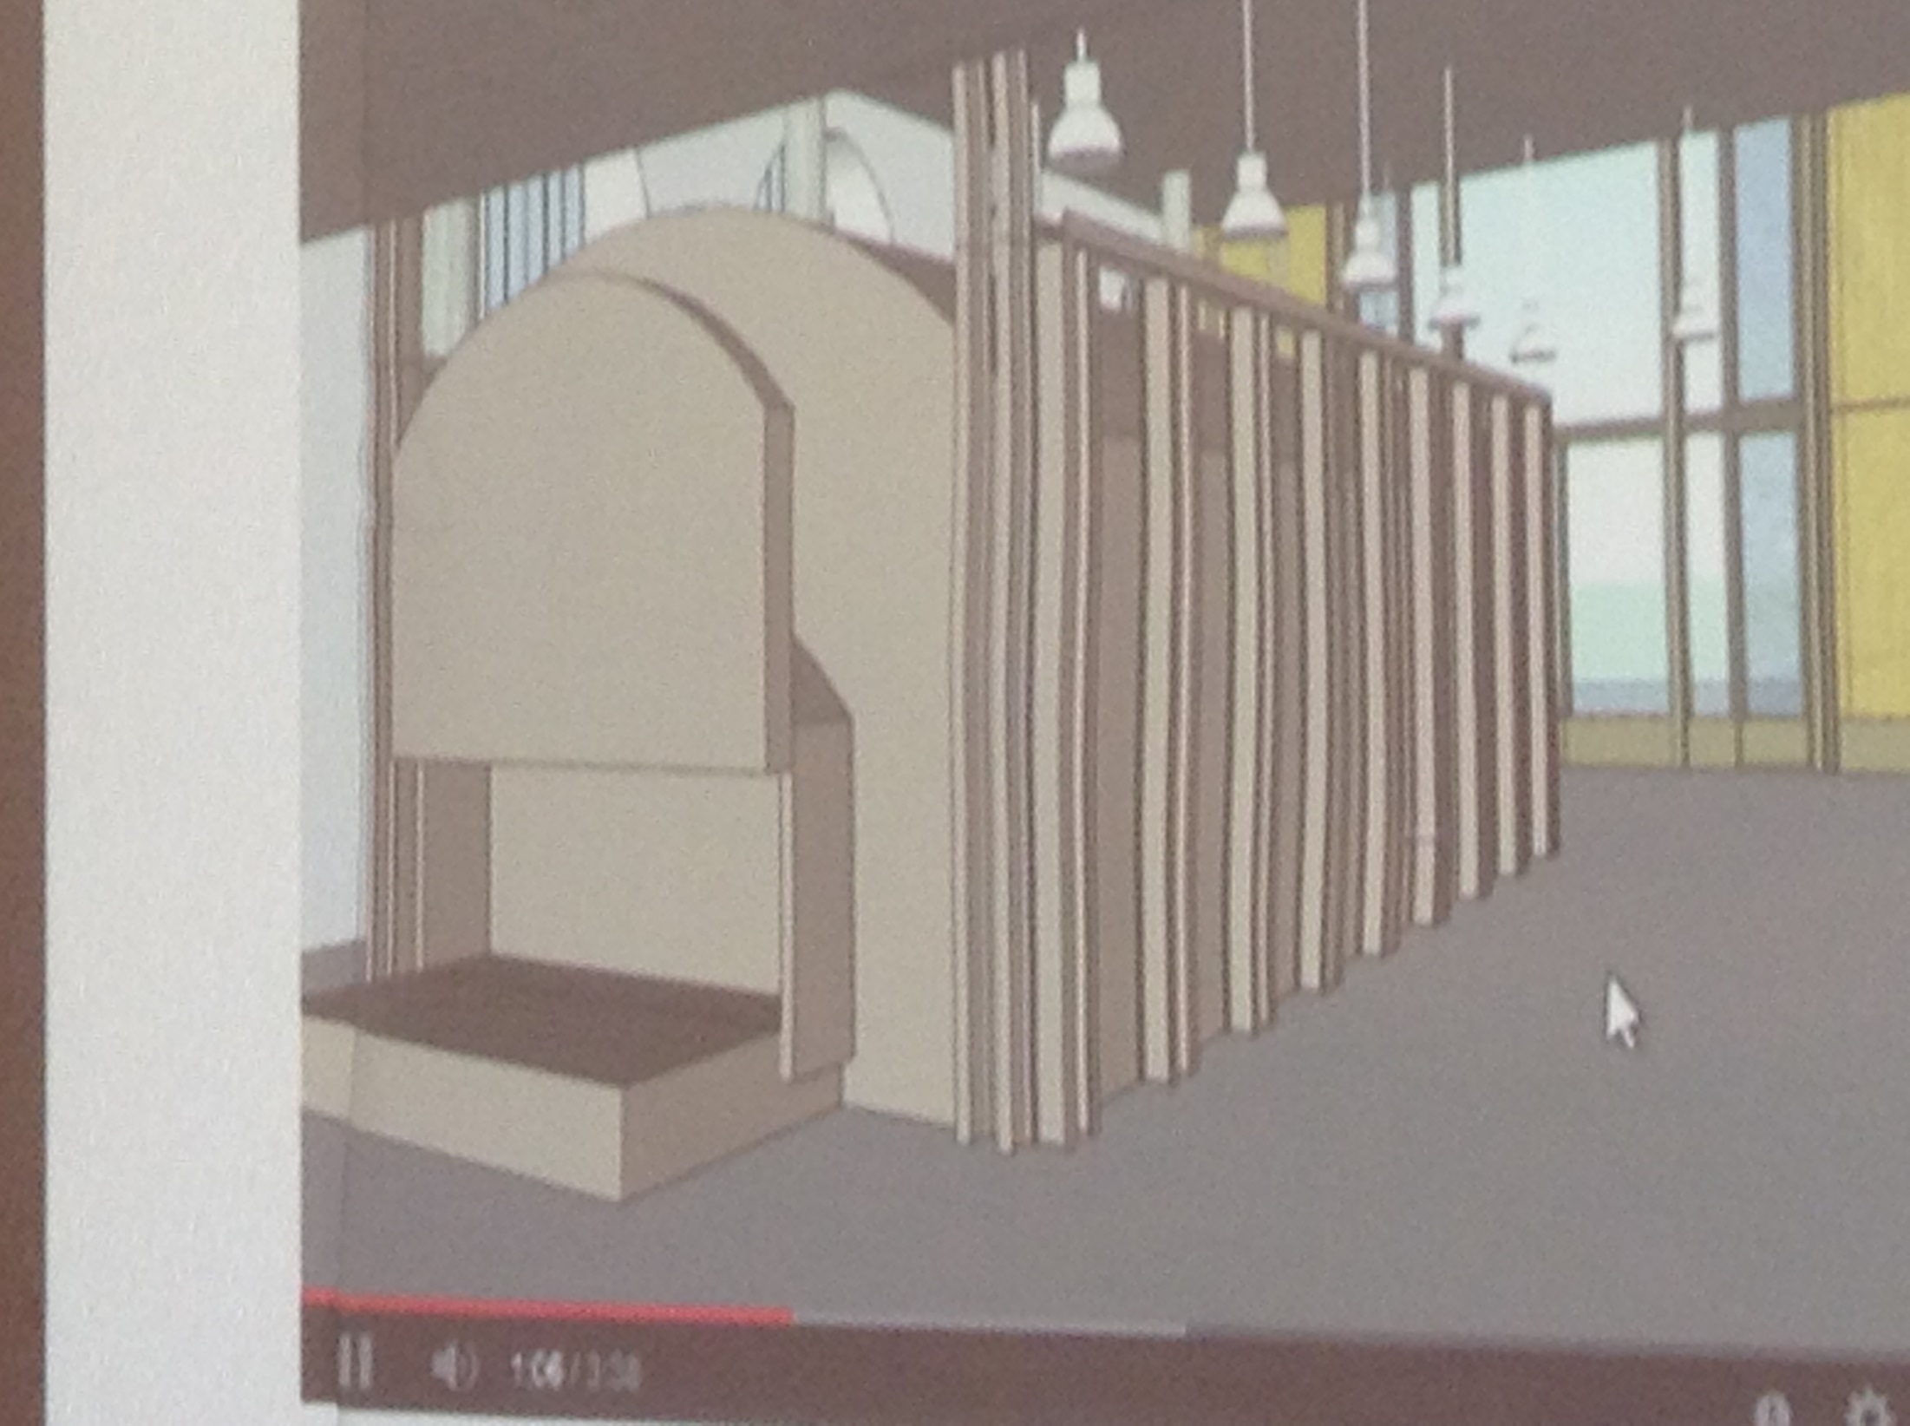

Slide 25
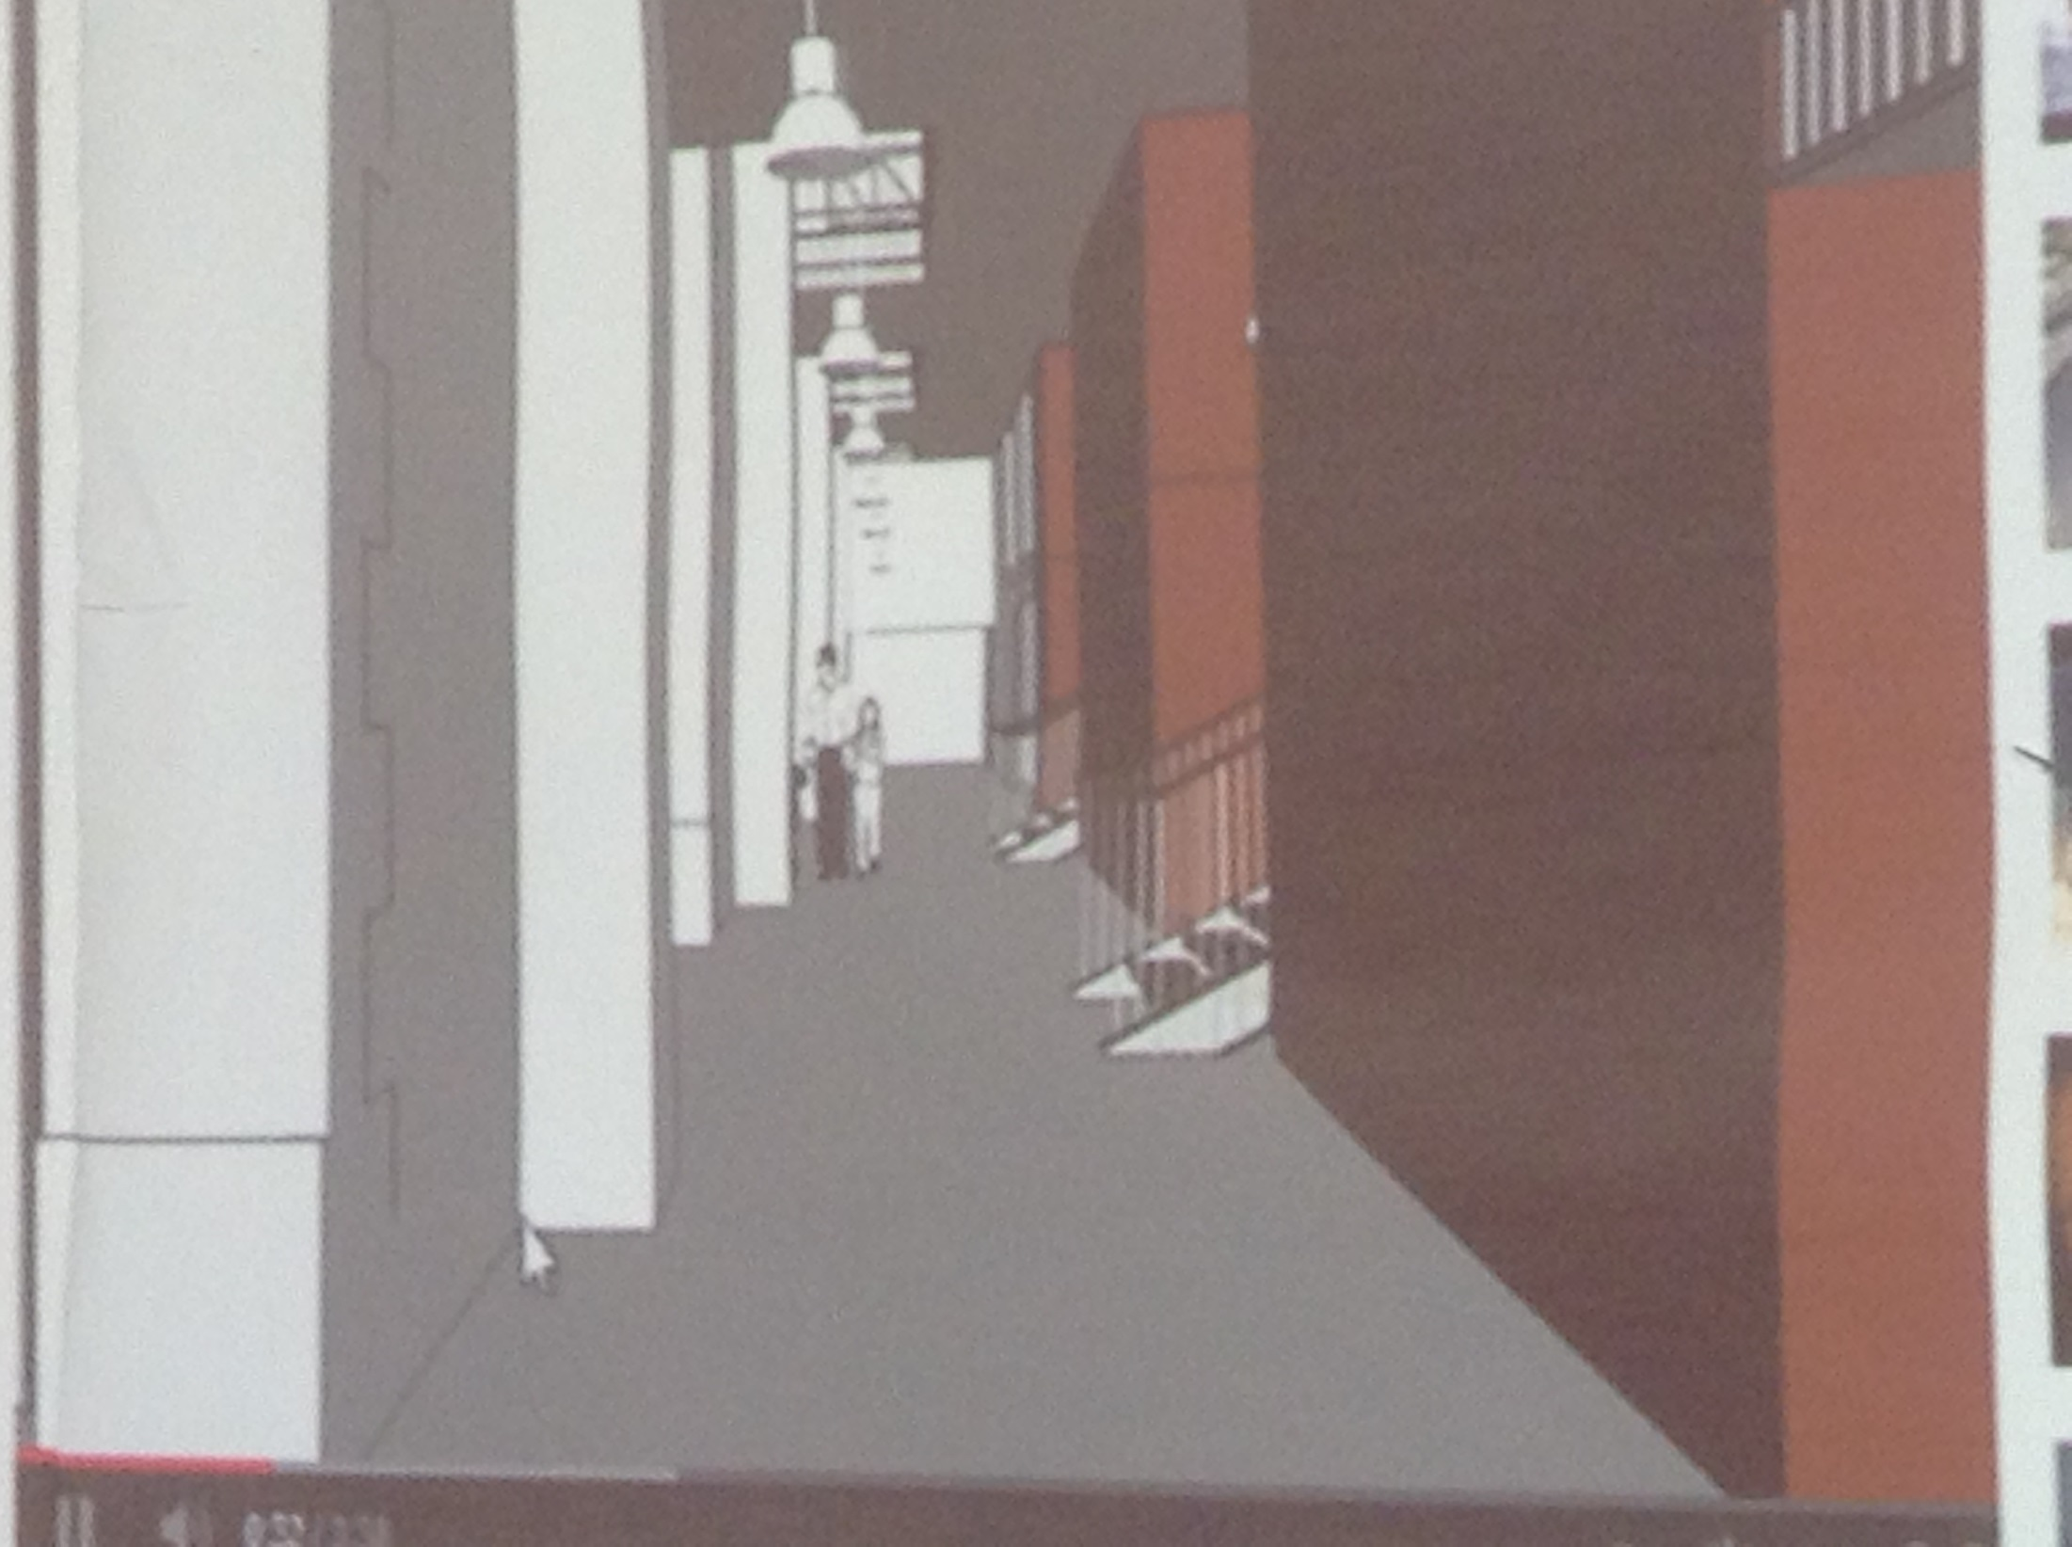

Slide 26
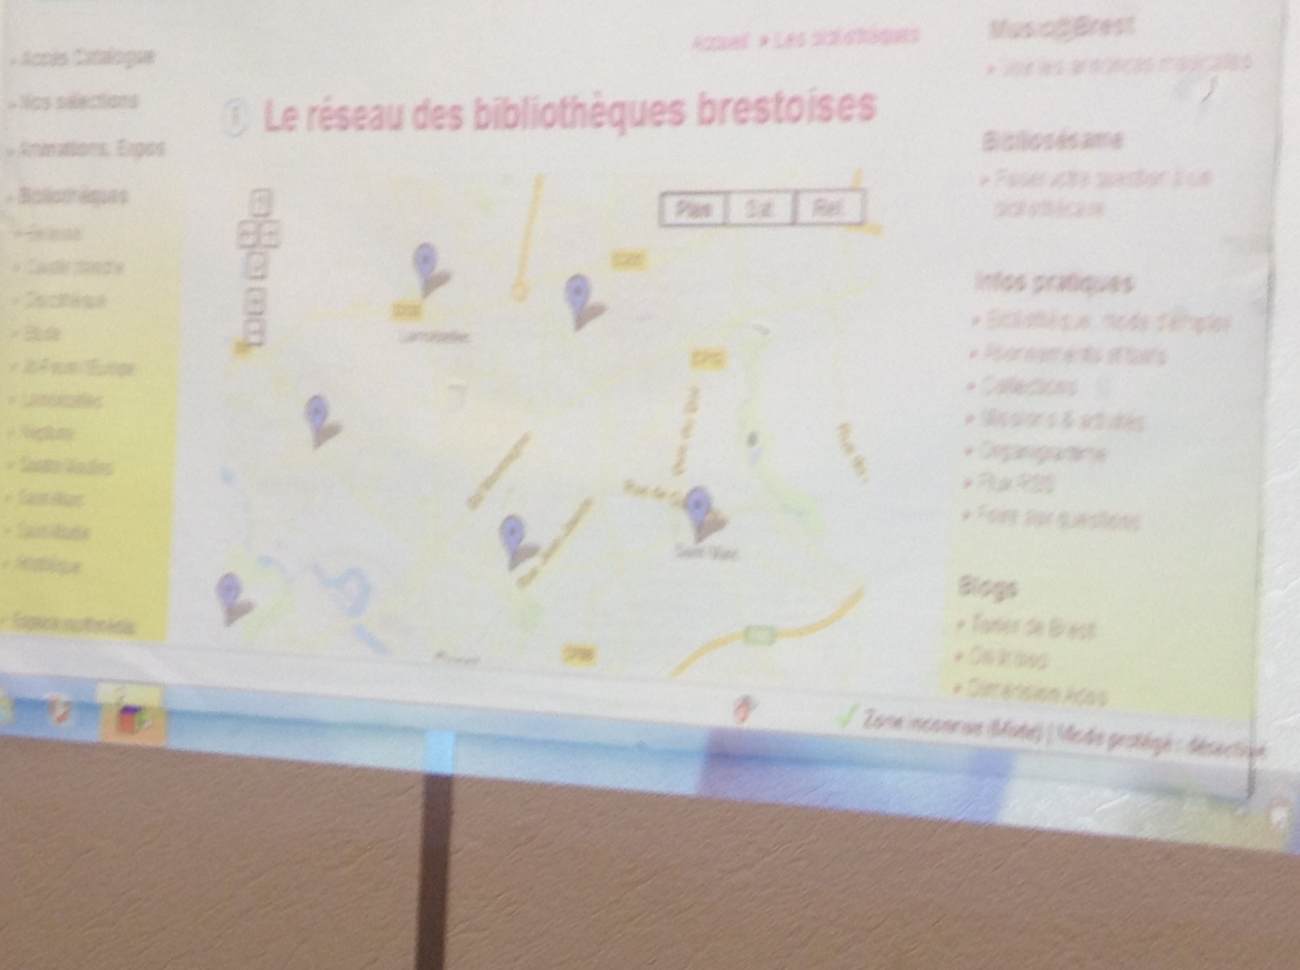
Branch Libraries

Slide 27
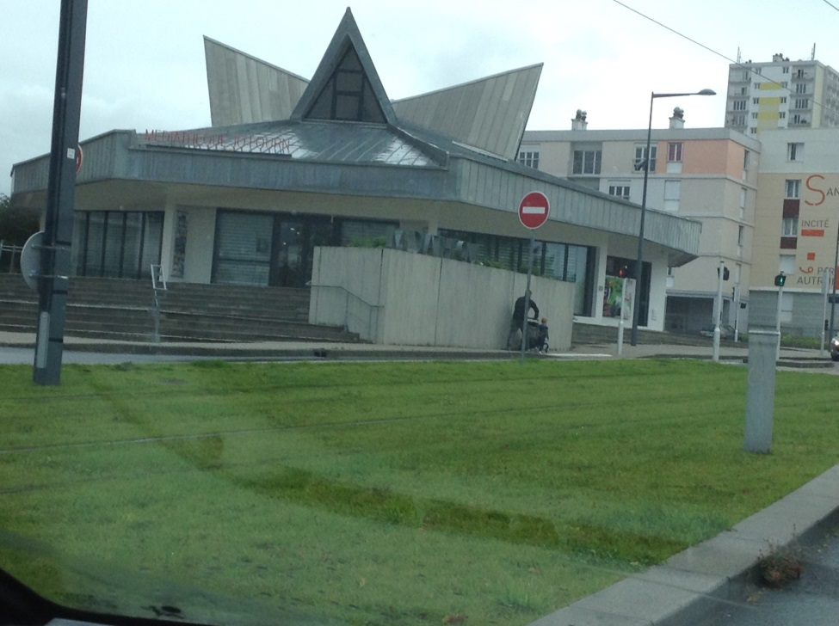
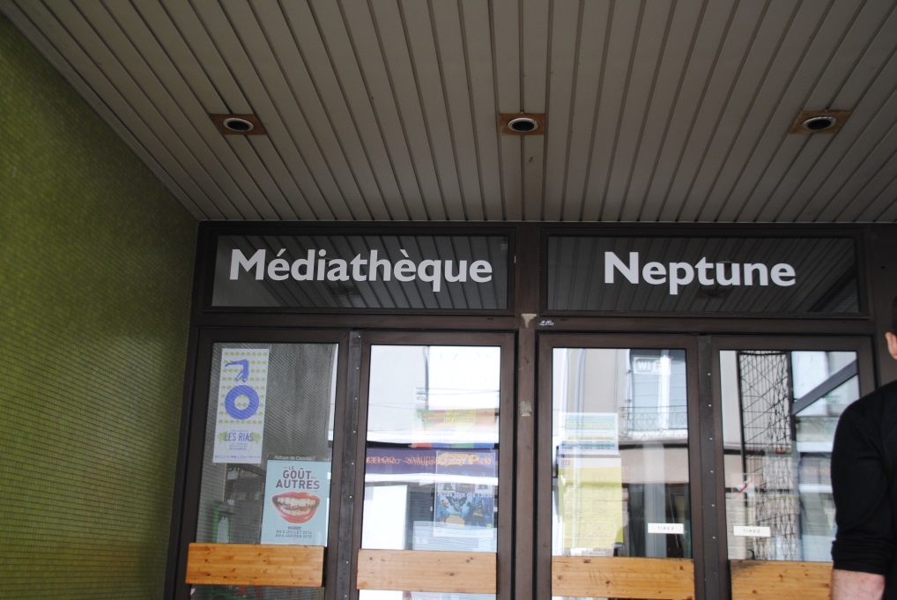
Branch Libraries

Slide 28
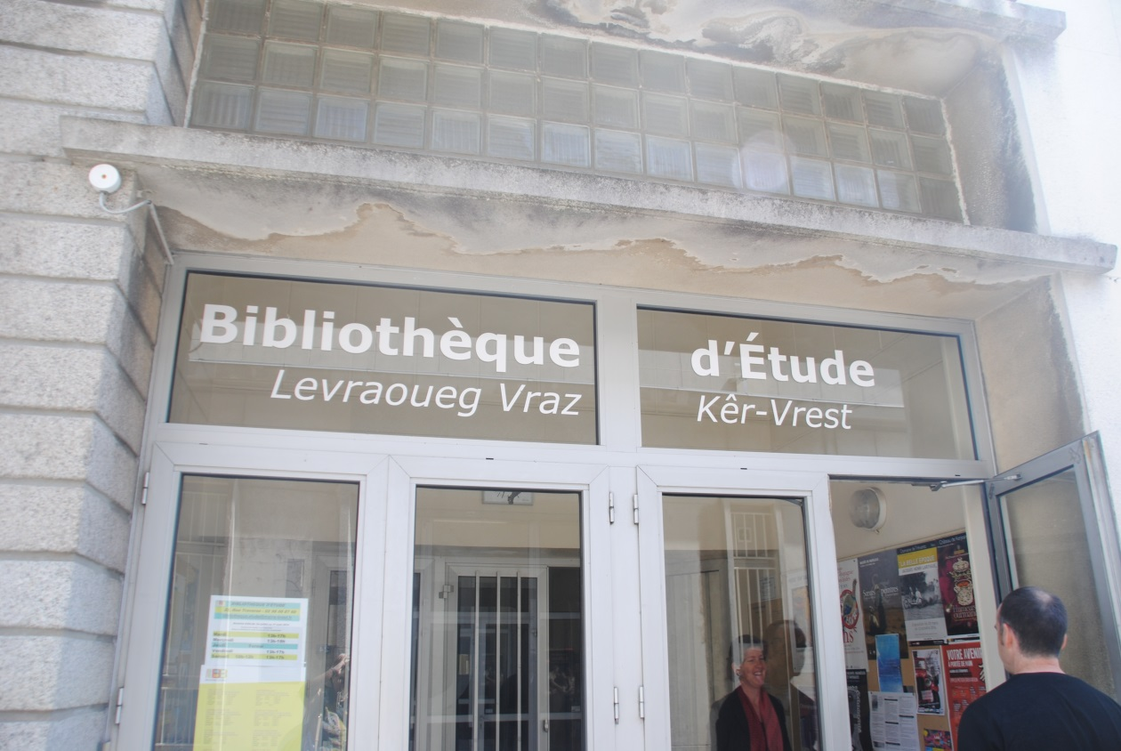
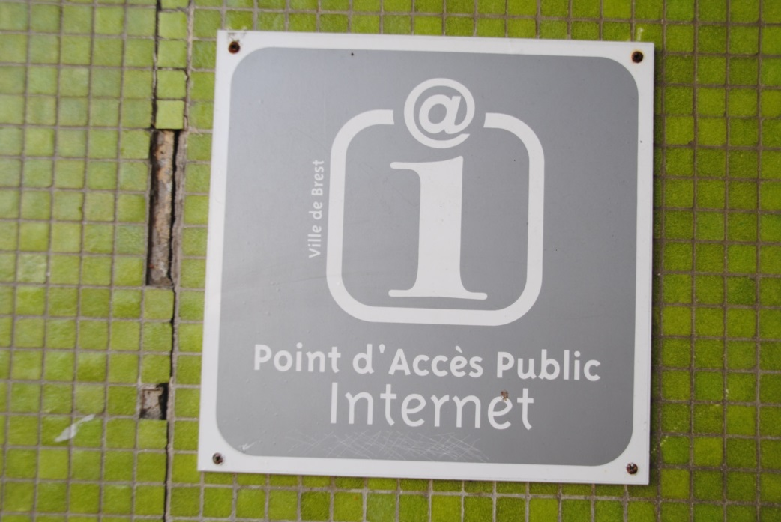

Slide 29
Lambezellec Mediatheque
Branch Library
Built in 1996
Popular DIY library
Extensive media – 4000 comics
Collection of Brezhoneg, Keltic collection
Will remodel and create
  Deep quiet
  Work spaces
  Maker spaces

Slide 30
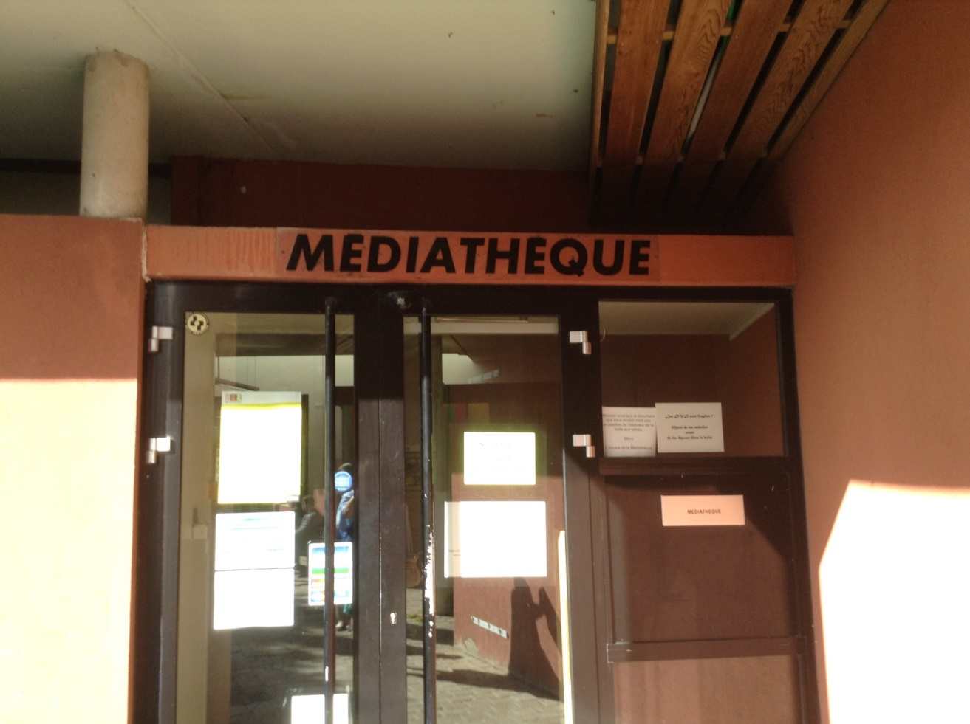
Lambezellec Mediatheque
Branch Library

Slide 31
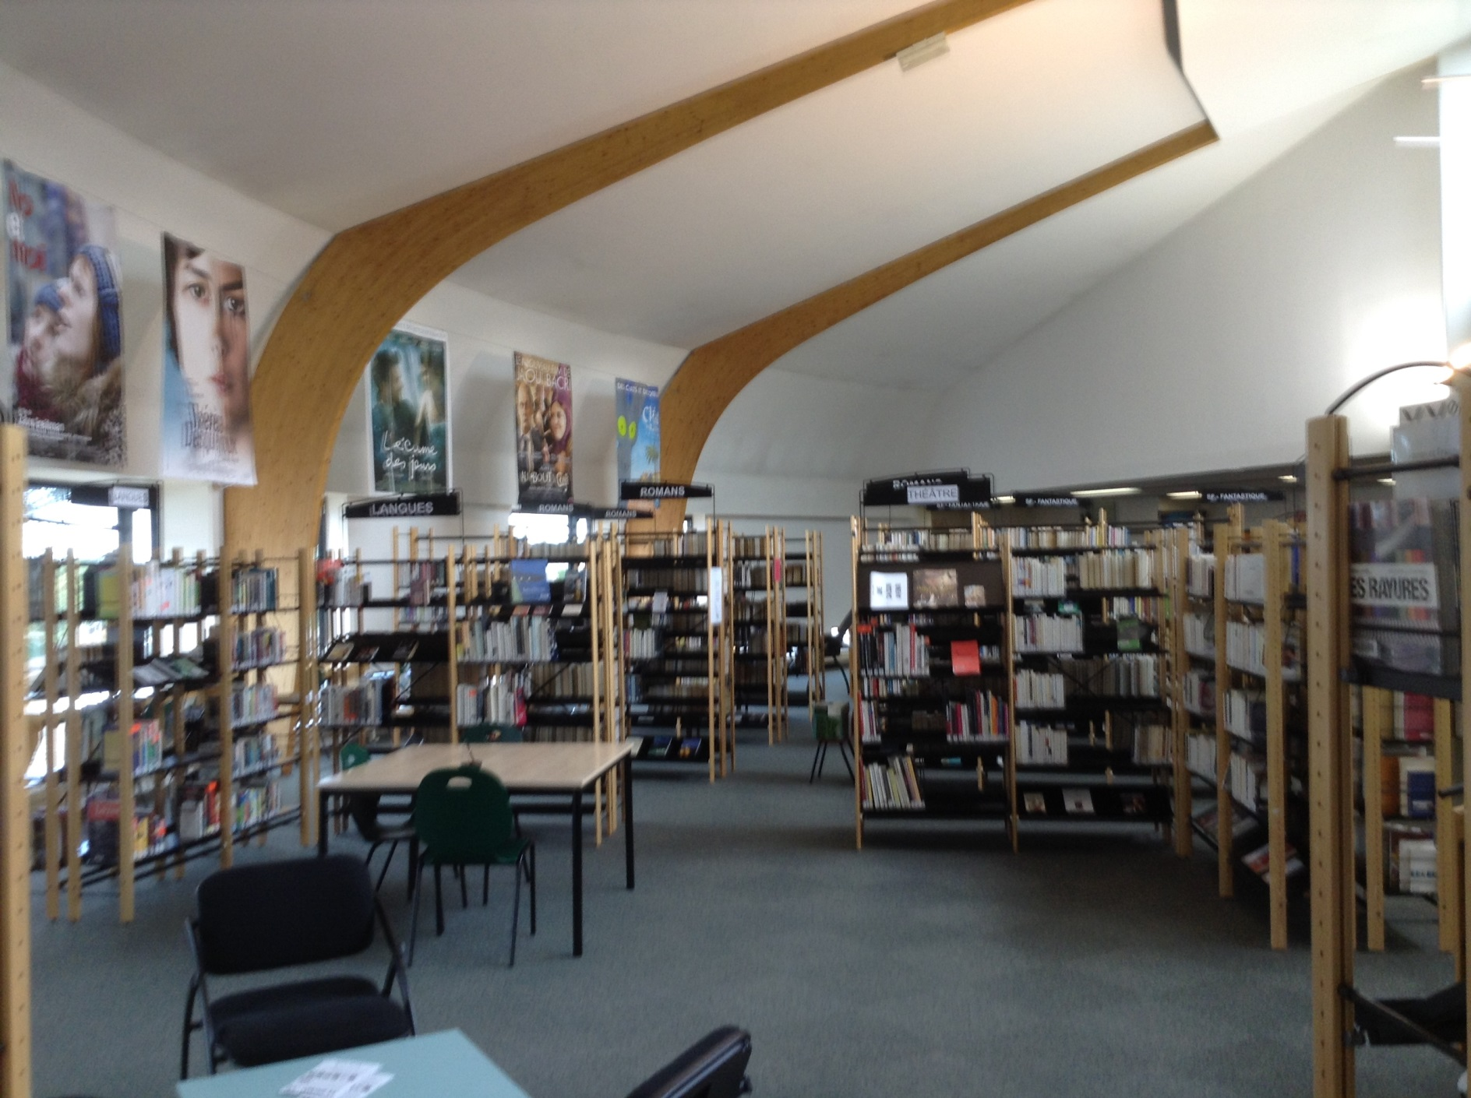

Slide 32
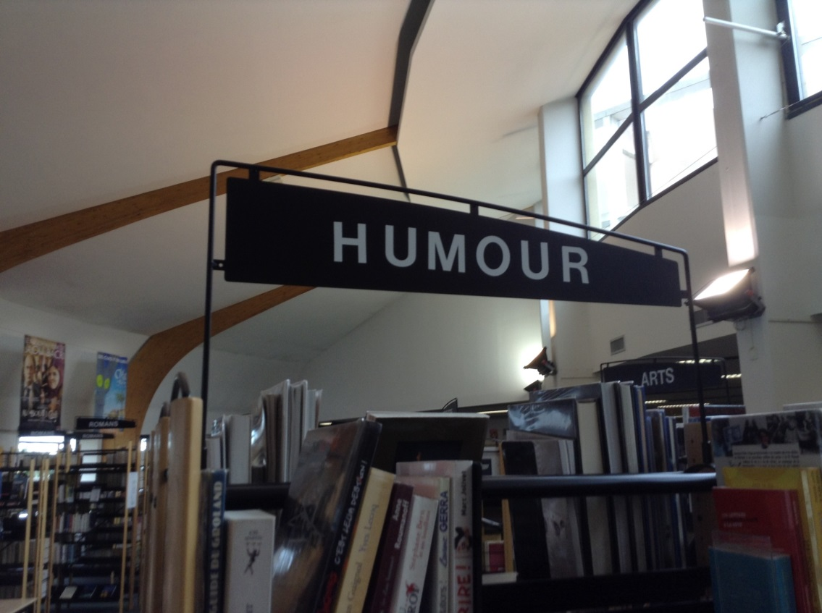
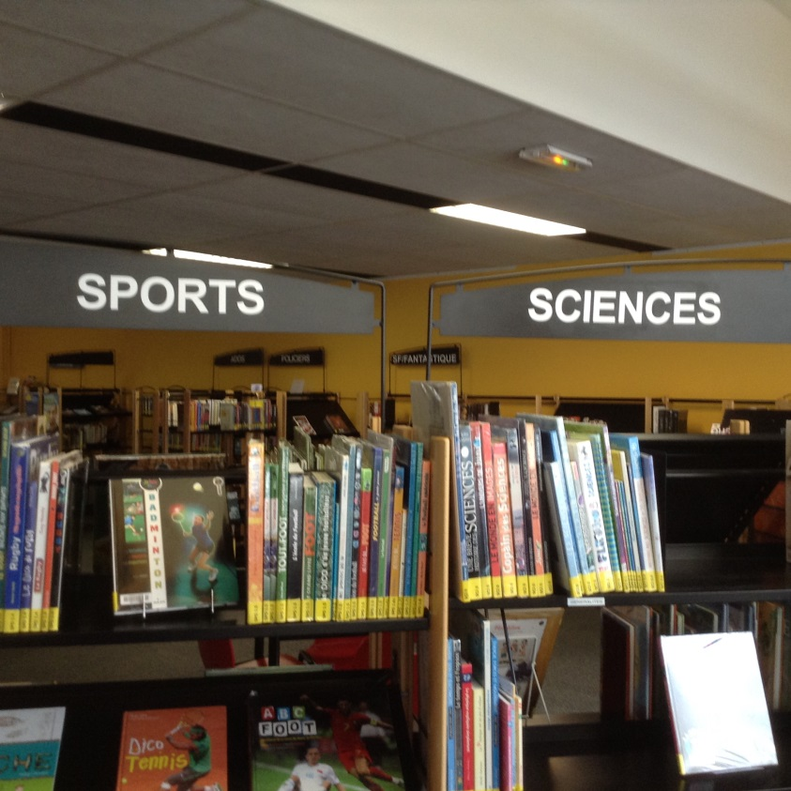
Book Store Arrangement

Slide 33
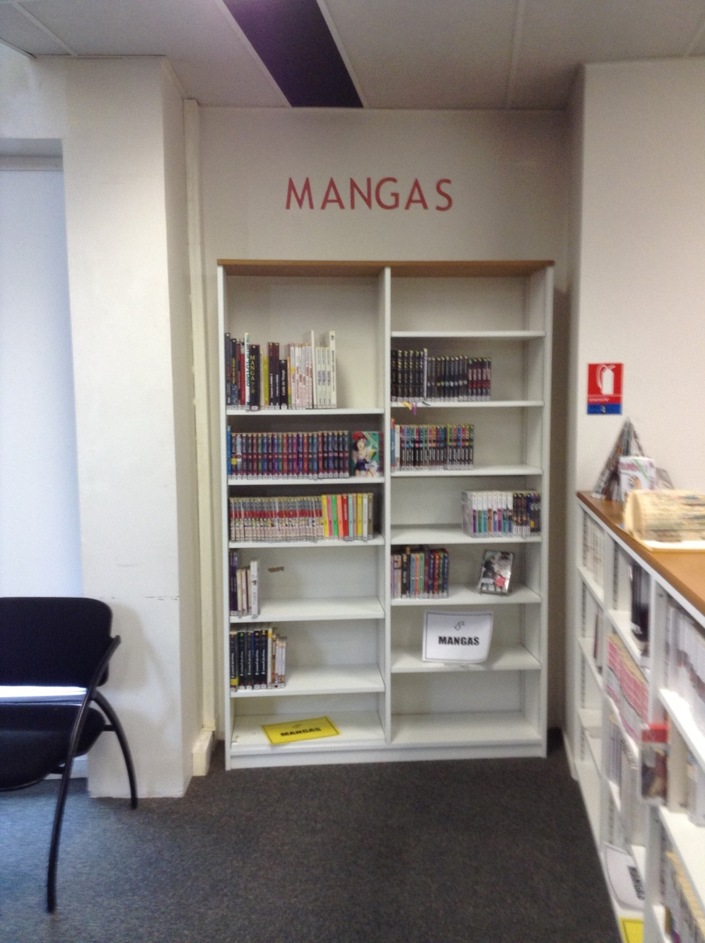

Slide 34
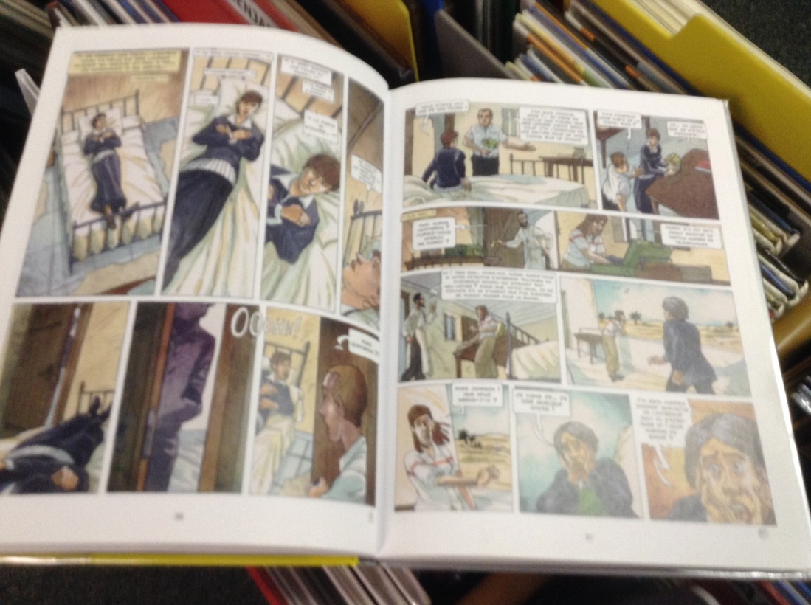
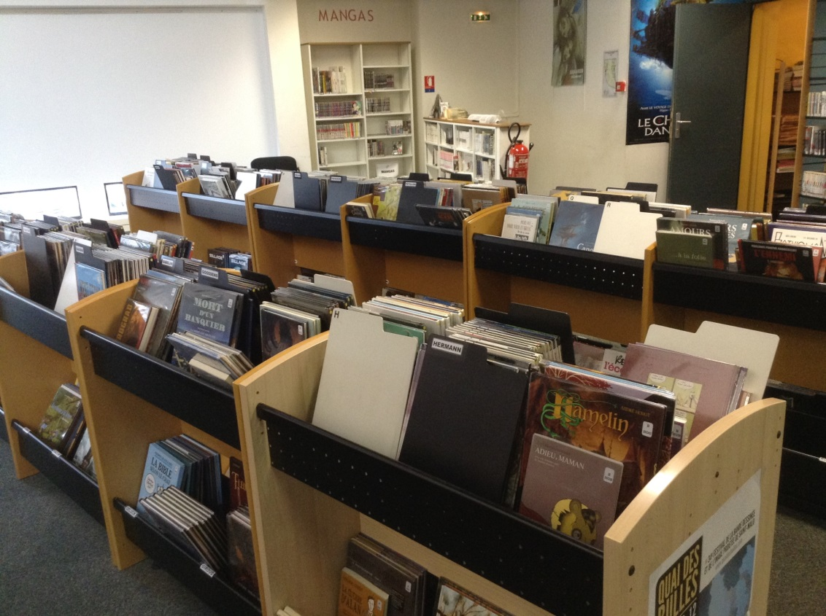

Slide 35
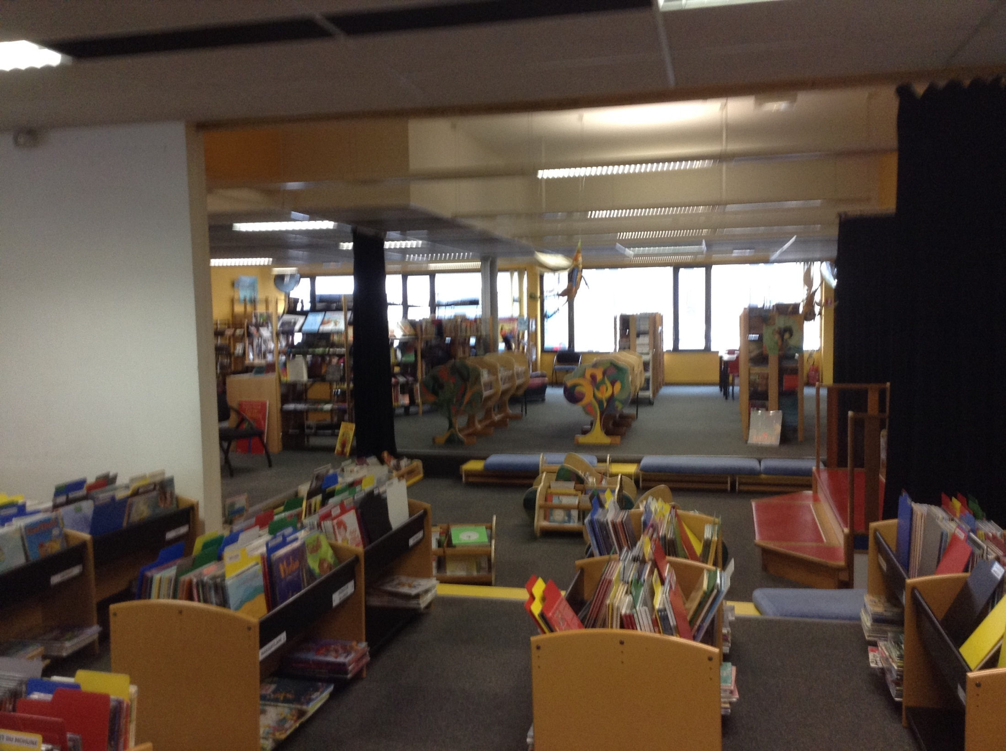

Slide 36
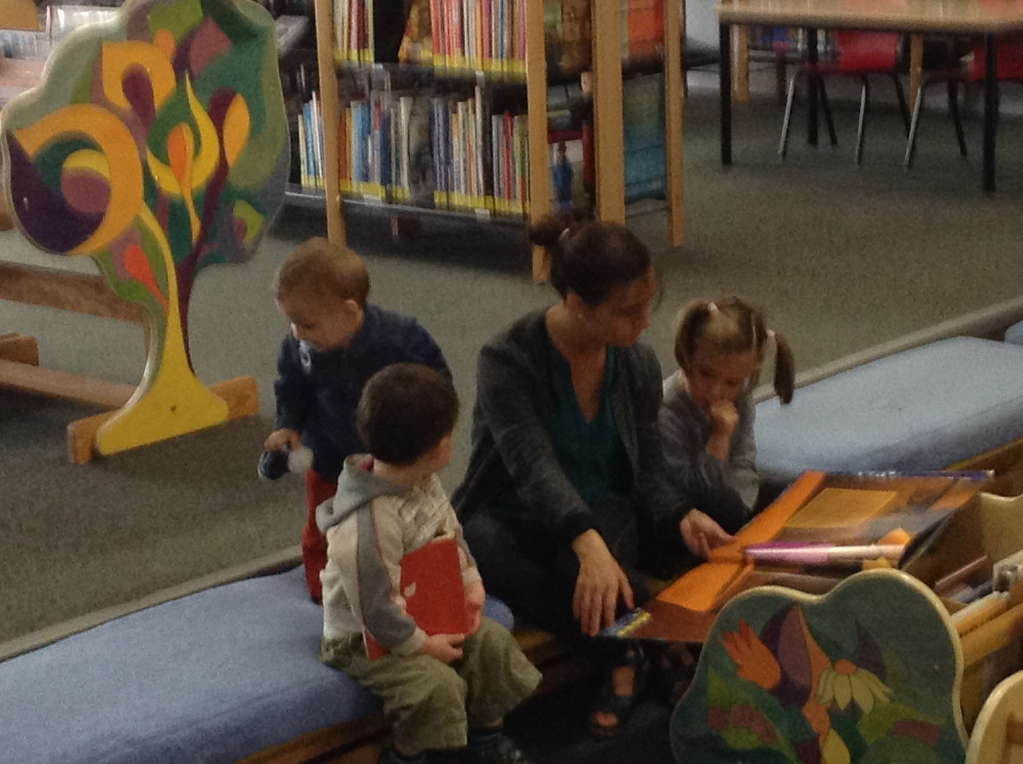

Slide 37
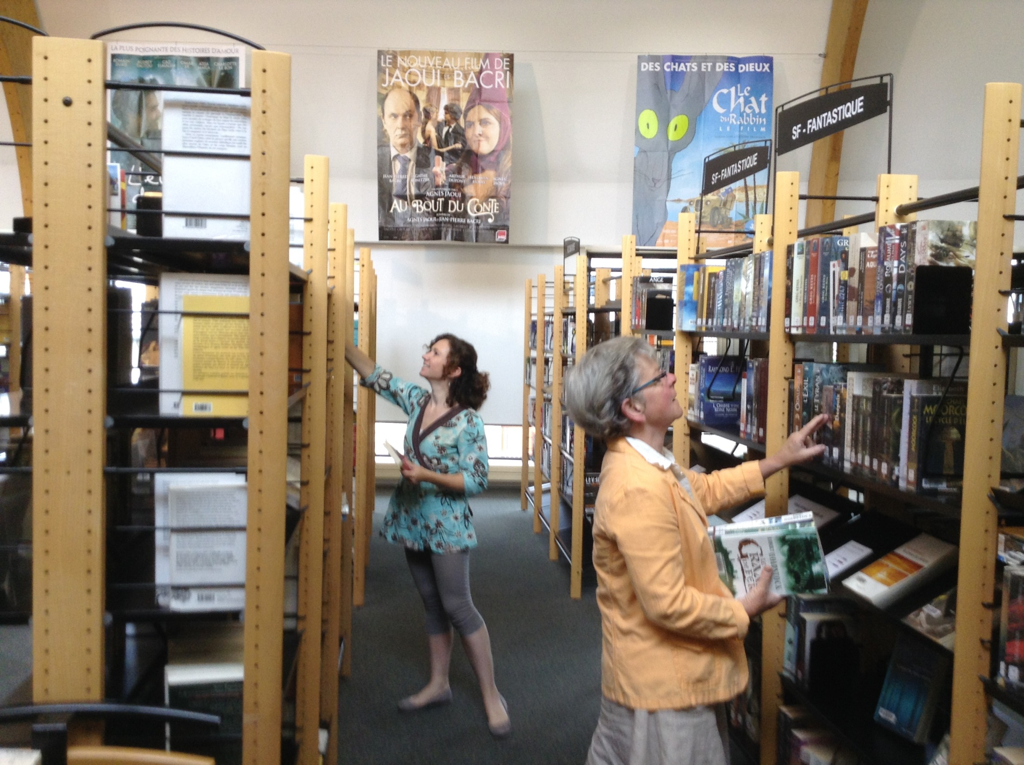

Slide 38
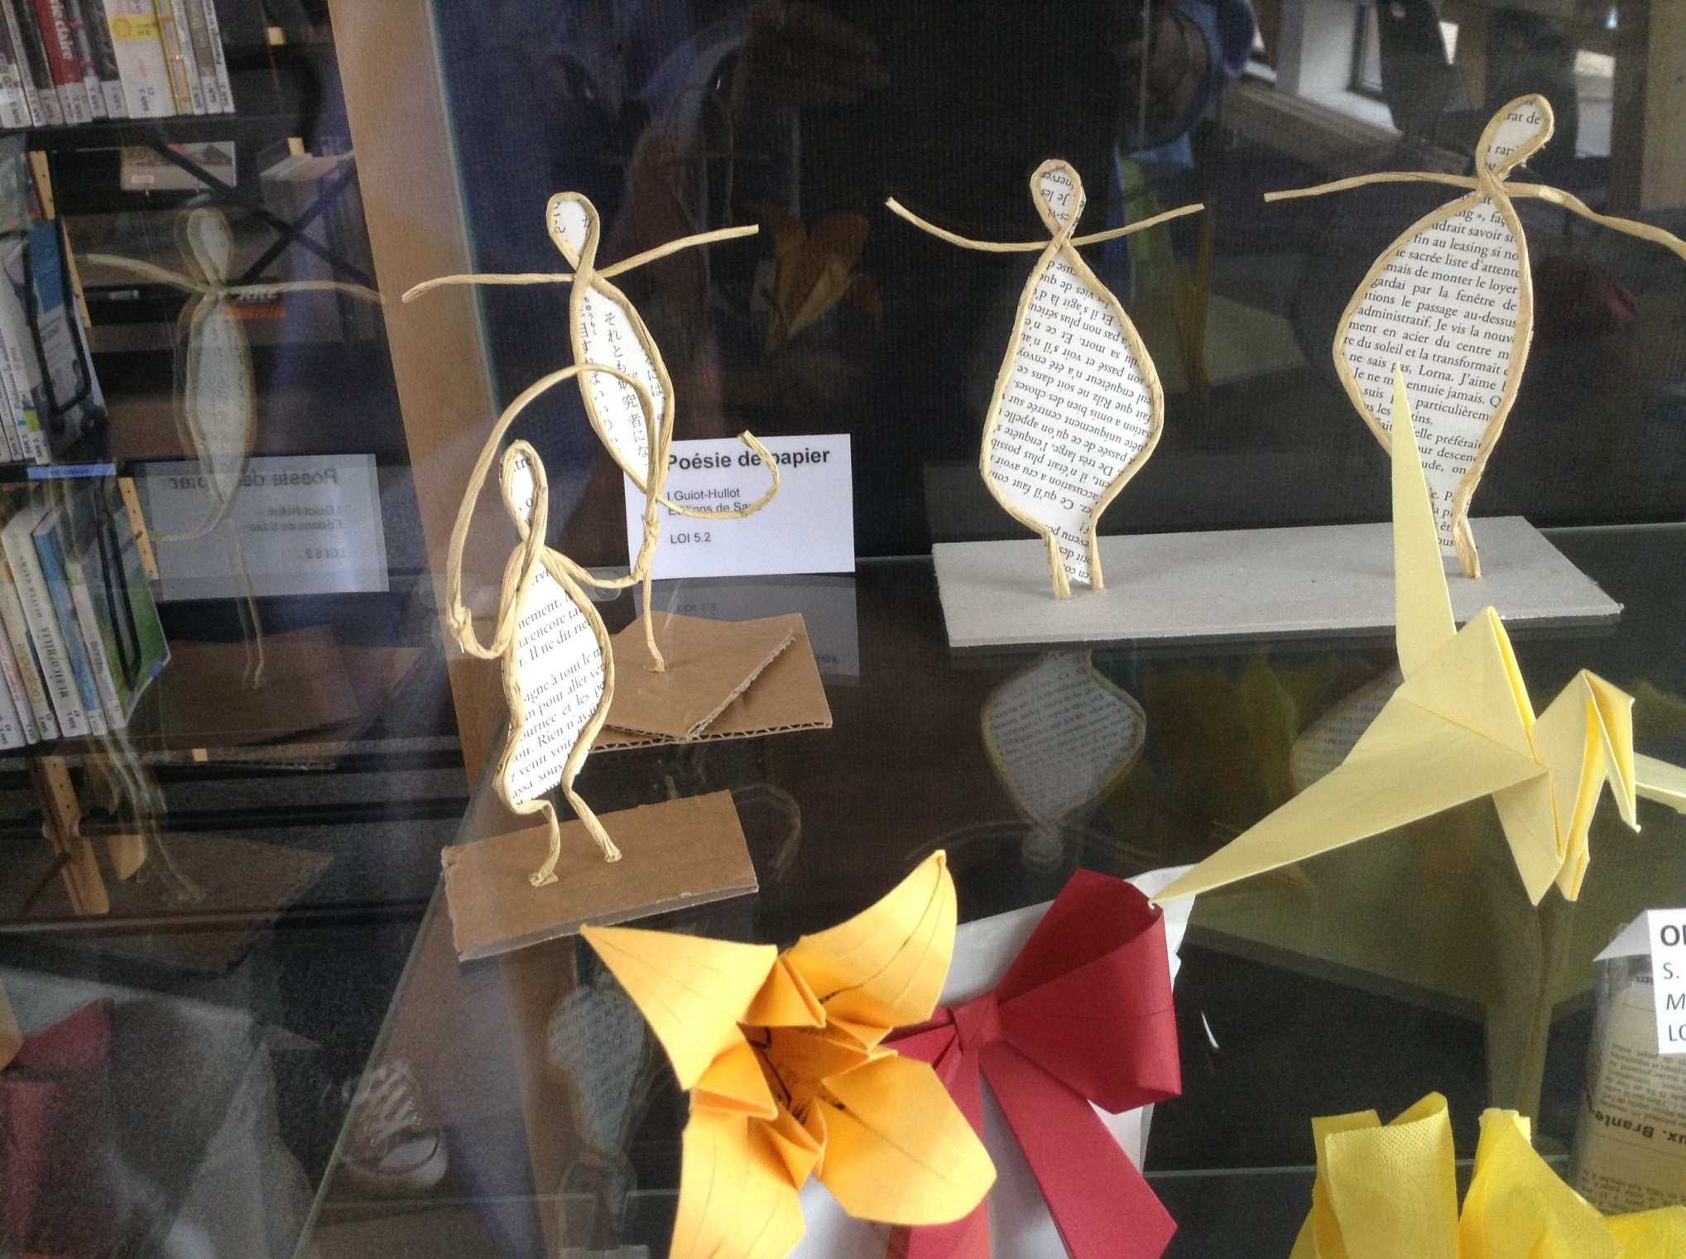

Slide 39
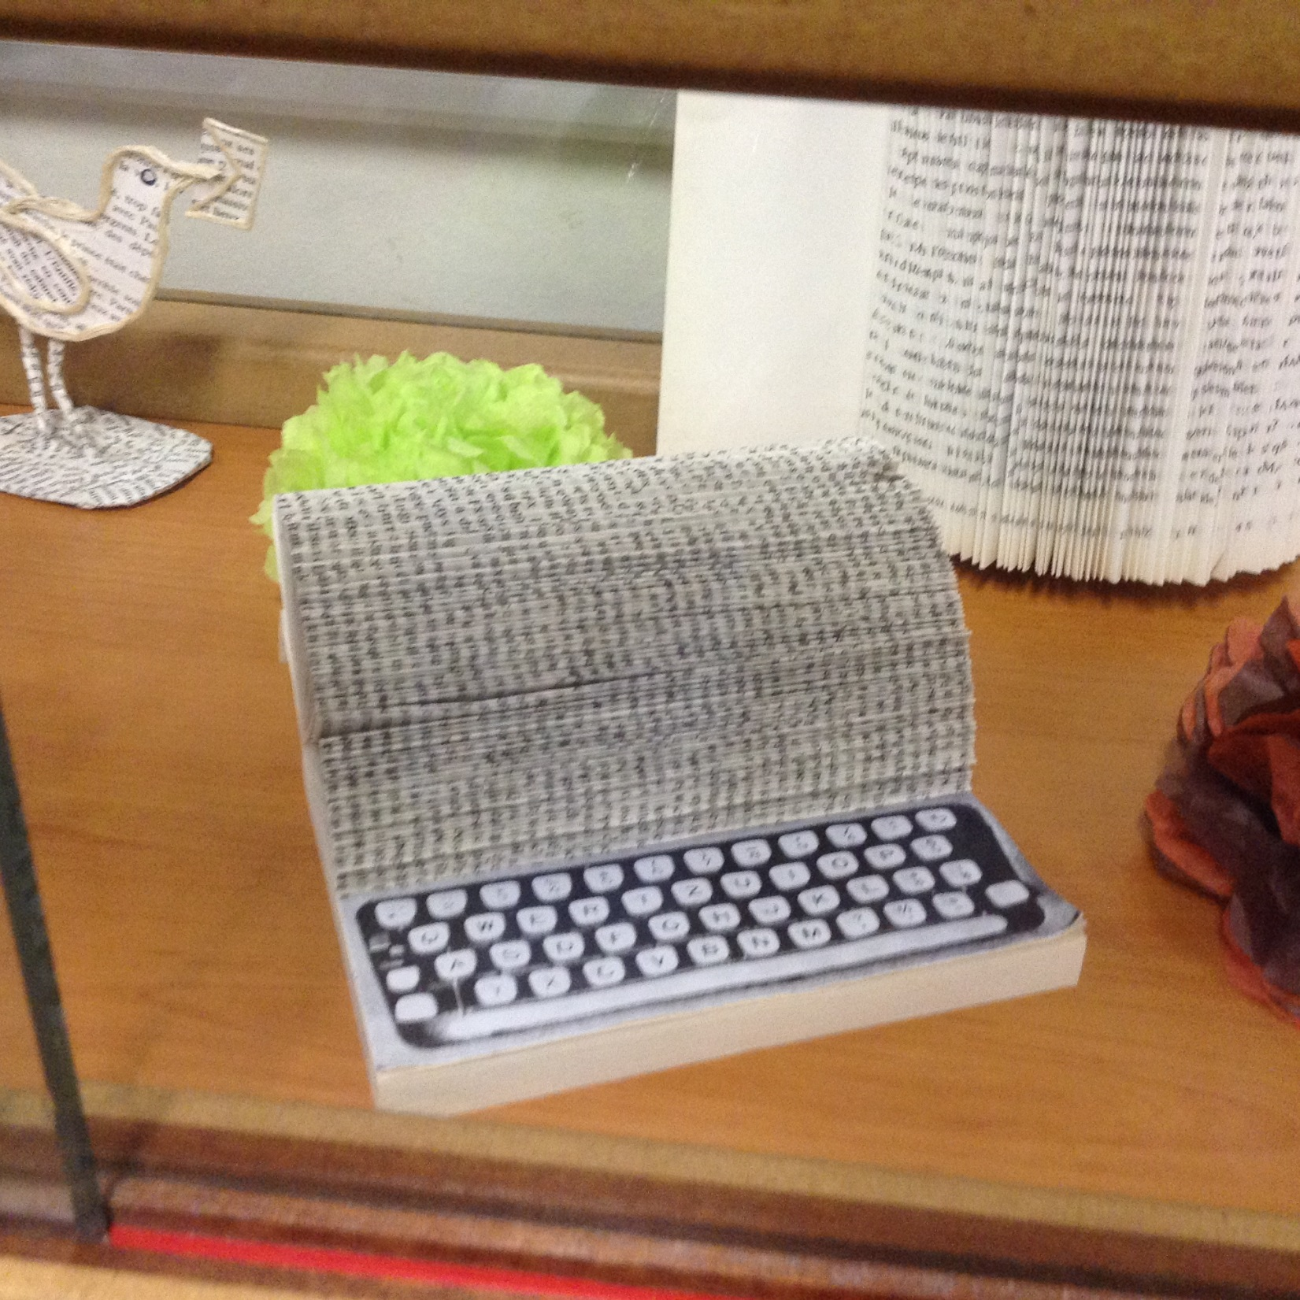

Slide 40
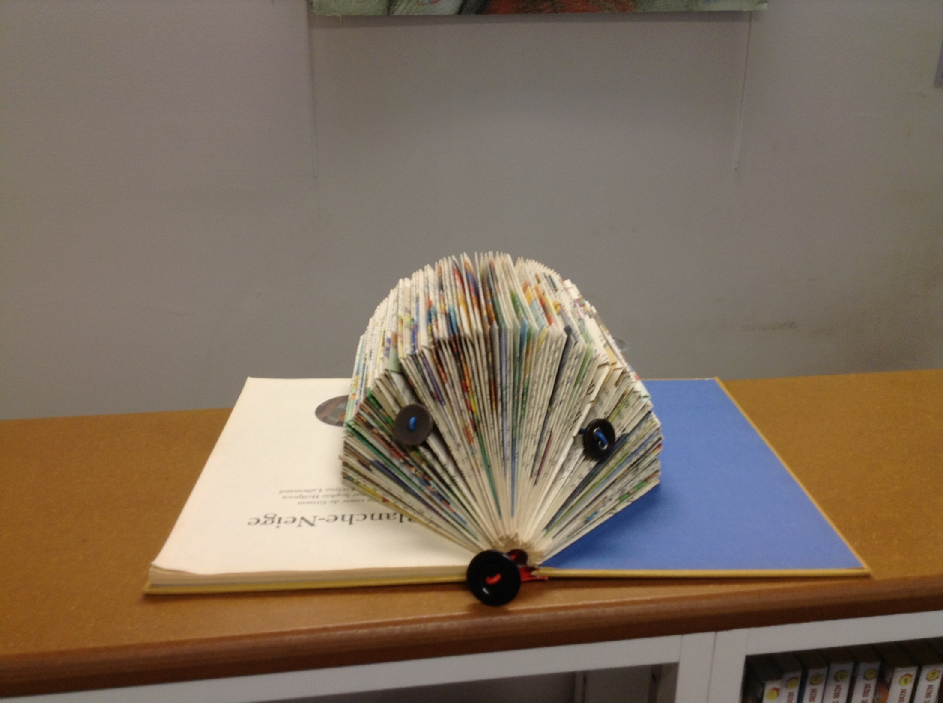

Slide 41
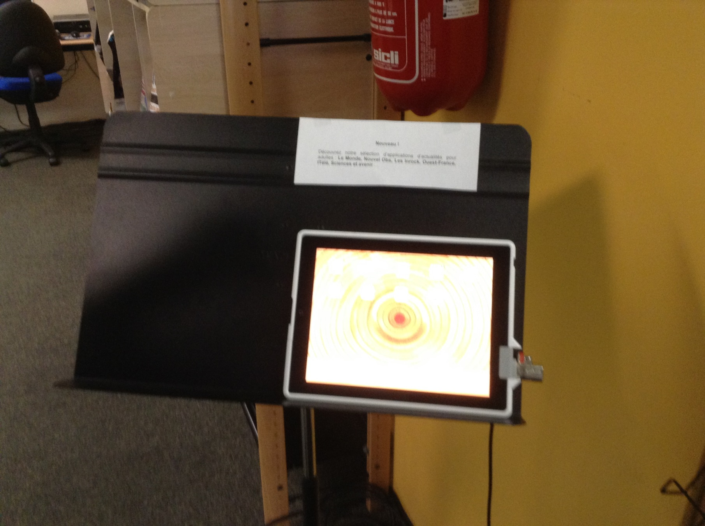

Slide 42
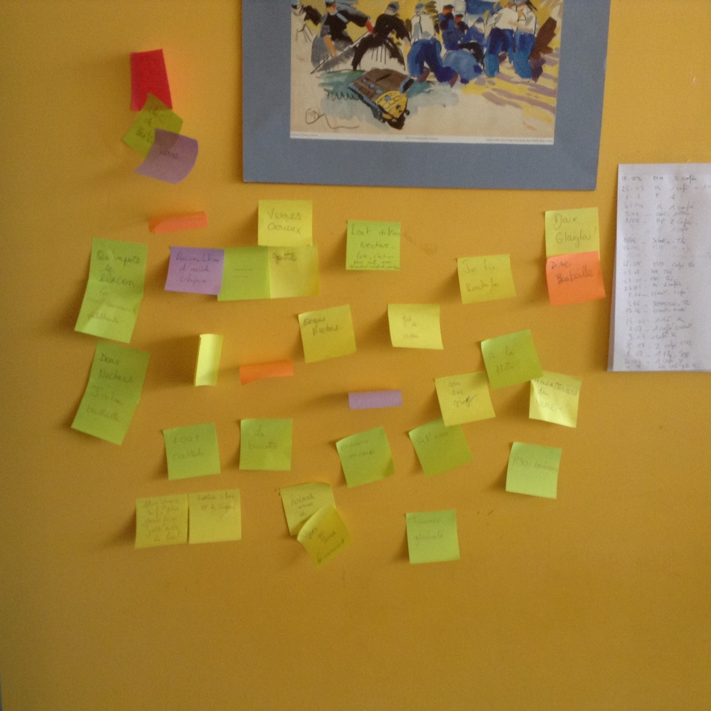

Slide 43
Ideas for Cooperation – Video Conferences
  Denver’s idea lab
    With librarians
    With teens
  How to organize a service to business
  How to serve immigrants

Slide 44
Ideas for Cooperation – Exhibits
Physical or Virtual
Celebrate centennial history of WWI – cooperation between US and Brest
Art work of teenagers, local artists
Historical children books from Brest
Photo exhibit of rare and incunabula books from both libraries

Slide 45
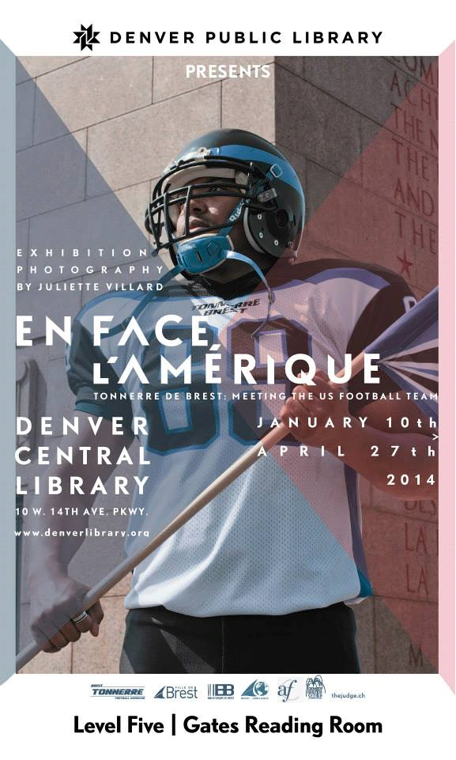

Slide 46
Ideas for Cooperation - Visits
Have to lobby the mayors for permission
Home library pays travel, visited library pays site expenses
May need a joint proposal to the mayors
“Let’s just get started and see what happens.”
Bénédicte

