Slide 1
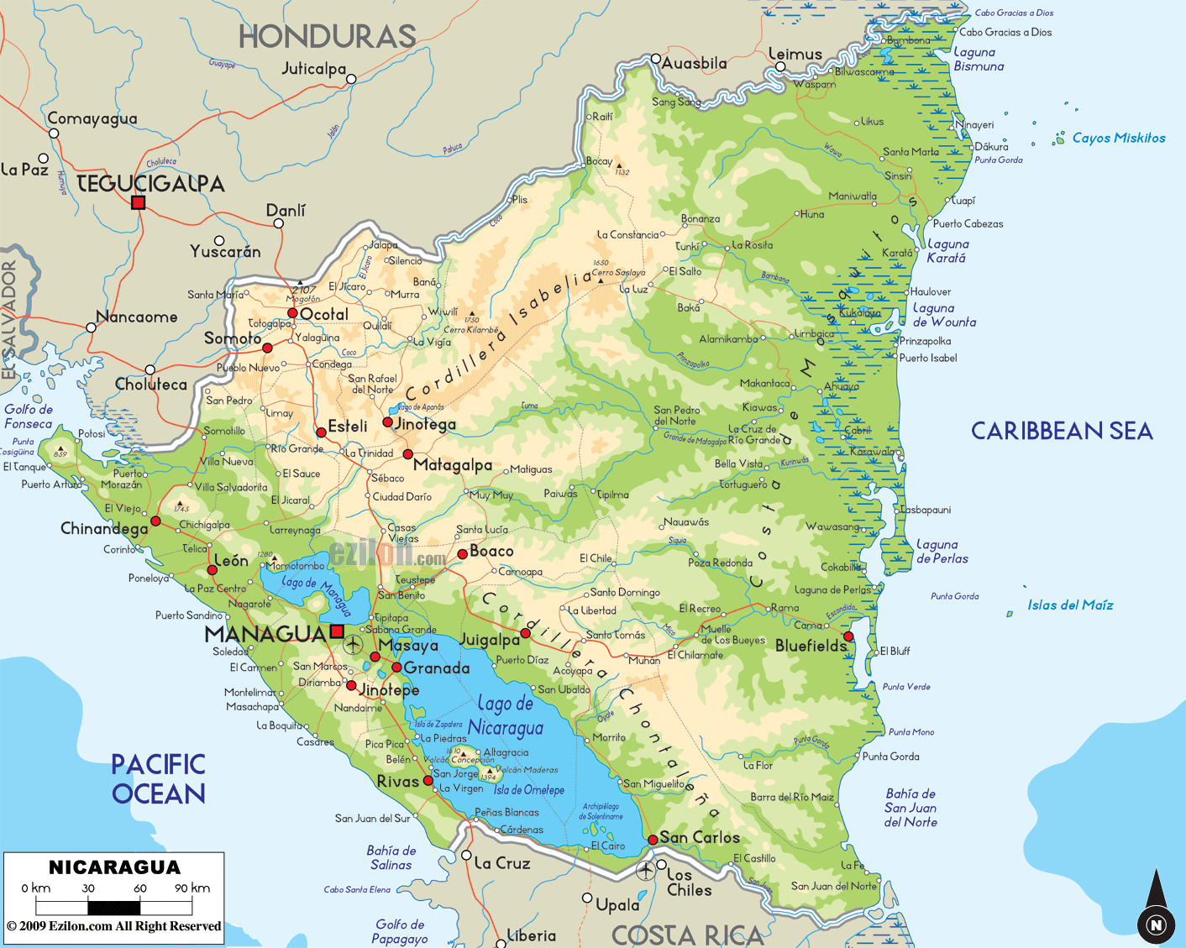

Slide 2
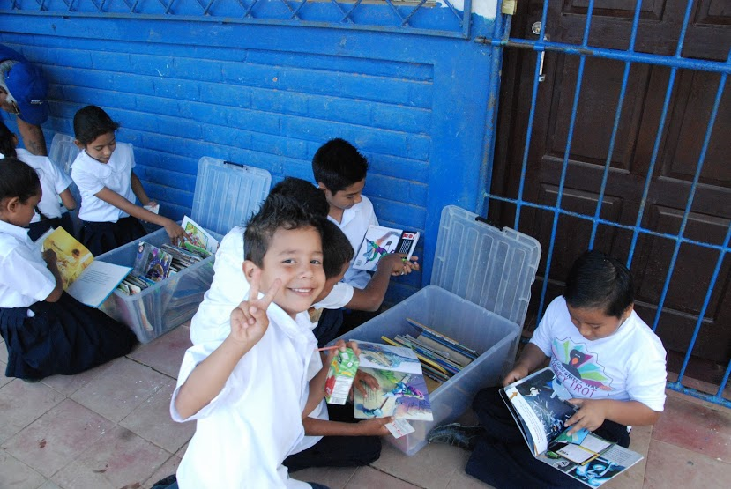
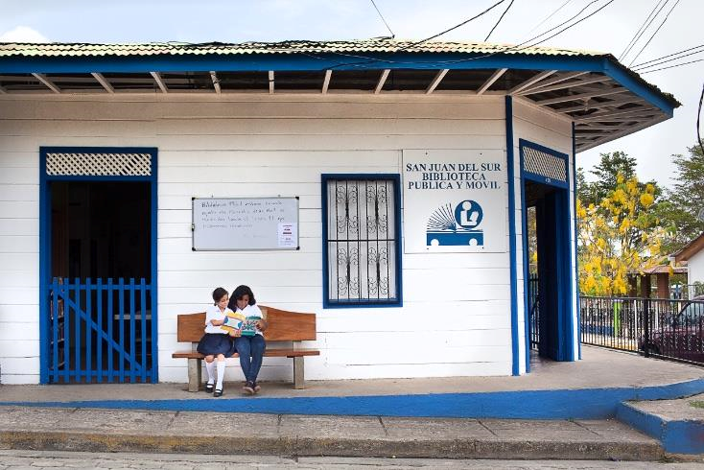
Notes:
Question 3: Library donations, people are resilient

Slide 3
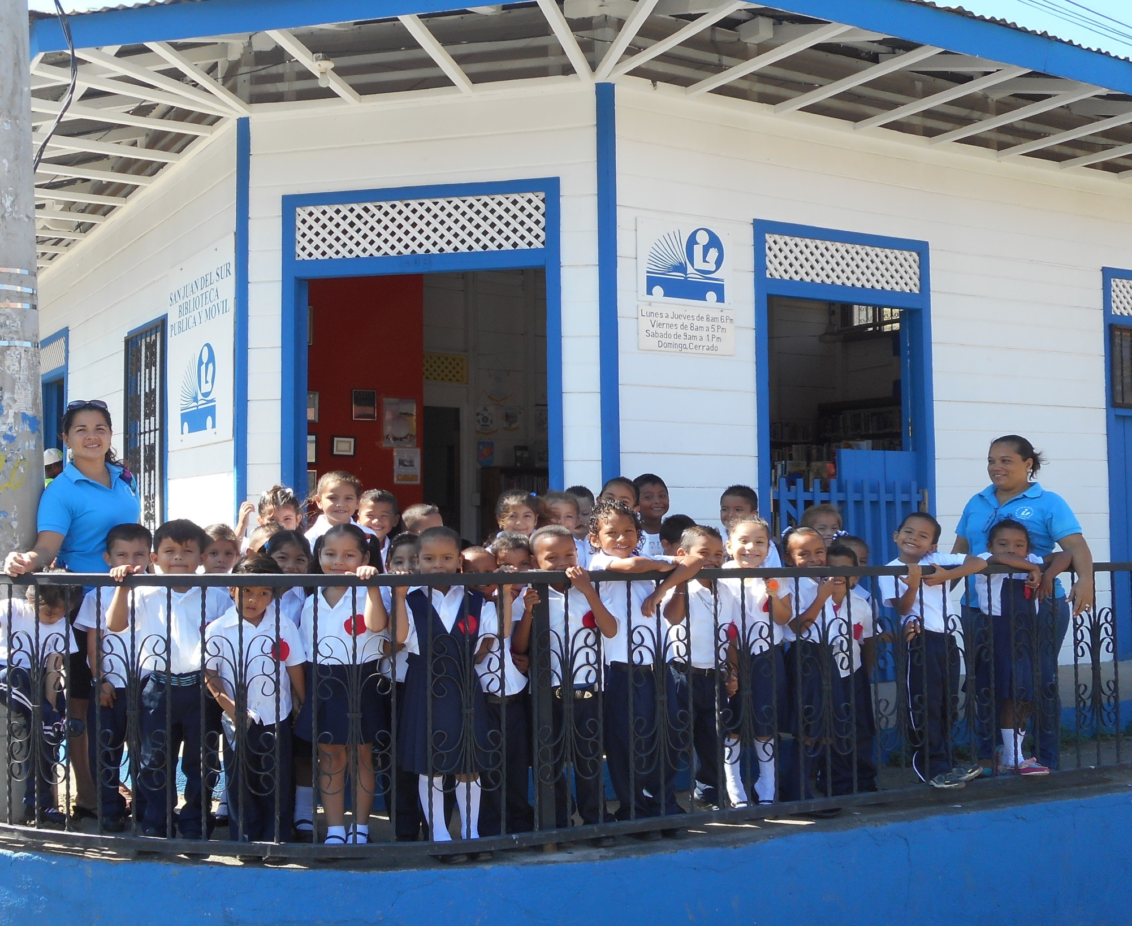

Slide 4
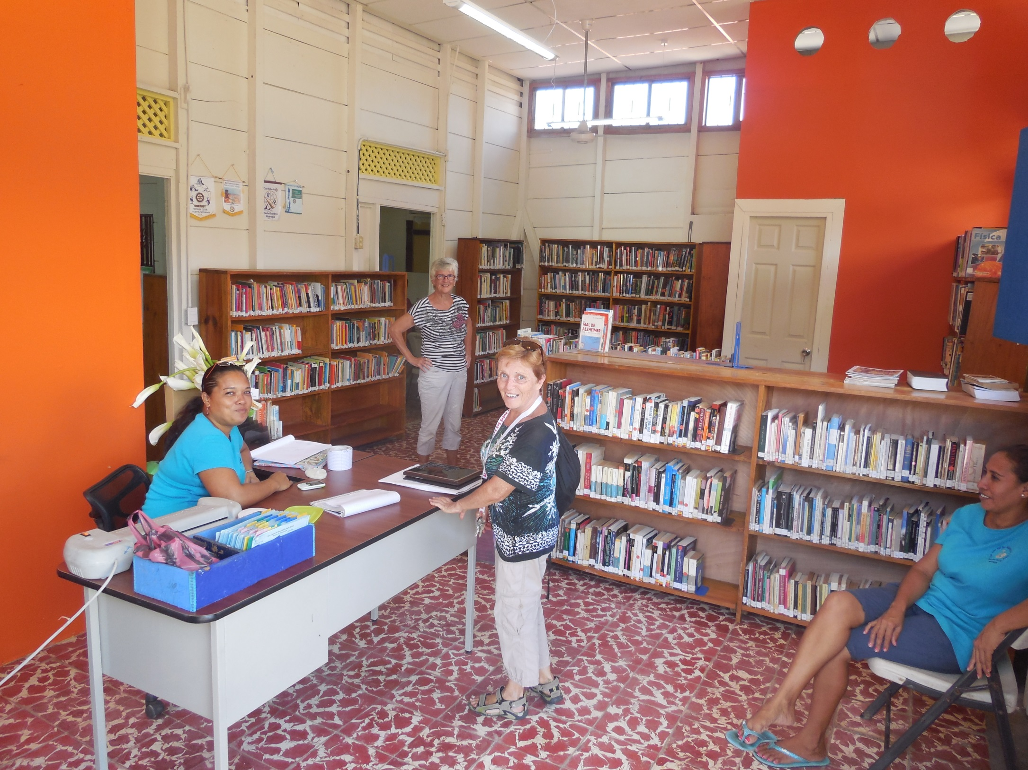

Slide 5
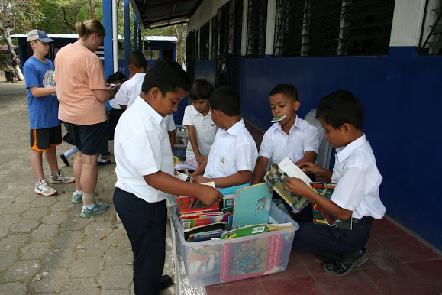

Slide 6
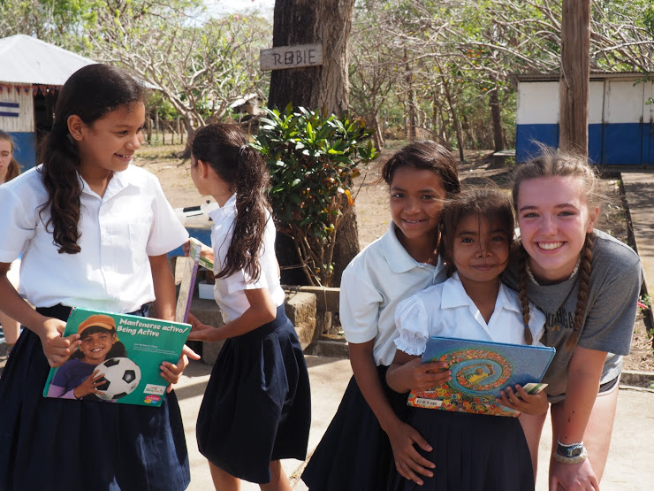

Slide 7
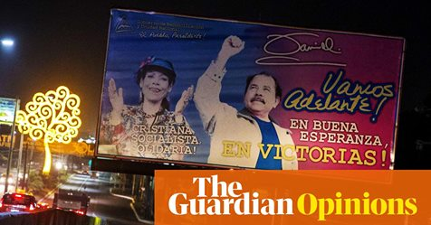

Slide 8
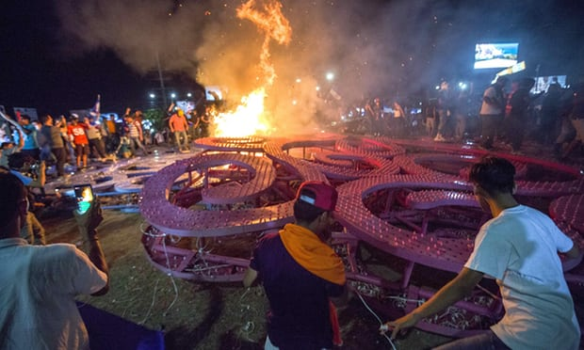

Slide 9
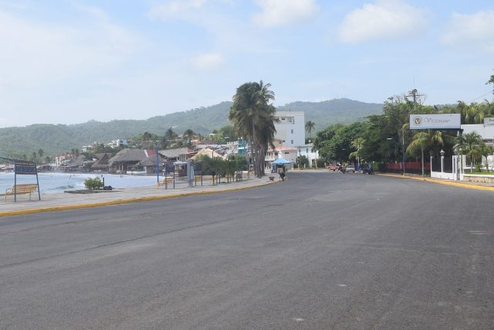
Notes:
Question 2: San Juan del Sur, empty – at a standstill.

Slide 10
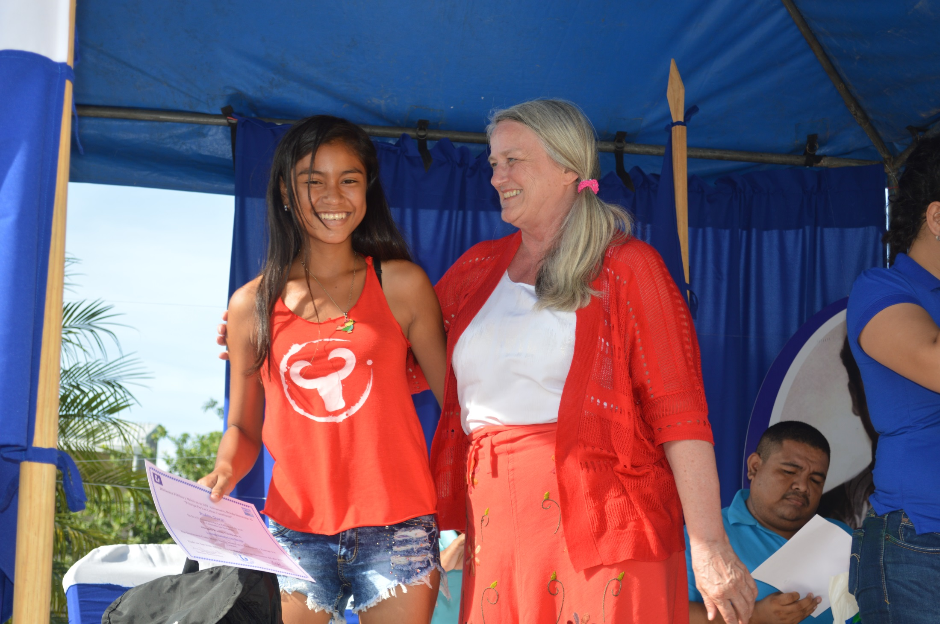

Slide 11
Reconsider travel to Nicaragua due to crime, civil unrest, limited healthcare availability, and arbitrary enforcement of laws.
On September 12, 2018, the U.S. Department of State lifted the ordered departure of non-emergency U.S. government personnel and family members. The U.S. Embassy remains open to provide emergency services for U.S. citizens and will gradually return to normal operations.
Throughout Nicaragua, armed and violent uniformed police or civilians in plain clothes acting as police (¿para-police¿) are targeting anyone considered to be in opposition to the rule of President Ortega. The government and its affiliated armed groups have been reported to:
Arbitrarily detain protestors, with credible claims of torture and disappearances.
Systematically target opposition figures, including clergy members.
Prevent certain individuals from departing Nicaragua by air or land.
Seize privately owned land.
Arbitrarily search personal phones and computers for anti-government content.
Arbitrarily detain certain individuals with unfounded charges of terrorism, money laundering, and organized crime.
These police and para-police groups often cover their faces, sometimes operate in groups numbering in the hundreds, and use unmarked vehicles.

Slide 12
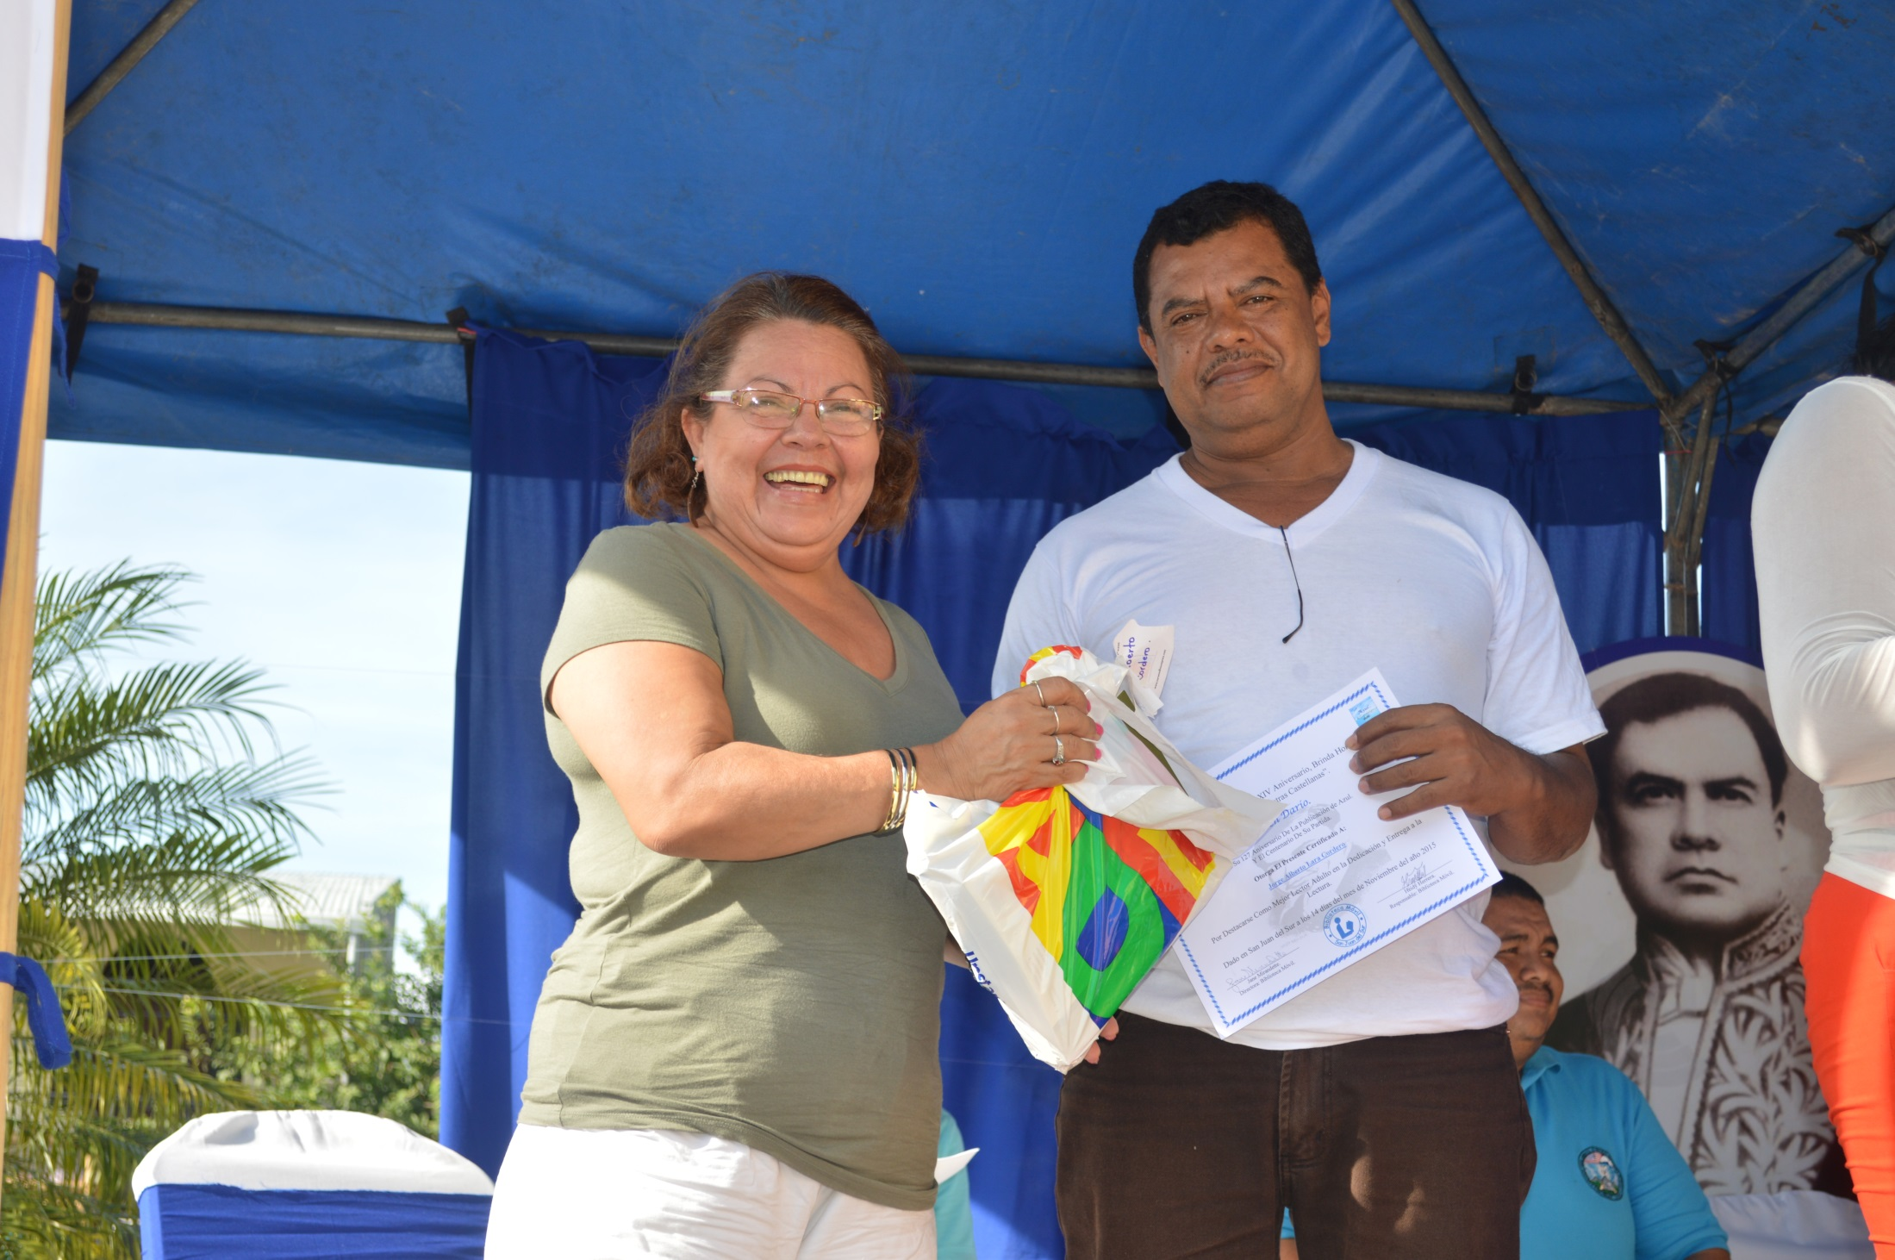

Slide 13
Costa Rica Travel Advisory Level 1: Exercise normal precautions, September 4, 2018
Exercise normal precautions in Costa Rica. Some areas have increased risk. Read the entire Travel Advisory.
Exercise increased caution in:
Central neighborhood in Limon due to crime.
Liberia city due to crime.
Desamparados neighborhood in San Rafael due to crime.
Pavas and Hospital neighborhoods San Jose due to crime.
Read the Safety and Security section on the country information page.
If you decide to travel to Costa Rica:
Enroll in the Smart Traveler Enrollment Program (STEP) to receive Alerts and make it easier to locate you in an emergency.
Follow the Department of State on Facebook and Twitter.
Review the Crime and Safety Report for Costa Rica.
U.S. citizens who travel abroad should always have a contingency plan for emergency situations. Review the Traveler's Checklist.

Slide 14
How can I receive updated information during a crisis?
We encourage all U.S. citizens traveling abroad, especially citizens who plan to be overseas for a significant amount of time, to enroll in the Smart Traveler Enrollment Program (STEP). It is important that you keep your contact information up-to-date so that we can notify you or your designated emergency contact of developments and provide valuable information.
Also be sure to monitor our website, travel.state.gov, for updates, as this is our primary tool to disseminate important information during a crisis. Our Facebook and Twitter accounts are also good sources of information. Rest assured that in case of a crisis, we will make use of all available modes of communication to keep our citizens informed, including the internet, social media, TV, and radio.

Slide 15
What the State Department Can and Cannot Do in High-Risk Areas
You are subject to the laws and the legal system of the country you are visiting.
In many high-risk areas, we cannot help you. This may be because of a lack of a functioning government, the ineffectiveness or policies of local authorities, armed conflict, or poor governance.
In many countries where the United States does not maintain diplomatic or consular relations, the U.S. government has no means to provide consular services to U.S. citizens. In the limited number of countries where the United States has an official Protecting Power arrangement with another country, very limited assistance may be available.
In a crisis in a high risk area, we may have to rely on local resources to resolve matters. See what we can and cannot do here during a crisis: Please refer to our webpage on What the Department of State Can and Can't Do in a Crisis.

Slide 16
The recent New Yorker article on Nicaragua entitled "Fake News" and Unrest in Nicaragua. Suppressing an uprising, President Daniel Ortega borrows tactics from autocrats abroad.
is an excellent and accurate description of the current crisis and a good historical view as well. It is very disconcerting to read: https://www.newyorker.com/magazine/2018/09/03/fake-news-and-unrest-in-nicaragua
The UN Team provider a critical report and were required to immediately leave the country : MSN: Nicaragua to expel UN team after critical report http://a.msn.com/01/en-us/BBMI23V?ocid=se
The UN met on Sept 5th to discuss intervention in Nicaragua and faced opposition from Russia and Venezuela. One comment heard was “ Nicaragua is a ticking time bomb”.
http://www.news4europe.eu/6350_world/5636405_divided-un-security-council-discusses-nicaragua-for-1st-time.html
Librarians are disseminating all of the not fake news via Facebook ,twitter at the risk of their lives. They are so courageous.
For more information and if you want to help:
Contact: Jane Mirandette
janecmirandette@gmail.com cell: 970 227 9287

