Slide 1
¡Gracia’s Omu!
Childhood Literacy workshop in Granada, Nicaragua
Presented by Jane Mirandette
President of the Hester J. Hodgdon Libraries for All Foundation

Slide 2
Librarians Gather to Collaborate, Share Early Childhood Teaching Skills, Internet Safety and Innovative Technology
Workshop was presented by the Hester J. Hodgdon Libraries For All Foundation with a Grant from the ILCE-IG grant in November of 2019
70+ attendees
9 speakers and activity coordinators from Nicaragua and the US
Luncheon subsidized and provided for $5 per attendee.
Activities based around the Jumpstart Read for the Record 2O19 book ¡Gracias Omu! and Google's Be Internet Awesome Campaign.

Slide 3
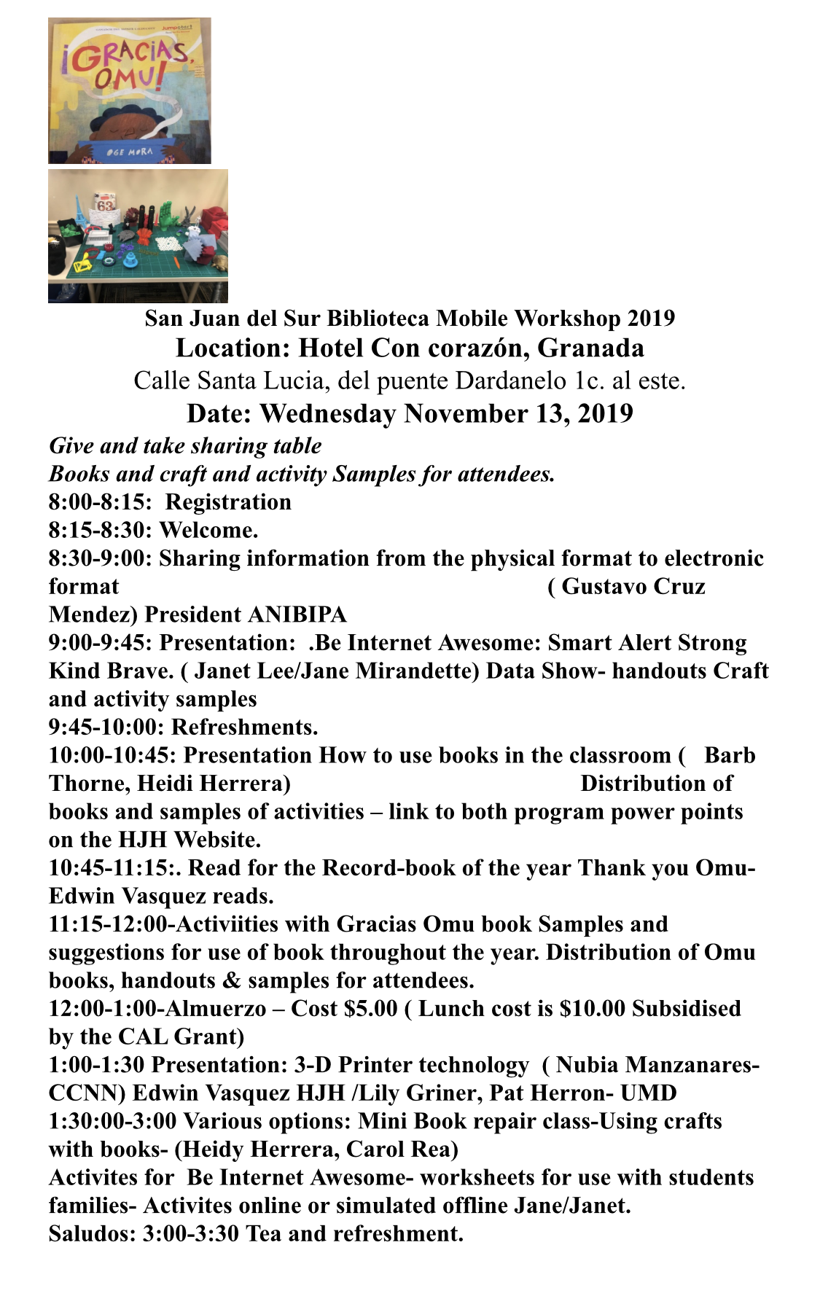
Workshop Topics:
Migrating Physical Format Information to Electronic Format
  Gustavo Mendez Cruz, president of ANIBIPA
Be Internet Awesome! Use and Security of Your Google Accounts
  Jane Mirandette and Janet Lee
Presentation Story Books and Activities
  Barb Thorne
¡Gracias Omu! Reading
  Edwin Vasquez
¡Gracias Omu! Activities
Presentation and Use of New Technologies (3D Printing)
  Nubia Manzanares, Edwin Vasquez, Lily Griner, Patricia Herron, Preston Tobery
Choice of Activities: Book Repair, Books and Crafts

Slide 4
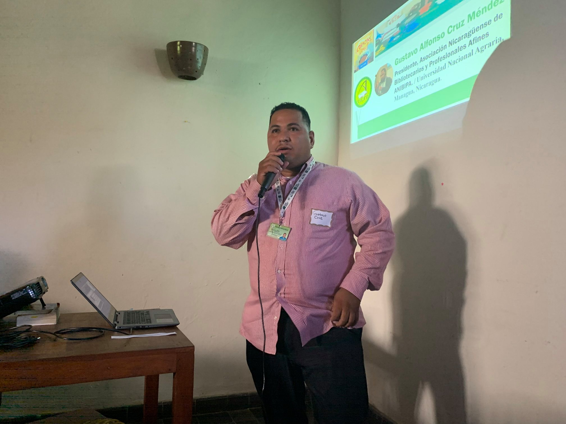
Getting Started:
The President of ANIBIPA, Nicaragua’s Library Association, Gustavo Cruz, presented on the challenges and successes libraries have faced migrating physical data in Nicaragua.

Slide 5
Be Internet Awesome!
Online privacy- Share with Care
Making strong passwords - Secure your Secrets
Talking to family about safety -Don’t Fall for Fake
Being kind on the internet - It’s Cool to be Kind
Responding to bullying - When in Doubt, Talk it Out
Family Link Guide for digital ground rules.
Guided by Google’s Be Internet Awesome campaign

Slide 6
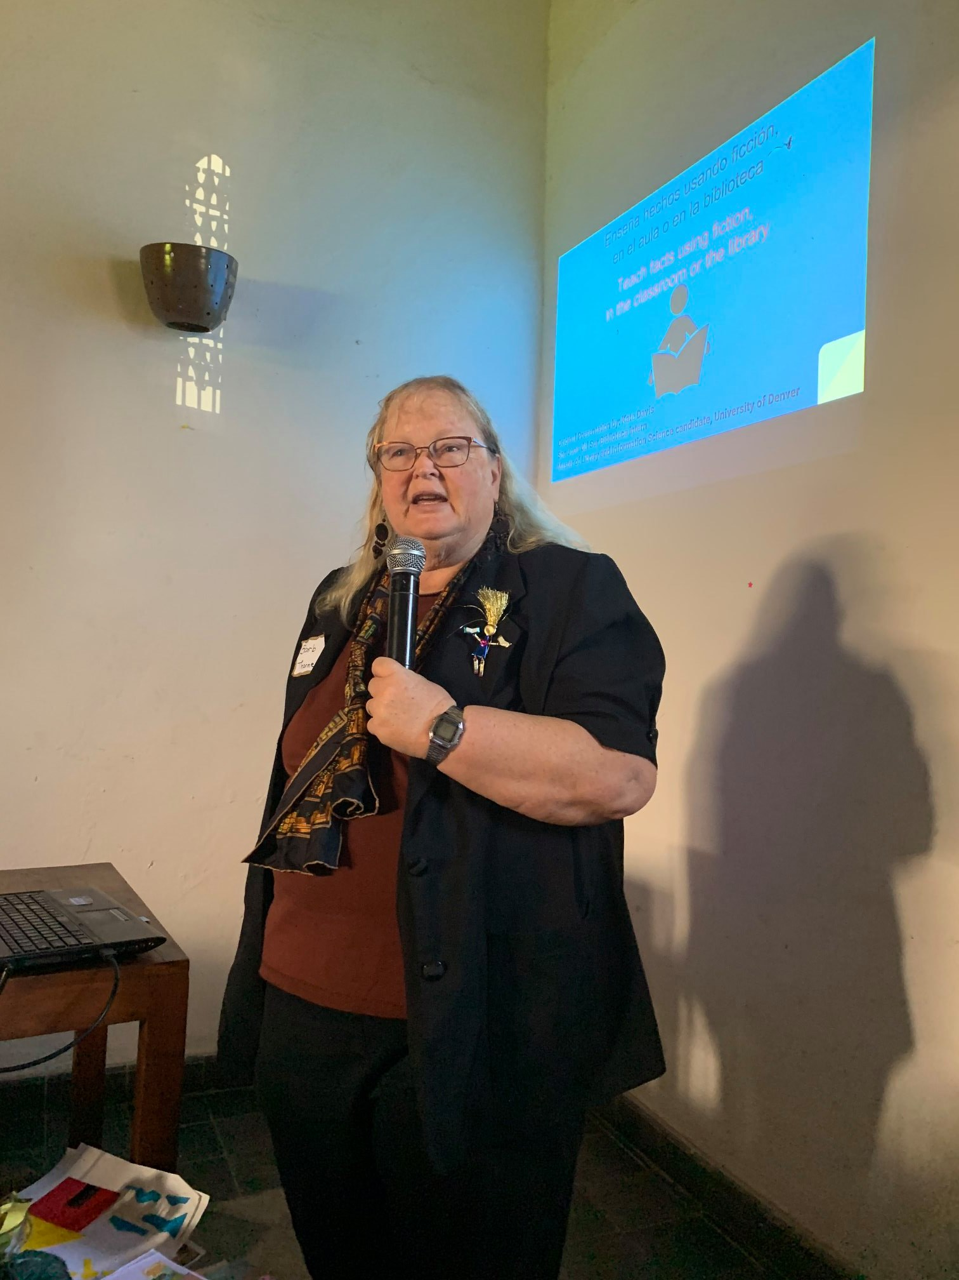
Story Time:
Barb Thorne presented a bilingual powerpoint demonstrating how to use a variety of books and associated activities for literacy learning in the classroom or library.
Both powerpoint programs offered in this workshop are bilingual and available to download on our website under lending library resources.

Slide 7

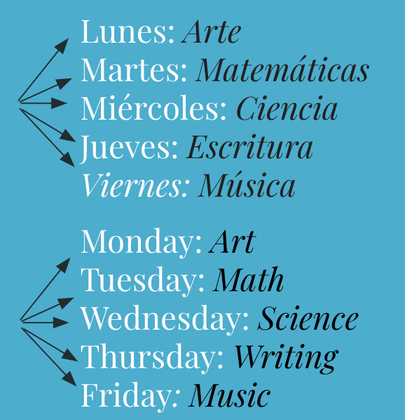
Example slide from Barb’s Presentation:
Utilice un libro por semana y conéctelo a su plan de estudios cada día.
Use a book each week and connect it to your curriculum each day.
`

Slide 8
Reading ¡Gracias Omu!
Jumpstart’s read for the record book of 2019
¡Gracias Omu! By Oge Mora

Slide 9
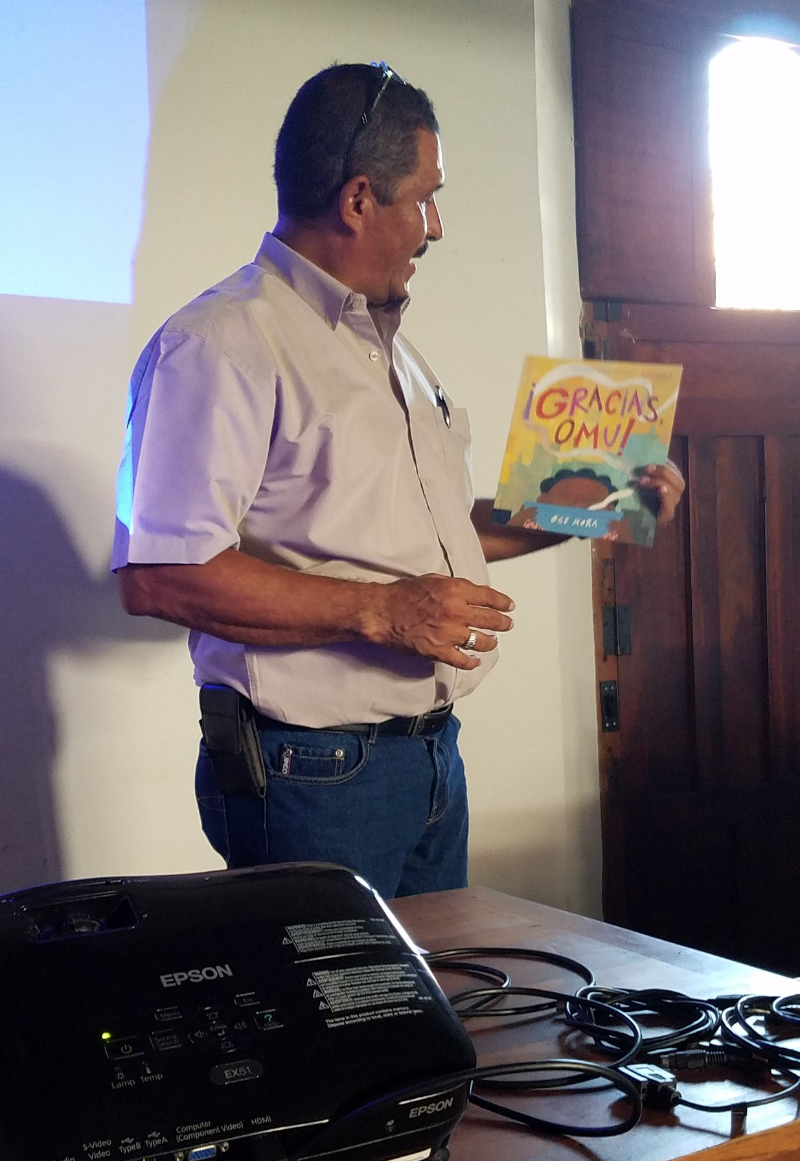
Reading ¡Gracias Omu!
Edwin Vasquez reads ¡Gracias Omu! aloud while the group reads along.
Copies of the book were distributed to each person or group to bring back to their libraries as part of the program.

Slide 10
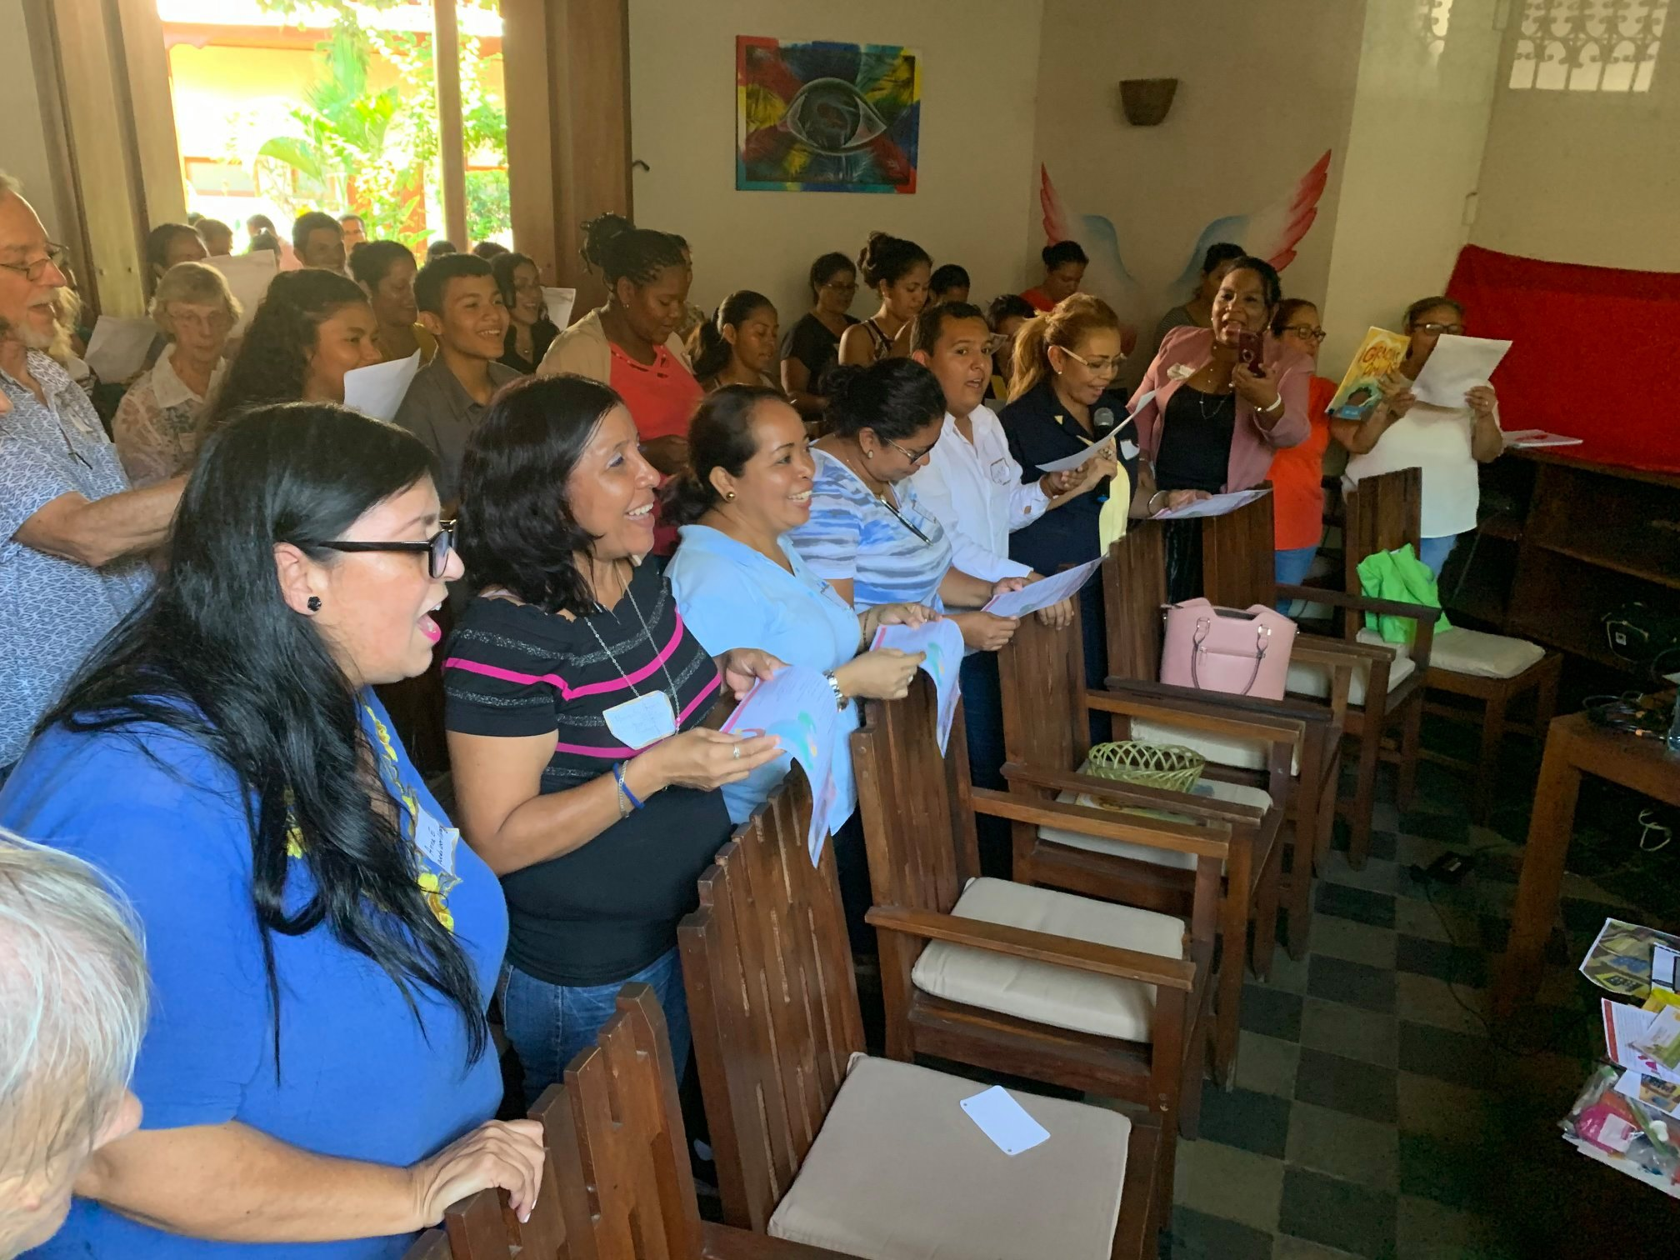
Activity: If you’re thankful and you know it…clap your hands!
Attendees sang along to a rendition of If You’re Happy and You Know It
Several activities were shared with the group to demonstrate using interactive activities in their classrooms or libraries.

Slide 11
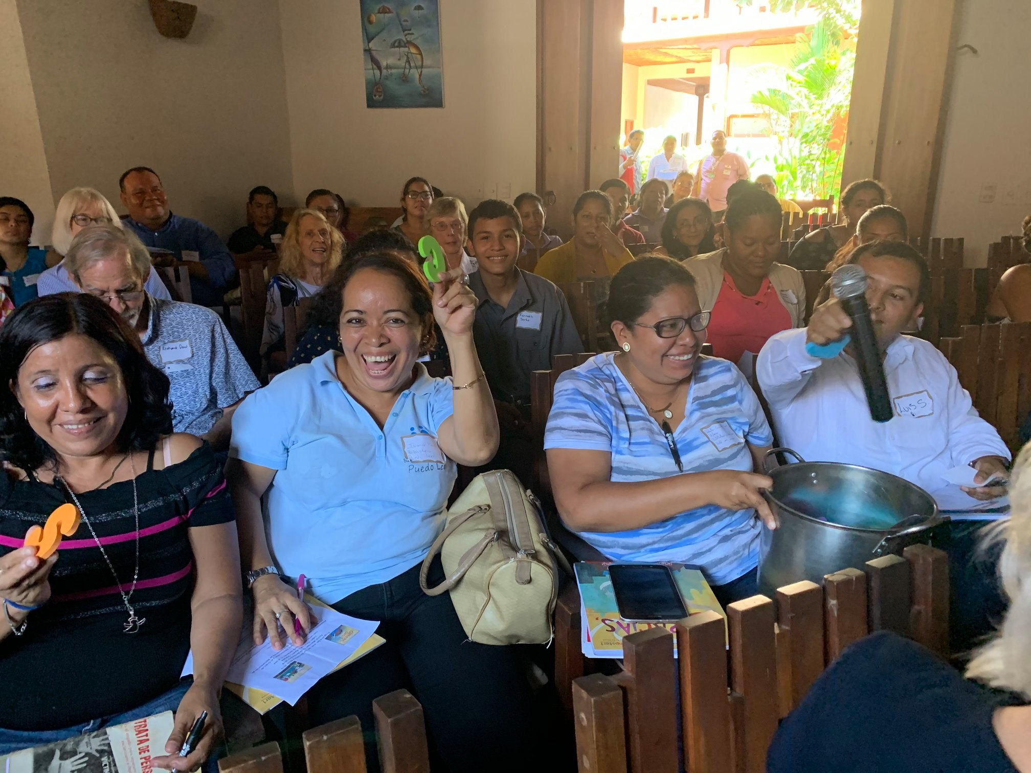
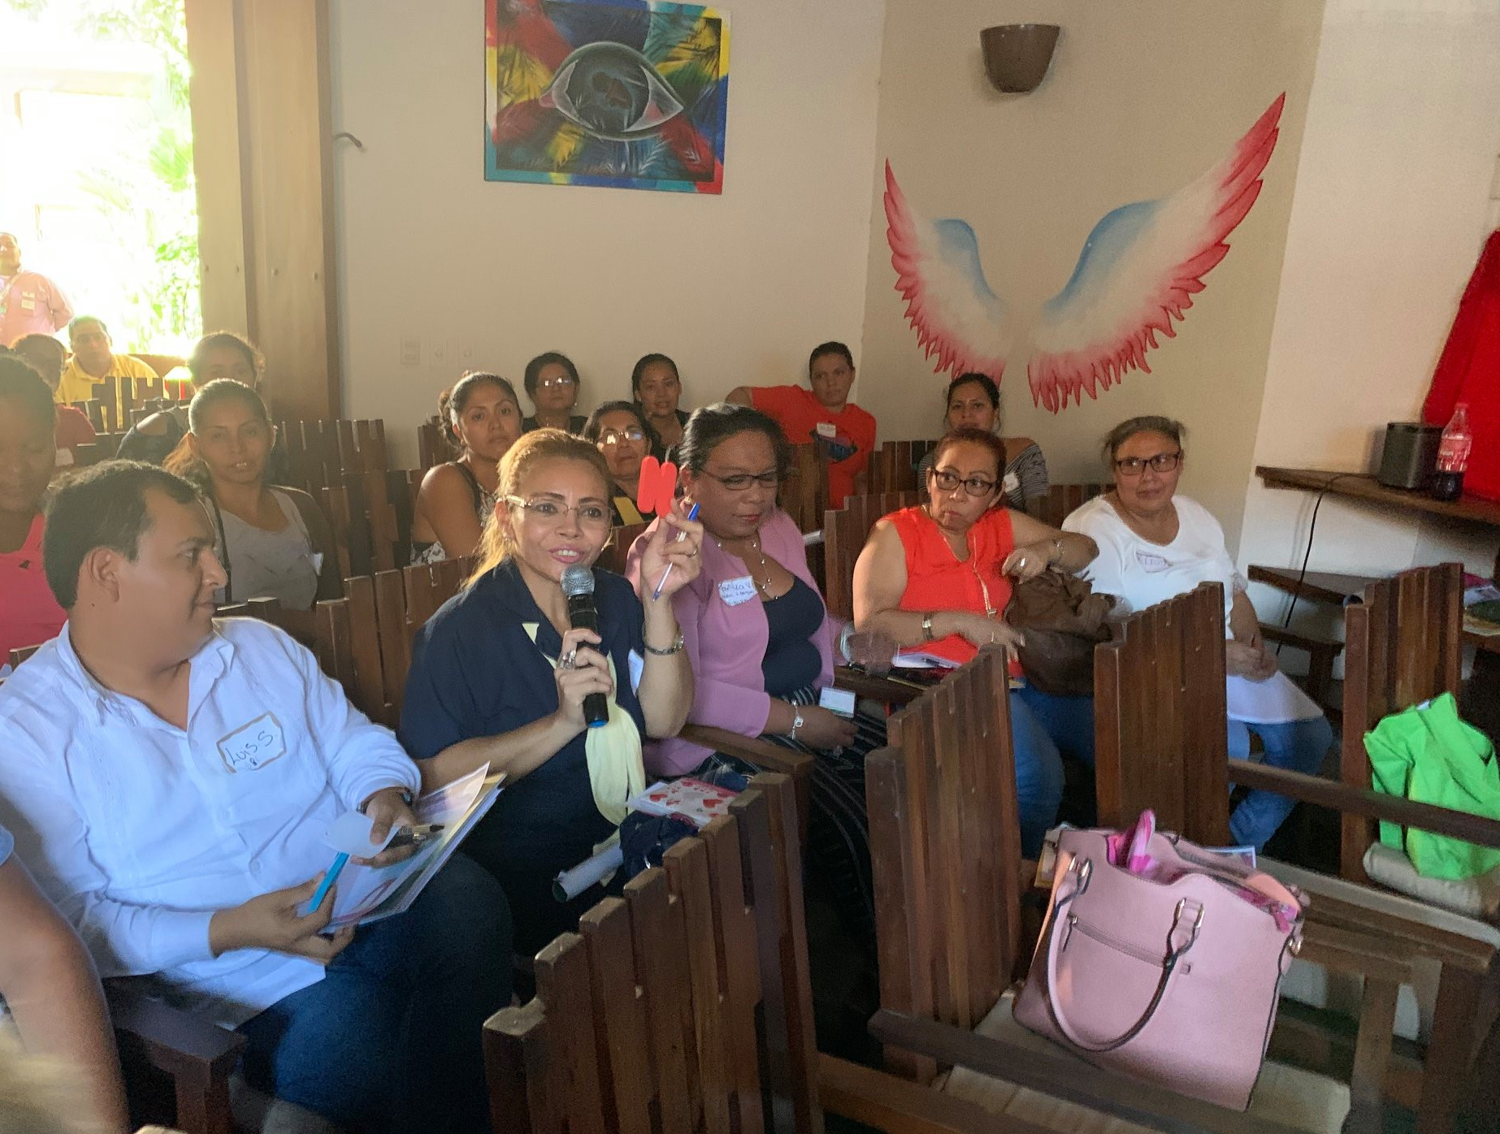
Activity: Alphabet Soup
Participants drew a letter from a soup pot and thought of a word that started with the letter they picked

Slide 12
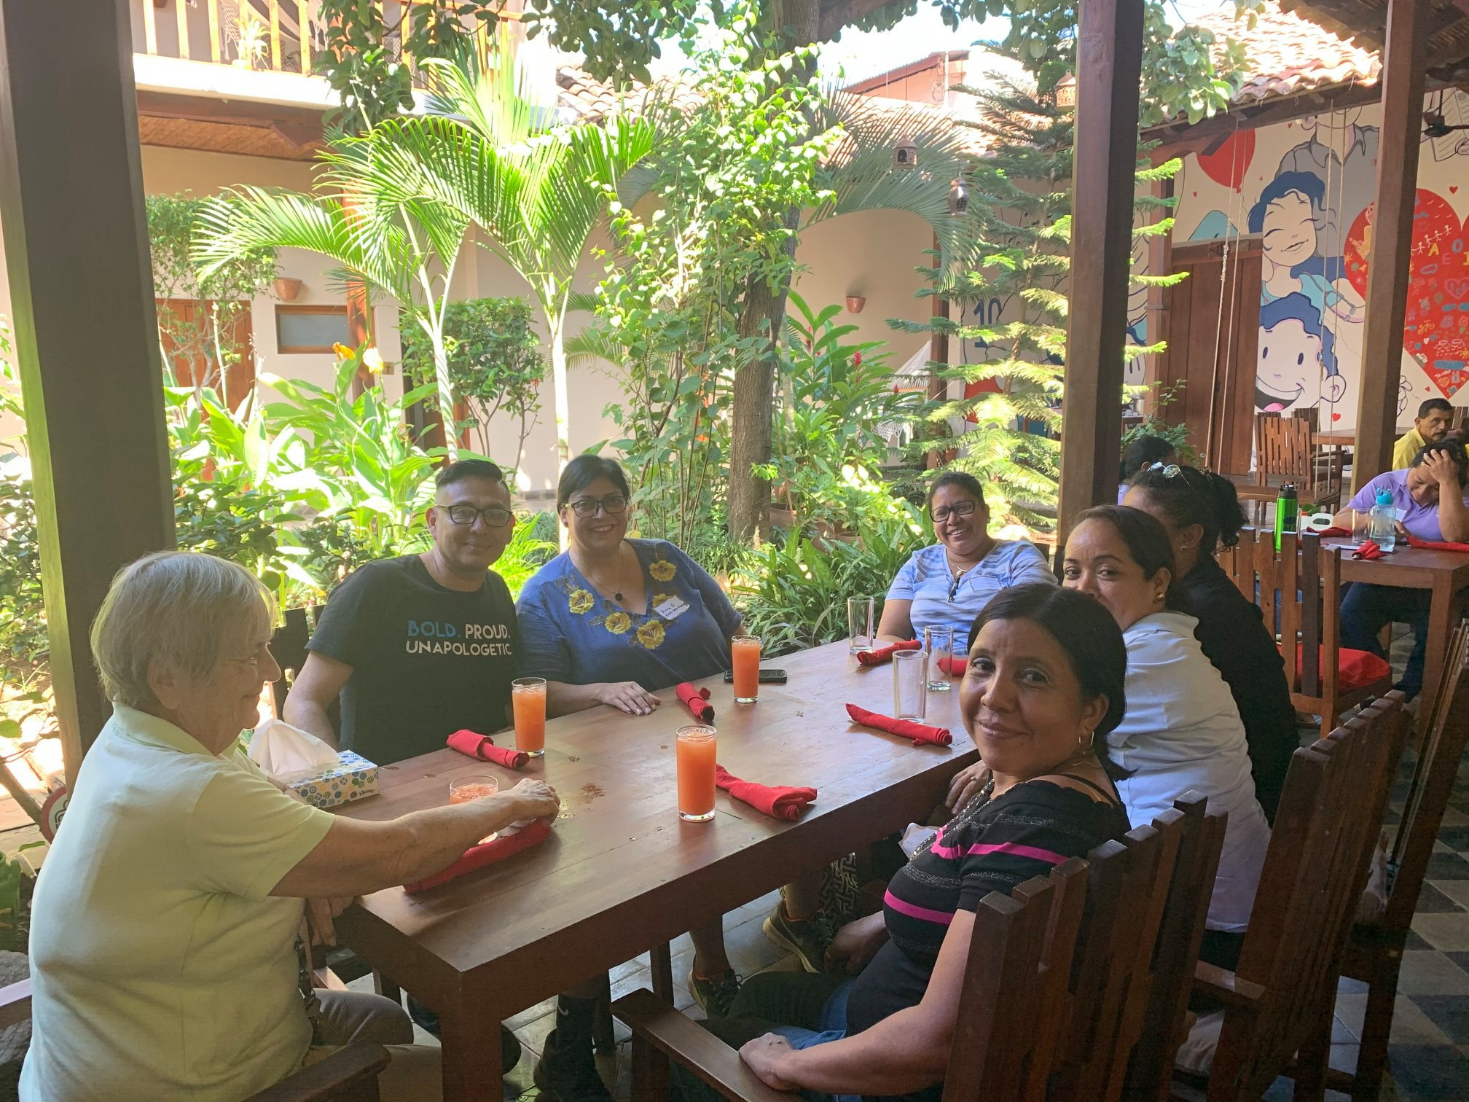
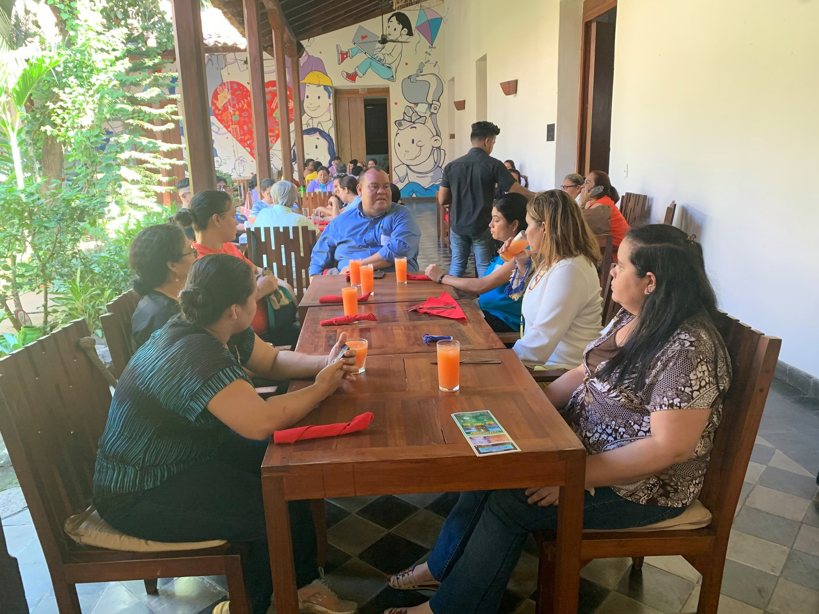
Lunch
Lunch was provided for all attendees at a reduced cost. It proved to be a great time for networking and sharing ideas among participants from the various local groups and other countries!

Slide 13
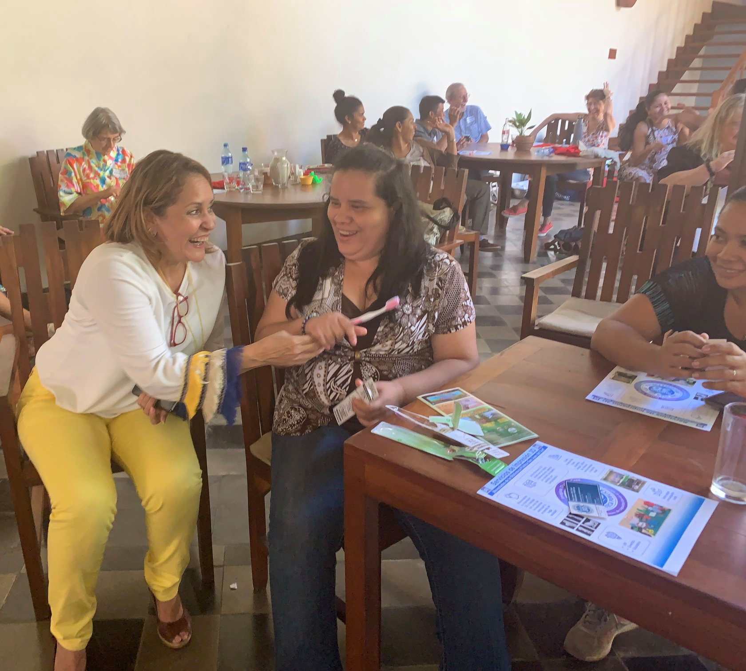
Internet Safety Activity
A lunch time activity: Every other participant was given a tooth brush and asked to brush their teeth. They were then instructed to pass the toothbrush to their neighbor to use to brush their teeth. There were no takers!
This activity reiterated, in a dramatic way, that sharing on the internet should be taken with the same cautions.

Slide 14
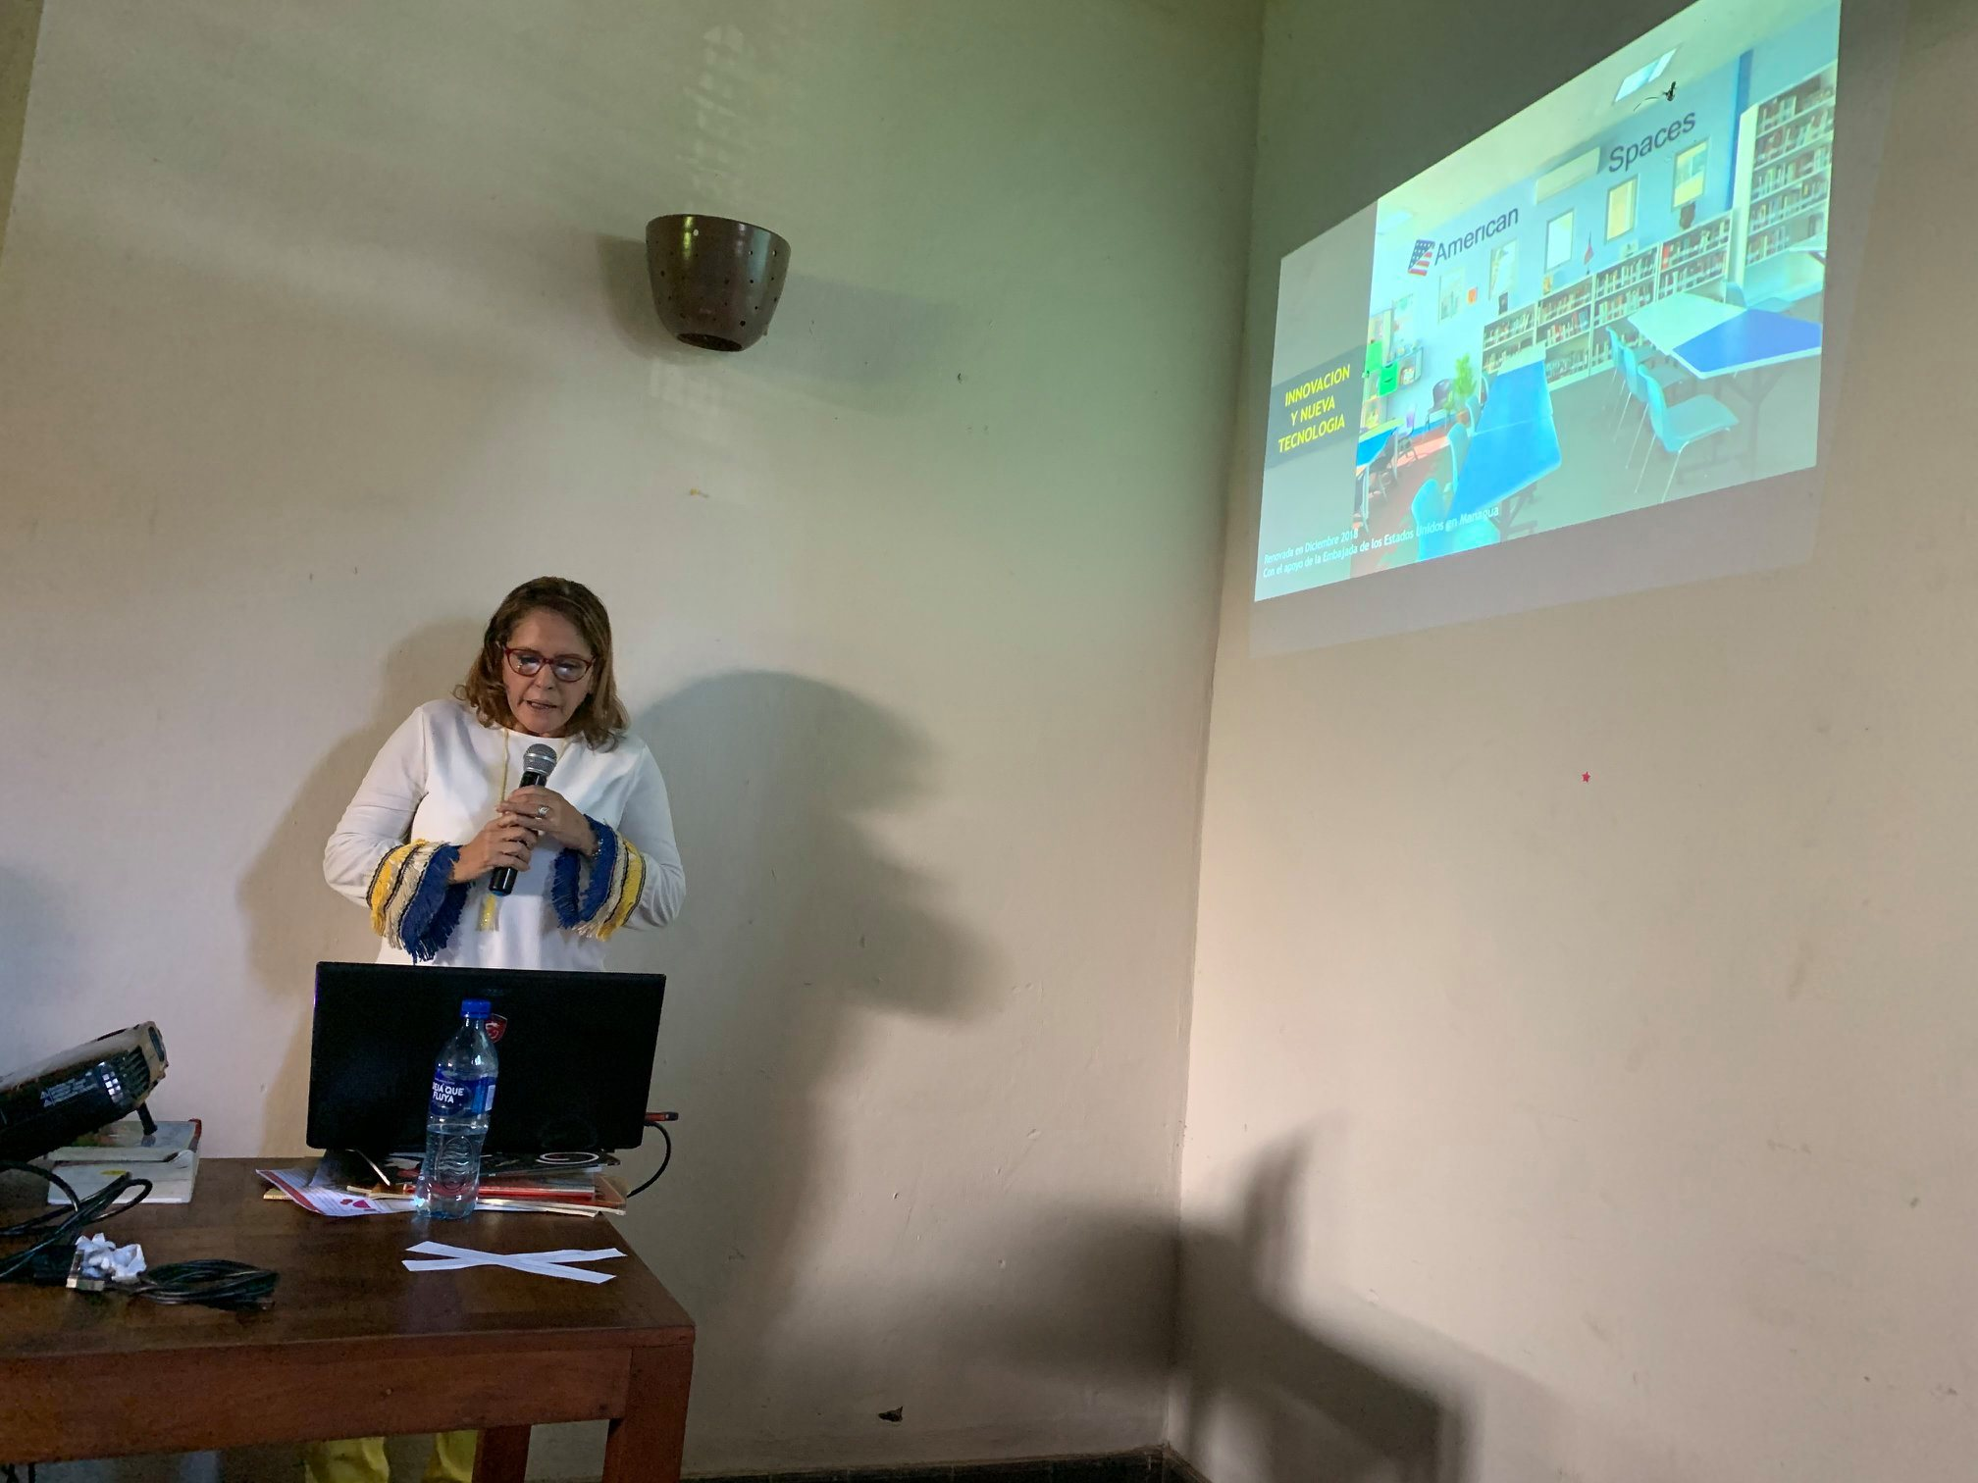
3D Printers, Robots, and Innovation
Nubia Manzanares from the US Embassy’s American Corners Library, established in Managua, Nicaragua, presented on 3D printing operations and classes available at their library.

Slide 15
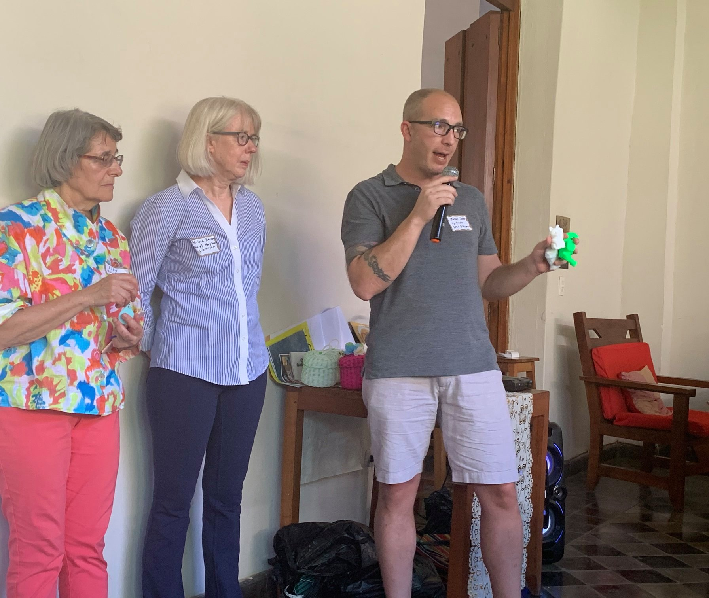
3D Printers, Robots, and Innovation
University of Maryland Librarians presented on the 3D printer that was installed at the San Juan del Sur Biblioteca the day before.
Preston Tobery emphasized that the sky's the limit when it comes to 3D printing and provided samples of items that were printed.

Slide 16
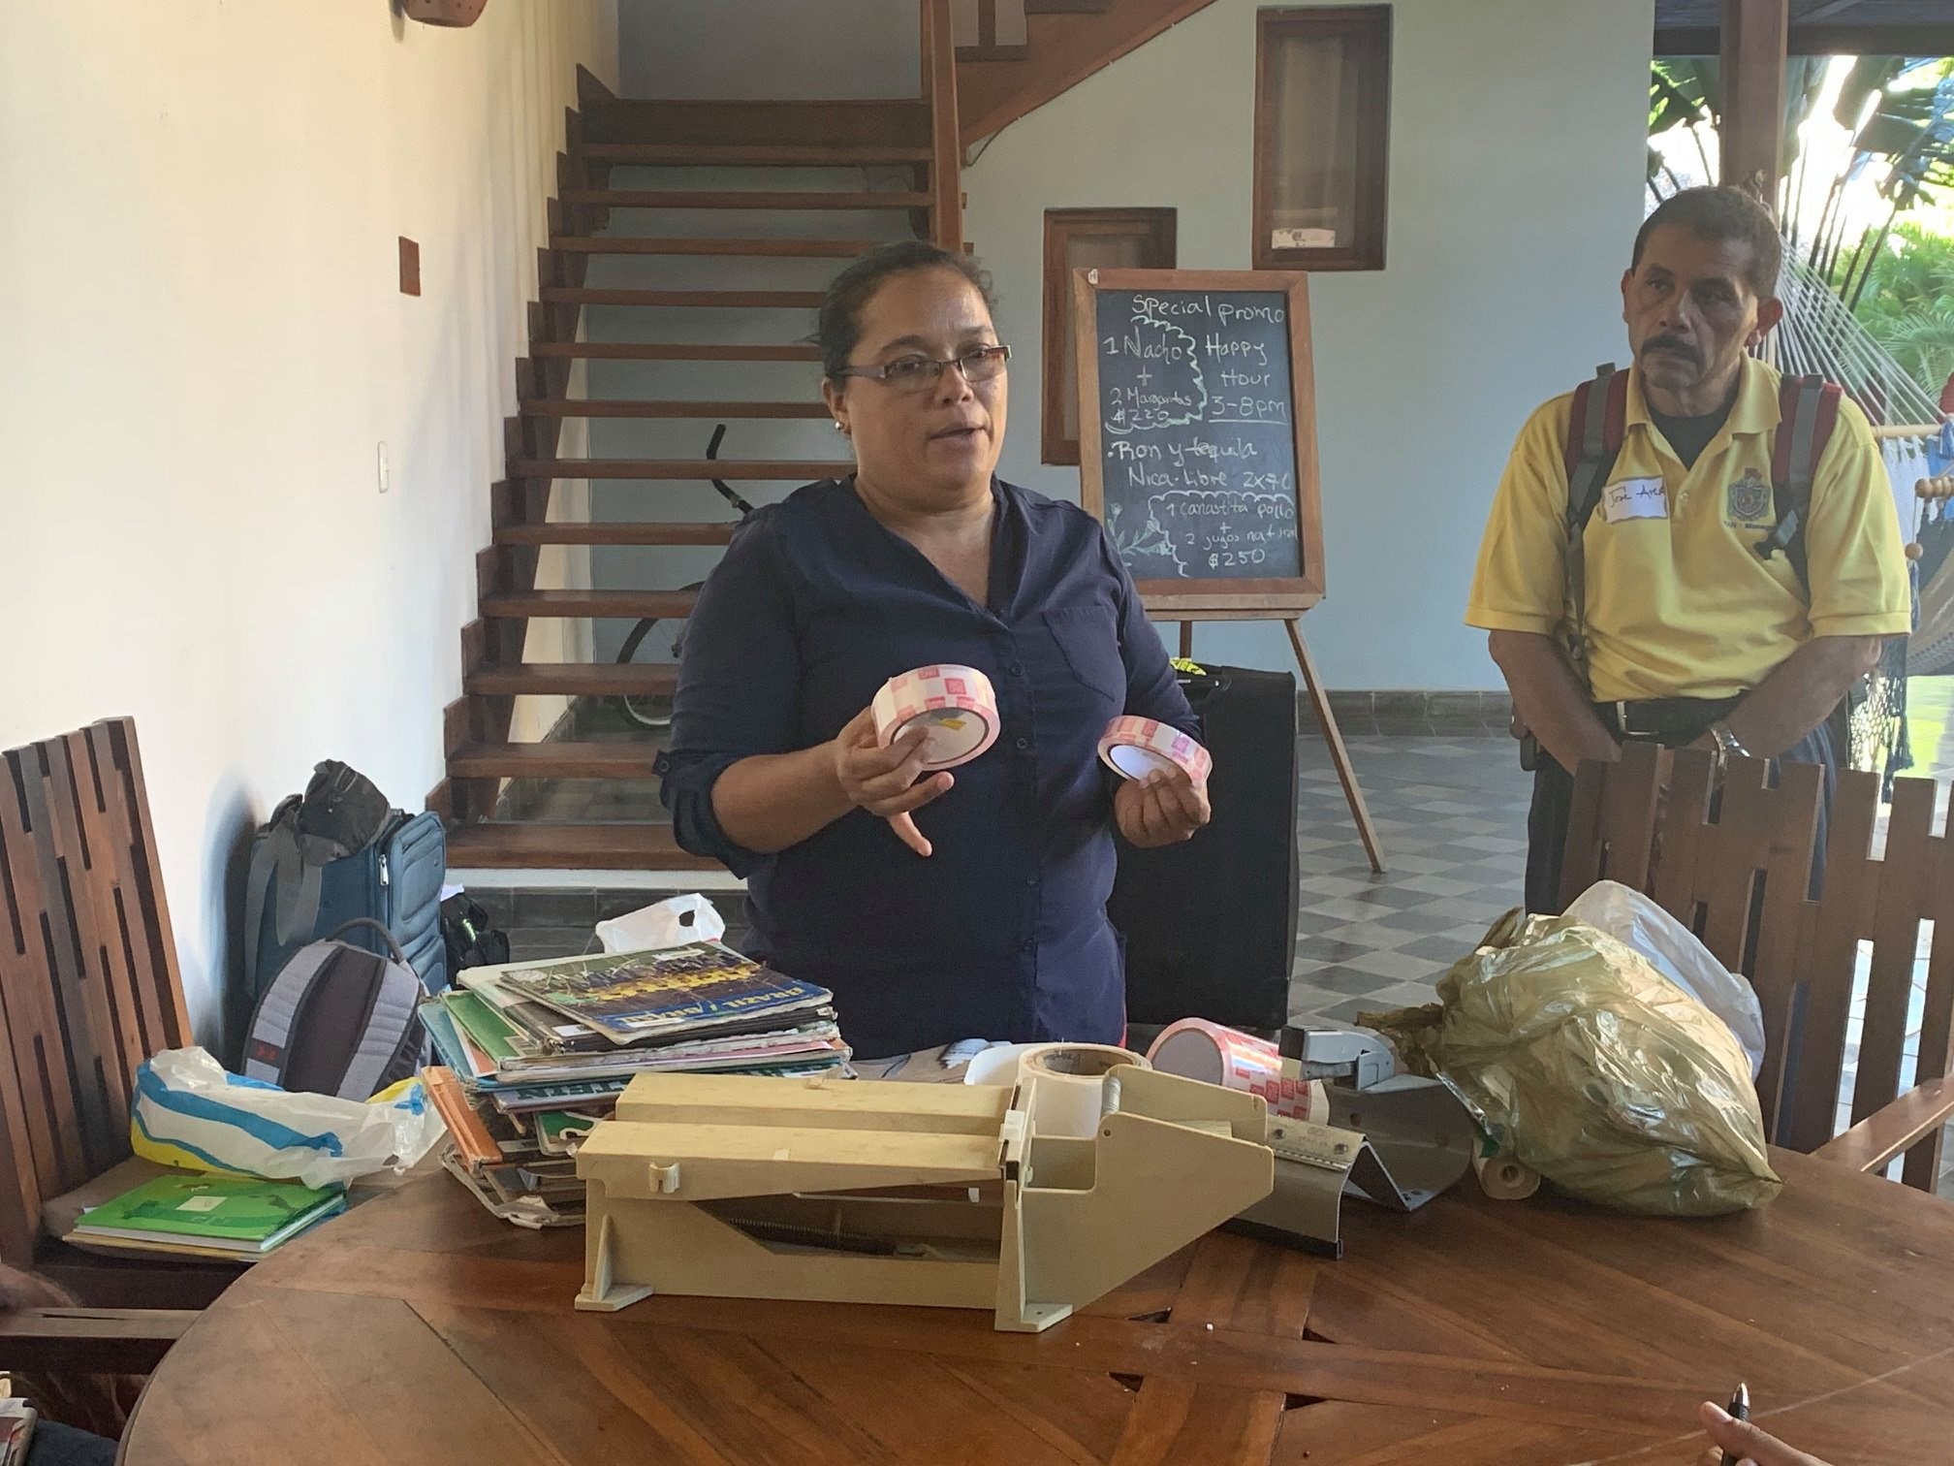
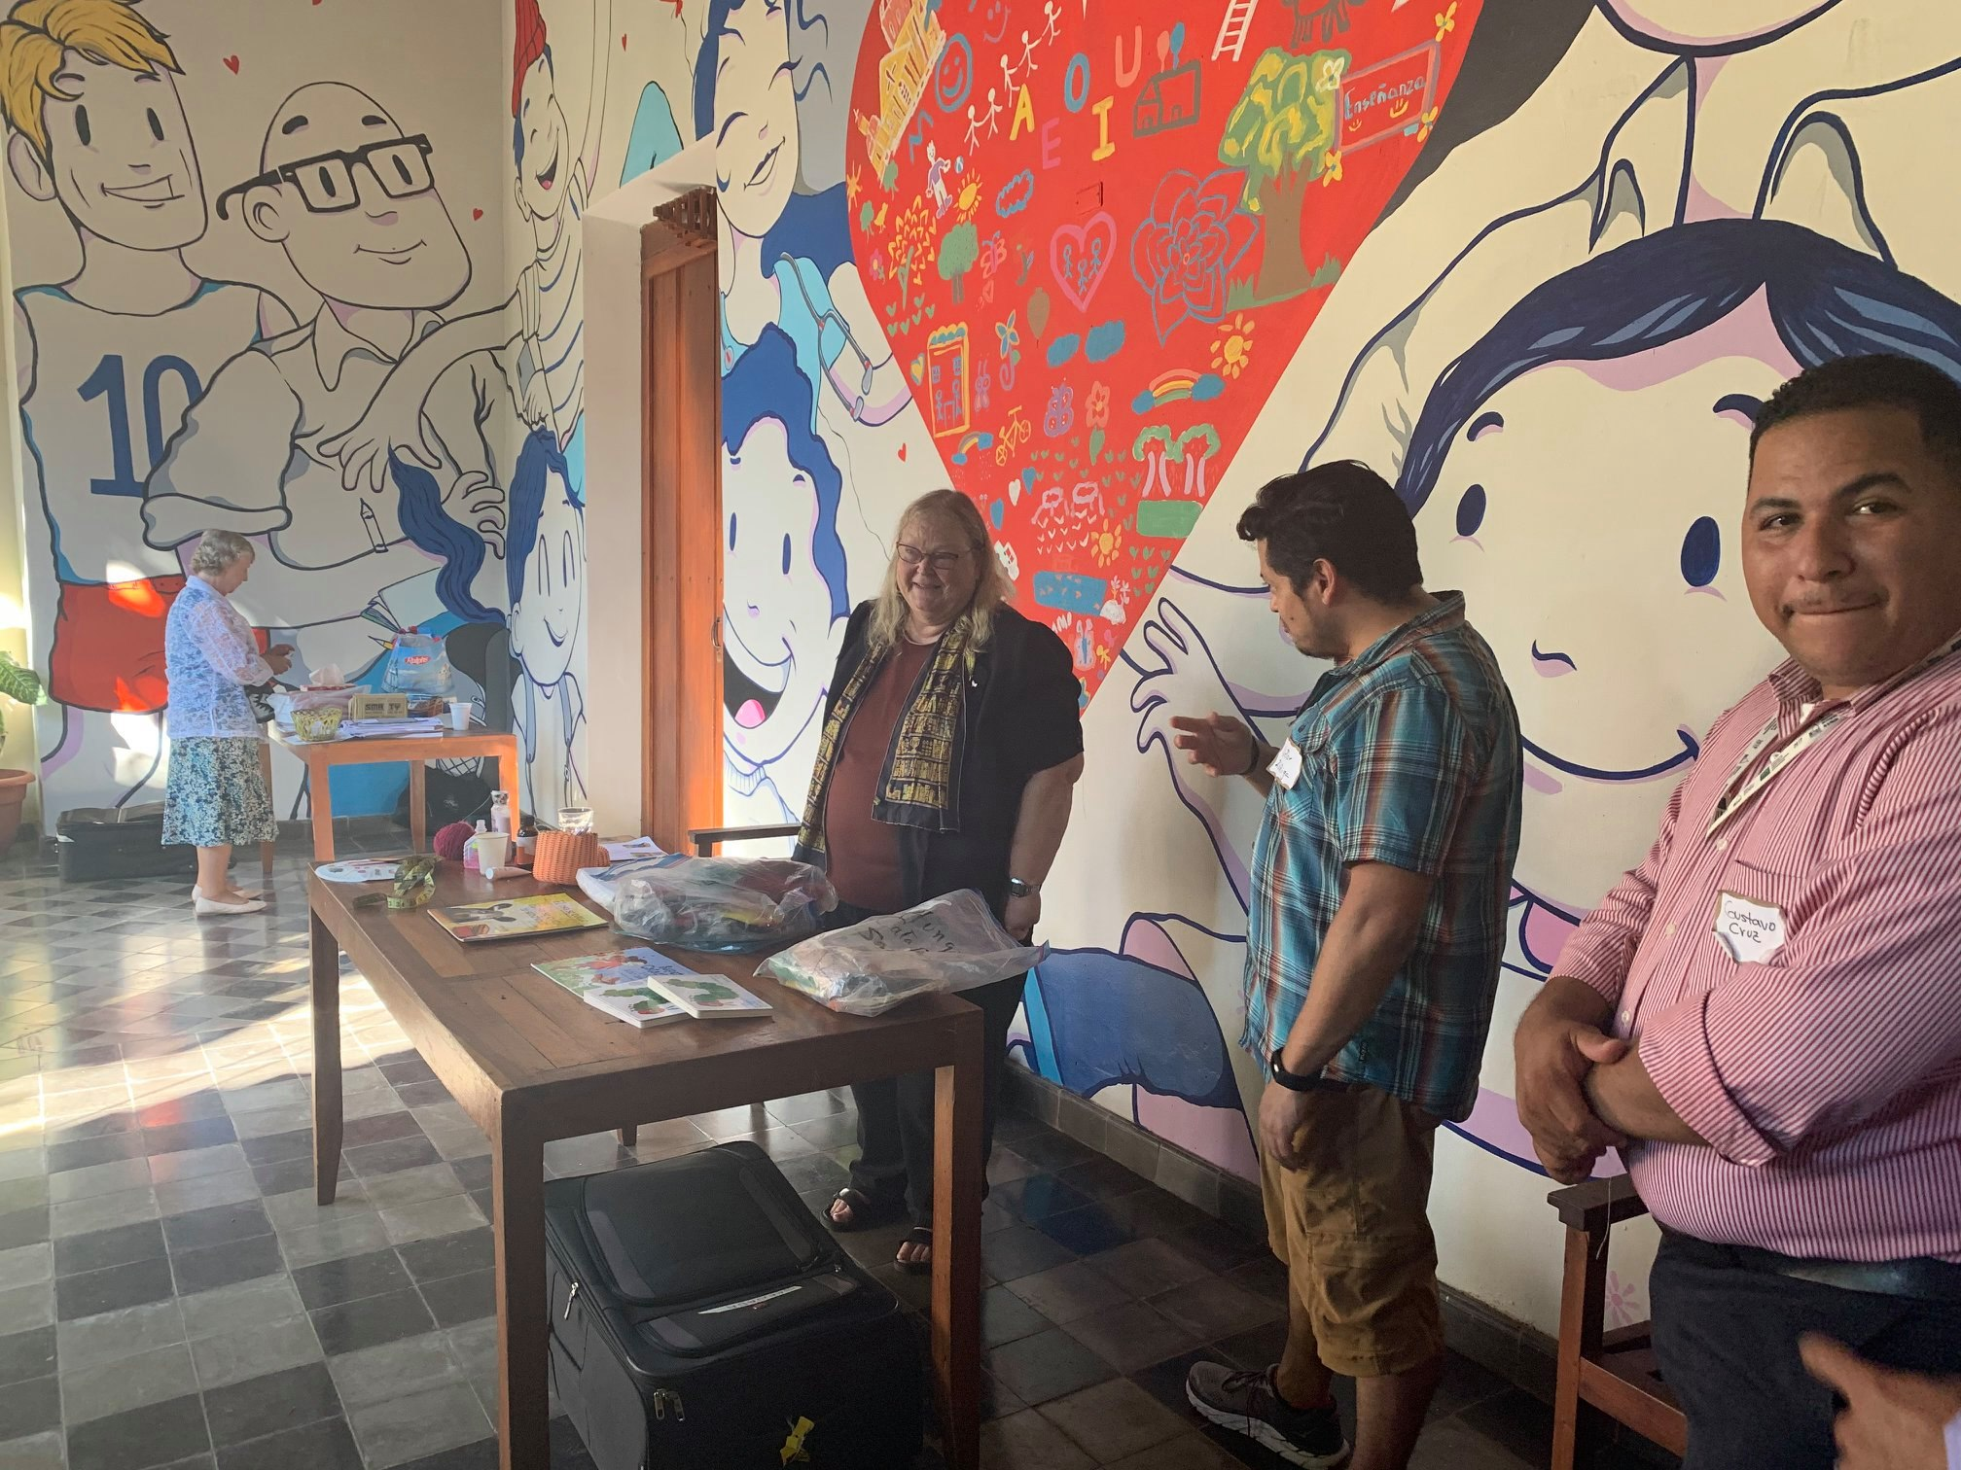
Activities: Book Repair and Crafts
Heidy Herrera (left) and Barb Thorne (right) provided additional activities to learn about repairing books and ways to encourage reading through crafts and other activities.

Slide 17
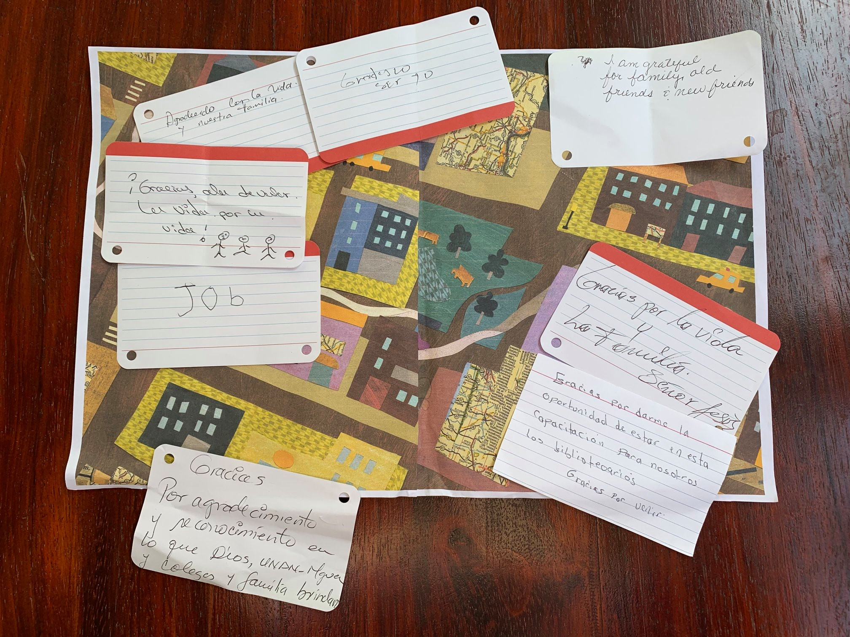
Ending with Gratitude:
¡Gracias Omu! features lessons on offering gratitude.
Participants were handed cards to write expressions of gratitude and some of the responses were attached to a gratitude map found in ¡Gracias Omu!

Slide 18
Gracias/Thank you!
HJH Libraries for All Foundation
  https://www.librariesforall.org/
Presentation on How To Use Books in the Classroom
  https://drive.google.com/file/d/1jW58L3C6WaAEUAguwuE0IiCTxHGkBfVl/view
Google Be Internet Awesome
  https://beinternetawesome.withgoogle.com/en_us/educators
Jane Mirandette
janecmirandette@gmail.com
(970)-227-9287

