Slide 1
A View from Another Country: Dealing with Crisis
Nancy Bolt
International Library and Cultural Exchange

Slide 2
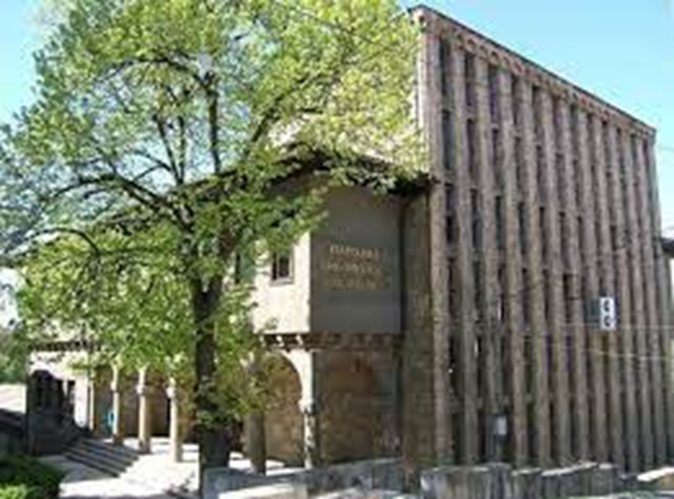
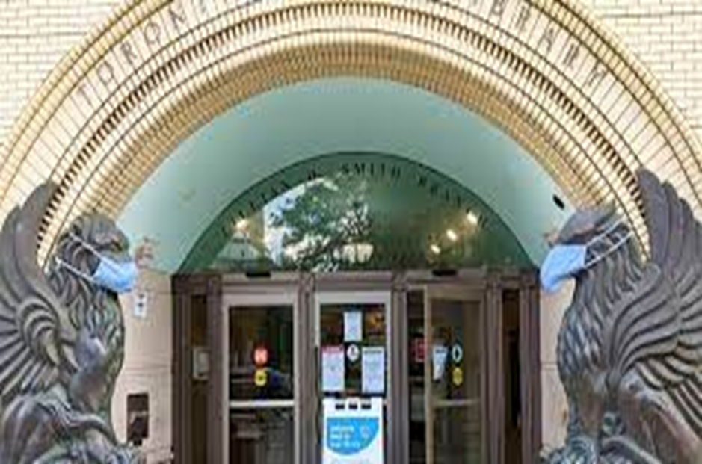
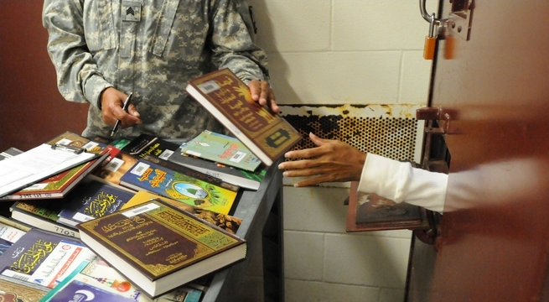
Other Countries COVID Experience
Veliko Tarnovo, Bulgaria
Toronto Canada
Prison Libraries

Slide 3
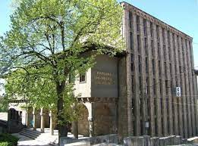
Slaveykov Regional Library, Veliko Tarnovo, Bulgaria
Founded in 1889
About 600,000 volumes
VT Population, 87,000
Library users, unknown

Slide 4
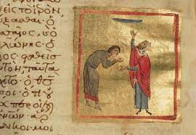
Modern Library for Bulgaria
Regional Library for 153 local public libraries
Sponsors an annual international library conference
Rare book collection dating back to 14th century
  Lenten Triodion
Summer children’s program featured online
interview with authors
Gender identity program “devil in our faces”

Slide 5
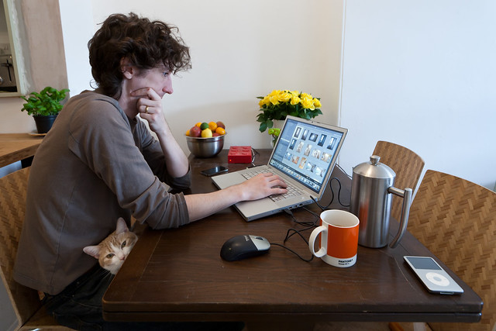
Complete Reorganization of Work Activity
Uncertainty of length of virus
Library closed from March 20 - May 14
Close library or reorganize library work?
Chose some in-library – some online
Opportunity to “catch- up” with digital library

Slide 6
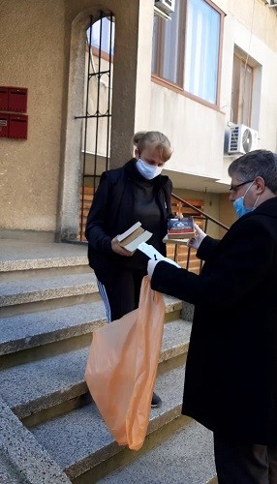
In-Person – Online
In-person
  Cleaning library
  Reorganizing facility
  Gathering books for home delivery
Online
  Tested for connectivity from homes
  Retroconversion of fiche file
  Added 16,000 new items to catalog
  150,000 analytical descriptions
  Added to special Digital Cultural Treasury

Slide 7
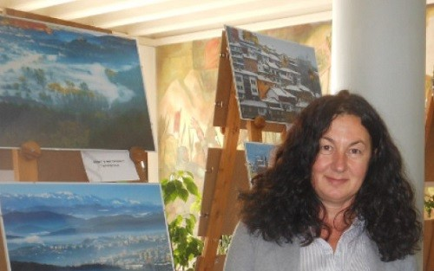
“During a pandemic...
Regional Library in Veliko Tarnovo offers home delivery of books”
Library closed in early March
Wanted to “prevent loss of content with
its most regular users”
Publicized would do home delivery
Used library car, wore masks and gloves
Delivered for eight weeks to 102 homes

Slide 8
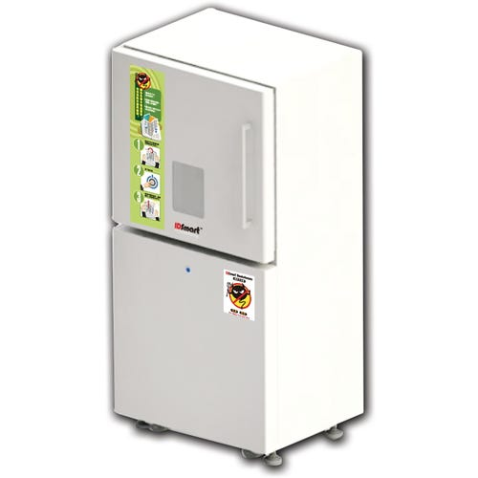
Disinfected Books
Before delivery and after return,
disinfected books
Used DEMCO “bookshower”
Discontinued fines

Slide 9
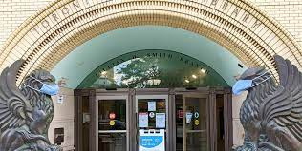
Toronto Public Library
Established in 1884
Arthur Conan Doyle Research Collection
Circulates musical instruments
Gives museums and art passes
100 branch libraires

Slide 10

Special Services for Marginalized Populations
Purpose
  Be inclusive during COVID
  Provide needed services
  Increase community contacts
  Increase community visibility
Deaf and hard of hearing
  Online resources about COVID supporting deaf population
  Publicized in community organization newsletters
  Highlighted closed captions and sign language movies and TV shows
  Dedicated phone and email service

Slide 11
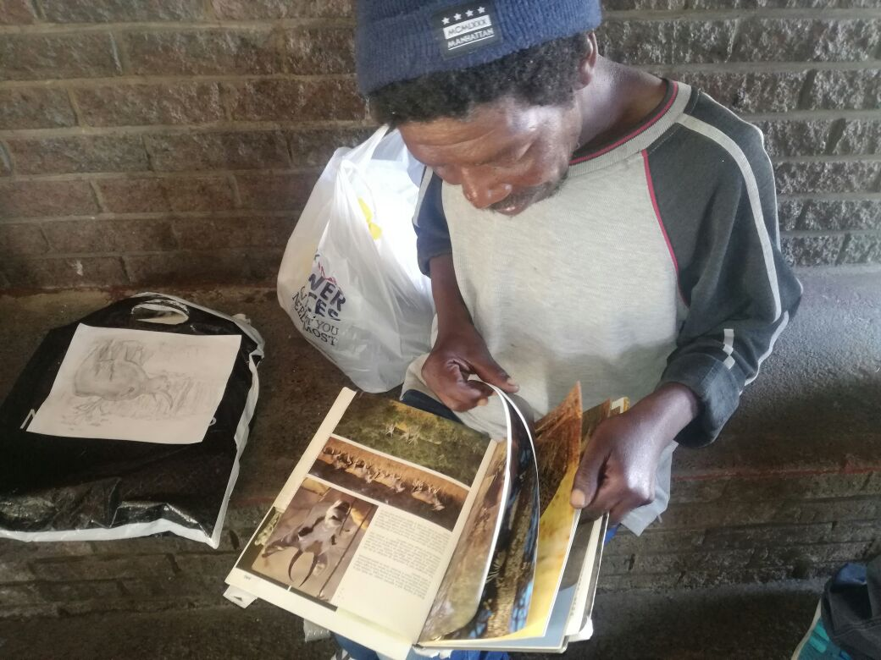
Visual Disabilities and Homelessness
Visual and print disabilities
  Cooperates with Centre for Equitable Library Assess (CELA)
  Sent users to CELA for books during pandemic
  Accessibility tips for using e-books
People Experiencing Homelessness
  Donated 1500 withdrawn books to 20 shelters
  Remote services to help shelter residents find jobs or housing
  Worked with partner to open 12 food banks in library branches
  Books for children and teens in family food baskets

Slide 12
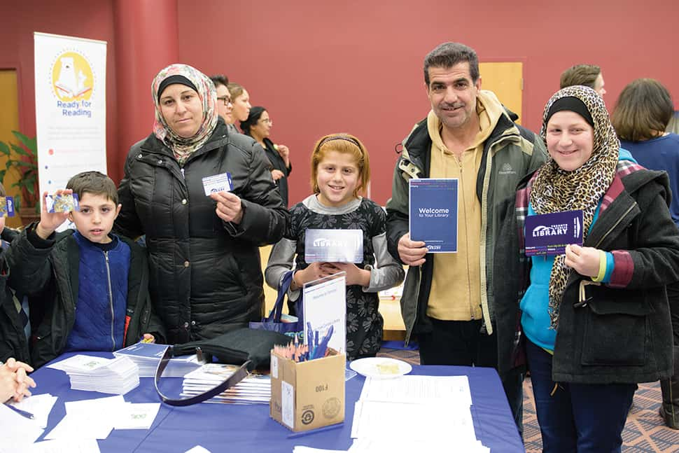
Refugees and Immigrants
Refugees and immigrants
  Library Settlement Partnerships
  Serves seven settlement communities
  Multilingual, one-on-one information and referral
  Done by phone and email during pandemic
  Delivered library information services with settlement workers
  Donated 300 new children and teen books to asylum seekers
  Virtual library information sessions delivered to sponsors

Slide 13
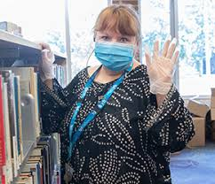
Older Adults and Seniors
Hardest hit demographic due to social isolation and lack of technical skills
Staff provided:
  Telephone assistance on digital literacy/device support
  Presentations on recreational use of online connections
  Virtual programming on health, finance, government services
  Online programming Toronto’s Seniors Active Living Centers
  In-Center programs as allowed by health guidelines
  Wellness checks with isolated seniors

Slide 14
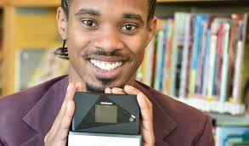
Online Resources and Wi-Fi Access
List of community resources online
  COVID-19 assessment centers and prevention advice
  Community health services
  Shelter and housing support
  Food banks
  Operated a community drop-in center
Wi-Fi
  Provided 1000 Wi-Fi Hotspots
  200 Internet Connectivity Kits (laptops and Hotspots)
  Wi-Fi connectivity in community spaces and bookmobile

Slide 15

Serving Prisoners during COVID
Problems of serving prisoners during COVID
  Concern about spreading COVID, visitors from outside
  If managed by outside staff, generally closed
  If managed by prison staff, open with limited services
  Major issue staying in touch with families
  Programming and education suspended

Slide 16
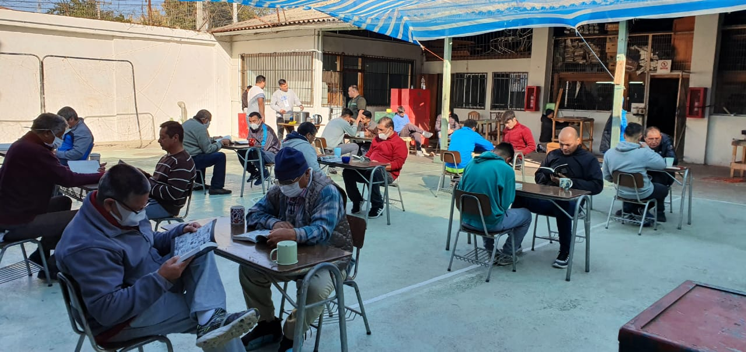
How Prison Libraries Adapted
  Allowed prisoners to use Skype to visit with families (Poland and Germany)
  Prisoners given phone card to connect with families (New Zealand, Croatia)
  Choosing materials form a printed catalog, books delivered directly to cells
  Allowed limited on-line distance learning
  Deposit collections in housing units (Canada)
  Use of library with social distancing (Chili)

Slide 17
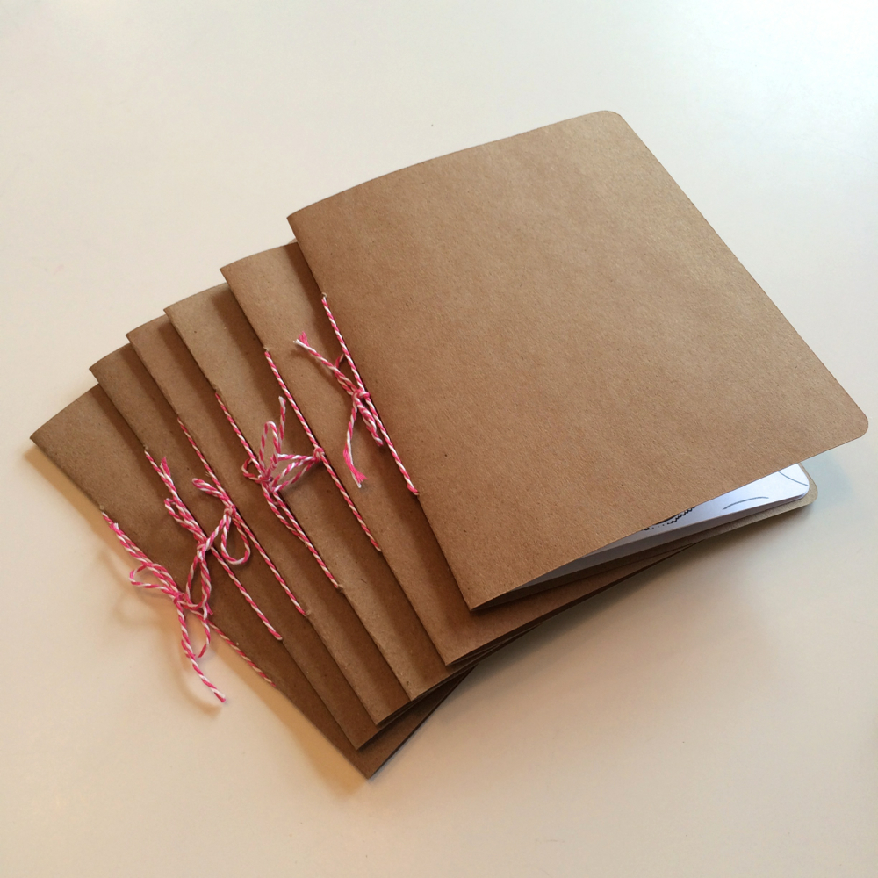
New Zealand
Created a weekly activity booklet for prisoners.
Included puzzles, guided meditation, in-cell Sunday services, origami instructions, sign language guides, and workouts.
Each was 40 pages long
Printed and assembled on a “manual conveyer belt”
Circulated 1100 booklets each week, total 13,200
Needs assessment by word of mouth
This Unknown AuthPhoto by or is licensed under CC BY-NC-ND

Slide 18
Thank You
Nancy Bolt
International Library and Cultural Exchange
nancybolt@earthlink.net
ILCE Webpage
www.ILCE-ig@wordpress.com
www.nancybolt.com

