Slide 1




Global Connections:
How to Build International Partnerships
International conference:
“Better Together: The Power of Global Library Connections”,
The International Library and Cultural Exchange Interest Group, Colorado Association of Libraries
March 7, 2023 (virtual), 2023 - Tuesday
Colorado School of Mines
Denver, Colorado, USA
Jesús Lau, PhD
Former Co-Chair, UNESCO MIL Alliance
Professor, Faculty of Pedagogy
Universidad Veracruzana, www.uv.mx, Veracruz Campus
Boca del Río, Veracruz, MEXICO
jlau@uv.mx / jesuslau@gmail.com / www.jesuslau.com.mx
Social and academic networks, jesuslau:
Twitter, FB, Instagram //
Google Scholar, Mendeley, Slideshare, LinkedIn, Wikpedia

Slide 2
Objective
Explore strategies:
  On how to develop international connections and partnerships

Slide 3

“Better Together:
The Power of Global Library Connections”
To demonstrate the role of libraries in establishing global connections;
To promote cultural understanding among people of different countries;
To facilitate networking among participants and speakers;
To demonstrate how to implement and participate in international library partnerships.

Slide 4

Seek – Identify Benefits
Personal
  Language skills
  Cultural experiencies
  Travel
  Learn
  Friendship
Professional
  Connect
  Exchange
  Collaborate
  Cooperate

Slide 5
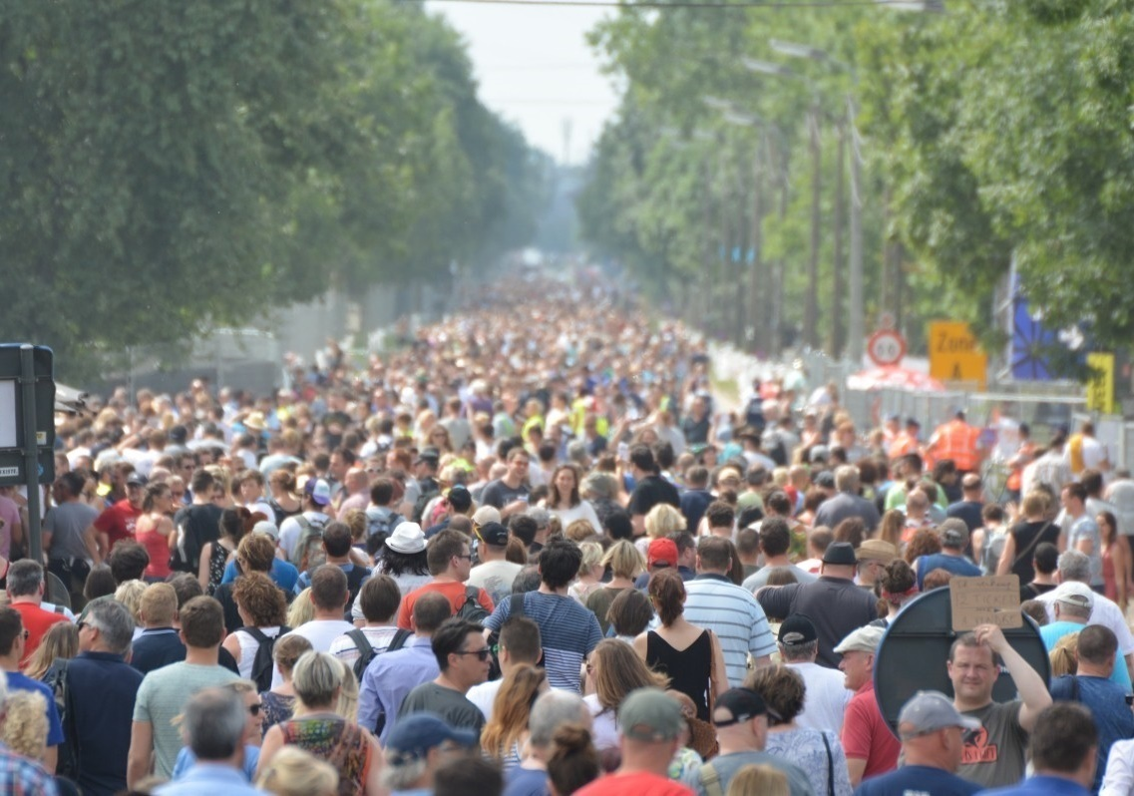
Developing Countries Interests
Management
Technology
Language
Culture

Slide 6

Cultural Understanding: Examples
Concept of time
Friendly ties
Sense of responsability
Human interaction

Slide 7



Macro National Development Factors
Economy - Budgets
Social – Planning, organization, language
Politics – Freedom, decision making

Slide 8

Types of Connections
Connection
Cooperation
Collaboration
Partnerships
Community development

Slide 9

Cooperation https://dictionary.cambridge.org/es/diccionario/ingles-espanol/cooperation
The actions of someone who is being helpful
by doing what is wanted or asked for:
Common effort

Slide 10
Collaboration https://www.oxfordlearnersdictionaries.com/definition/american_english/collaboration
The act of working with another person or group of people
to create or produce something

Slide 11
Cooperation Versus Collaboration https://english.stackexchange.com/questions/28752/whats-the-difference-between-collaborate-and-cooperate
Cooperating means working with someone in the sense of enabling: making them more able to do something (typically by providing information or resources they wouldn't otherwise have).
Collaborating means actually working alongside someone (from Latin laborare: to work) to achieve something.

Slide 12

Partnership https://www.oxfordlearnersdictionaries.com/definition/english/partner_1
A relationship between two people, organizations
A person that you are doing an activity with, such as dancing or playing a game
Participation; association; joint interest.

Slide 13
Collaborate Versus Partner
To collaborate is to work together with others to achieve a common goal while
partner is to be associated with another in a common activity or interest.

Slide 14

Community Development Approaches
There are overlapping approaches to community development.
Some focus on the processes, some on the outcomes/ objectives.

Slide 15

Community capacity building https://en.wikipedia.org/wiki/Community_development
Clay, Roger A.; Jones, Susan R. (2009). "A Brief History of Community Economic Development". Journal of Affordable Housing & Community Development Law. 18 (3): 257–267. JSTOR 25782846
Focuses on helping communities obtain, strengthen, and maintain the ability
to set and achieve their own development library objectives

Slide 16
Community Development https://en.wikipedia.org/wiki/Community
"Community development". UNTERM. Archived from the original on 14 July 2014. Retrieved 7 July 2014.
The United Nations defines community development as:
"a process where community members come together to take collective action and generate solutions to common problems."

Slide 17
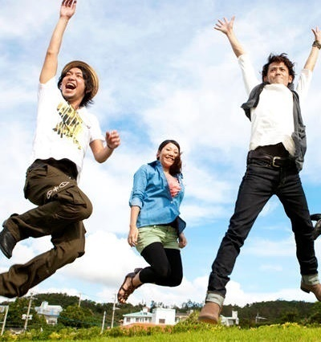
Friendships https://www.awakenthegreatnesswithin.com/35-best-friend-quotes-on-success/
“I’m a success today because I had a friend who believed in me and I didn’t have the heart to let him down.”
Abraham Lincoln

Slide 18

Colleagues - Comraderie https://www.awakenthegreatnesswithin.com/35-best-friend-quotes-on-success/
“Don’t walk behind me; I may not lead. Don’t walk in front of me; I may not follow. Just walk beside me and be my friend.”
Albert Camus

Slide 19

Ways to begin
Starting the connection on your own
Institutionally promoted

Slide 20
Personal Versus Institutional
Arranged marriages work less
Personal initiated ones work better

Slide 21
Tips and tricks – Partnerships https://www.healthline.com/health/benefits-of-friendship#takeaway
Pursue your interests
Make the first move
Few is better than many
Stay in touch
Know when to let go

Slide 22
Attend Conferences
Have a partnering objective before you sail
Attend international meetings
Meet colleagues
If possible travel abroad

Slide 23
Associations – Great Venues
IFLA – International Federation of Library Associations and Institutions
UNESCO – United Nations Educational, Scientific and Cultural Organization
SLA – Special Library Association
ALA – IRRT – American Library Association
BRLA – Border Regional Library Association (TX, NM, Chihuahua MX)
AMBAC – Mexican Library Association
CNB – Professional Librarians Guild
REFORMA – Latino library association, ALA Affiliate
SALALM – Latin American Acquisitions

Slide 24
International Partnering Organizations
Sister Libraries – American Library Association https://www.ala.org/aboutala/affiliates/relatedgroups/sisterlibraries/sisterlibraries
Sister Cities - https://sistercities.org/
Rotary International – https://www.rotary.org/en
Government cooperation programs

Slide 25

Rotary International – Vision https://my.rotary.org/en/learning-reference/about-rotary/action-plan
“… a network that spans the globe
—bridging cultural, linguistic, generational, and geographic barriers
—and shares the vision of a better world.”

Slide 26
Libraries Without Borders https://www.librarieswithoutborders.org/
Bibliothèques Sans Frontières (Libraries Without Borders), since 2007
Works to bring knowledge and information to people in need.
Provides access and resources that connect people to books and digital resources.
Expands the reach of libraries, training facilitators in post-emergency situations, and addressing the needs of under-resourced communities.

Slide 27
Connection Roles:
You Decide
Ally
Associate
Colleague
Companion
Friend
Participant
Cohort
Collaborator
Comrade
Teammate

Slide 28

Conclusions
Building personnal connections requires to take a step beyond mental, physical and technical borders
Benefits can of all sorts but mainly personal and secondarily to your organization, i.e library or association, Etc.
When you create international synergies you make this world more humane
The world is as small as your international connections are
Be part of the world…

Slide 29
References
Cooperation. https://dictionary.cambridge.org/es/diccionario/ingles-espanol/cooperation
Cooperation Versus Collaboration. https://english.stackexchange.com/questions/28752/whats-the-difference-between-collaborate-and-cooperate
Collaboration. https://www.oxfordlearnersdictionaries.com/definition/american_english/collaboration
Colleagues – Comraderie. https://www.awakenthegreatnesswithin.com/35-best-friend-quotes-on-success/
Partnership. https://www.oxfordlearnersdictionaries.com/definition/english/partner_1
Friendships. https://www.awakenthegreatnesswithin.com/35-best-friend-quotes-on-success/
Community Development. https://en.wikipedia.org/wiki/Community. "Community development". UNTERM. Archived from the original on 14 July 2014. Retrieved 7 July 2014
Community capacity building. https://en.wikipedia.org/wiki/Community_development
Clay, Roger A.; Jones, Susan R. (2009). "A Brief History of Community Economic Development". Journal of Affordable Housing & Community Development Law. 18 (3): 257–267. JSTOR 25782846
Professional Association Concept / Benefits. https://en.wikipedia.org/wiki/Professional_association
"Our definition of a Professional Body". Science Council. Archived from the original on 24 February 2019. Retrieved 23 February 2019.
Tips and tricks – Partnerships. https://www.healthline.com/health/benefits-of-friendship#takeaway
Rotary International – Vision. https://my.rotary.org/en/learning-reference/about-rotary/action-plan
Libraries Without Borders. https://www.librarieswithoutborders.org/

Slide 30

¡GRACIAS!

