Slide 1
Patrick Lucero Library—Sister Libraries in Pueblo & Vietnam
Pueblo City-County Library District
Pueblo, Colorado

Slide 2
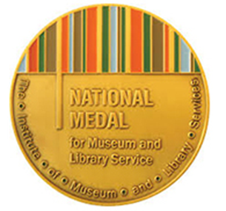


About PCCLD & Lucero Library
The Pueblo City-County Library District continues a long tradition of public library service in Pueblo County, CO. The District services a population of 168,000 making it a medium-sized public library focusing on current and popular materials (8 library locations and 4 satellites).
The Patrick A. Lucero Library serves the historic East Side community in the city of Pueblo. The branch library was one of three identical library buildings built in 2013-14.
The branch library is staffed by a number of individuals who grew up in the community.
Notes:
SHERRI

Slide 3
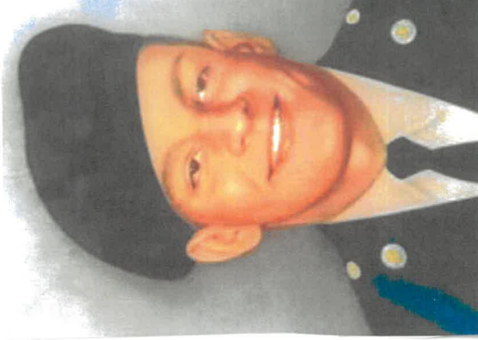
Patrick A. Lucero—Pueblo youth & Veteran
Patrick A. Lucero grew up on the East Side of Pueblo. Patrick was killed on March 14, 1968 at the age of 19 while serving in the U.S. Army 173rd Airborne Battalion during the Vietnam War. Through a partnership between his family and the Peace Trees Vietnam organization another library bearing his name was built where he died in Vietnam’s Quảng Trị Province in 2010.
In that library, a plaque recognizing Patrick hangs with this quote inscribed, “May children who gather here find peace, love and harmony.”
The Patrick A. Lucero Library was built and opened in Pueblo in 2014.

Slide 4
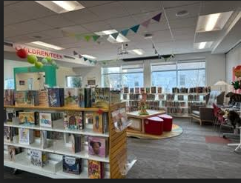
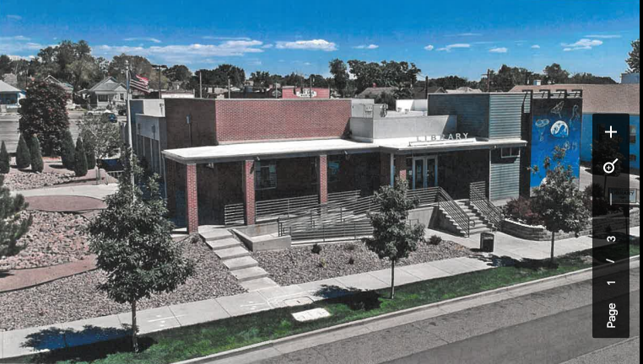
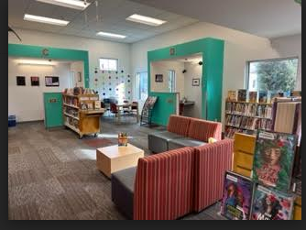
Contributions to the community
Notes:
KRISTI
Ray Oldenburg refers to third places as those where people spend time between home (‘first’ place) and work (‘second’ place) and that third places are locations where we “exchange ideas, have a good time, and build relationships.” (https://www.brookings.edu/blog/up-front/2016/09/14/third-places-as-community-builders/) The Patrick Lucero branch library is a community hub for the East Side of Pueblo filling a third place niche, but sometimes serving as a first and second place too. The contributions to the community are many as the branch provides a wide range of programs and services. In terms of the more general types of services, many of our adult patrons coming to the branch use our public computers, to access the internet and to print and make copies. We have a large meeting room that is booked on a regular basis for birthday parties and even baby showers. Kids use the library after school and on weekends, as a place to hang out and do the typical library activities such as get on the computers to play games, check out books, and socialize with their friends.
As public library workers we know the importance of establishing community partnerships in order to provide a wider range of programs and services to the communities that we serve..
A few of the regular partnerships that we have established include the:
Boys and Girls Club
Hardknox Gang Intervention and Prevention–which is a non profit that facilitates a chess program after school
School District 60’s nutrition program—provides an after school dinner program
Recovery Solutions–an agency that supports those overcoming addiction
SRDA–an agency that provides meals to seniors (our meeting room serves as the congregate meal site twice a week).

Slide 5
International Librarianship & Global Connections
PCCLD’s mission includes “...presenting access to information from all over the world.” These words were penned 20 years ago and still hold today.
Review of literature indicates longtime focus on global librarianship
Contemporary focuses on global knowledge access
COVID-19 health pandemic showed us how interconnected our world is
Global focus and connections give us the sense that our profession is present and at work all over the world
Notes:
SHERRI & KRISTI
https://worldlibraries.dom.edu/index.php/worldlib/index

Slide 6
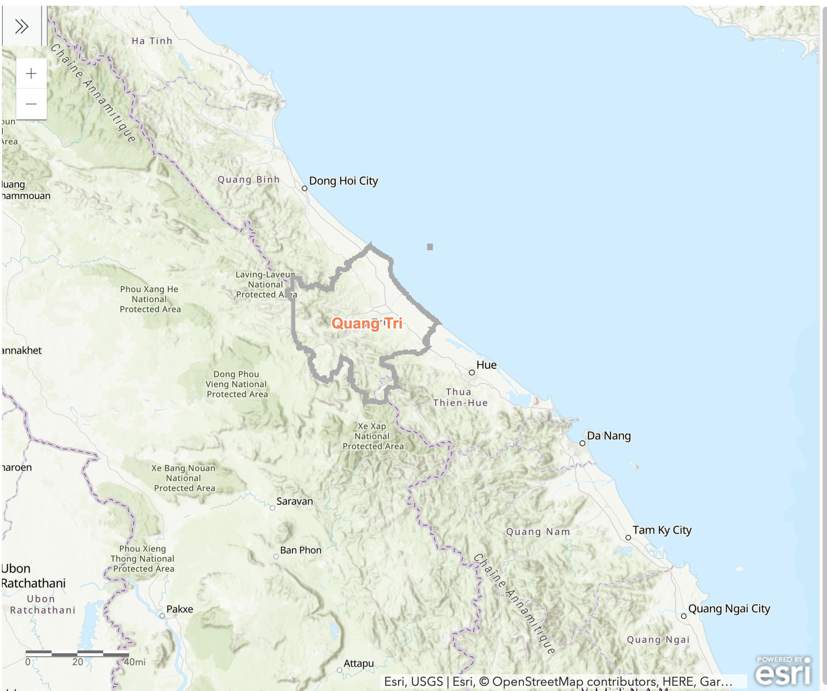
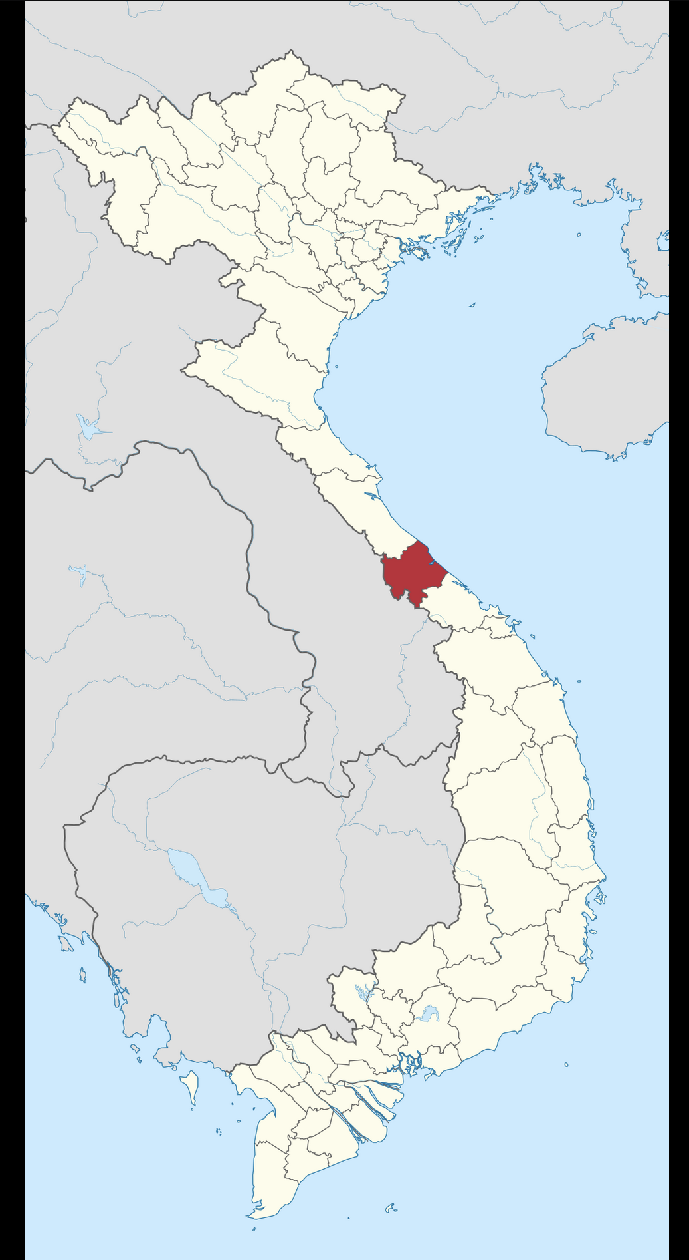
Patrick Lucero Library, Quảng Trị Province, Vietnam
Notes:
DUSTIN (Description of where it’s located - remote, rural community)

Slide 7
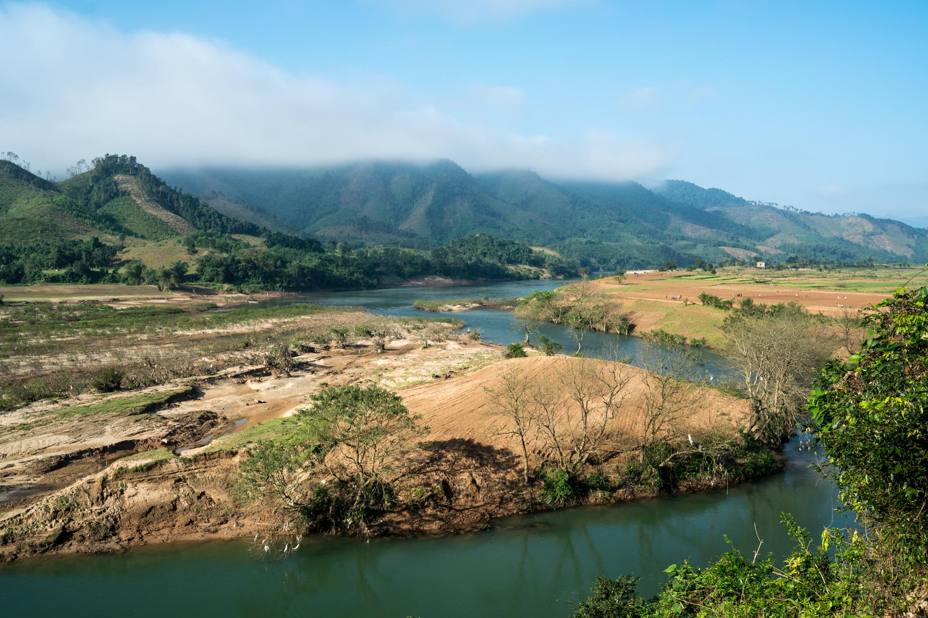
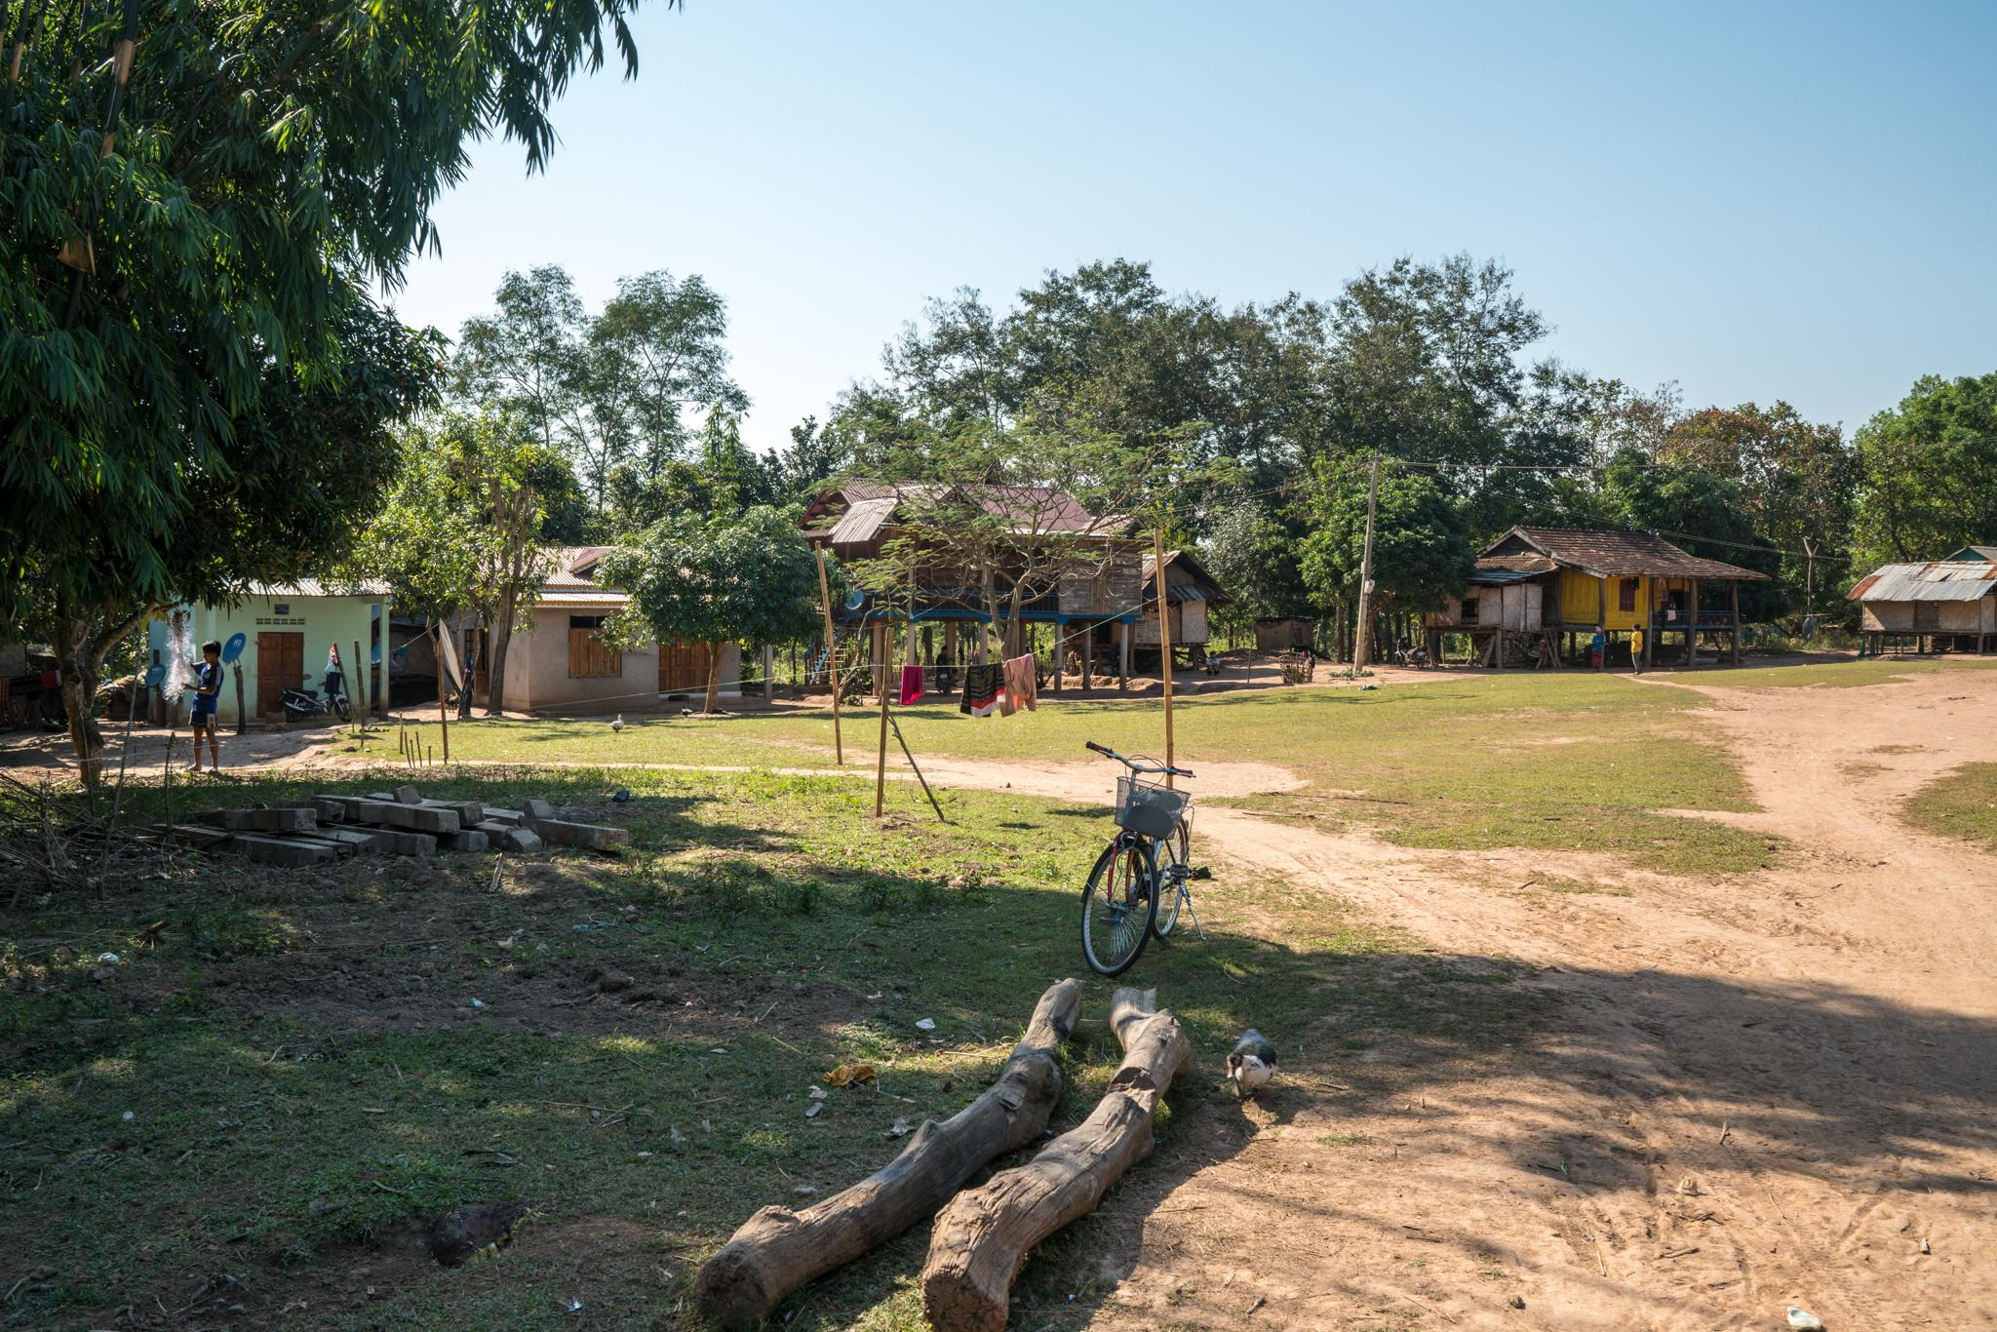
Patrick Lucero Library, Quảng Trị Province, Vietnam
Notes:
DUSTIN (Description of where it’s located - remote, rural community)

Slide 8
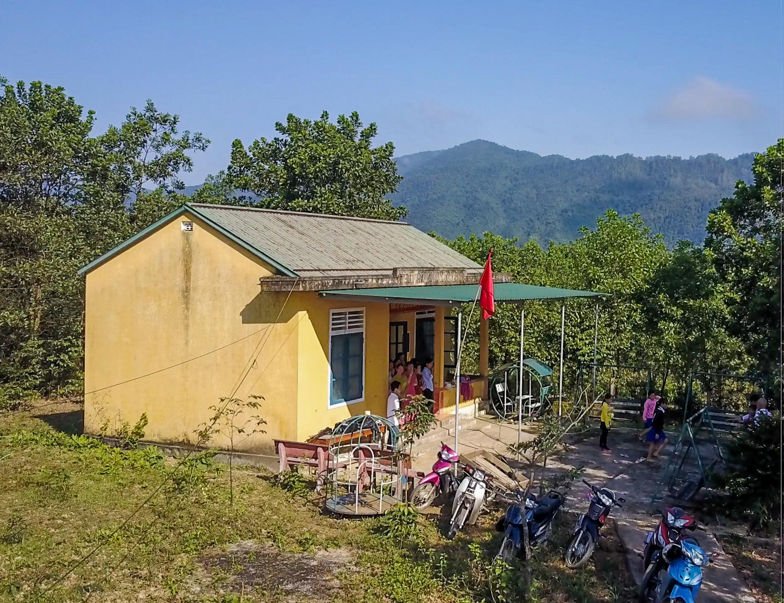
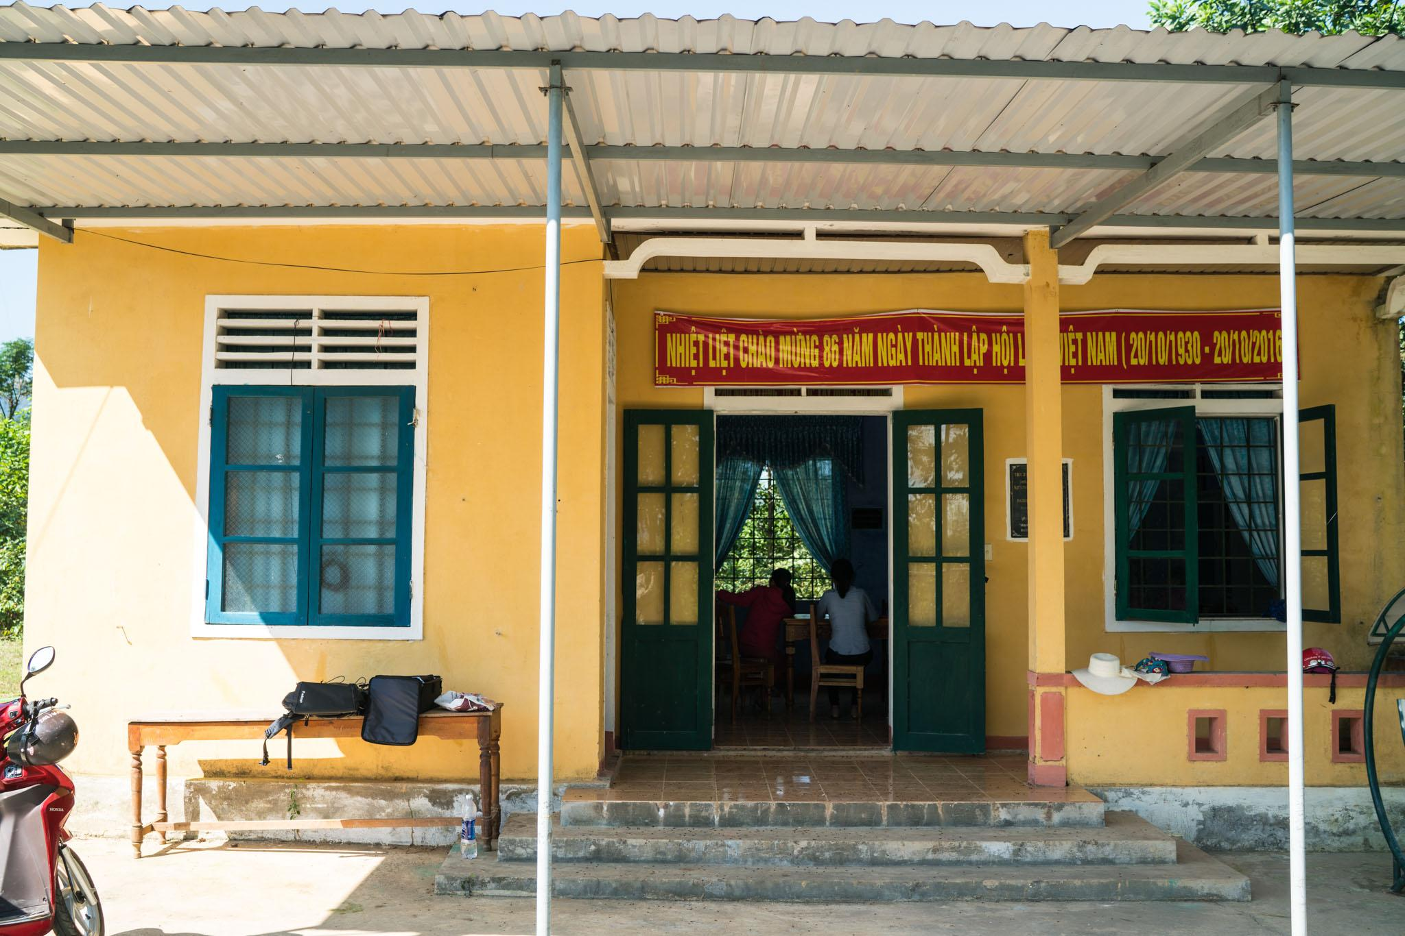
Origins of Pat Lucero Library
Notes:
DUSTIN (Library itself - how it came about). Namesake

Slide 9
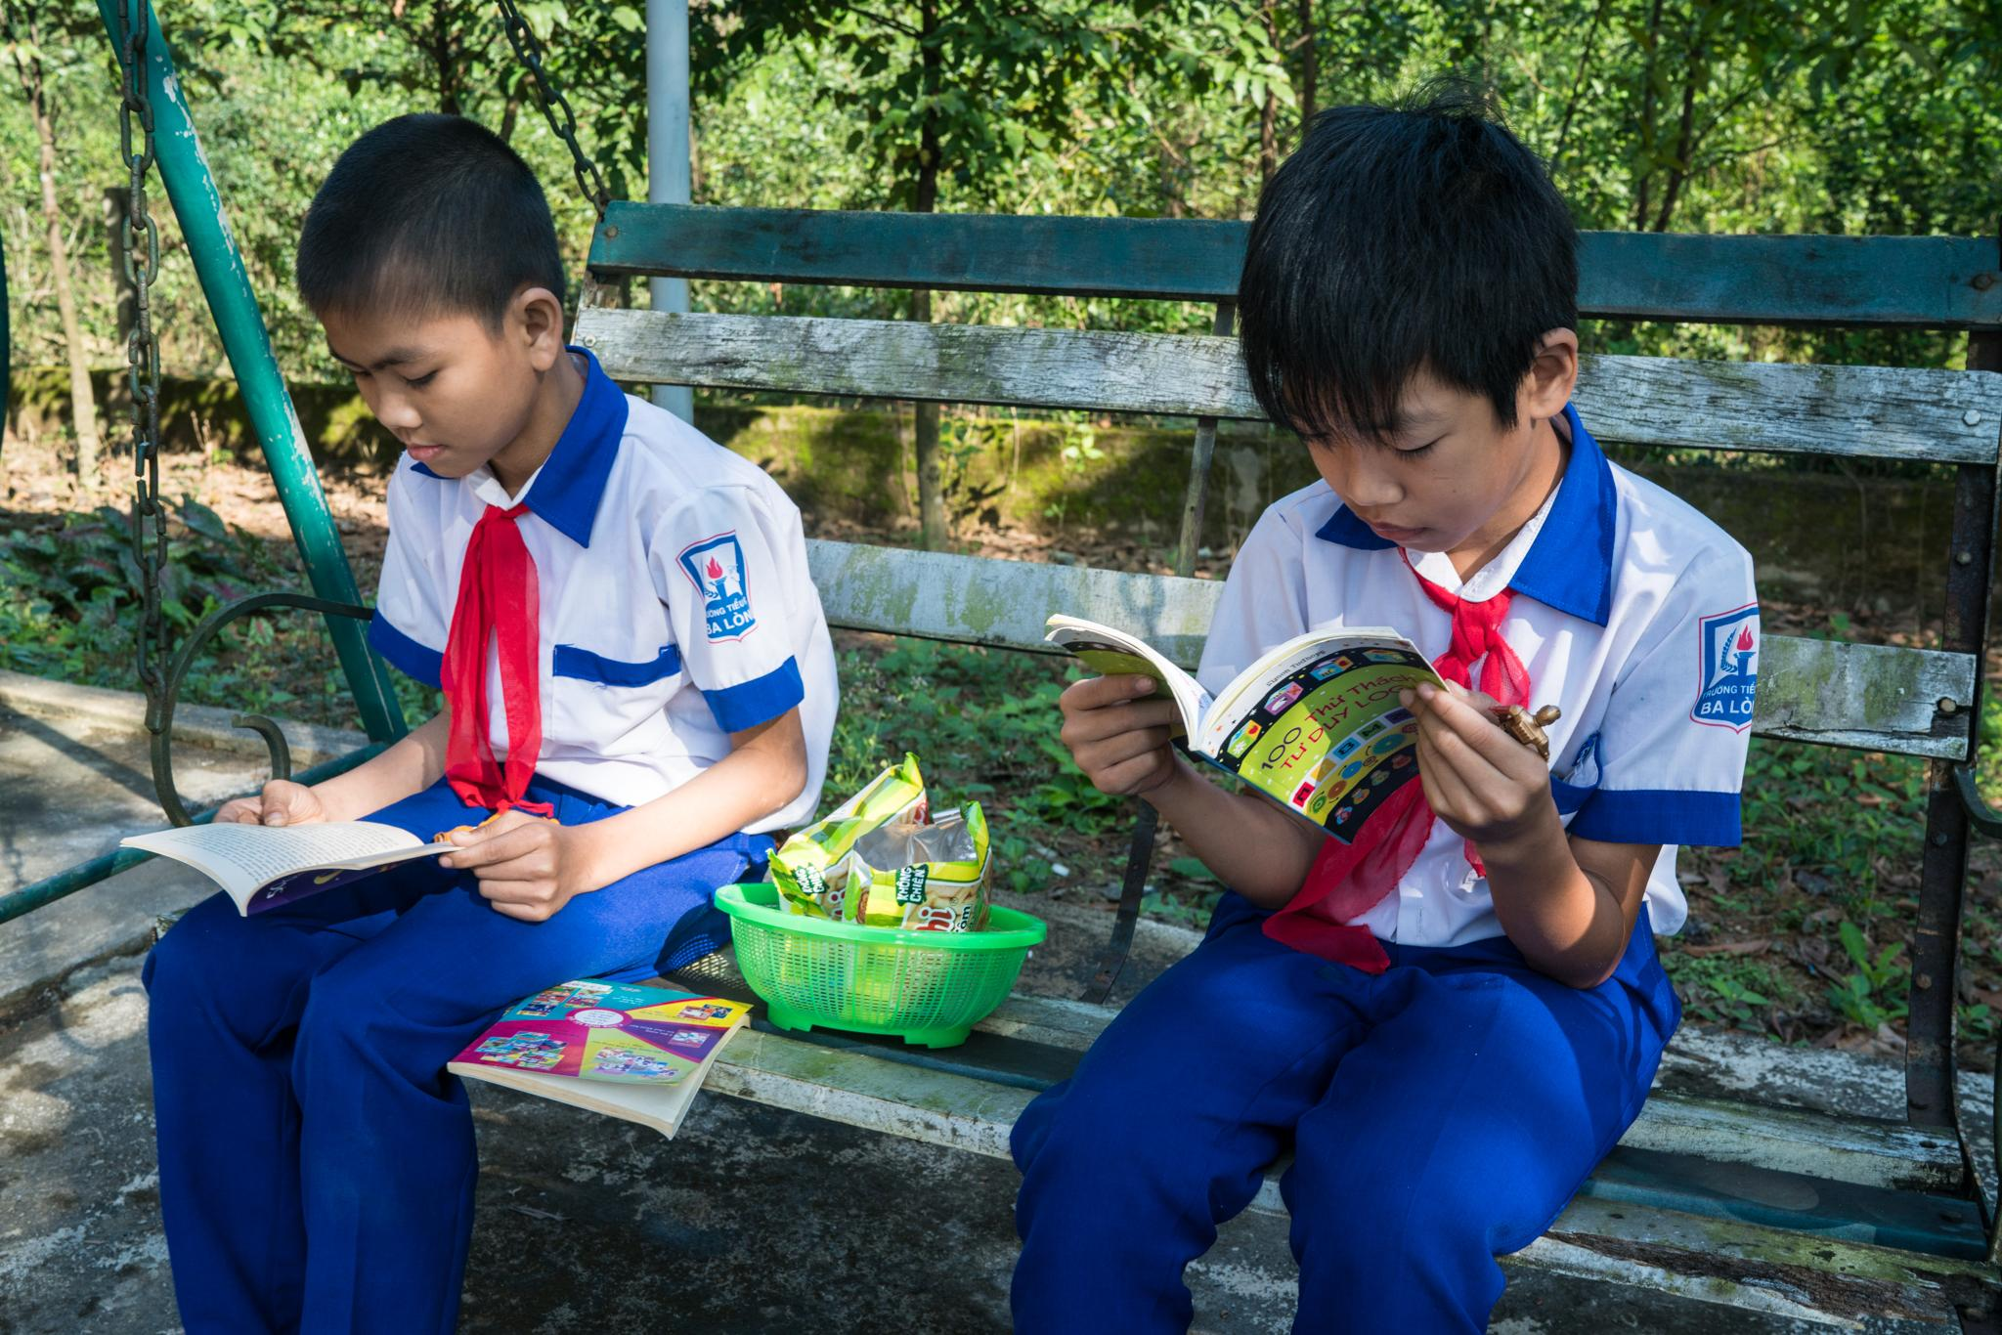
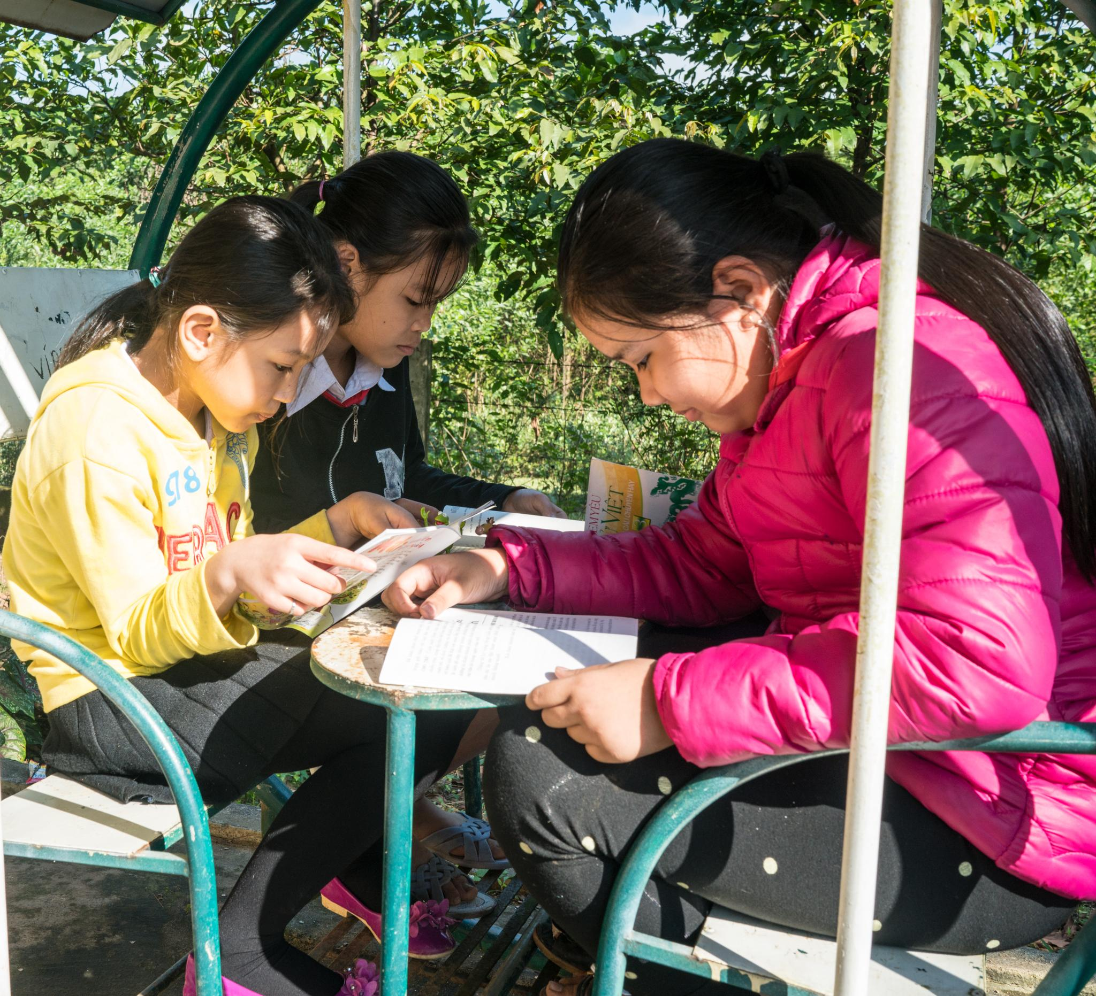
Source of Learning
Notes:
DUSTIN - children read in the morning before school. It’s a place of learning. - interview children

Slide 10
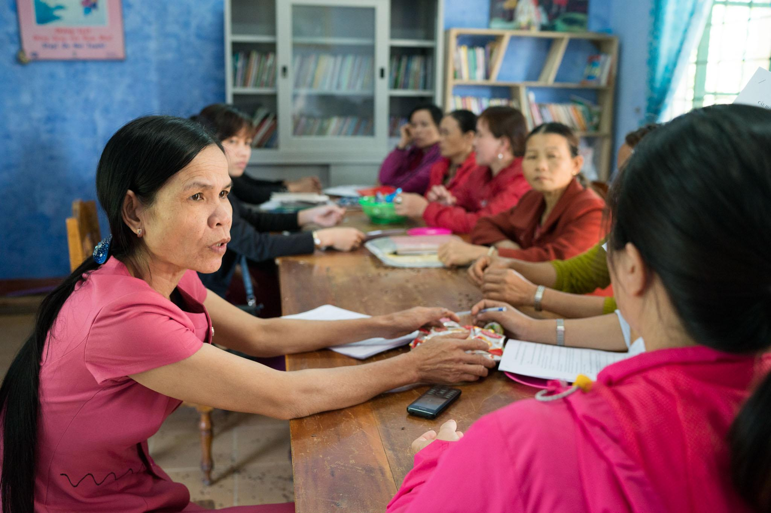
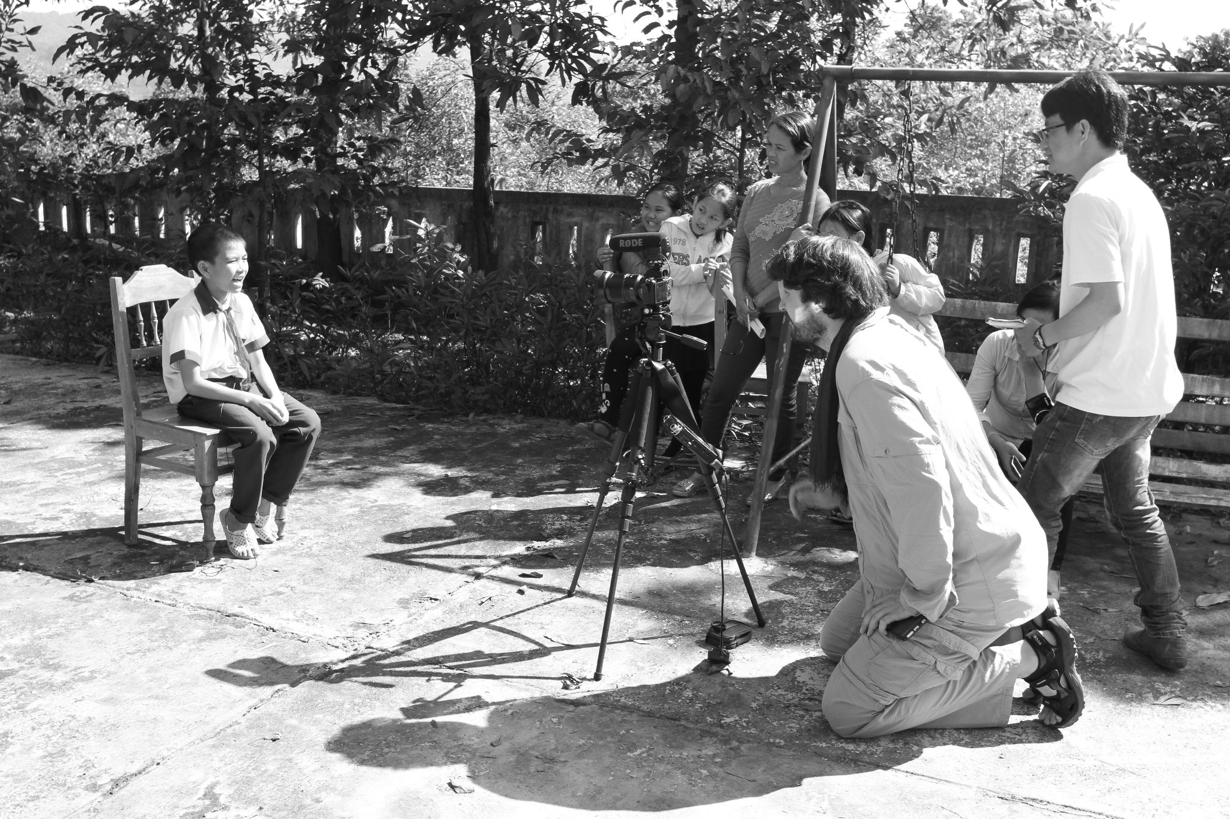
Community Space
Notes:
DUSTIN - as community space for leadership meetings, support groups, educational programs.

Slide 11
Barriers, Community Gain & Partnership
Distance and language barriers to establishing and maintaining the relationship exist
Identifying needs is key
Sharing a common goal
Having a namesake has been beneficial
Community partners are important to keeping the story alive
So much is gained from having this lasting and meaningful relationship
  Strengthens the legacy of the work done by the library and Patrick A. Lucero’s contribution
  Serves as an opportunity for educating the public and youth about civic responsibility, contributions of the military, and pride in one’s community and neighborhood
Notes:
SHERRI & KRISTI

Slide 12
Questions or Comments?

Slide 13
Notes:
Dropping Patricks picture here to use in one of the slides
https://www.brookings.edu/blog/up-front/2016/09/14/third-places-as-community-builders/

