Slide 1
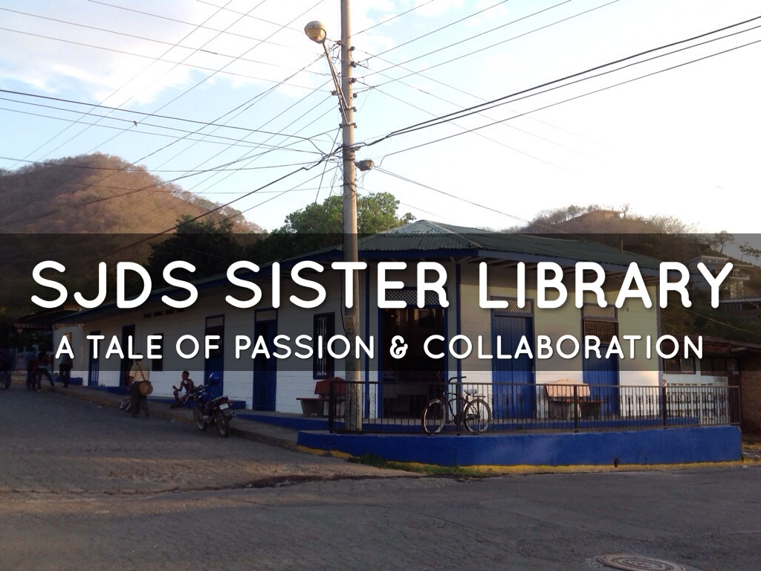

Slide 2
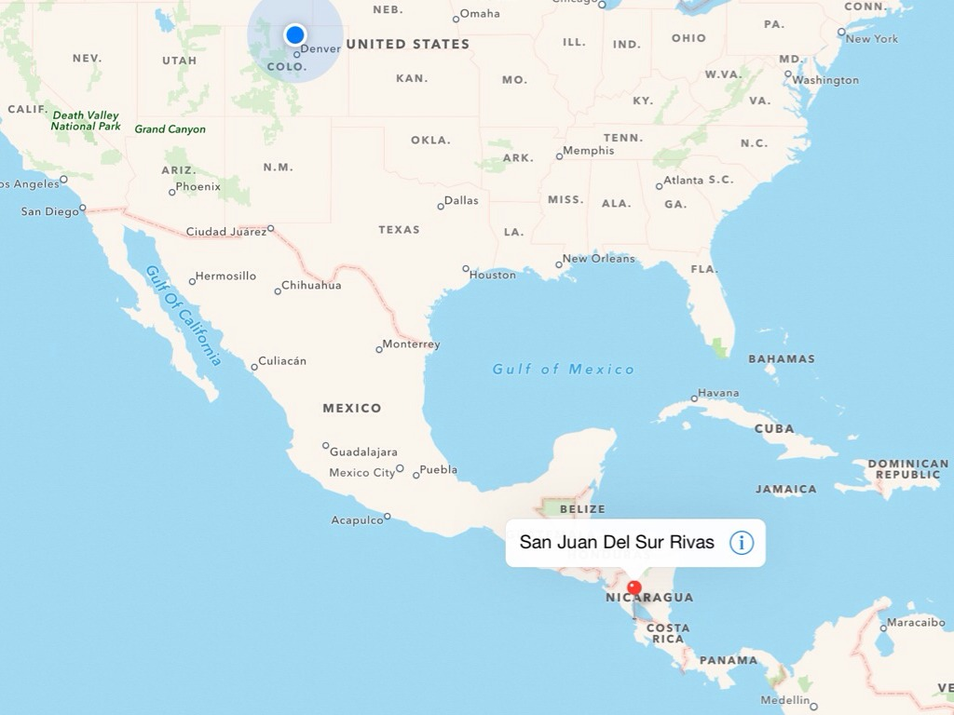

Slide 3

It all started with a conversation….

Slide 4
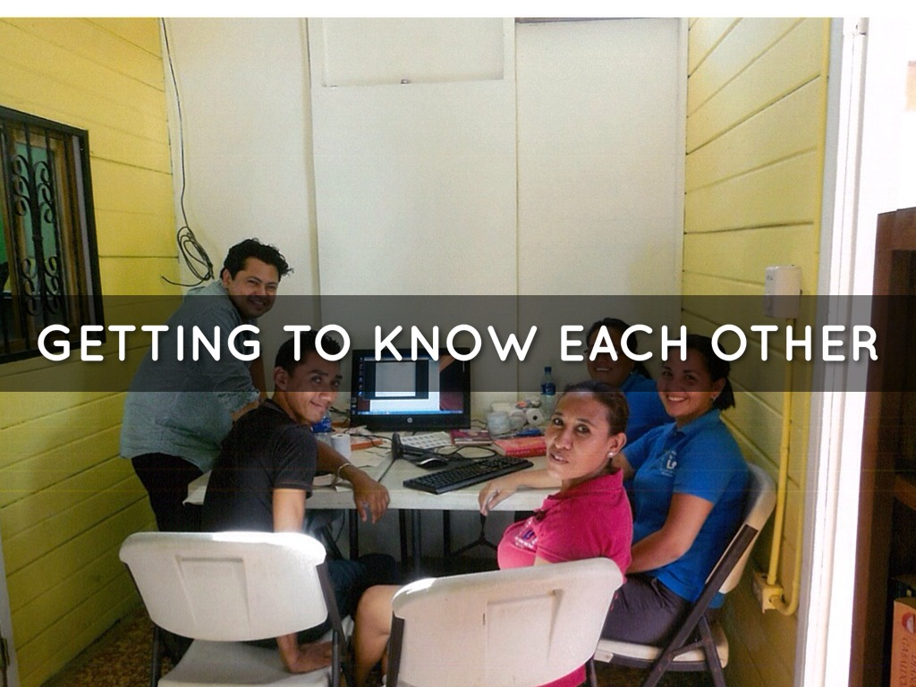

Slide 5
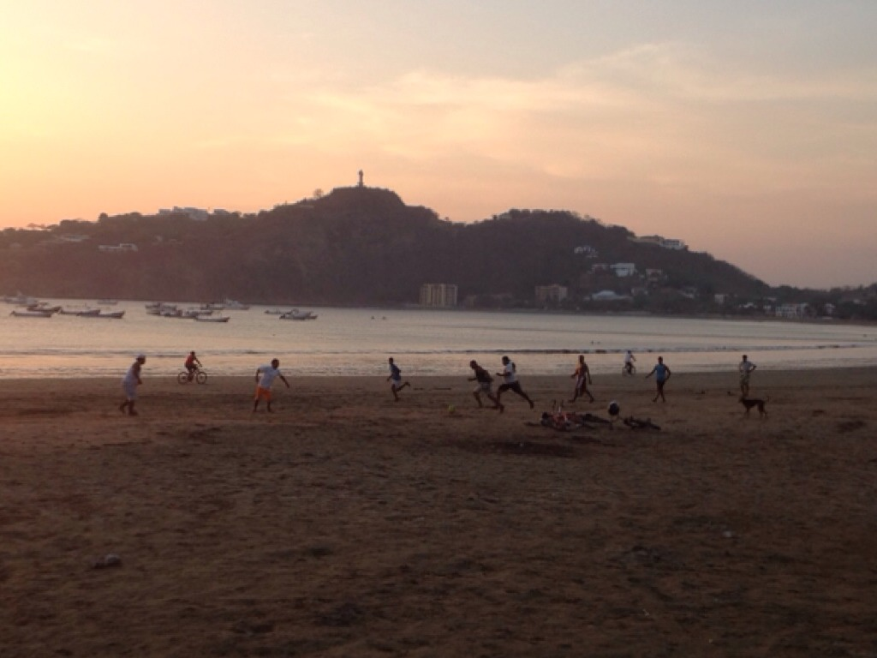

Slide 6
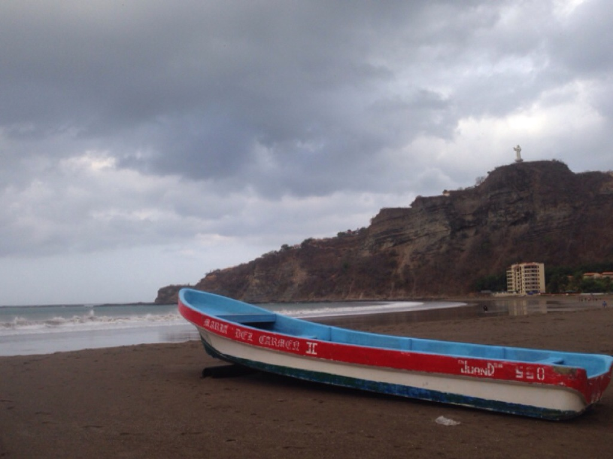

Slide 7
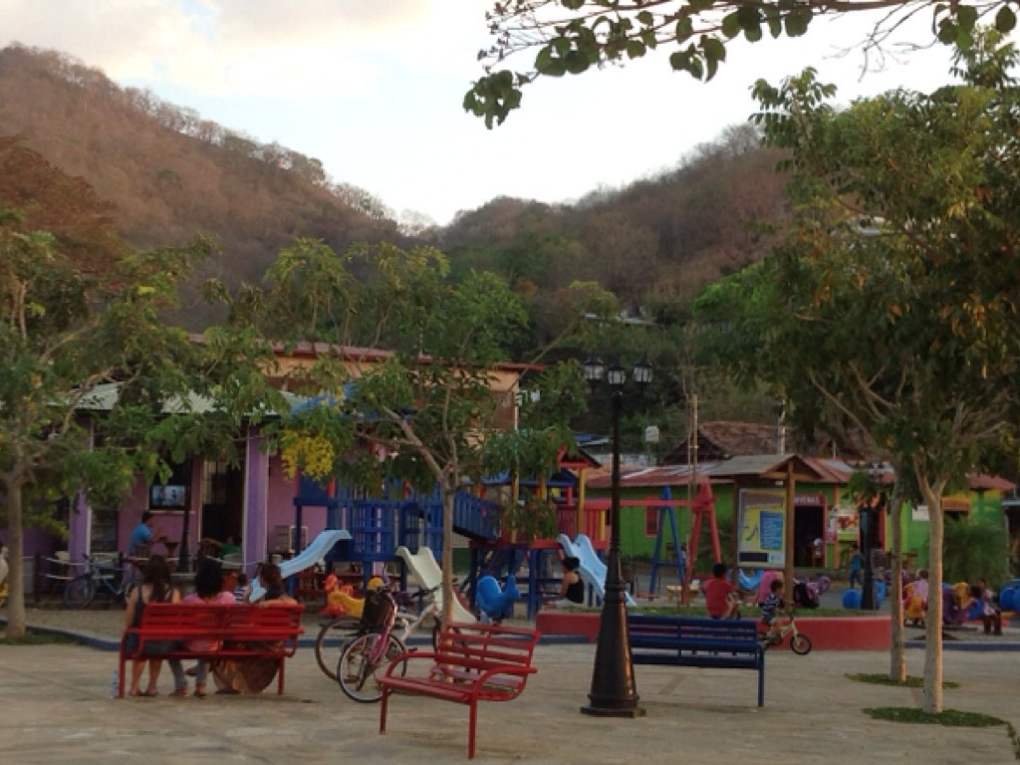

Slide 8
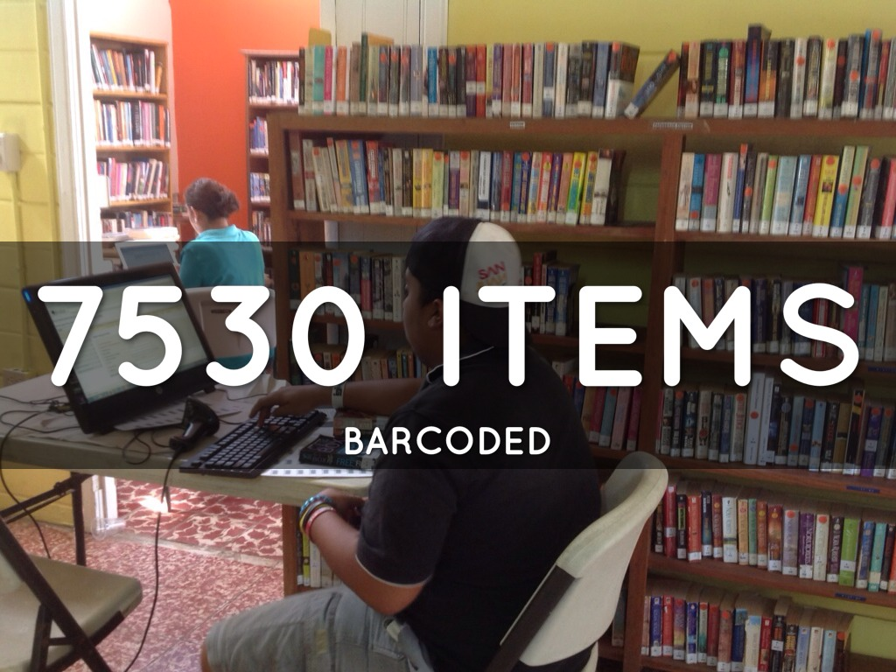

Slide 9
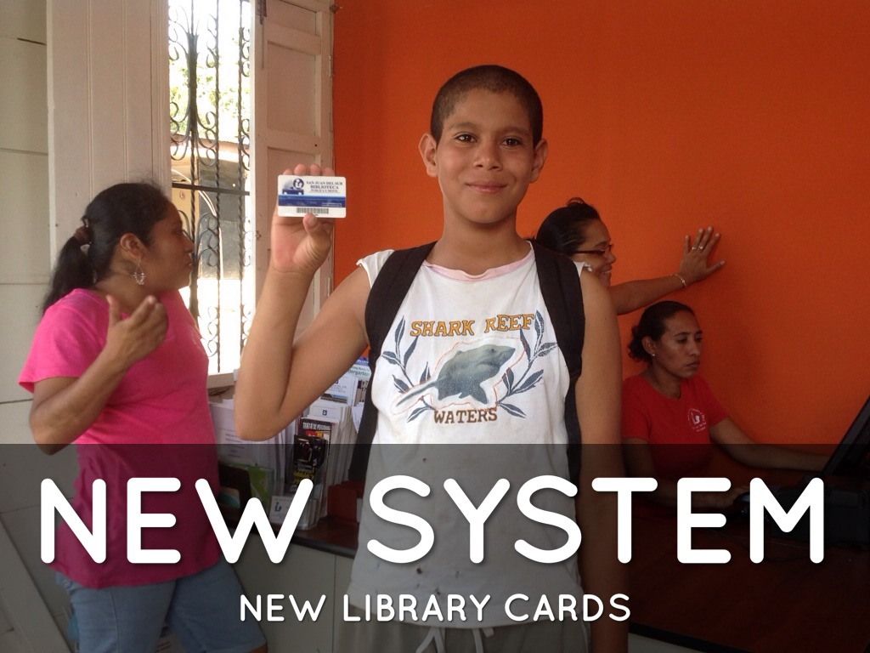

Slide 10
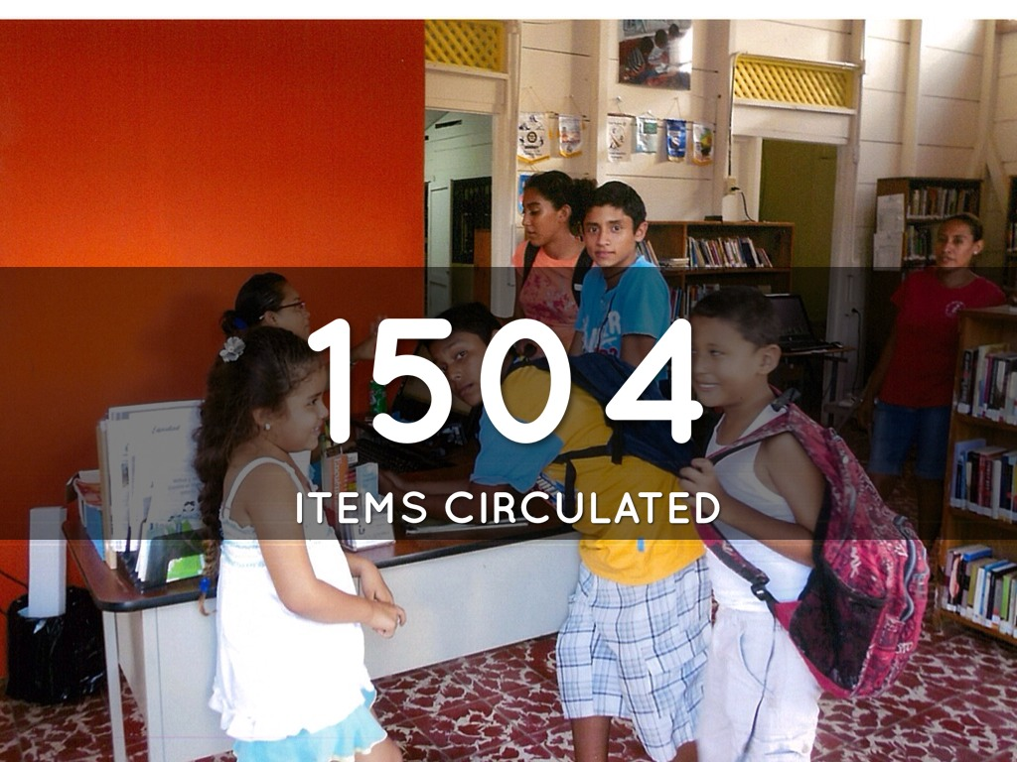

Slide 11

The Result?...
A 9 year strategic partnership between PRPRL and SJDS
An integrated library system (ILS) using the KOHA open source catalog software
A bookmobile service providing access to 35+ rural schools in the region, including an offline client to track the checked out items; then, sync the data back into the system when back at the main library (Due to lack of reliable internet connection in the area)
A 3D Printer program to teach local high school students and entrepreneurs ways to create:
  Accessories
  Tools
  And their own products for sale
RACHEL (Remote Area Community Hotspot for Education and Learning)
  A portable, battery-powered, device that contains copies of educational websites in offline format. This means RACHEL can go anywhere in the world and wirelessly deliver free digital educational content to nearby tablets, laptops, or smartphones with no internet or data plans required.
Notes:
Resources:
kOHA: https://koha-community.org/
RACHEL: https://worldpossible.org/

Slide 12
Thank You!
Victor Zuniga
vzuniga@poudrelibraries.org

