Slide 1
Introduction to Sister Cities
Connect globally. Thrive Locally.

Slide 2
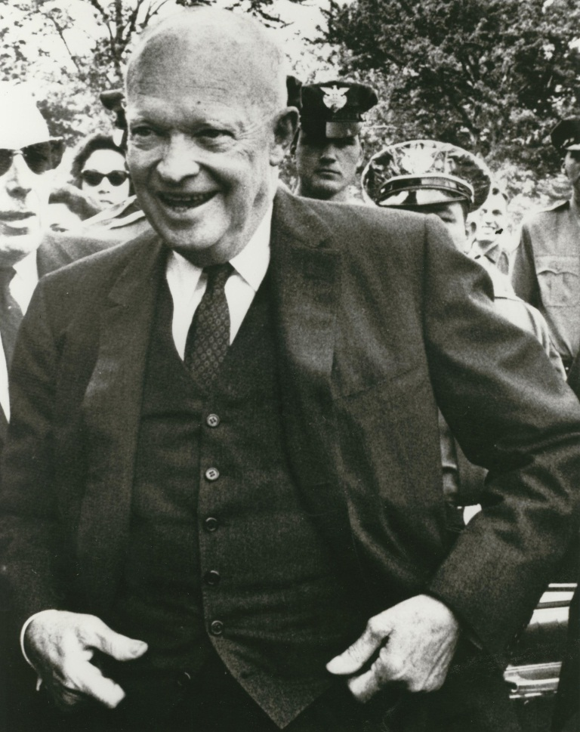
What is Sister Cities International?
Founded in 1956, Sister Cities International is a nonprofit citizen diplomacy network that creates and strengthens partnerships between U.S. and international communities.
Mission: to promote peace through mutual respect, cooperation, and understanding—one individual, one community at a time.
Notes:
- SCI arose out of post WWII environment, hence the large number of partnerships in Germany, Japan, Italy, France
- Foundation as a peace-building organization;
- Role of cultural exchange and encouraging understanding is part of SCI’s DNA

Slide 3
What is citizen diplomacy?
Citizen Diplomacy is the concept that the individual has the right, even the responsibility, to help shape U.S. foreign relations 'one handshake at a time.' Citizen diplomats can be students, teachers, athletes, artists, business people, humanitarians, adventurers or tourists. They are motivated by a responsibility to engage with the rest of the world in a meaningful, mutually beneficial dialogue. (US Council on Citizen Diplomacy)
Notes:
Sister Cities as medium for Citizen Diplomacy;
Role of citizens to be active in foreign relations;
Idea that when people connect with each other directly w/o federal/national government involvement it leads to understanding and peace

Slide 4
What is a sister city?
A sister city organization is a volunteer group of ordinary citizens who, with the support of their local elected officials, form long-term relationships with people and organizations in a city abroad.
Each sister city organization is independent and pursues the activities and thematic areas that are important to them and their community including municipal, business, trade, educational and cultural exchanges with their sister city.
Sister city organizations promote peace through people-to-people relationships—with program offerings varying greatly from basic cultural exchange programs to shared research and development projects between cities with relationships.

Slide 5

How do sister cities begin?
Cities can, and often do, create their own criteria or requirements for new sister cities.
All sister cities are formalized by an agreement between the two mayors or highest elected/appointed officials.
Notes:
Cities and local programs are ones that ultimately decide whether or not to partner, and under what circumstances they will partner;
SCI can assist in building partnerships, by helping troubleshoot, explain the process, assist in narrowing down possible partners, reaching out on cities’ behalf, and utilizing our network

Slide 6

Who can be part of a sister city program?
ANYONE!
  City officials, students and professors, local businesses, NGOs, religious groups, artists and musicians, local institutions and everyday citizens.
  The most successful and stable programs have volunteers from across these sectors.
  Youth are frequently engaged
  in sister city programs!
Notes:
Sister city programs are not just for high school students, or nonprofits, or municipal governments;
The best programs have different layers of engagement;
Diverse programs are more active, respond better to challenges, and are less likely to become dormant

Slide 7
How do partnerships begin?
A relationship is formally created when the mayors or highest elected officials from two communities sign a memorandum of understanding establishing the sister city partnership.
Sister city relationships may develop from a number of sources, including:
  preexisting mayoral relationships,
  trade relationships,
  historical connections,
  ancestral/demographic connections,
  expatriate communities,
  shared geographic/sector challenges,
  faith‐based groups,
  and personal experiences ranging from study/work abroad to marriages.
Notes:
- There is no one path to developing a sister city; culture, history, economy, geography all can be motivators/enablers in building partnership
- Current trends are for partnerships based on shared industries/economic development, as well as partnerships based on new immigrant communities

Slide 8
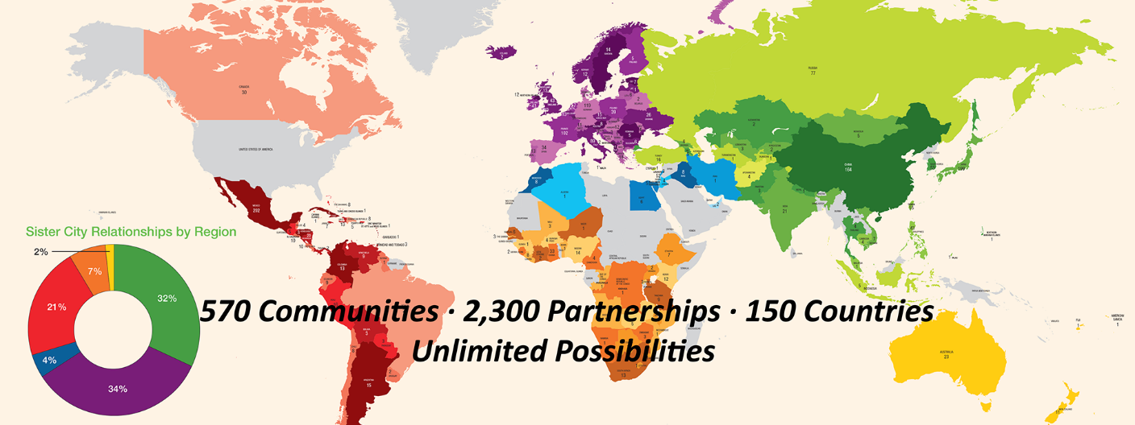
The sister cities network
560 U.S. cities, counties, and states represented.
Over 2,300 partnerships with communities abroad.
Partnerships in 150 countries on six continents.

Slide 9
What do sister cities do?
Cultural Exchange
  Arts, music, traditions, customs, performances
Youth and Education
  Study abroad, virtual exchanges, learning opportunities, leadership building
Community Development
  Municipal and technical exchanges, best practices, policy exchanges, staff development
Business and Trade
  Trade delegations, business incubation, import/export assistance
Notes:
Stick to 4 general areas (makes sister cities easier to conceptualize);
Emphasize that leading programs do activities in all these areas;
Areas may overlap; cities set their own agenda;
All activities go both ways;

Slide 10

Who are our sister cities?
To find out who your sister cities are, use Sister Cities International’s City Search on our homepage, www.sistercities.org.
You can also find a digital copy of our membership directory at www.sistercities.org/2016directory.

Slide 11
Youth Exchanges
Many sister city programs organize high school and youth exchanges, both inbound and outbound.
Most exchanges are short term (2 weeks) and often involve homestays, programming on a particular theme, and/or service learning.
Contact your local sister cities chapter to find out what exchanges are happening in your community!

Slide 12
J-1 High School Homestay
http://sistercities.org/hshs
International students come to U.S. for semester/year
Live with host family and attend local high school in one of their sister city communities
Opportunities for U.S. based Kiwanians to serve as host families
Wonderful chance to learn about another culture and share your life with someone else!
If interested clubs should contact their local Sister Cities chapter
Notes:
Flyer on our website for more information
Deadline for student applications for fall 2017 semester or 2017-2018 academic year- May 1, 2017

Slide 13
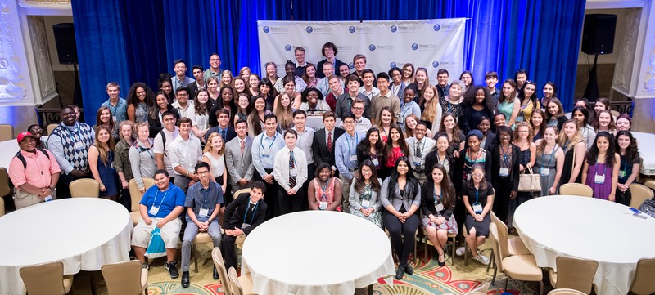
Youth Leadership Summit
Open to both U.S. and international high school students
Engage the next generation of leaders and expose them to international affairs
Activities include a U.N.-style simulation developed by the U.S. Diplomacy Center, guest speakers from the world of international affairs, service opportunities, and tourism.
2017 Conference- Virginia Beach, VA July 12-15, 2017
Registration- www.sistercities.org/YLS
Notes:
2016 Rates: Youth from SCI Member City with lodging- $600
Youth from non-member city with lodging- $650
Youth from member and non-member cities without lodging- $350
Students stay in the dorms of a local college/university- great opportunity to get a ‘taste’ of college life
Supervised by chaperones
Flyer on the SCI website with more information

Slide 14
Service opportunities
Many sister city programs do humanitarian or development work that complements Kiwanis’ mission. This includes, but is not limited to:
  Disaster Relief
  Medical missions
  Nurse/doctor exchanges
  Provision of supplies/funding to hospitals/clinics
  Water and sanitation projects
  Educational partnerships aimed at development/health
  Municipal exchanges in fields such as sanitation or health management

Slide 15
Next Steps
Encourage local Kiwanis clubs to connect with their local sister city chapter directly
Educate clubs about J-1High School Homestay- can volunteer to be a host family for an international high school student
International key club members can apply to study in the U.S.
Inform about Youth Leadership Summit opportunity- interested students should contact their local sister city to apply

Slide 16
For more information contact us at info@sistercities.org or visit us online at www.sister-cities.org

