Slide 1

Better Together: The Power of Global Library Connections
March 7, 2023
https://youtu.be/v8pEmMiNHHM?t=203

Slide 2
Denver Sister Cities International
Our Sister Cities
Brest, France
Nairobi, Kenya
Cuernavaca, Mexico
Chennai, India
Axum, Ethiopia
1948
1975
1983
1984
1995
1960
1977
1983
1986
2001
Takayama, Japan
Karmiel, Israel
Potenza, Italy
Kunming, China
Ulaanbaatar, Mongolia
Fun Fact: Each of our Sister Cities has a park!

Slide 3
Denver Sister Cities International
Our Friendship Cities
Akureyri, Iceland
Panama City, Panama
2013
2012
2017
Ramat HaNegev, Israel

Slide 4
Our Mission
To promote peace through mutual respect, understanding, & cooperation with cultural, educational, economic, and humanitarian endeavors.
Citizen Diplomacy

Slide 5
What is a Sister City?
A selected, long-term relationship based on interest and connection between two communities in two countries.
Official diplomatic relationship, created only when two top municipal officials, usually mayors, agree to agree and sign an agreement.
Connection can be based on anything: similar geographical features (Kunming, Cuernavaca), strong diaspora or communities (Axum, UB), or two mayors hitting it off. Names: Toledo - Toledo; Pueblo - Puebla; Dull - Boring

Slide 6
Sister City History
Relationships called sister cities, twin towns, or friendship towns have been around for centuries with the first recorded twin towns occurred in Europe in 836AD.
Expanded substantially following WWII
President Eisenhower created the national Sister Cities program (then called People to People) in 1956* at the White House Conference for Citizen Diplomacy
"...

Slide 7
Sister City History
our faith in the great promise of people-to-people and sister city affiliations in helping build the solid structure of world peace.“ – Dwight D. Eisenhower
  “The origin of modern diplomacy was in the relations between cities. Today, cities are
  our conduits for world trade, our main communicators of culture, and a proven
  training ground for future world leadership. The Sister City programs help provide a means by which all of these important assets can be made more meaningful.”
  —Henry A. Kissinger, former Secretary of State
* The Denver/Brest Sister City pre-dated the official creation of the US Sister City program by 8 years!
"...

Slide 8
Our Pillars
EDUCATION
Student and Adult Exchanges
ECONOMIC DEVELOPMENT
Delegation Trips
Business Connections
CULTURAL
Art, Music and Food Exchanges
HUMANITARIANISM
Disaster Relief

Slide 9
Current Activities/Programs
Brest Committee
  Mural Exchange
  Jazz Exchange/Delegation Trip
  Taste of France on Larimer Square
Takayama Committee
  Festivals
  Japan Culture Day
  Adult Delegation Trip
Nairobi Committee
  Adult Delegation Trip
  Library Exchange
  University of Nairobi American Studies Program
  Sports Exchange
Kunming Committee
  US China Heartland
Ulaanbaatar Committee
  35/20 Celebration
  Morin Khuur Ensemble
Potenza Committee
  Simone Pippa Concert
  Bocce Ball Tournament
Axum Committee
  Tigray relief

Slide 10

Libraries and Literacy Campaign

Slide 11
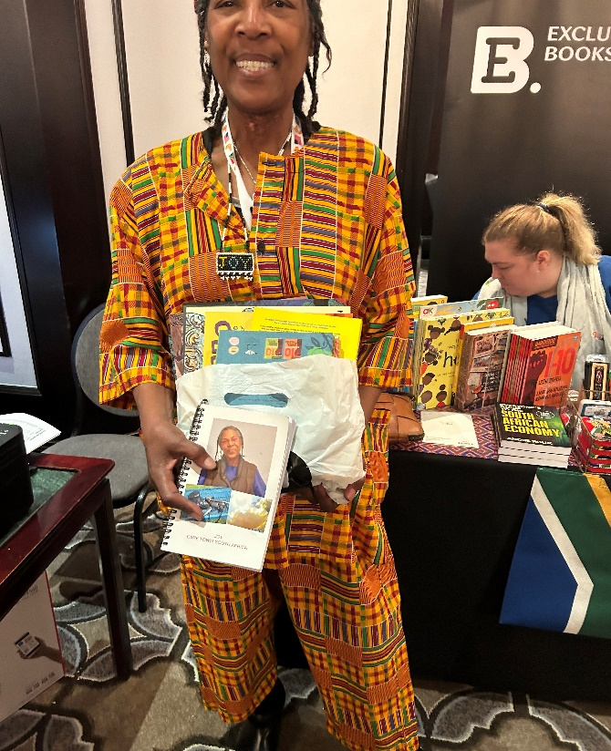
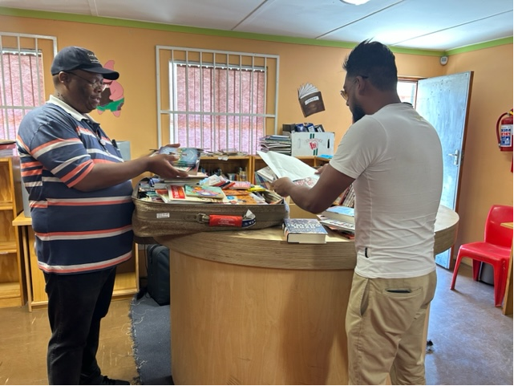
Libraries and Literacy Campaign
Delivered over 5,000 books to school libraries in Langa Township.

Slide 12
More Information!
www.denversistercities.org

