Slide 1

Teaching in Taiwan
Challenges and Opportunities of a Fulbright Grant during the Pandemic
Brianna Buljung
Teaching & Learning Librarian
2021 US Fulbright Scholar in Taiwan

Slide 2
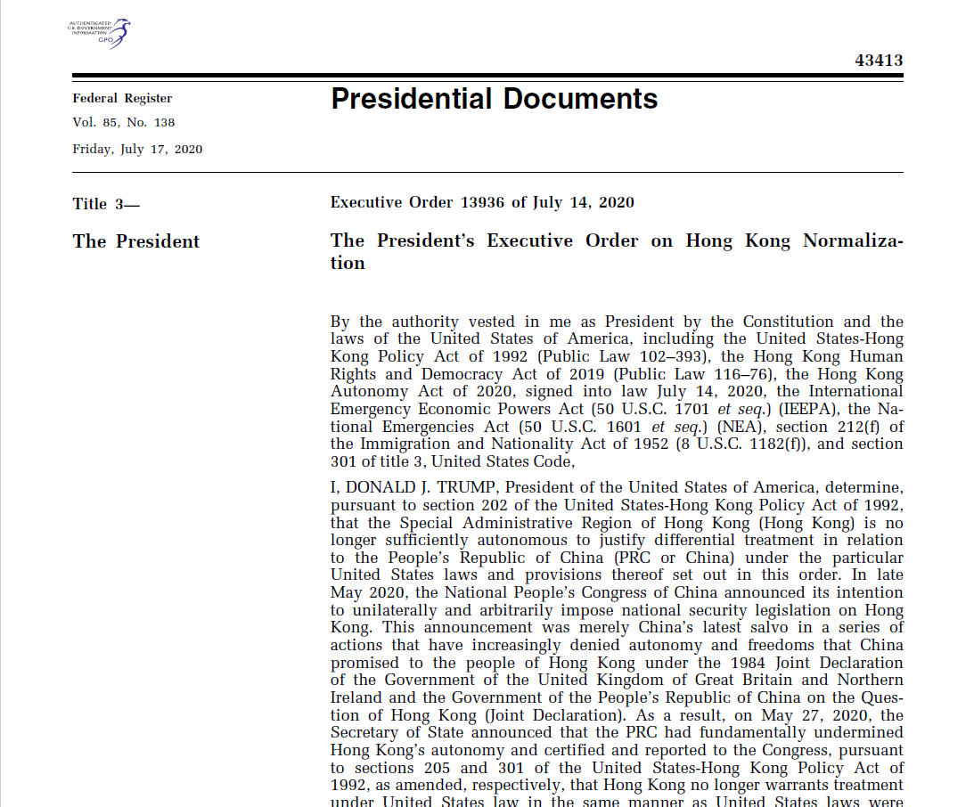
We’re going to China…
Or Not
The original plan:
Applied – September 2019
Passed peer review – December 2019
Accepted – April 2020
Plan to teach spring 2021 at CUMT in Xuzhou, China
Change of Plans:
China program shut down - August 2020
Transferred to Taiwan – September 2020
Invited to teach at Tunghai University in Taichung, Taiwan
COVID complications
2020-2021 program postponed to spring 2021
Unsure we’d be going until we actually stepped on the plane in January 2021

Slide 3
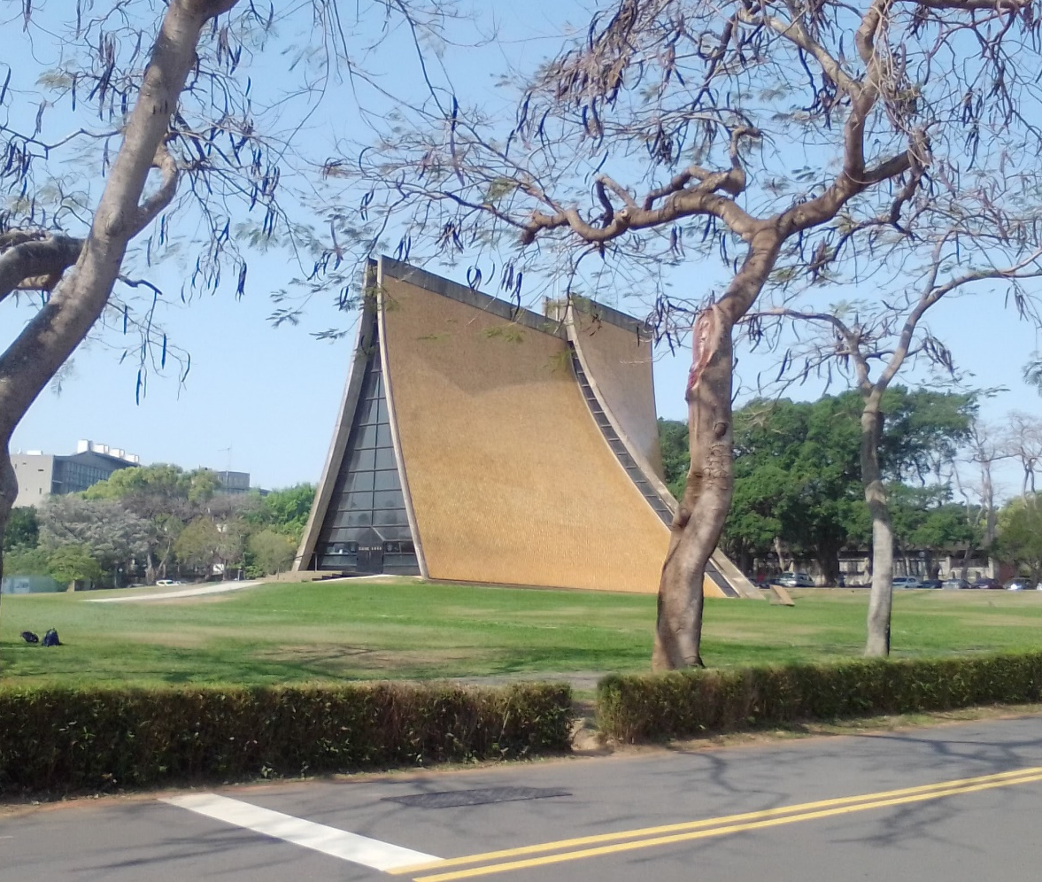
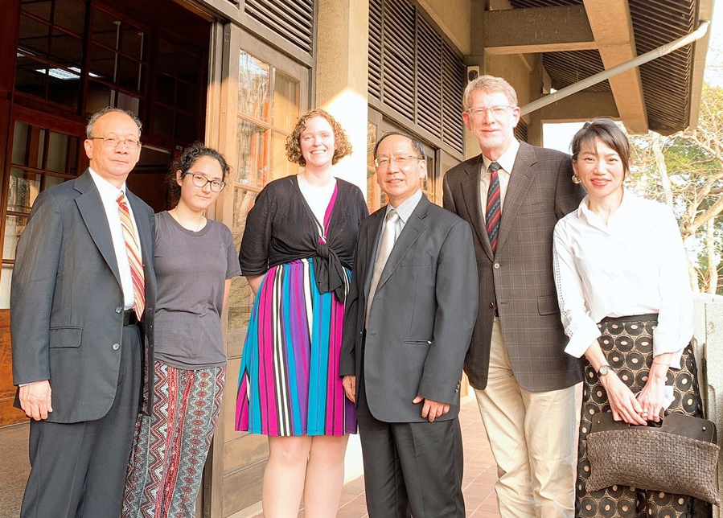
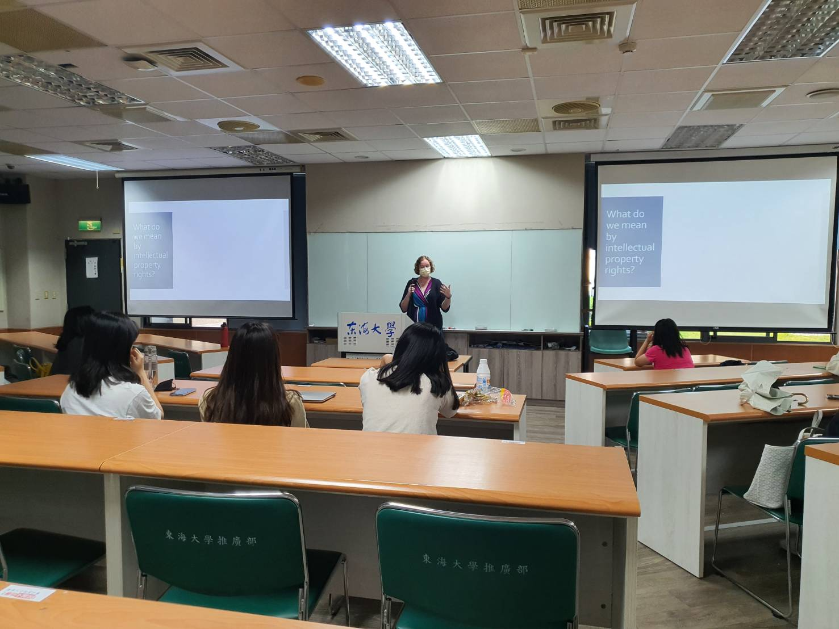
Tunghai University
History and Geography for our Interconnected World
13 weeks (12 in person)
43 students
Conducting Research and Navigating the Research Lifecycle
4 weeks (fully online)
5 students

Slide 4
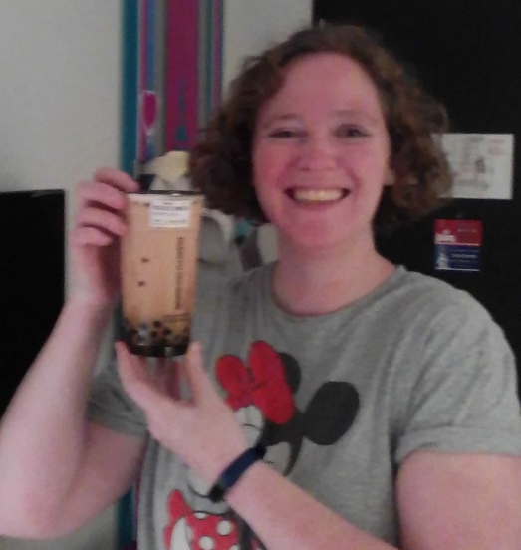
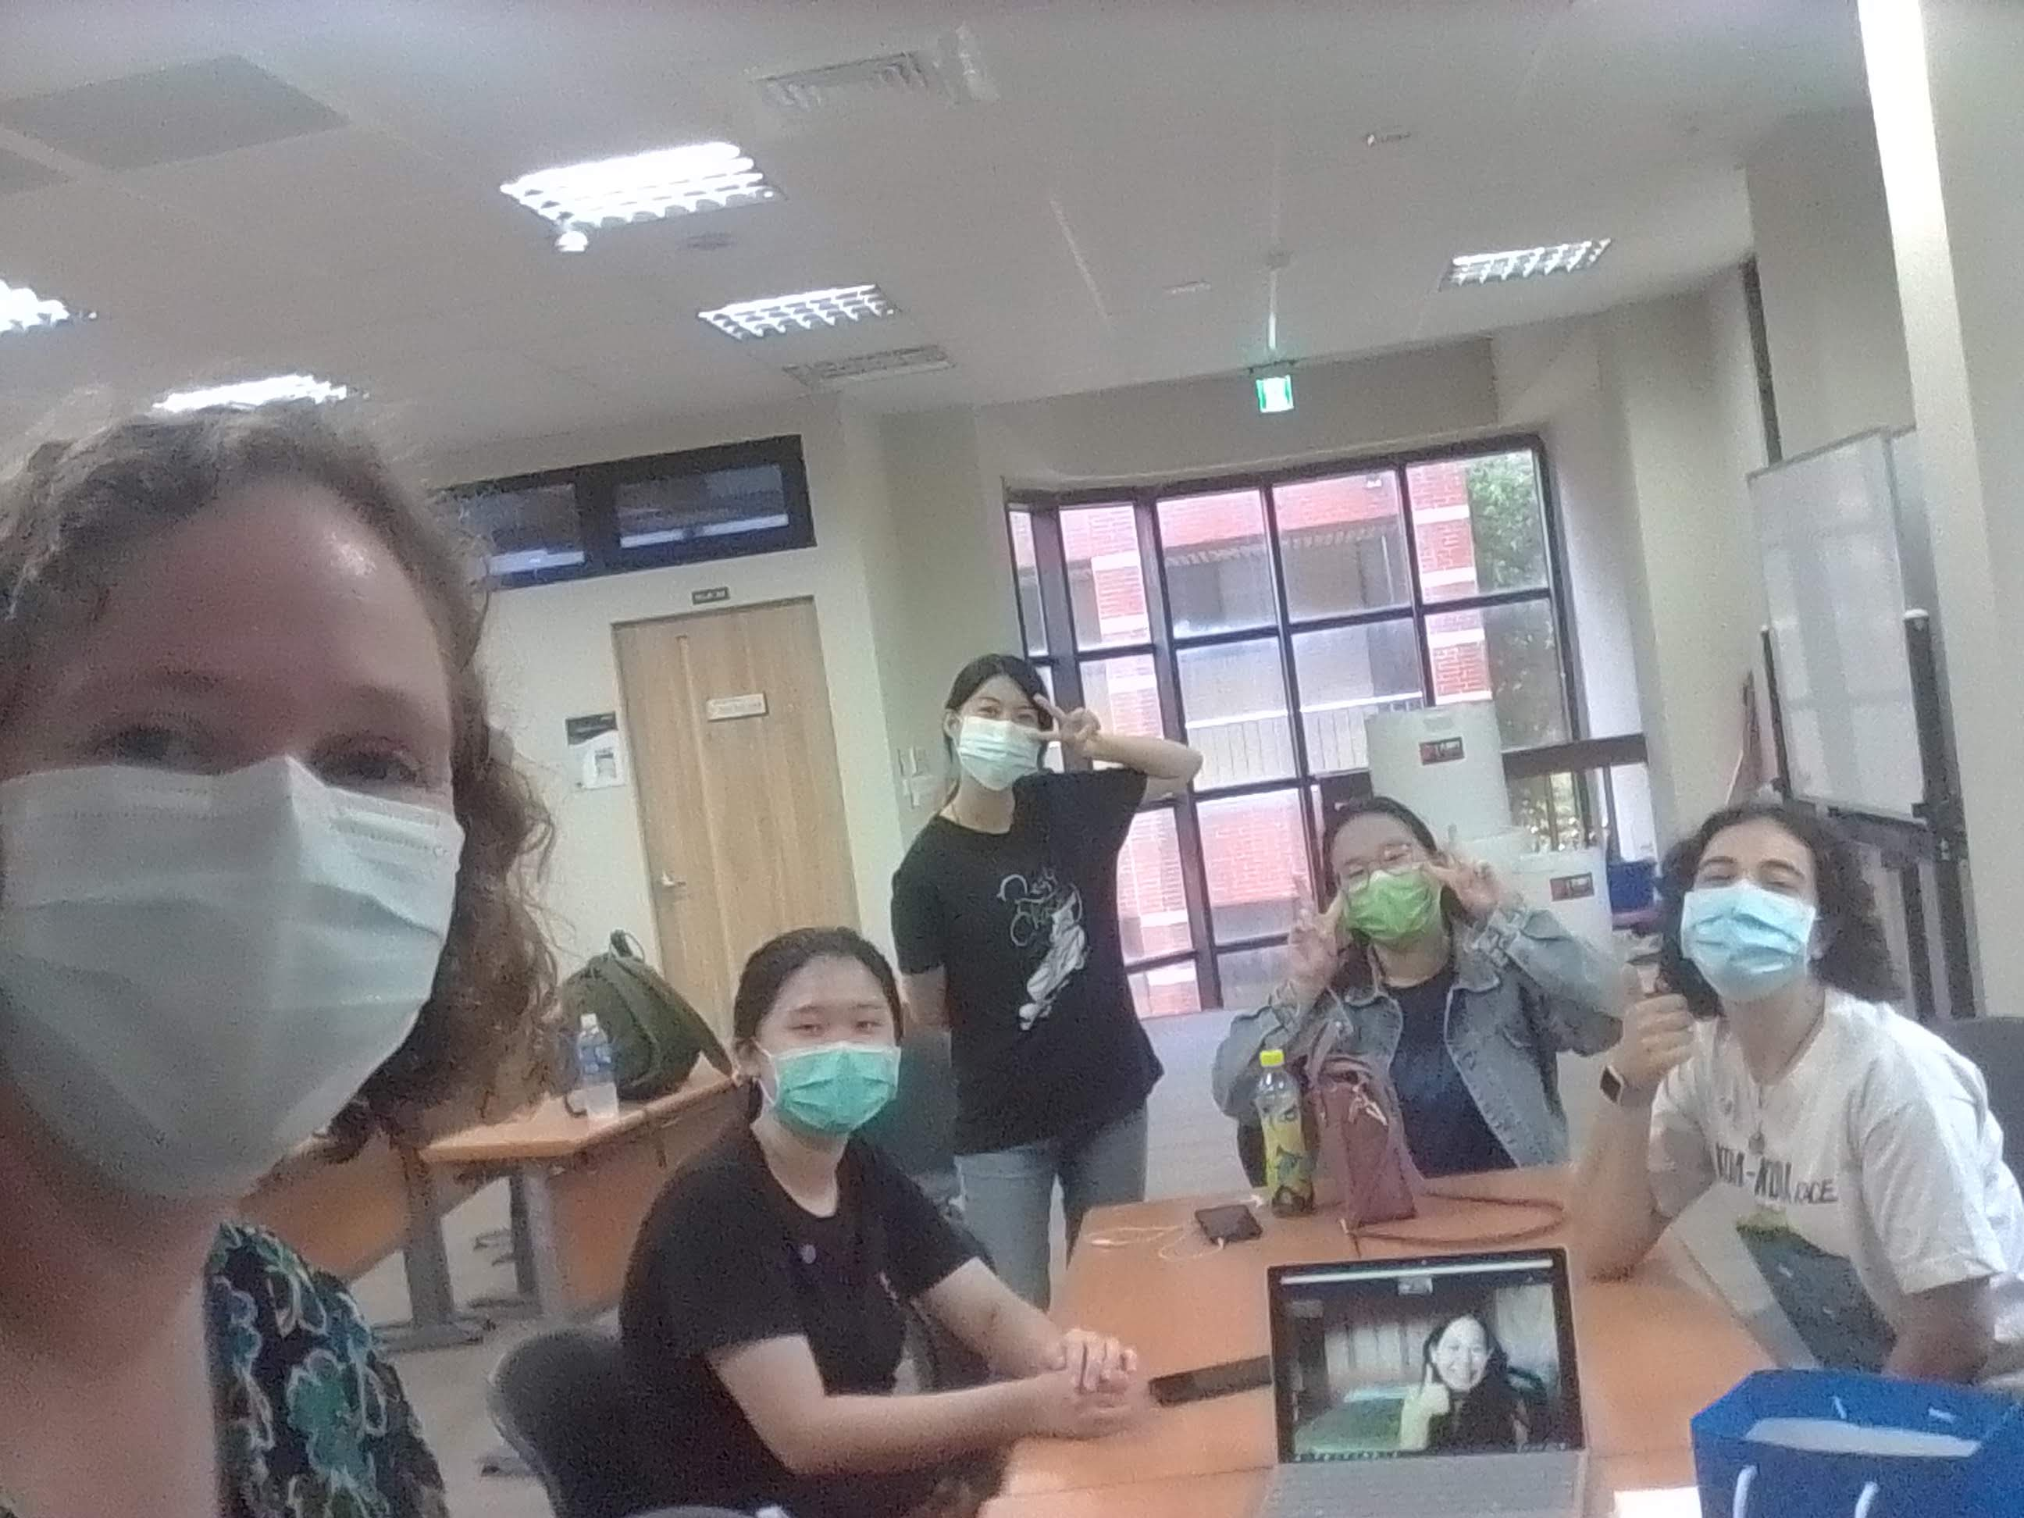
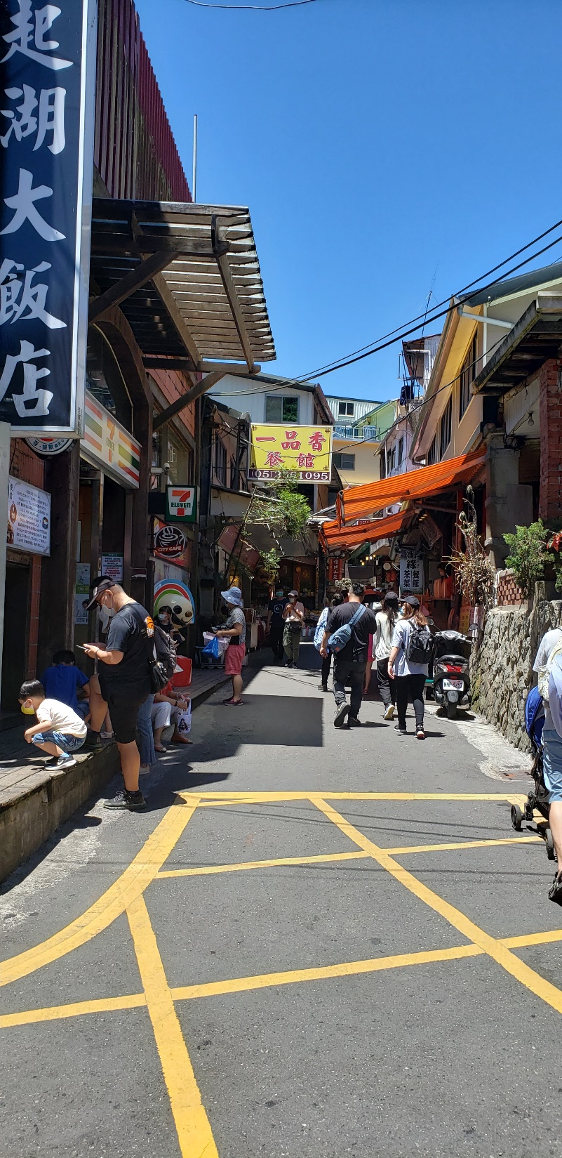
Lessons Learned

Slide 5

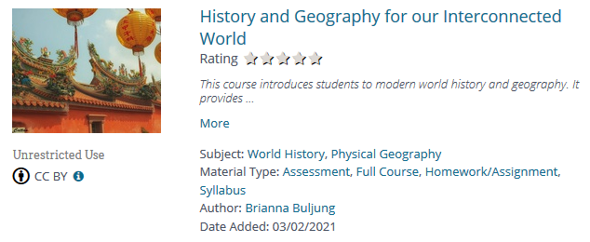
Open History Course
https://www.oercommons.org/courseware/lesson/77796

Slide 6

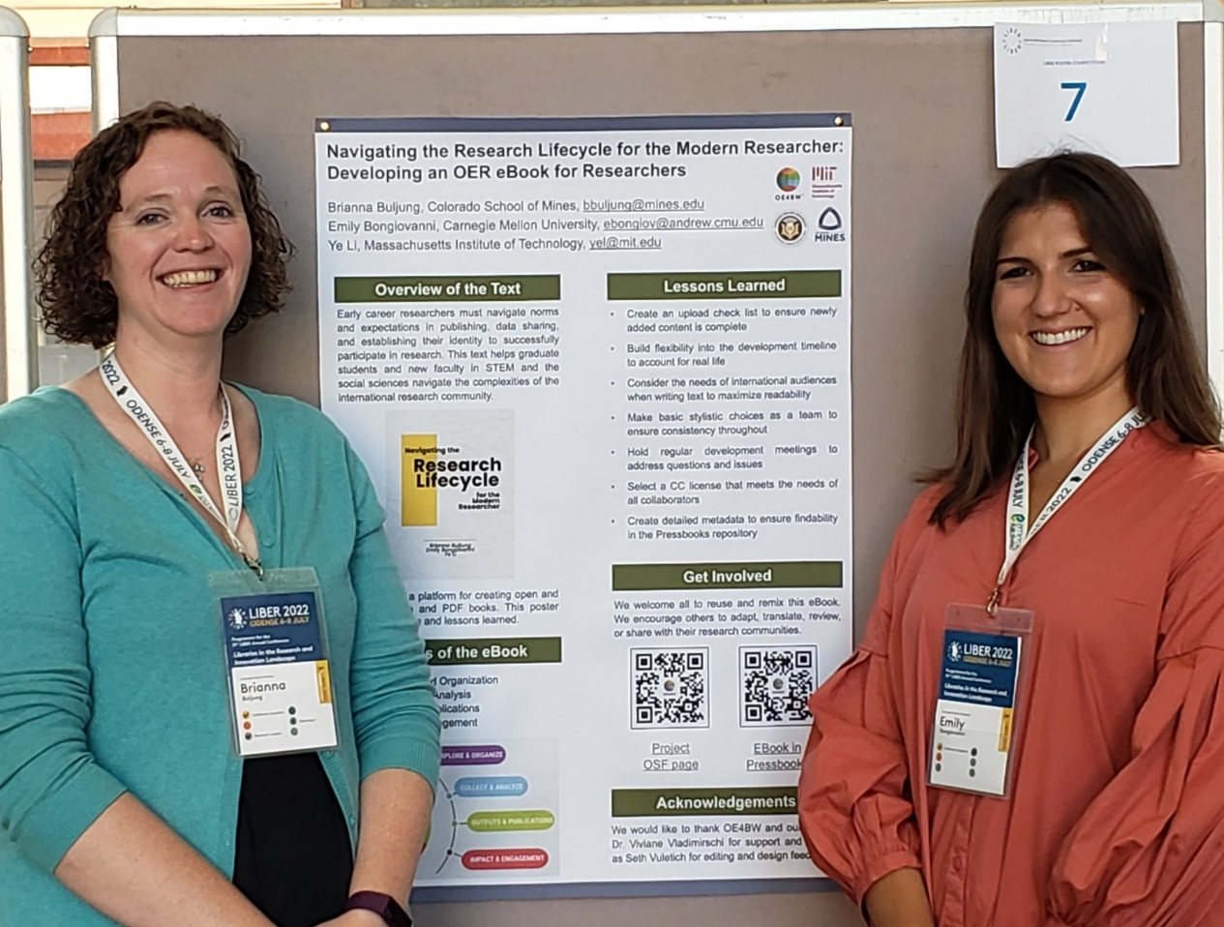

Navigating Research Book
https://pressbooks.pub/researchlifecycle/

Slide 7
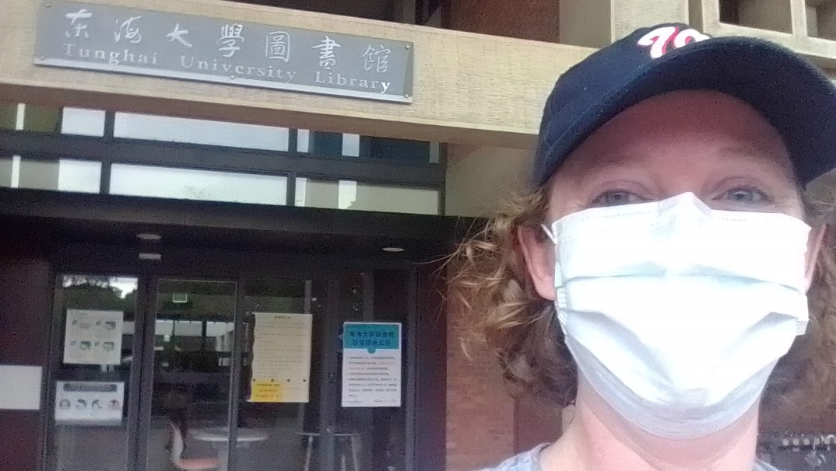
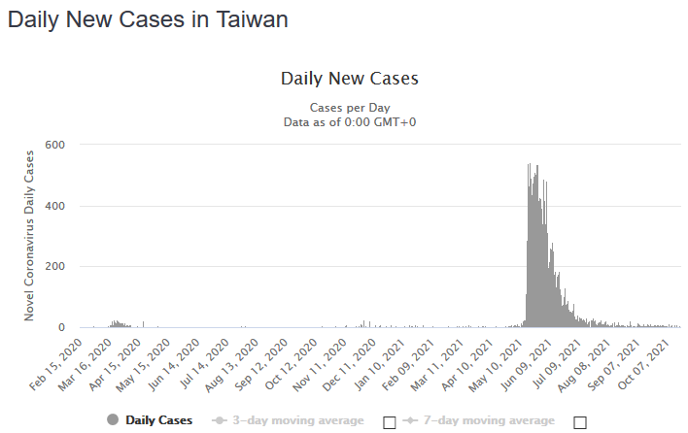
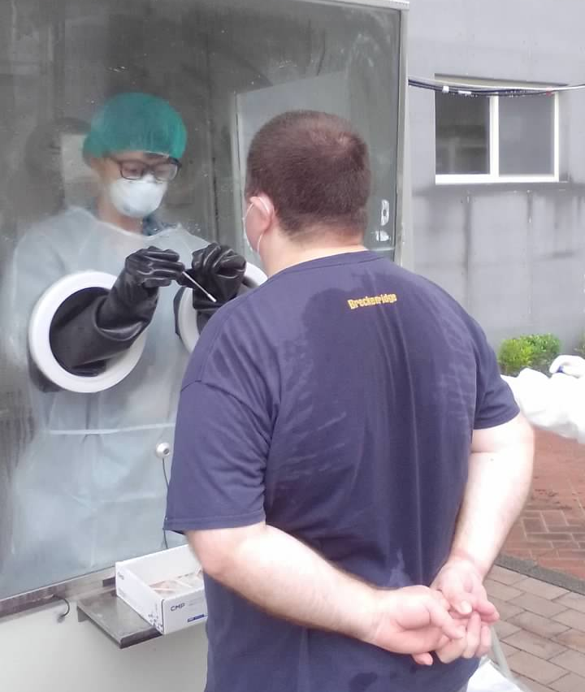
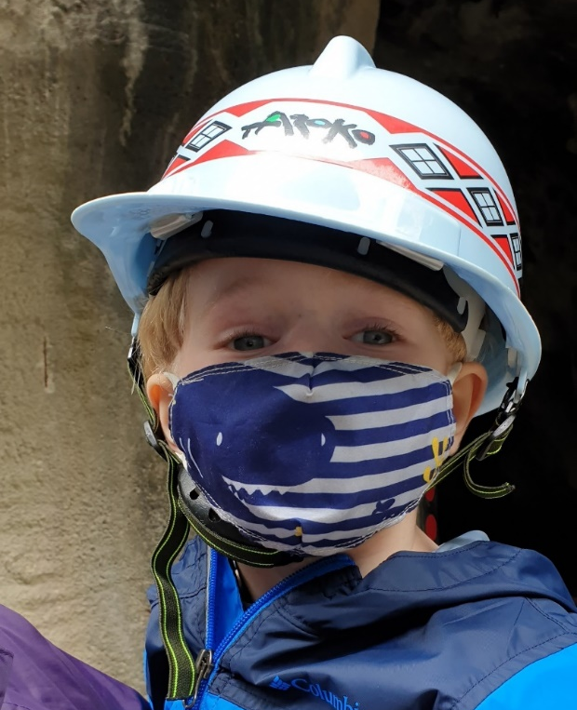
Impact of COVID-19

Slide 8
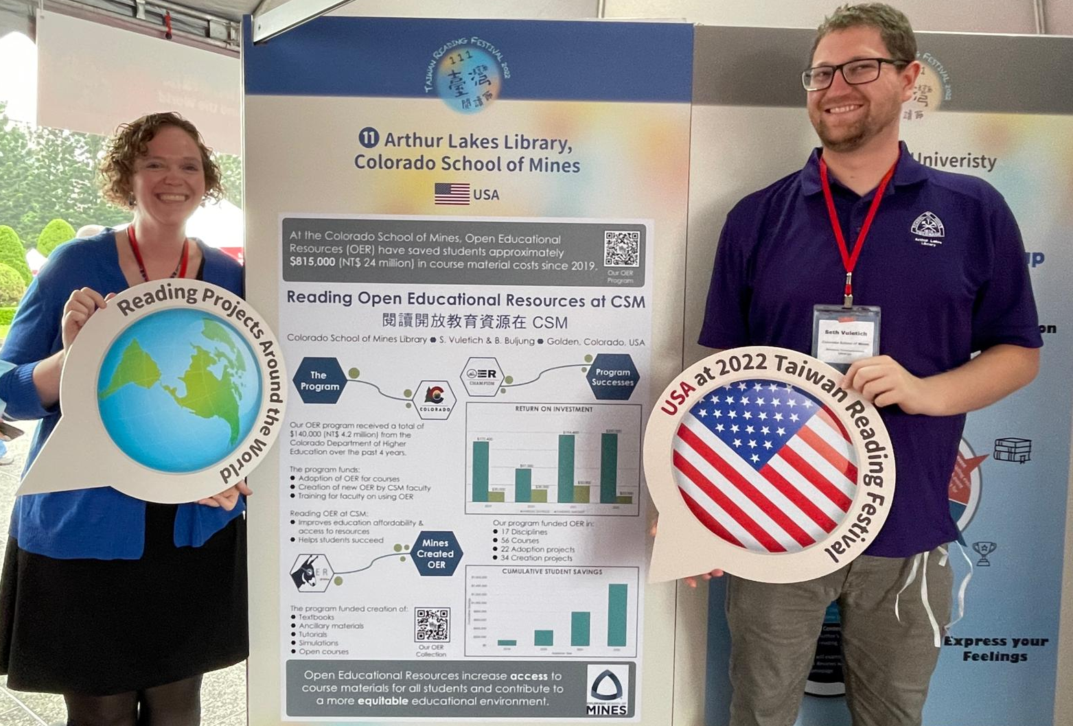
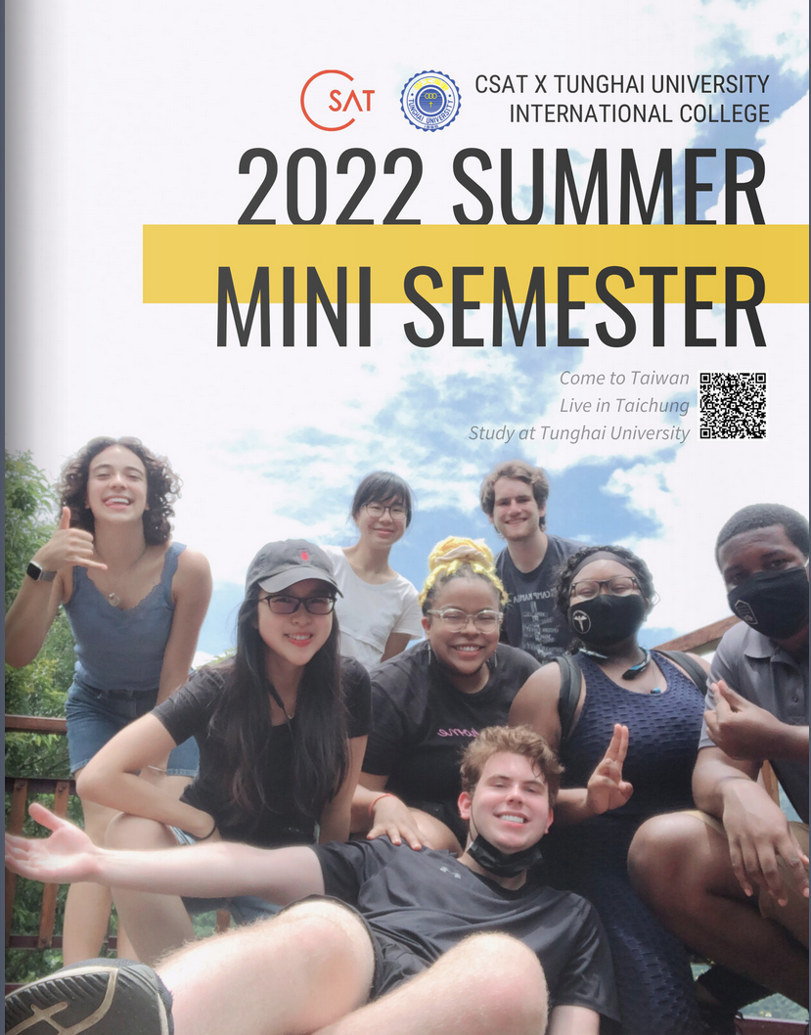
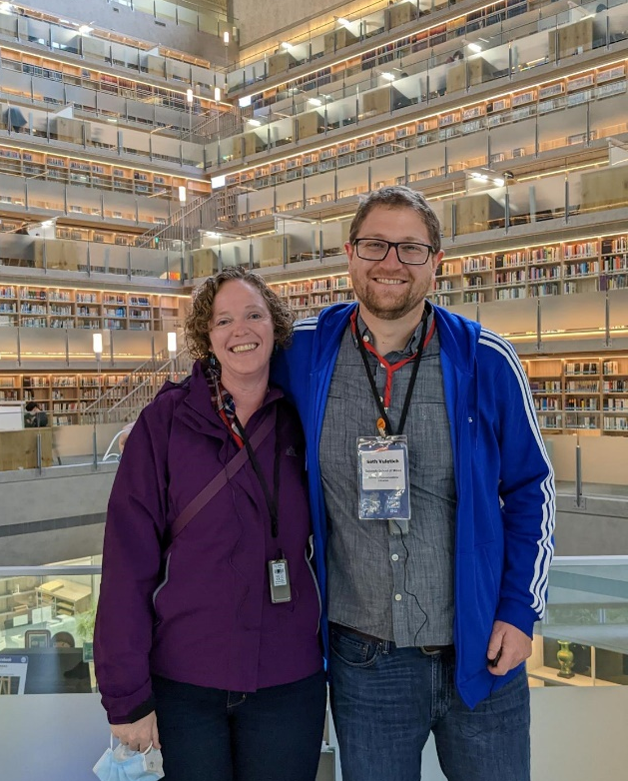

Staying Connected to Taiwan

Slide 9

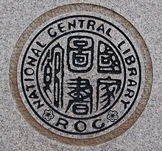

Fulbright and Librarians
Participation from American librarians
Increase knowledge of opportunities
Bring librarians to the US
Connection to Taiwanese Libraries
Learn about practice in Taiwan
Form collaborations

Slide 10


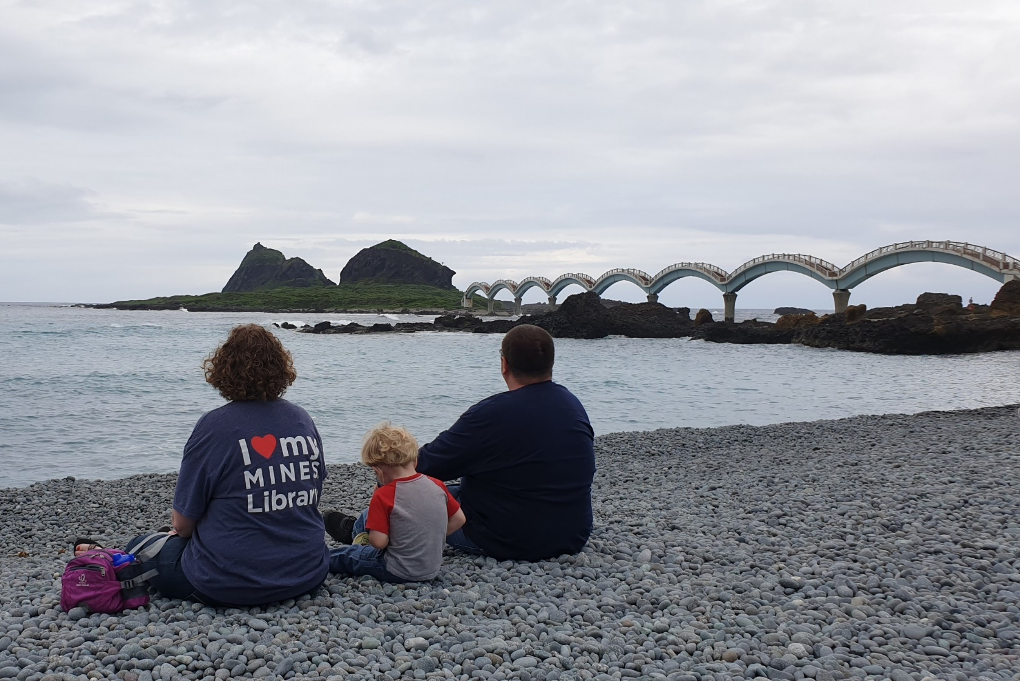
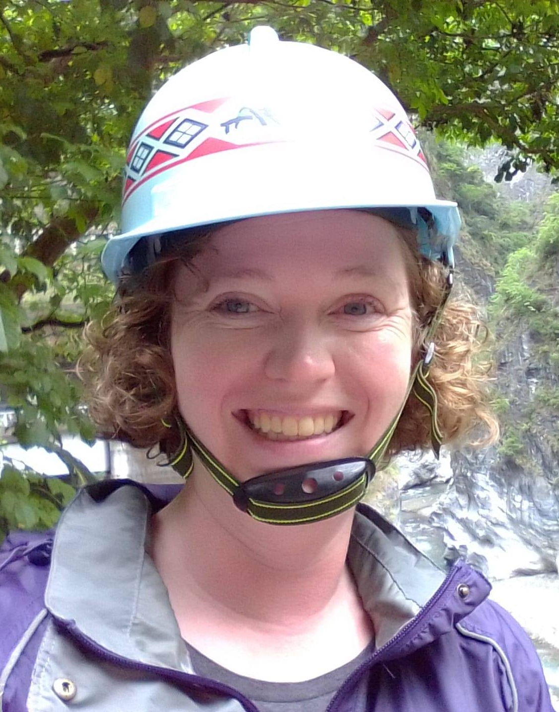

Thank you!
BRIANNA BULJUNG
Teaching & Learning Librarian
bbuljung@mines.edu

