Slide 1


After the Fulbright: Conflict, Resolution, Rebuilding
Axum, Ethiopia
Janet Lee
Better Together: The Power of Global Library Connections, March 7, 2023

Slide 2
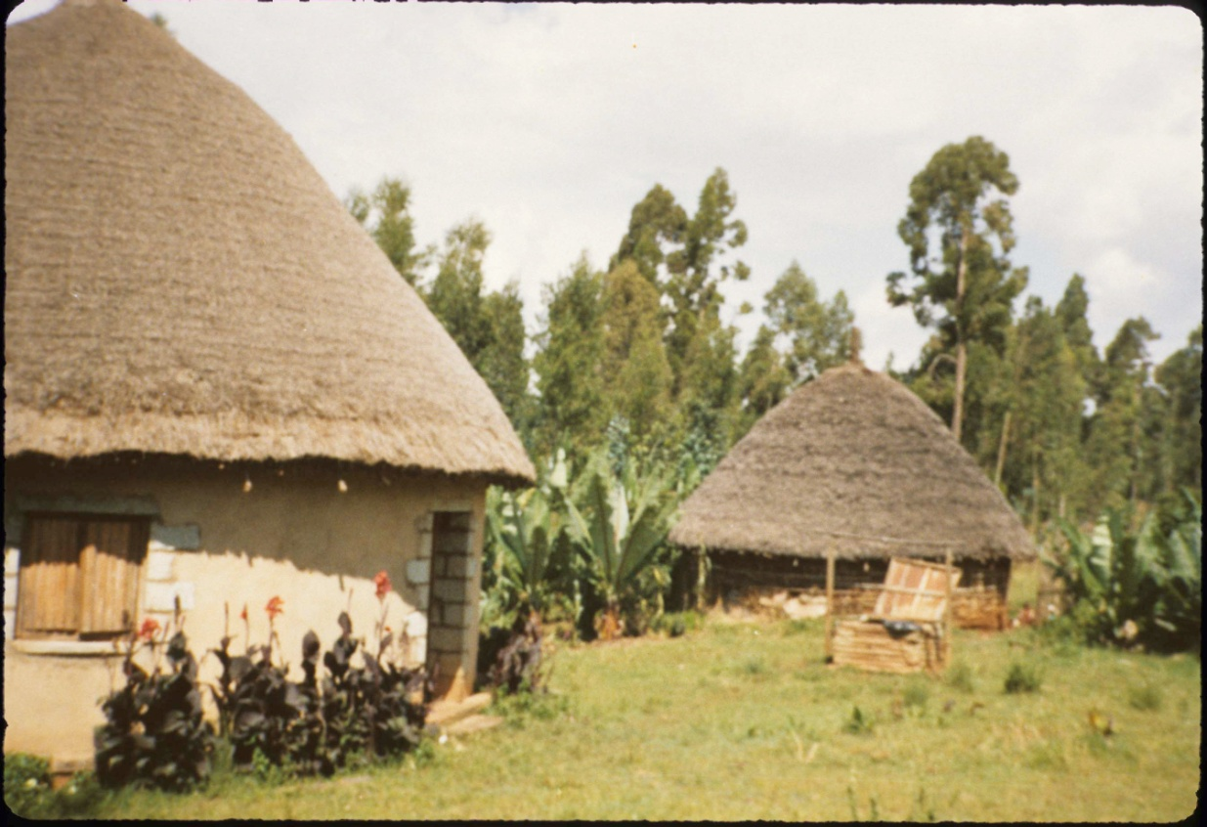
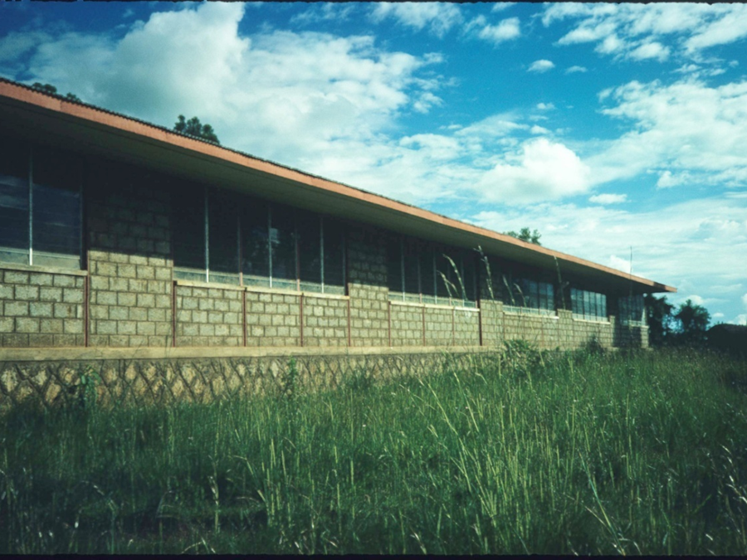
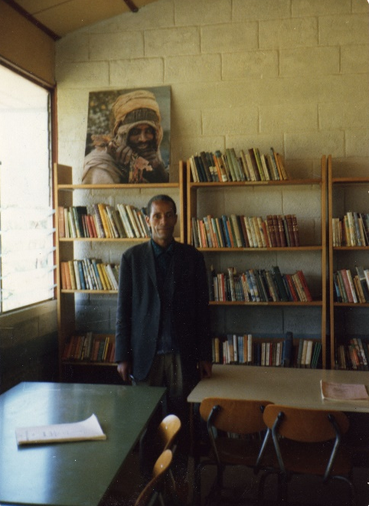
Where it all began
Peace Corps Ethiopia 1974-76
Emdeber, Ethiopia
Haile Selassie I Secondary School
Ato Wolde, the school librarian

Slide 3
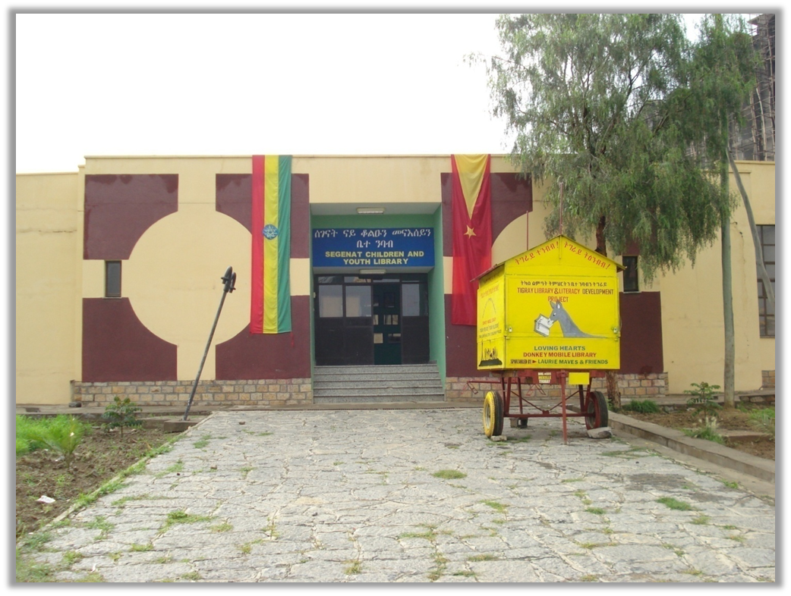
Where it all began
Mekelle, Ethiopia 2010
Five-month Sabbatical

Slide 4
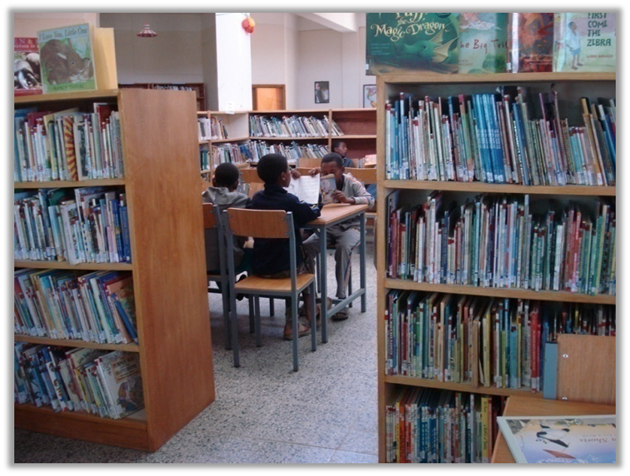
Where it all began
Mekelle, Ethiopia
Five-month 2010 Sabbatical

Slide 5
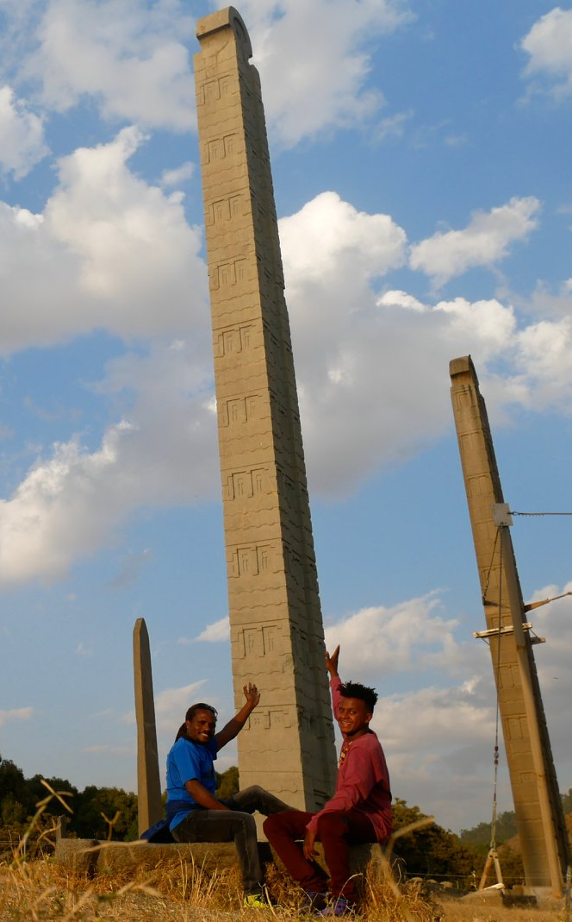
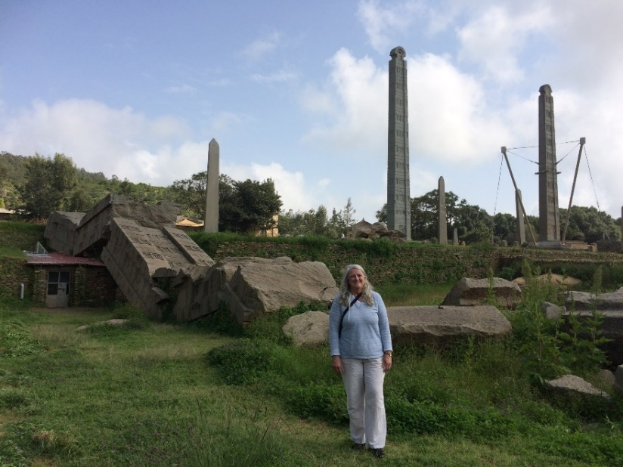
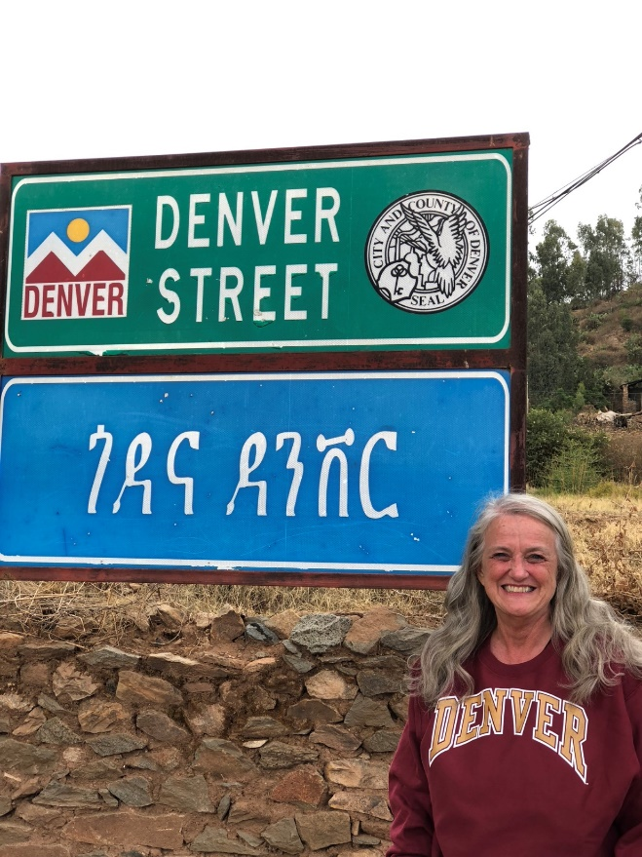
Axum, Ethiopia
2017-18
Stelae fields

Slide 6
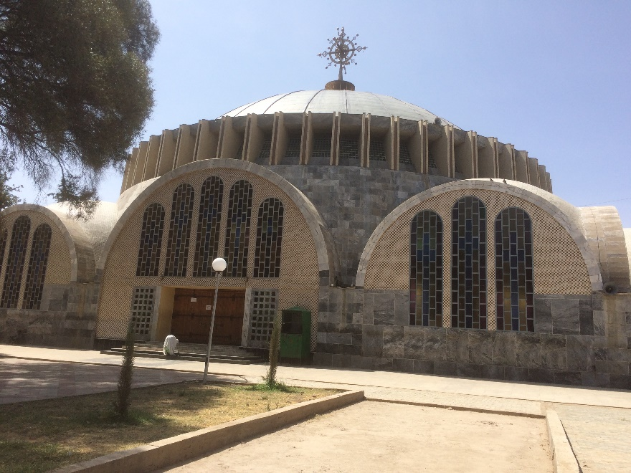
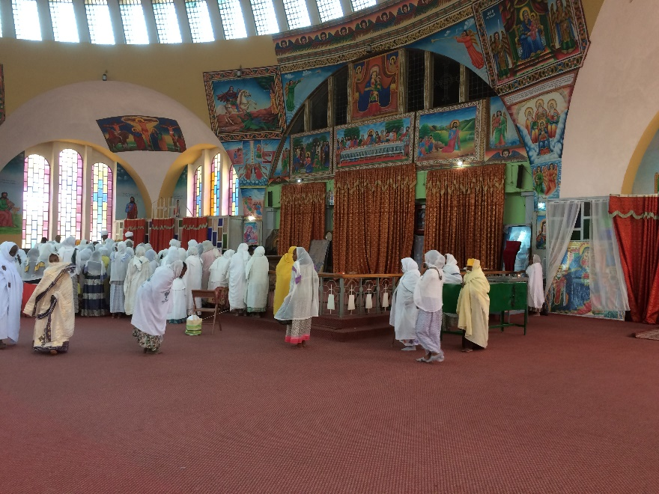
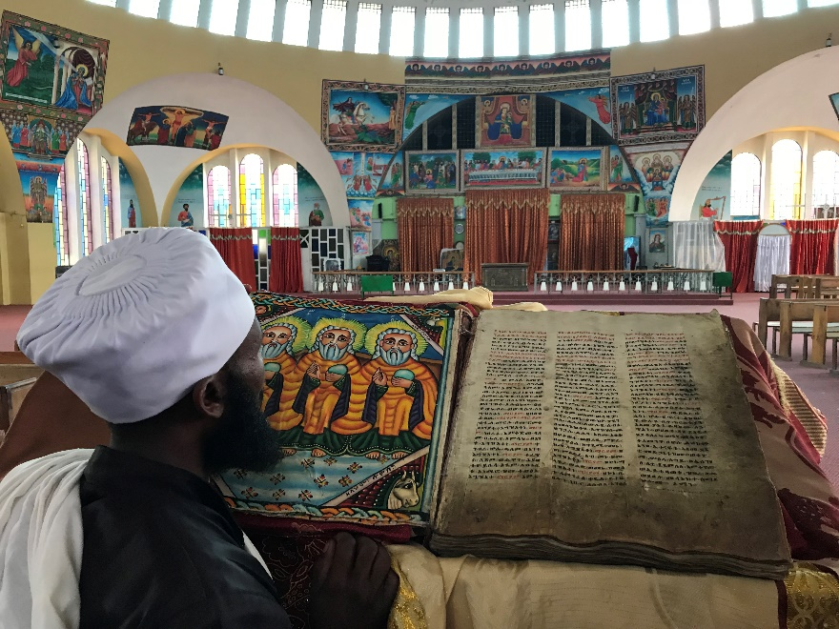
Axum, Ethiopia
St. Mary of Tsion Church

Slide 7
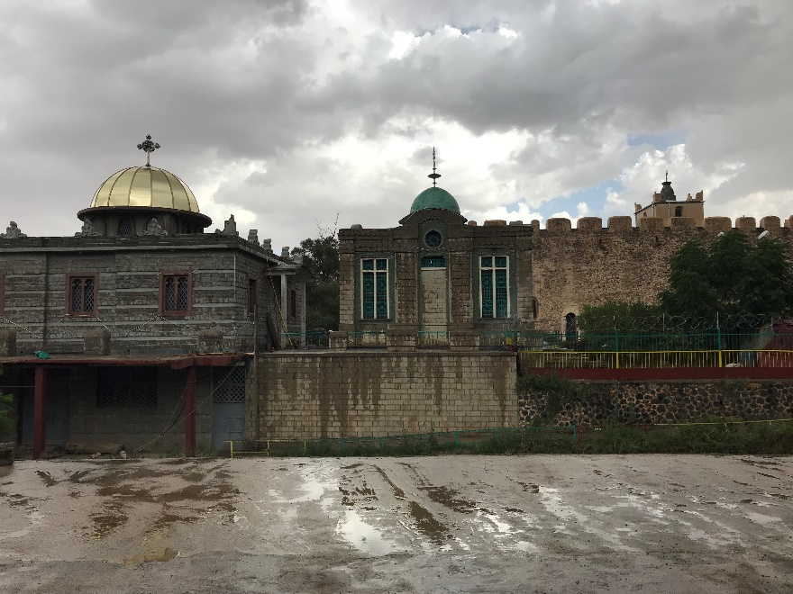
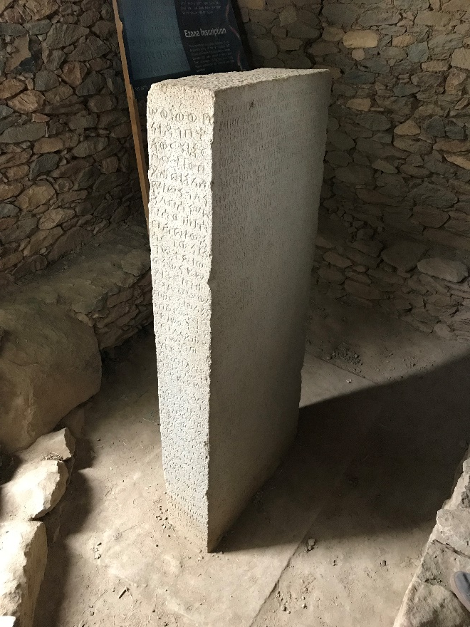
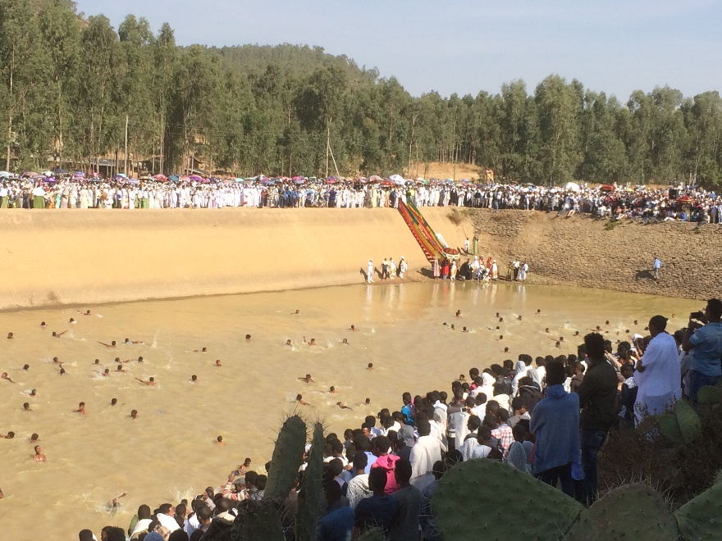
Axum, Ethiopia
Ark of the Covenant
Queen of Sheba baths Epiphany celebration
Ezana stone

Slide 8
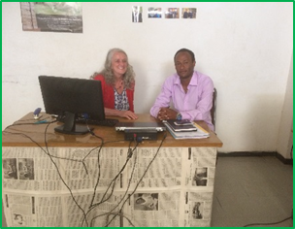
Stated Projects
Open Access Publishing
Koha (Online catalog)
Secondary Projects:
Children’s book publishing
Axumite Heritage Foundation Library
Chromebook Lab
Digital Library Class
With Eskinder Asmelash, IT specialist

Slide 9
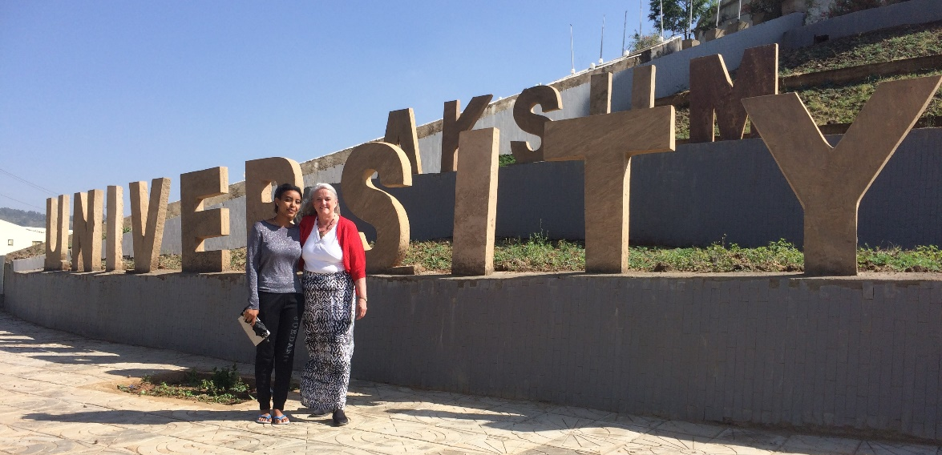
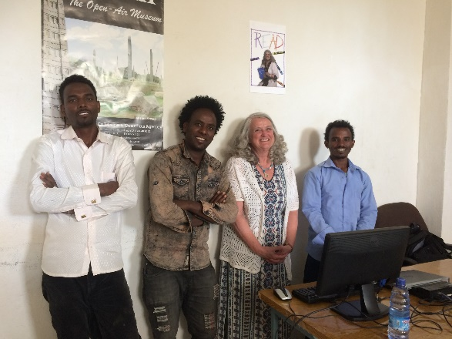
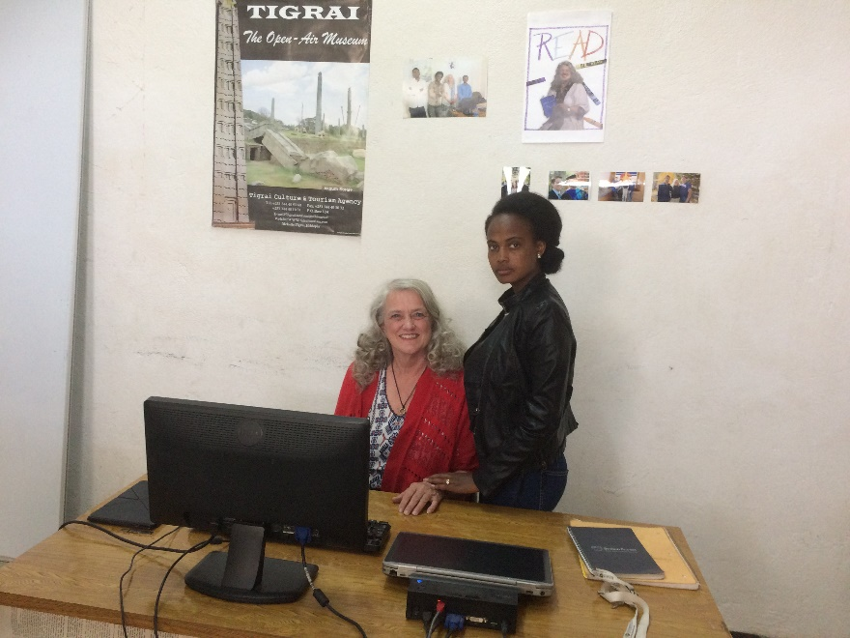
Aksum University, Axum, Ethiopia

Slide 10
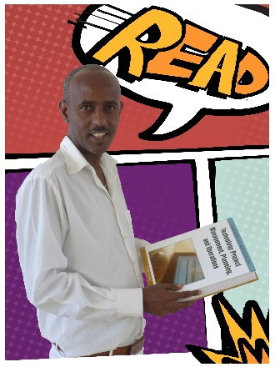
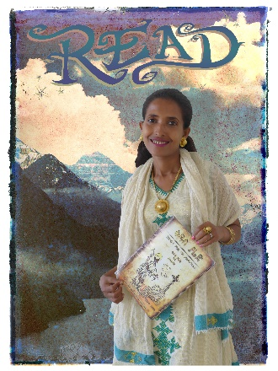
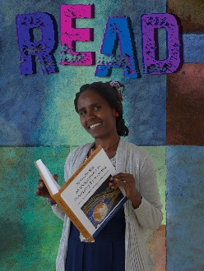
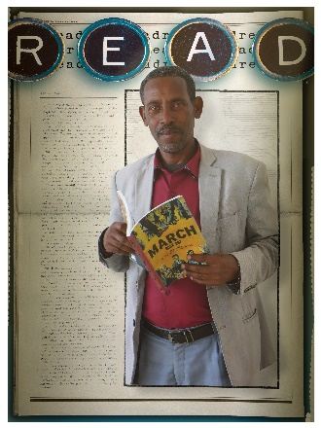
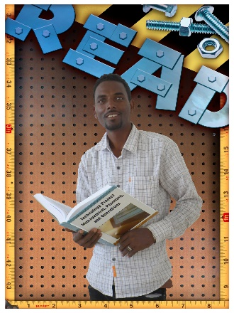
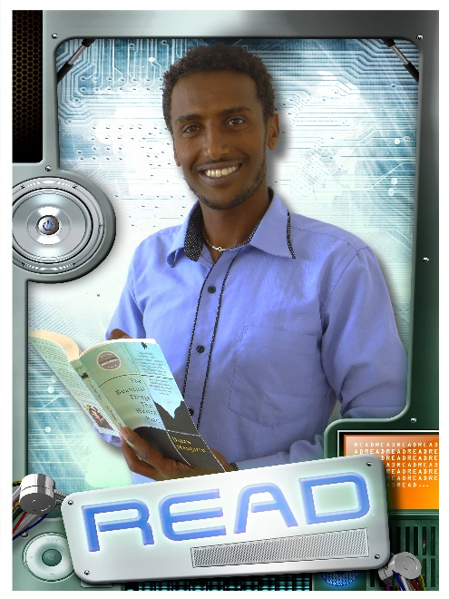
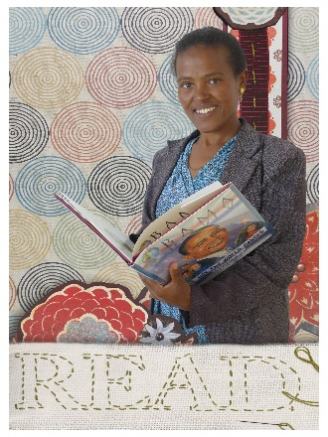
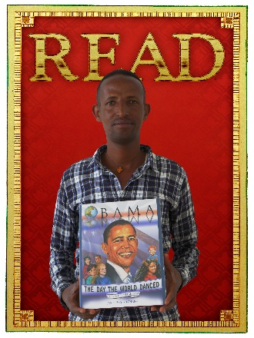
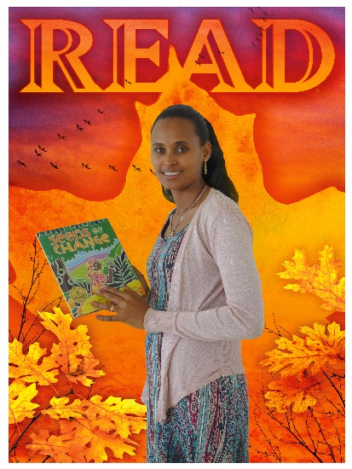
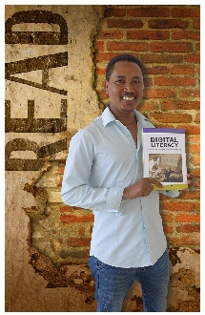
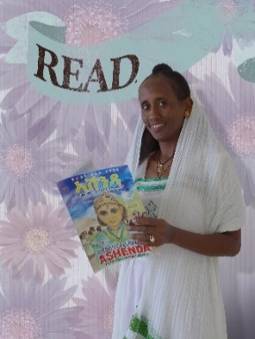
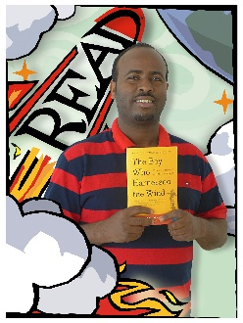
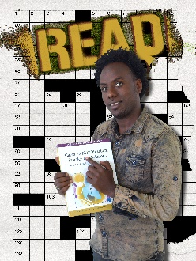
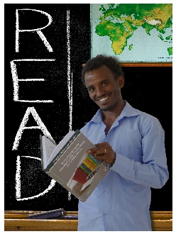
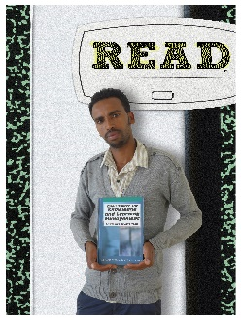
Aksum University

Slide 11
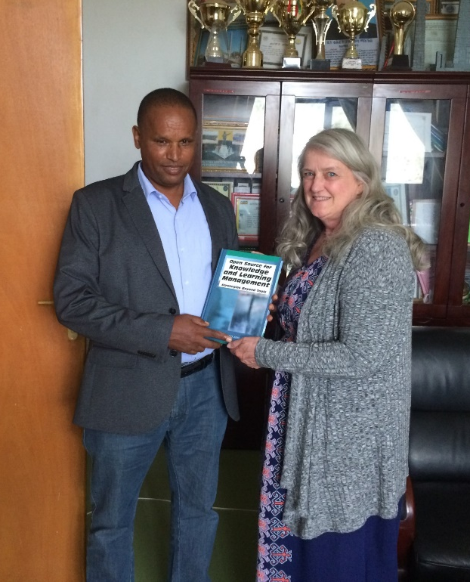
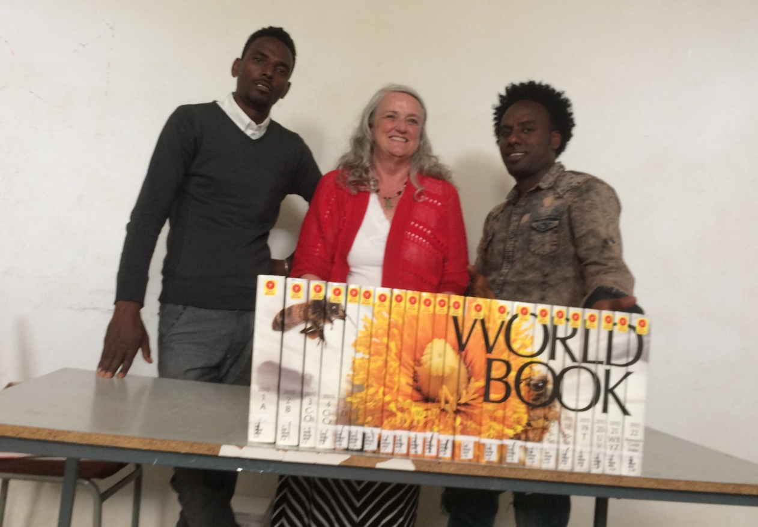
Aksum University, Axum, Ethiopia
Dr. Tsehaye Asmelash, President
Berihuley Kahsay and Gebre/Gereziher Gidey

Slide 12
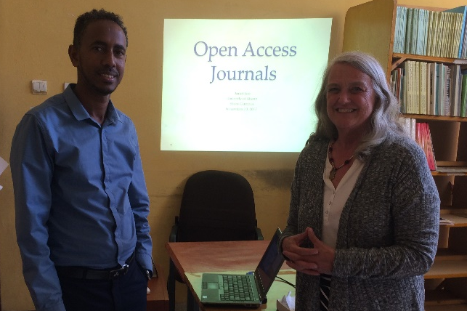
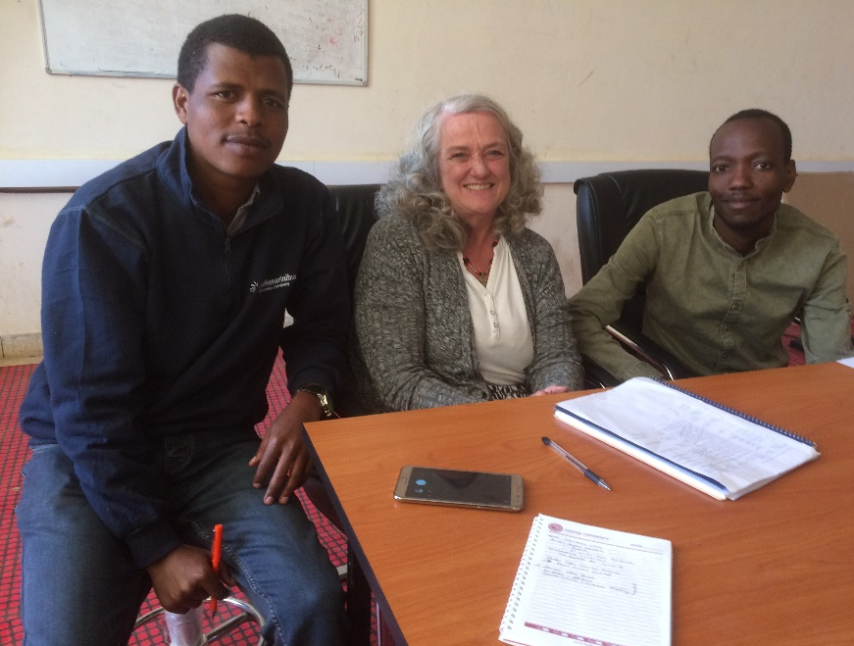
Open Access Journals/Digital Libraries Course
On the Shire campus of Aksum University with faculty Kiros Gebretsadik
At Haramaya University with Tilahun and Zacharias

Slide 13
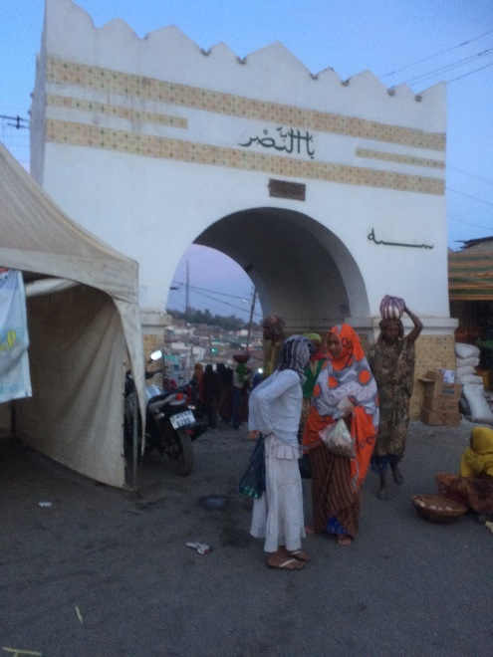
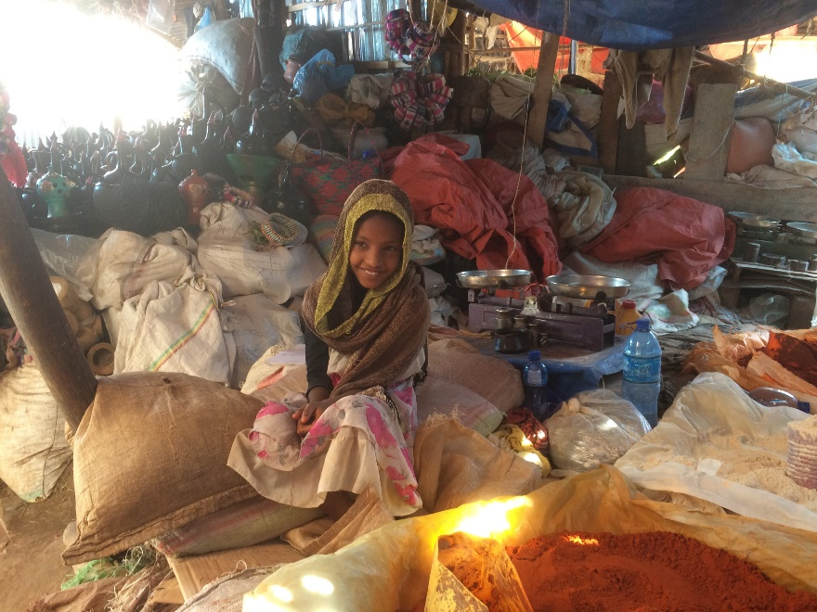
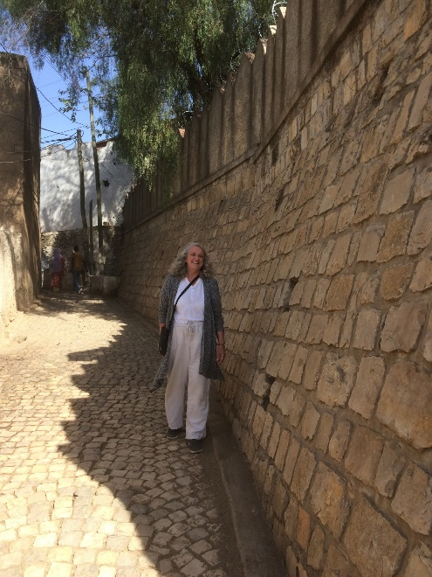
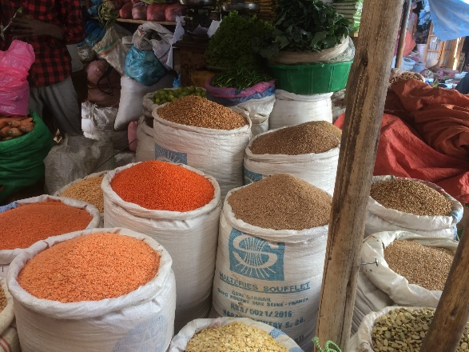
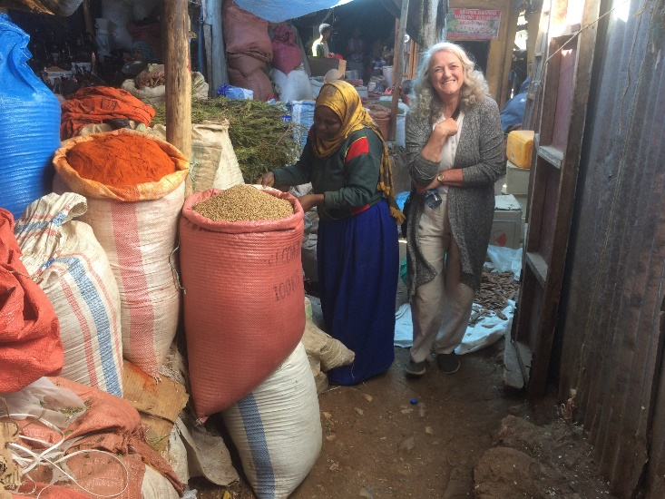
All work and no play
A side trip to my old Peace Corps training site in Harar

Slide 14
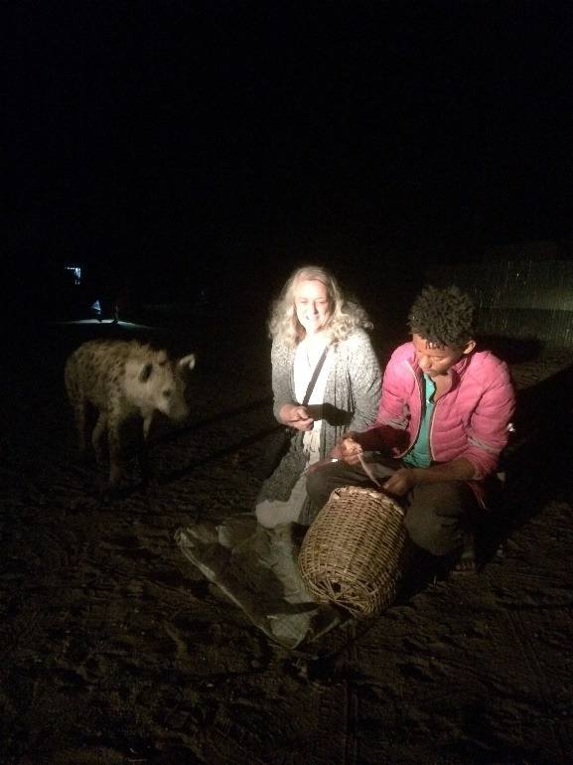
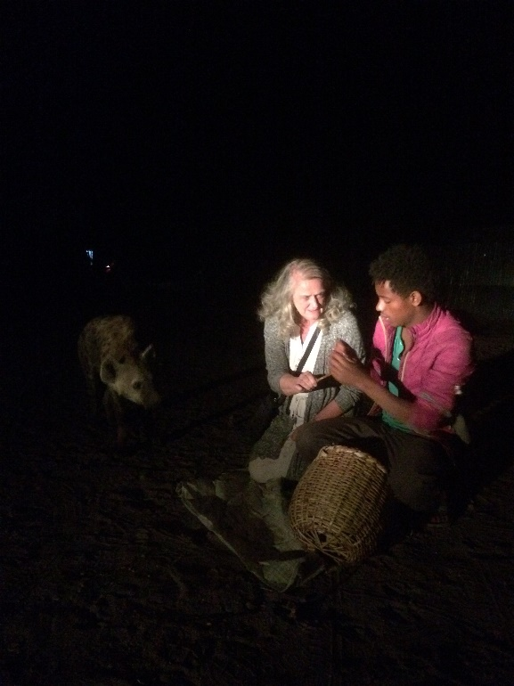
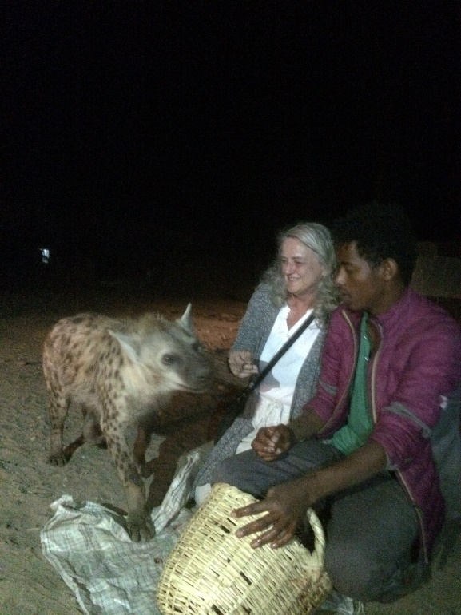
All work and no play
A side trip to my old Peace Corps training site in Harar

Slide 15
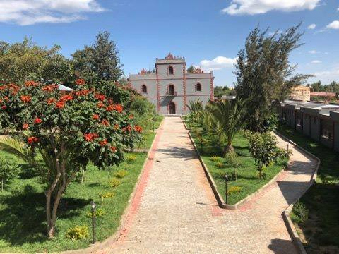
Axum Heritage Foundation Library
Former library in the old Governor’s Palace

Slide 16
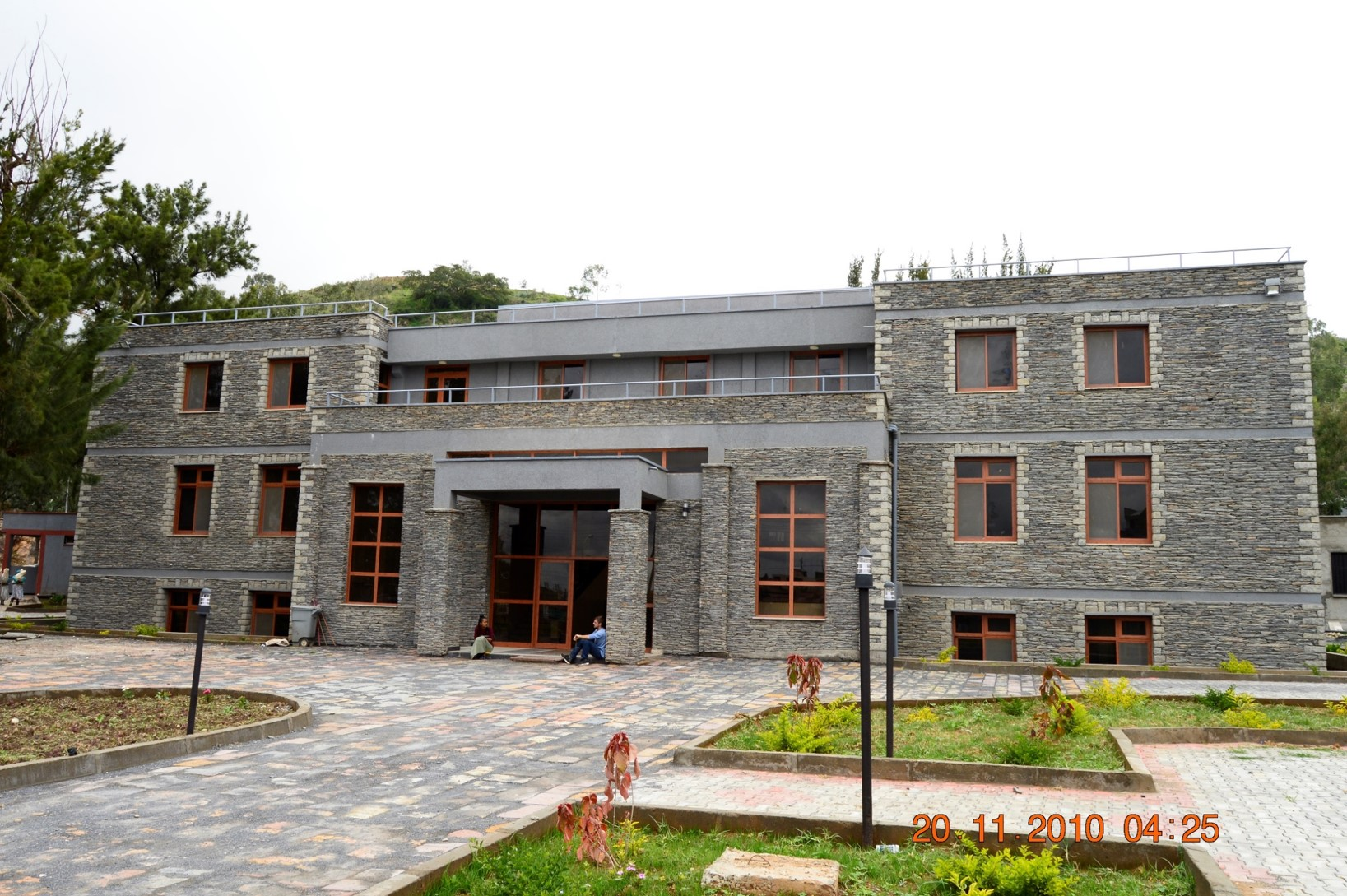
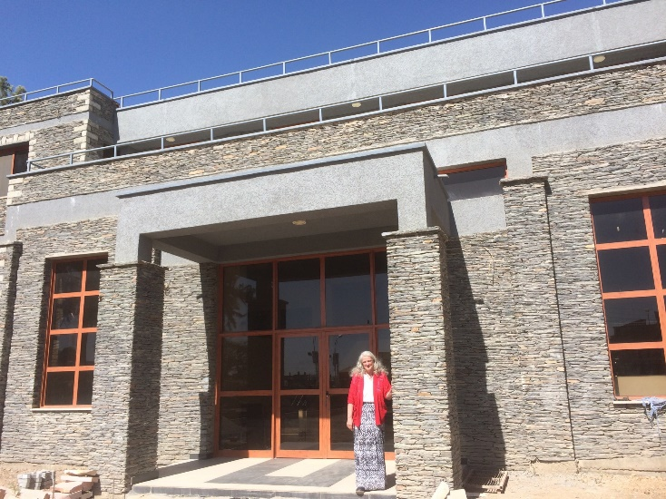
Axum Heritage Foundation Library

Slide 17
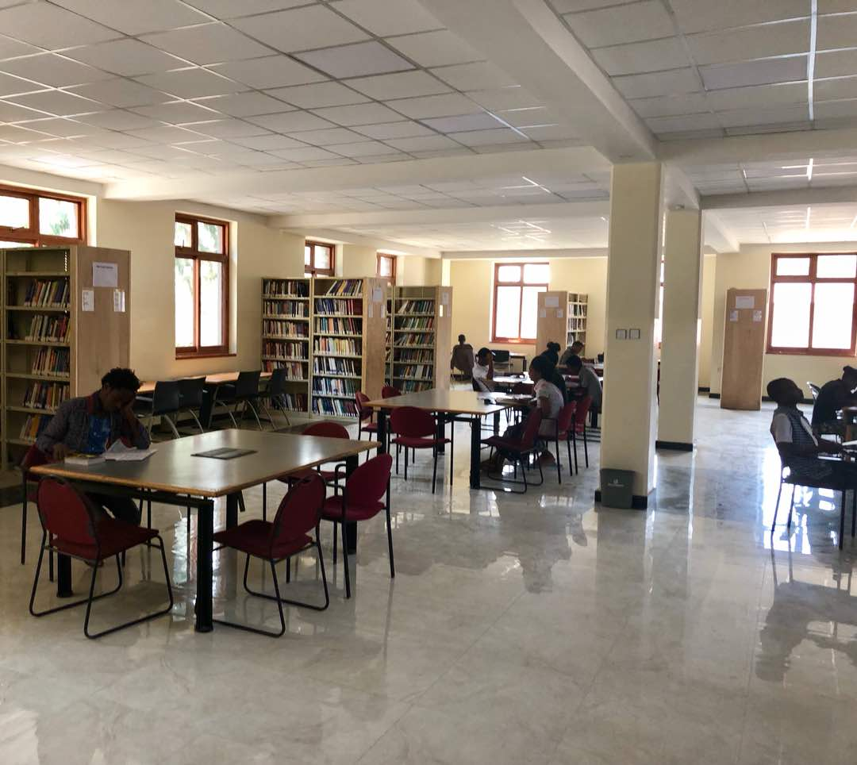
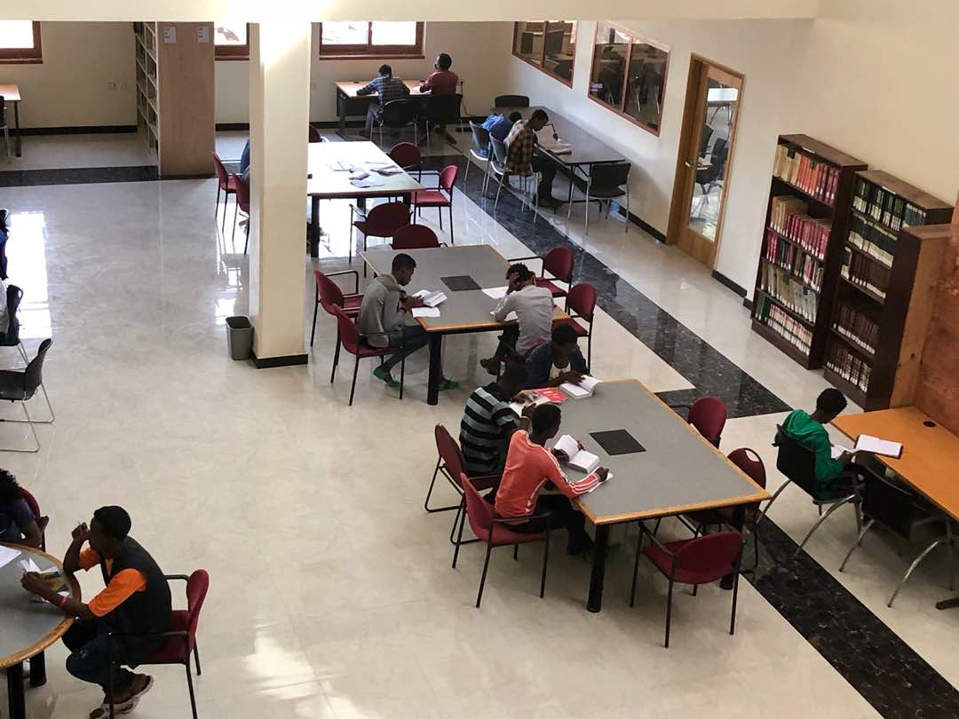
Axum Heritage Foundation Library
Great reading room

Slide 18

Axum Heritage Foundation Library
Children’s Library funded by Ethiopian Returned Peace Corps Volunteers Legacy Grant

Slide 19


Axum Heritage Foundation Library
Auditorium

Slide 20



Axum Heritage Foundation Library
Chromebook Lab. Self-funded, funded by an ALA IRRT Mission Enhancement grant and by fellow Ethiopia RPCV.
With Ashenafi Kebede

Slide 21



Axum Heritage Foundation Library
Chromebook lab/RACHEL server: Entire Ethiopian school curriculum; Khan Academy and numerous OER textbook databases.

Slide 22

African Storybook Project
With a grant from the Colorado Association of Libraries International Library Cultural Exchange-Interest Group
http://africanstorybook.org

Slide 23


African Storybook Project
http://africanstorybook.org
236 languages
3713 storybooks
7218 translations
Ethiopia has over 80 languages and dialects
Amharic 132 stories in the collection
Afaan Oromo 44 stories in the collection
Tigrigna 32 stories in the collection
Creative commons license
Translate with attribution
Read online
Read on a device
Print landscape as pdf
Print vertical as a storybook

Slide 24


African Storybook Project
Mezemir Girma in Debri Berhan: Ras Abebe Aregay Library & Bookstore
Dorcas Wepukhulu, African Storybook Project founder, at Adama Science and Technology University.

Slide 25

Peaceful Transitions
His Excellency Prime Minister Abiy Ahmed receives flag from His Excellency Prime Minster Hailemariam Desalegn

Slide 26



Denver Community

Slide 27

Protests

Slide 28



Protests

Slide 29




Reaching Out for Support
Mayor Wellington Webb, Rep. Jason Crow, Mayor Michael Hancock, Rep. Joe Neguse.

Slide 30


Rebuilding
PS. You’re Here. Art in the park grant. Basketball court.

Slide 31




Aksum University Library

Slide 32




Refugee camp in Sudan

Slide 33


Best Emerging Technology Application Award
sponsored by Chatstaff and LibraryH3lp
Presented to Janet Lee and Dr. Tegest Hailu for the
Kindle Early Language Learning Project in Hasheba Refugee Camp in Sudan. $3,000 Award.
Reference and User Services Association. Emerging Technology Section of the American Library Association

Slide 34

Never forget

Slide 35

Never forget

