Slide 1
From Curtains to Bridges
Jamie LaRue, Executive Director, jlarue@gcpld.org
Garfield County Public Library District
970-625-4270 x 2125

Slide 2
The Journeys
2004, Bulgaria - Sofia and Dobrich
2012, Russia - Moscow and Nizhniy Novgorod
2014, Bulgaria again - Sofia only
2017, Norway - Oslo

Slide 3
Bulgaria

Slide 4
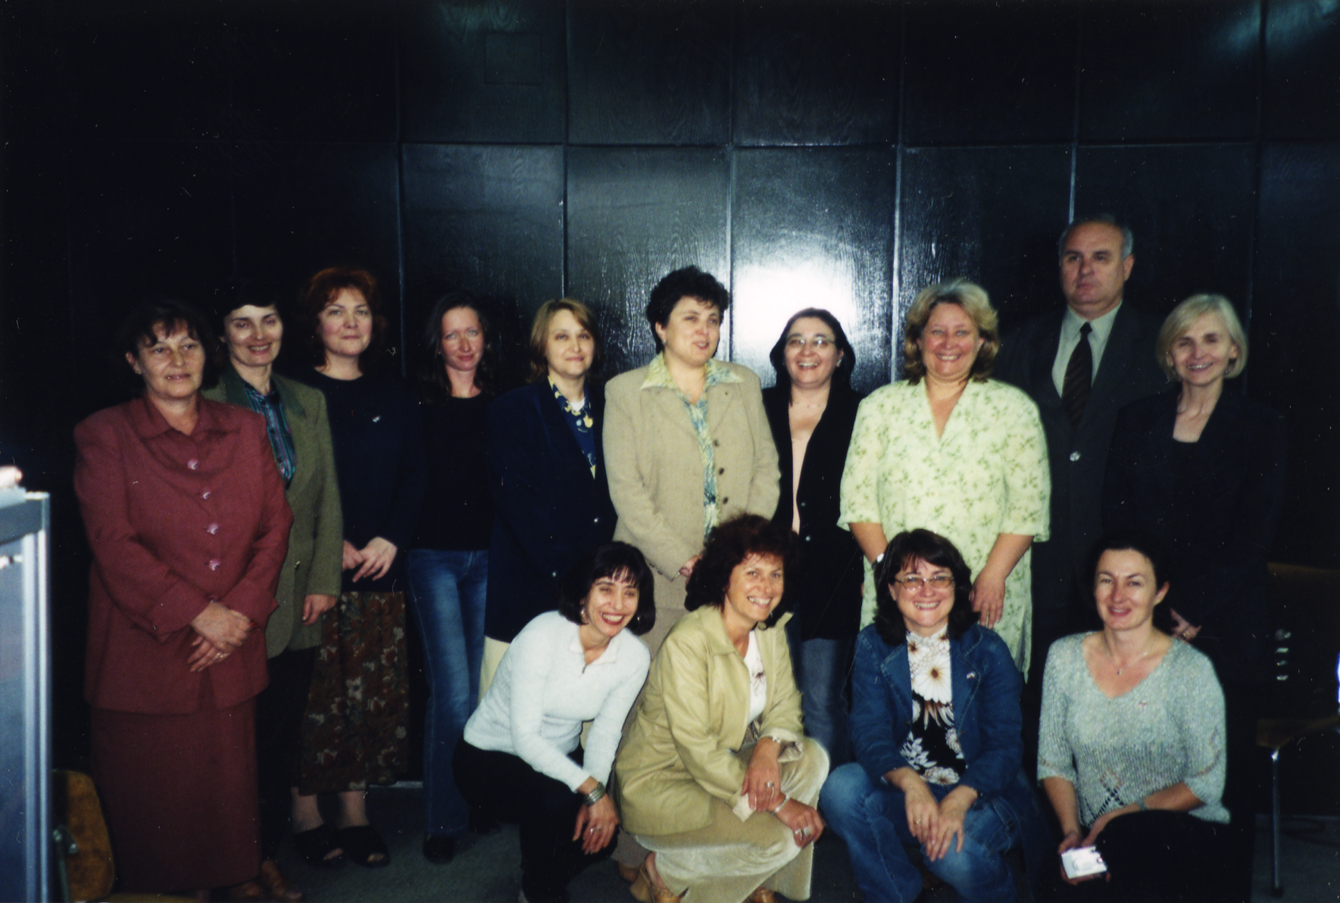
Attendees of workshop on Community Information, Sofia
Collapse of Soviet Union
Distrust of propaganda
Idea of reaching out to community
Notes:
Collapse of Soviet Union
Distrust of propaganda
Idea of reaching out to community

Slide 5
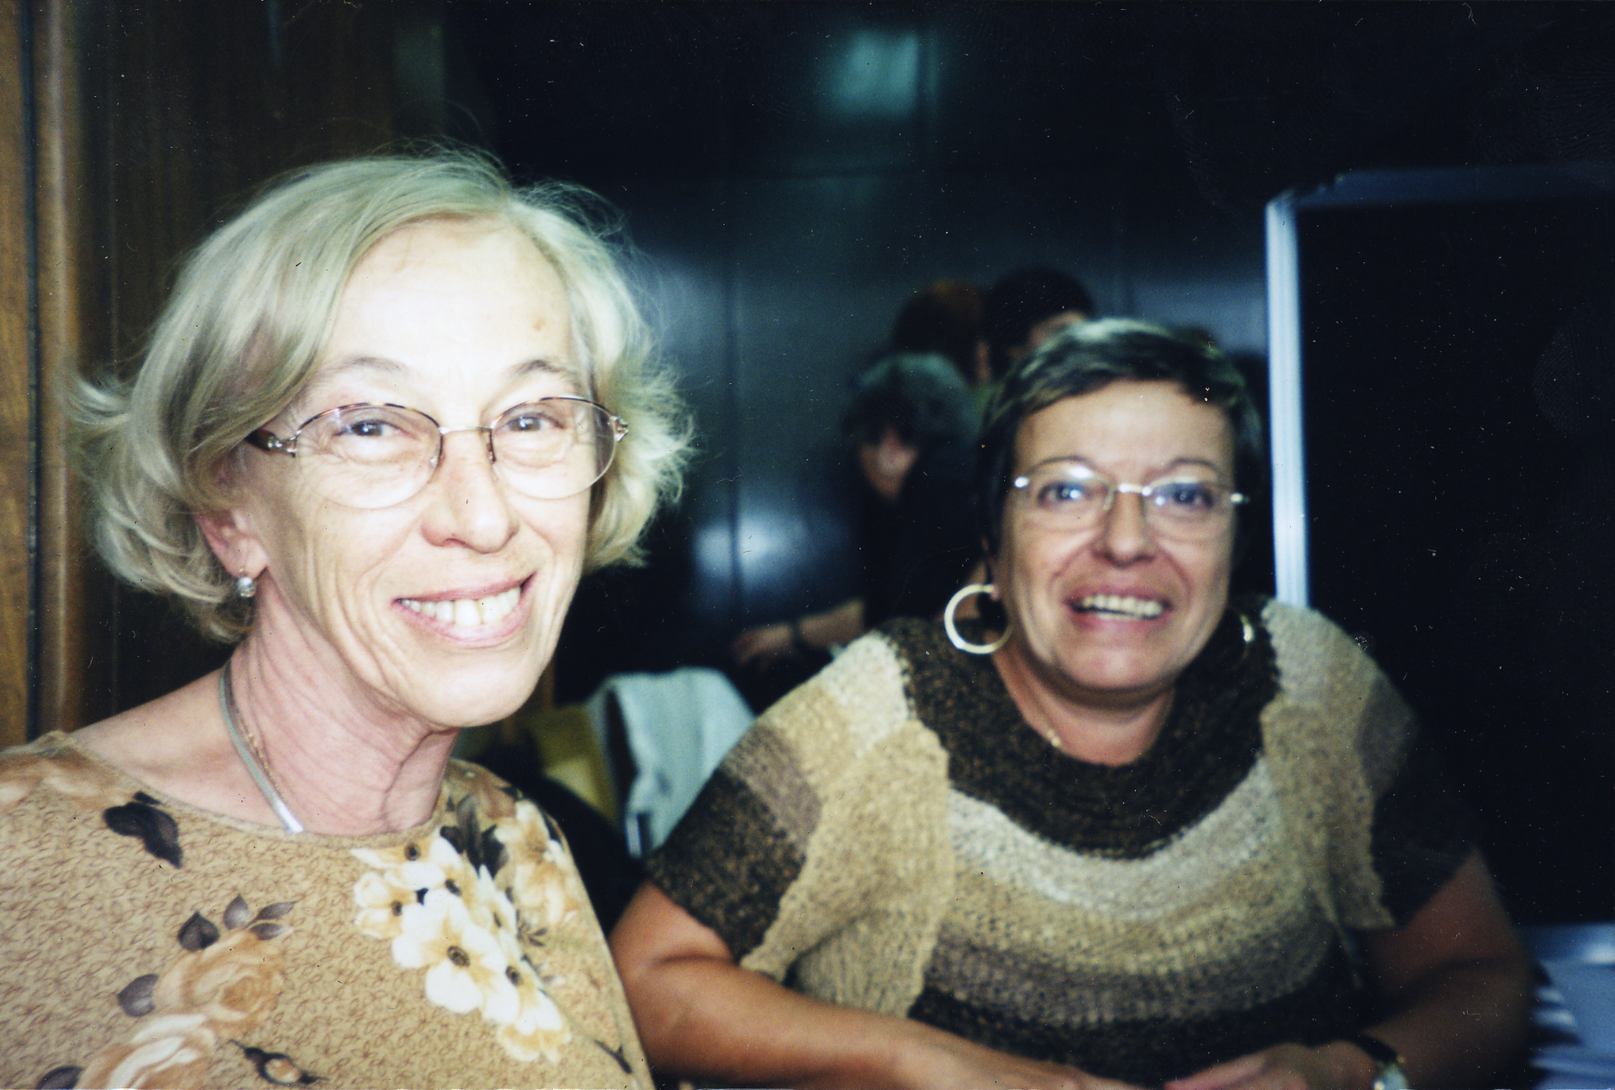
Translators
How to tell a joke through a translator
Humiliation of the soul
Notes:
Translators
How to tell a joke through a translator (get shorter)
Humiliation of the soul

Slide 6
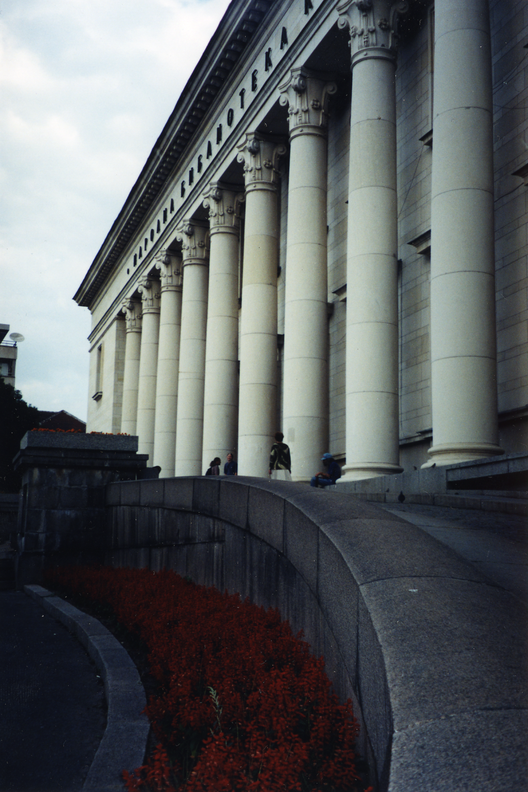
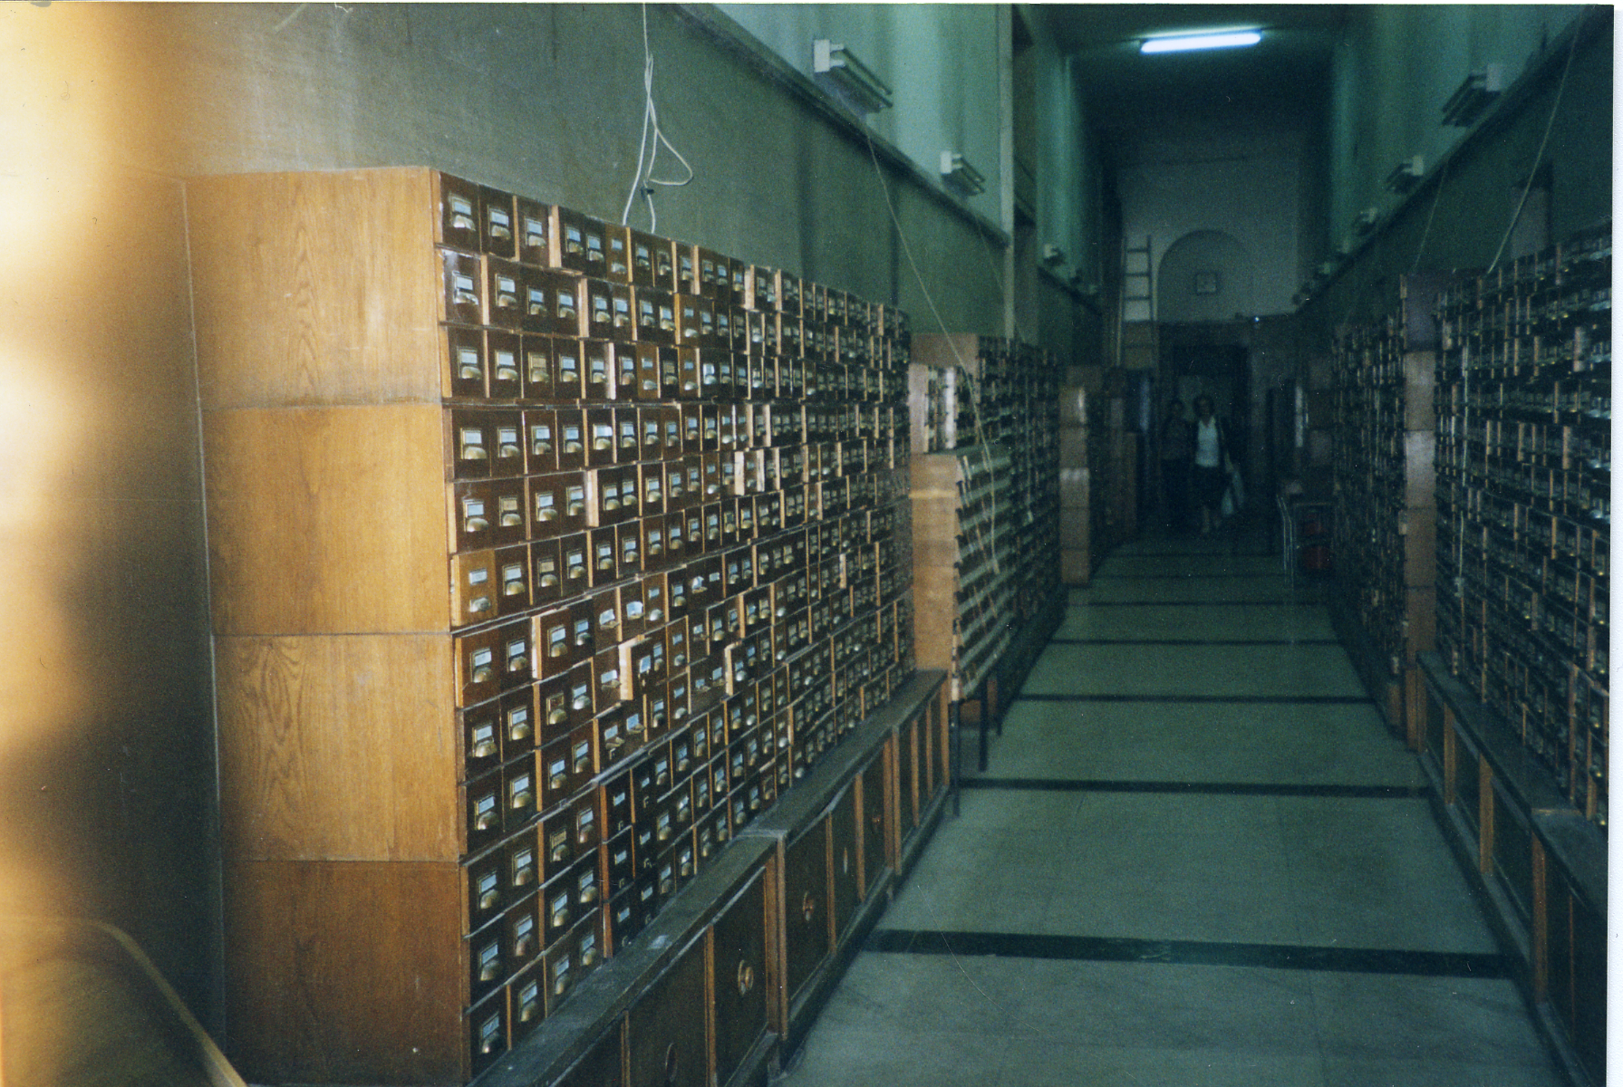
National library: Saint Cyril and Saint Methodius
Notes:
Bulgarian state library

Slide 7
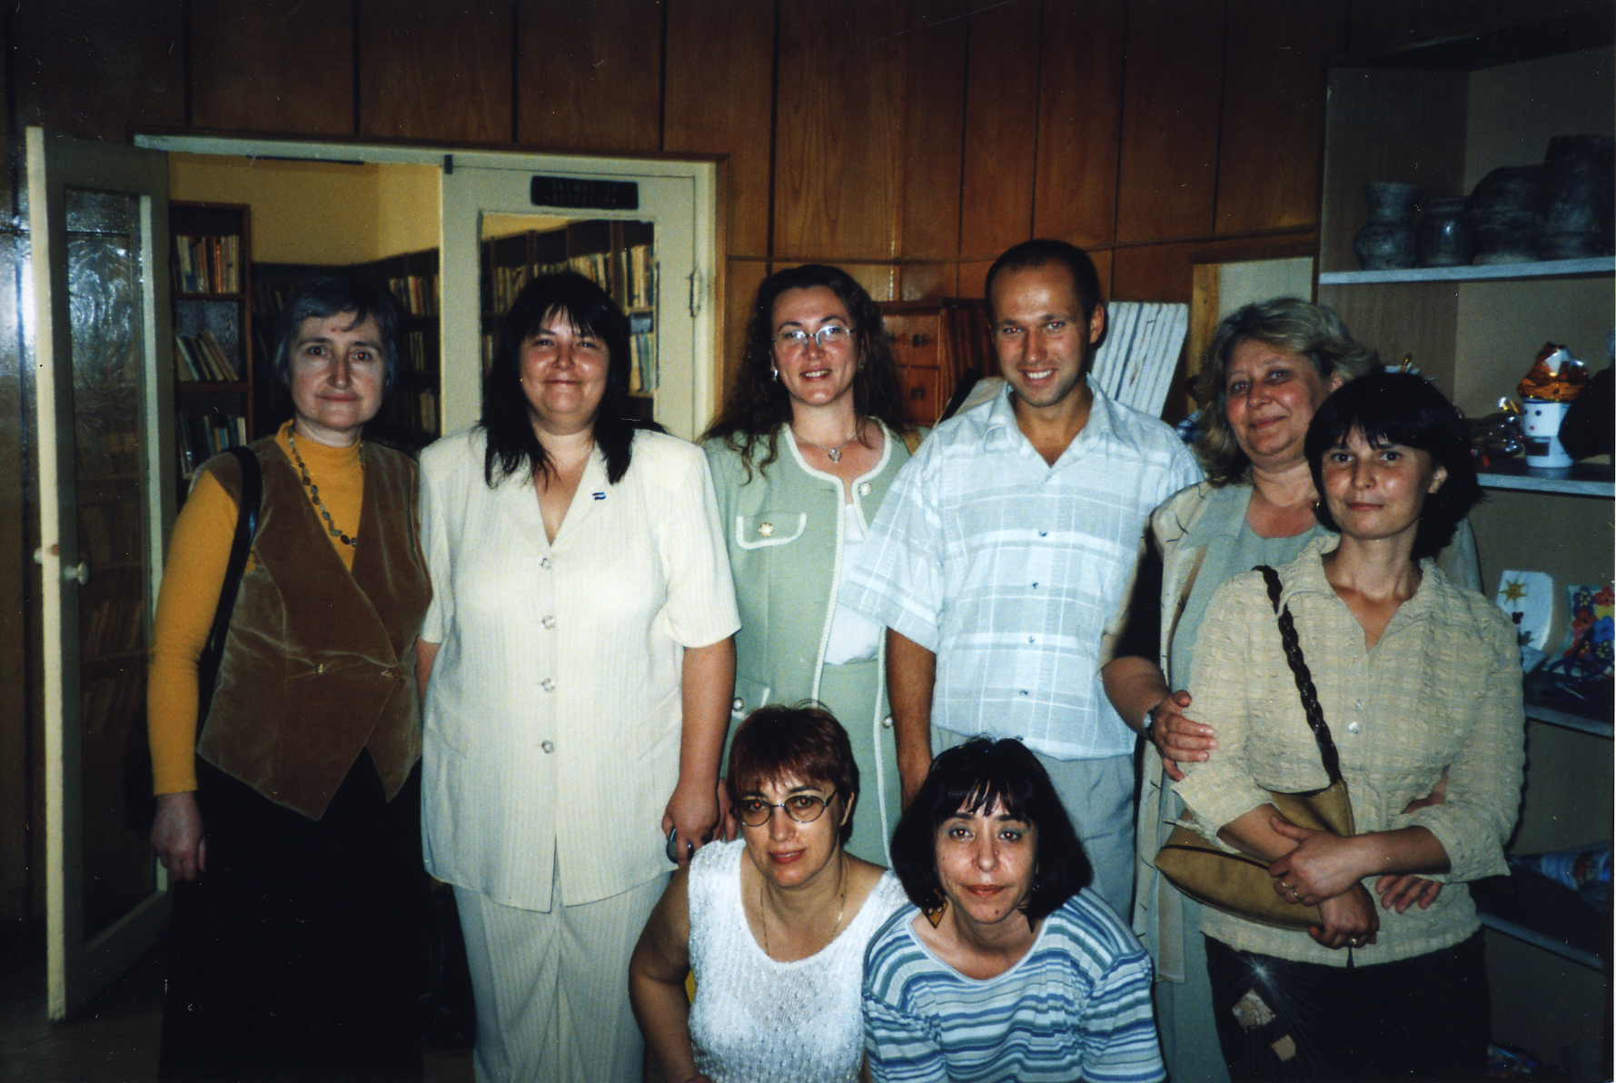
The “cultural center” - chistalistes
Notes:
Chistalista - cultural center with activities and children’s services

Slide 8
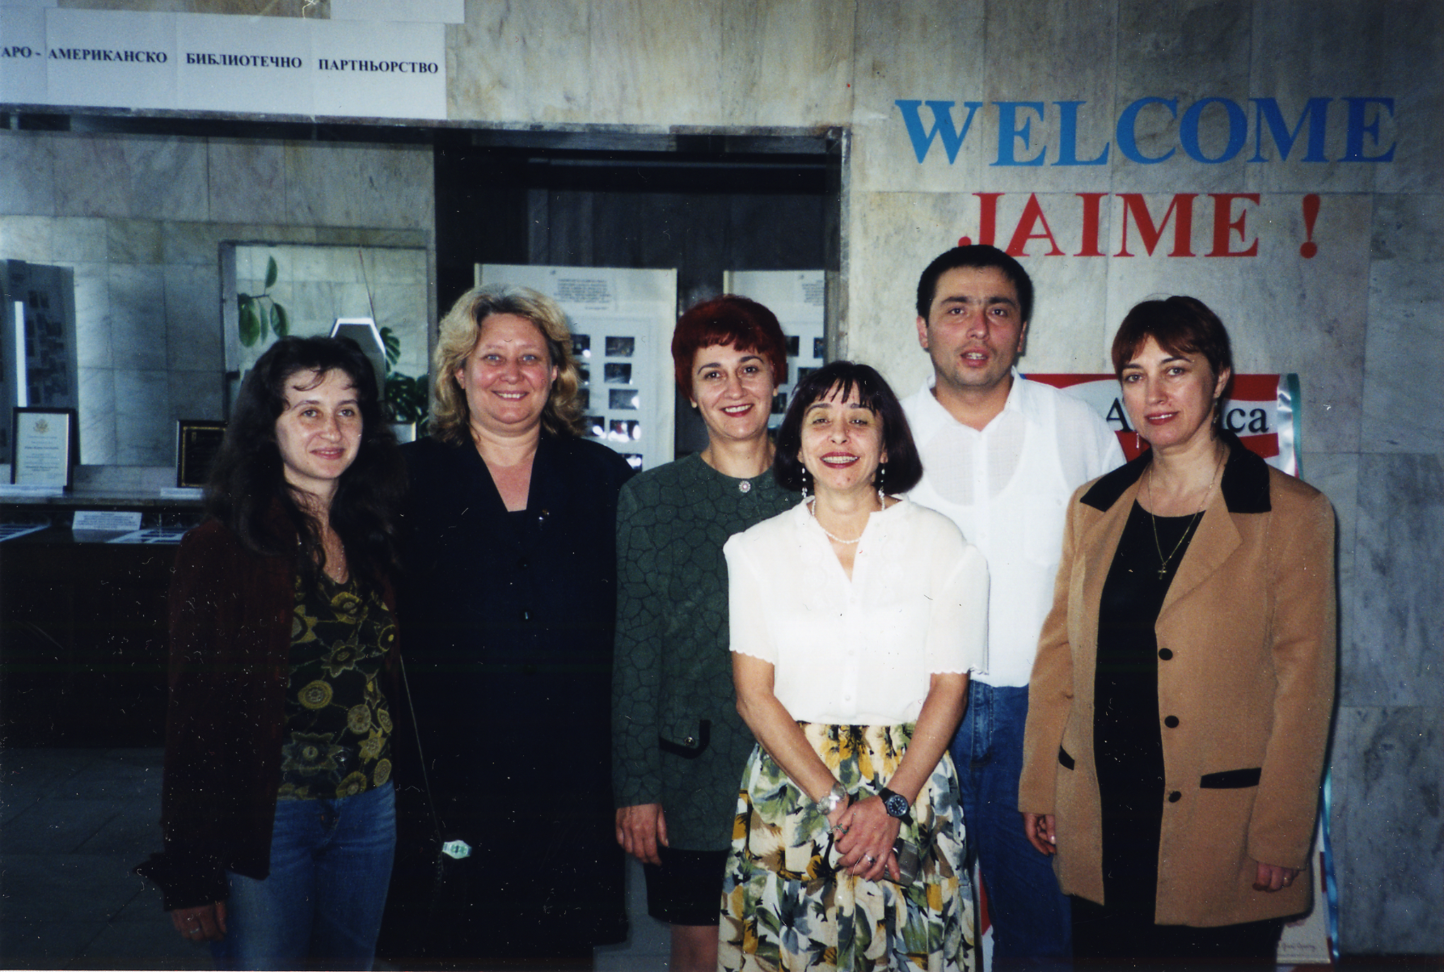
Dobrich Library
Former site of the Communist Party
Small rooms, lots of staff
Shadowed Elena
Great dedication and warmth
Notes:
The Dobrich library - formerly the Communist Party headquarters. No purpose built libraries in the nation.
Small rooms, lots of poorly paid staff, dated collections, poor building repair
Shadowed for several days, attended meetings
Great enthusiasm and insight, dedication. Administration issues always the same.

Slide 9
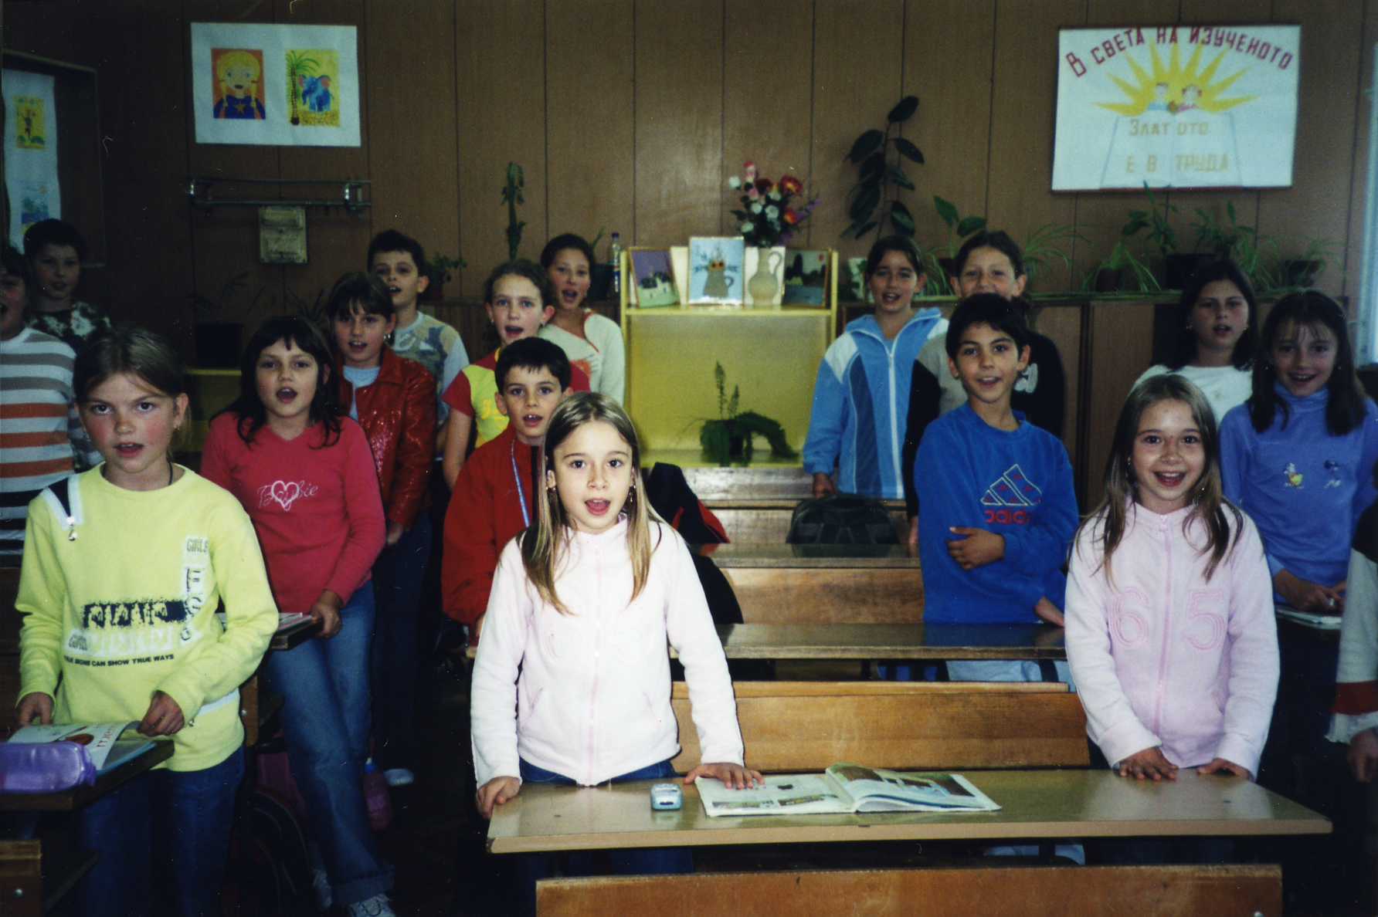
The Embassador with Emerald Shoes
(A school room with students)
Notes:
With Elena Yurchenko, then director of the Dora Gabe Library in Dobrich, and thanks to Nikolai, my translator, I was able to meet representatives of the Mayor’s Office, the Rotary, the Bulgarian Red Cross, the Chamber of Commerce, and a local elementary school. I also enjoyed a visit to the Black Sea, and the National Library in Sofia. One of the many library luminaries we met was Snejana Ianeva. Her extraordinary work as Director of the Information Resource Center at the US Embassy in Sofia and the President of the Bulgarian Library and Information Association set the stage for Bulgaria’s first National Library Week. Sneja was a passionate and dedicated advocate for literacy and libraries. Her efforts not only took important steps to highlight the importance of the library in Bulgarian society, but she also cultivated and maintained many international friendships.

Slide 10
2 local visits
Bulgarian librarians visiting Colorado
Ertan, IT professional, worked with us for a few weeks

Slide 11
Findings
We take for granted our currency, modernity
Hard to change a brand: focus on the past, propaganda, repository of books
Focus on children = focus on the future
Lecture with library students
  A history that stretches to 6500 BC
  Rate of change (marginalized groups)
Funding structures
Larger political settings: capitalism, EU, crime and corruption
But librarians are the same the world round

Slide 12
Russia
Book festival - huge interest and demand
Ebooks (theft and display)
Intellectual Freedom: at state level, very prescribed what must be collected and saved. Pussy Riot arrests. Proscribed topics: terrorism.
Journalists: convergence of state, religion, crime, rising anti-American sentiment
But translator comments about Americans
Youth library (13-30) with daycare and gym in basement
Notes:
Next was an embassy car ride to the Russian State Library for Young Adults. The director (I don't seem to have her name) was remarkable. This library was a delight: modern, wired (and wireless), it is dedicated to youth ages 13 to 30. It was set up as a series of maybe 400 sf rooms. One was dedicated to a cafe experience. One a viewing station with benches and pillows. Another a listening station to older vinyl. One was a science collection. Another, art. One room was dedicated to the history of printing, and included several books (in cases) printed before the founding of the USA. They do have history. One room for comic books and manga. One space (with books and chairs) for small children, either of staff, or visiting siblings of the youth). I have to say that this really worked - a collection and staff really focused on one age group might be very effective not just in Russia.

Slide 13
Bulgaria Part II
From Slavic roots to EU
English language instruction
Persistent problems of funding and visibility
Rising crime
Notes:
Beavis and Butthead

Slide 14
Norway
Multilingual
State support for Norwegian - even poets!
An intellectual freedom difference

Slide 15
Reflections
So grateful for opportunities
So impressed with Foreign Service, State Department
Hard to maintain ties, regular communications
Much to learn from each other
Warm encouragement to travel and to host

