Slide 1
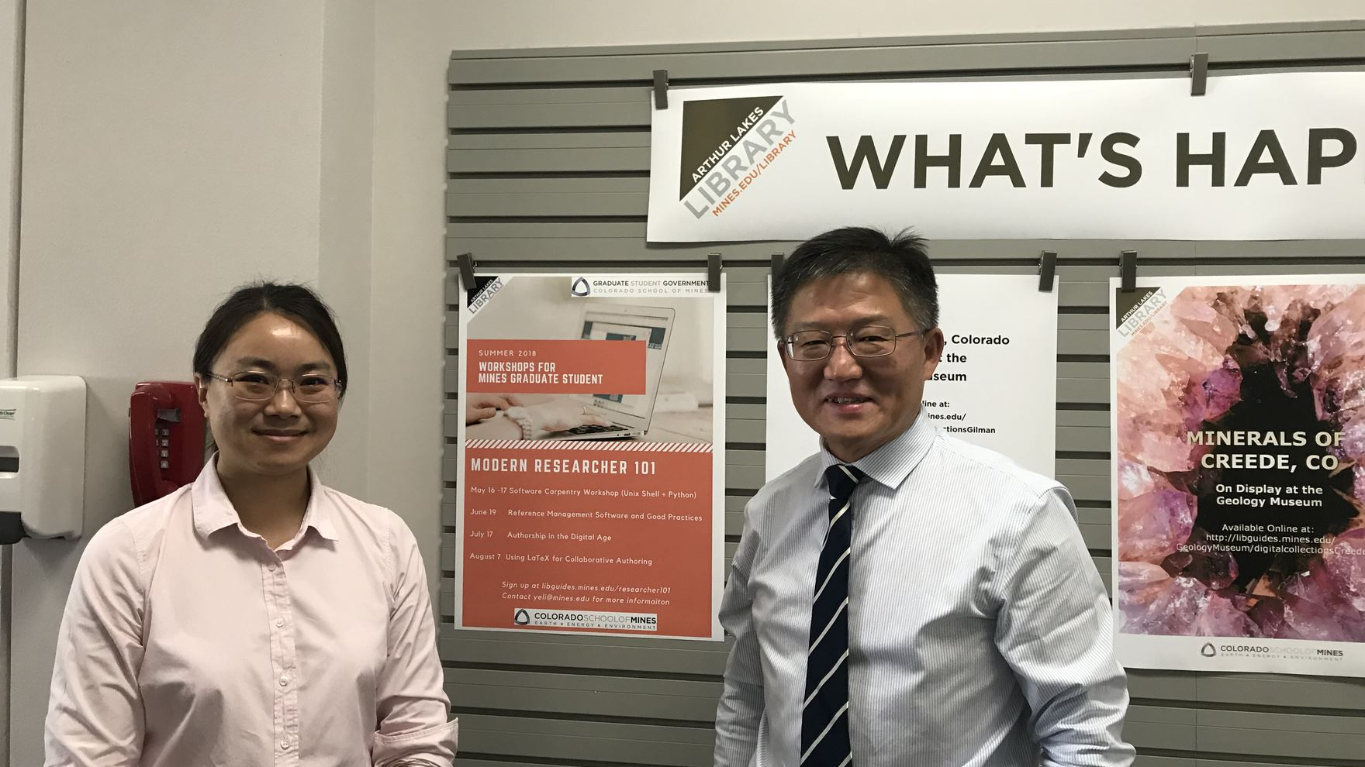
July 11, 2018: Touring the Arthur Lakes Library

Slide 2
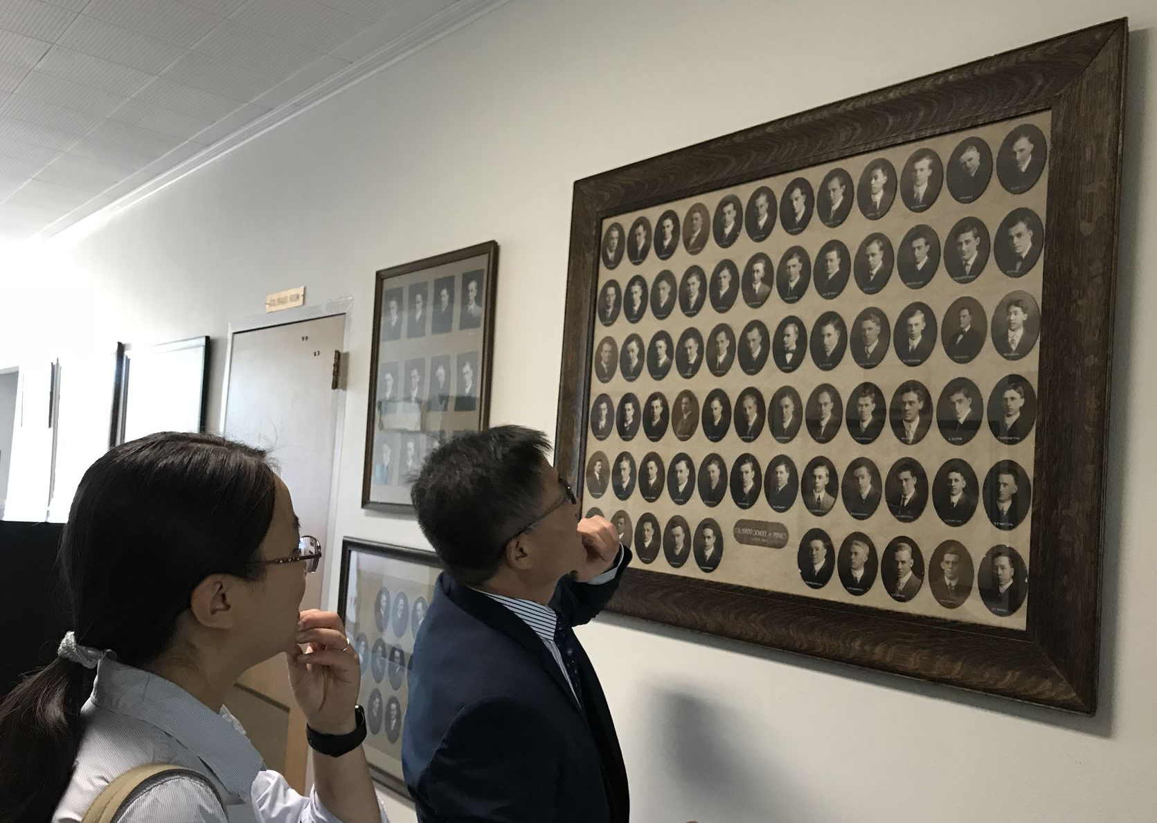
July 11, 2018: Learning about early Chinese students at the Colorado School of Mines

Slide 3
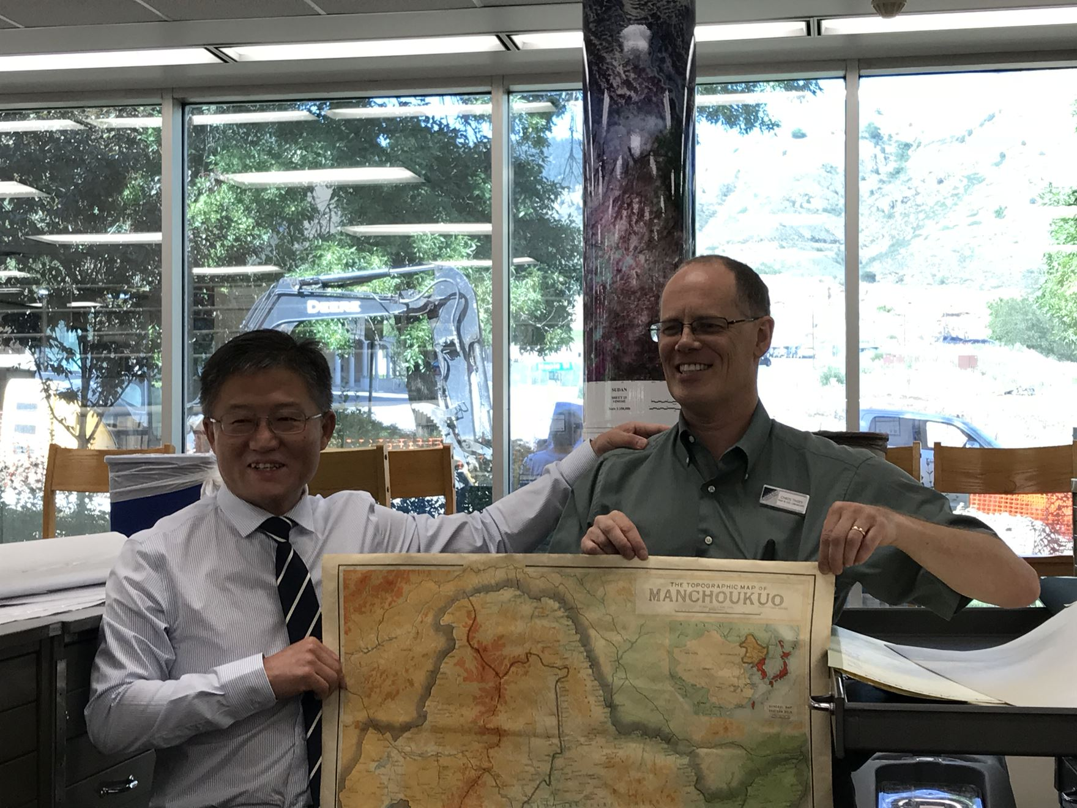
July 11, 2018: Touring the Arthur Lakes Library

Slide 4
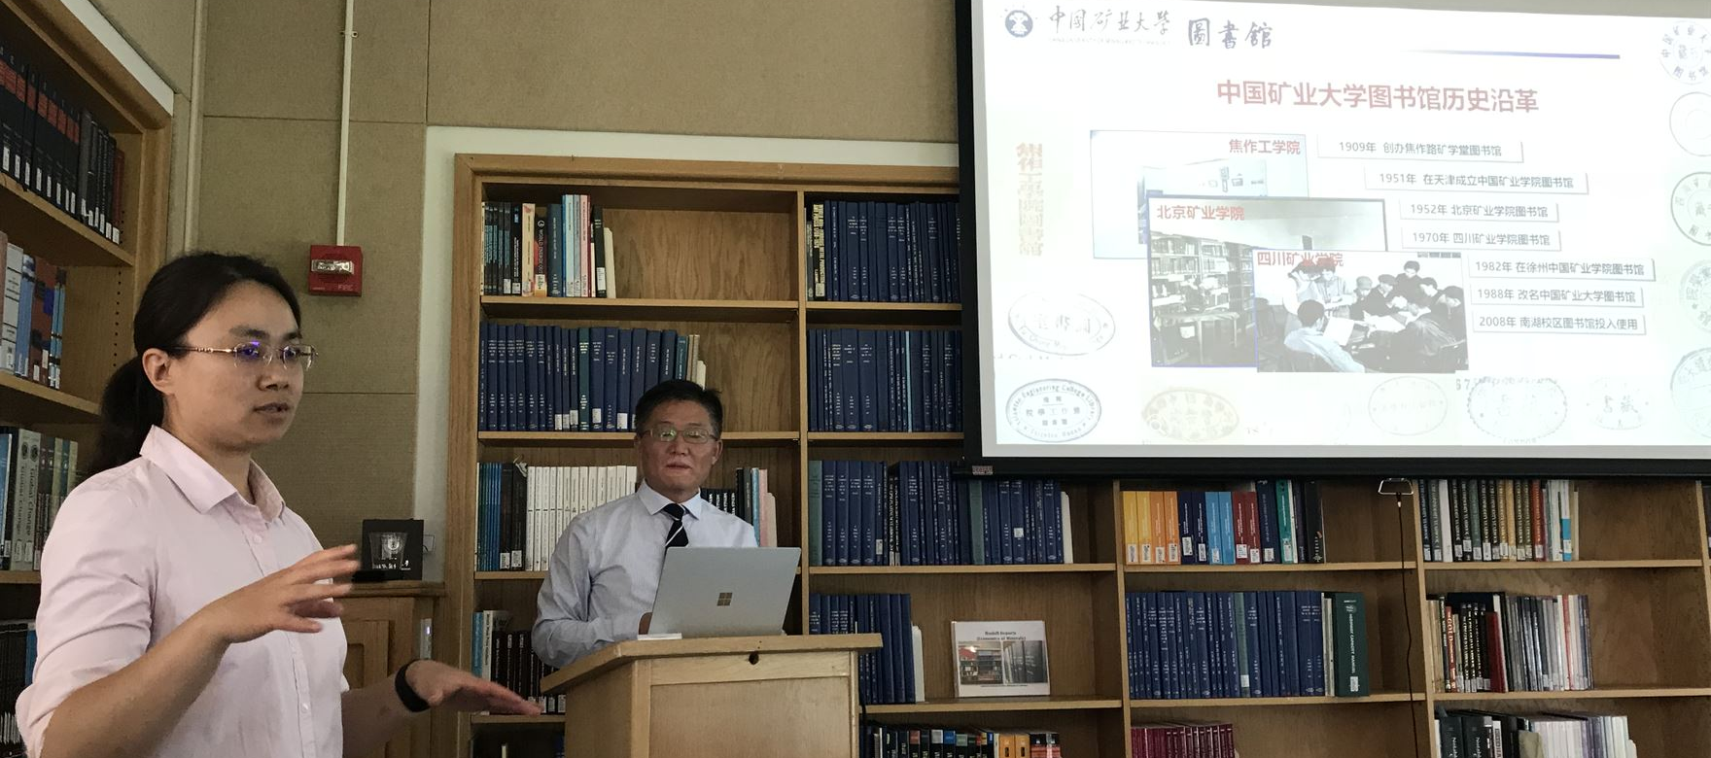
July 11, 2018: Library Presentation by Director Song Yingfa

Slide 5
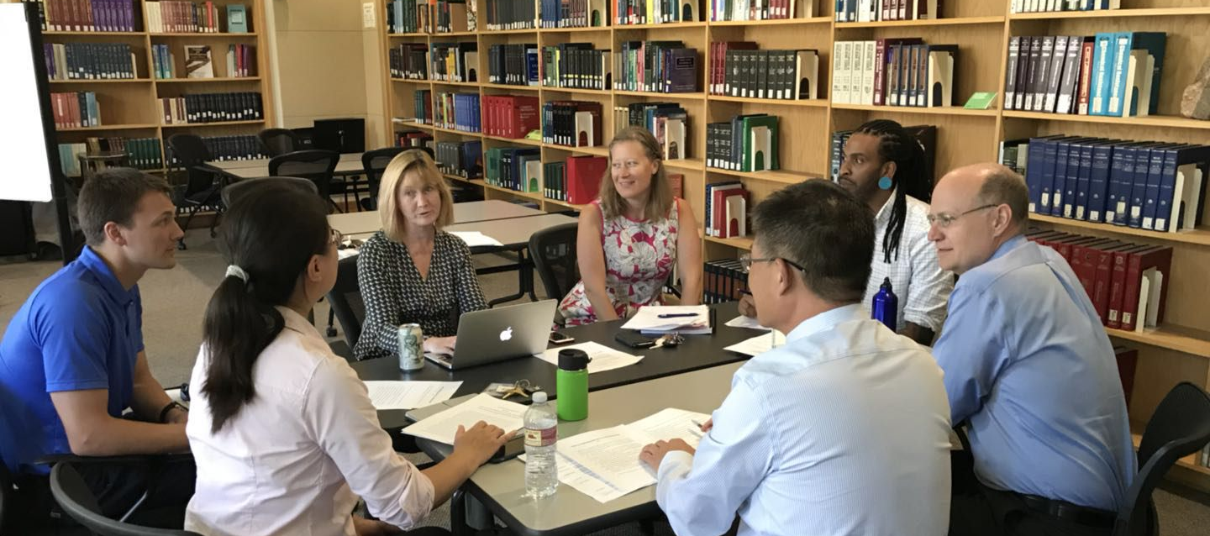
July 11, 2018: Catered lunch discussion on collaborative opportunities

Slide 6
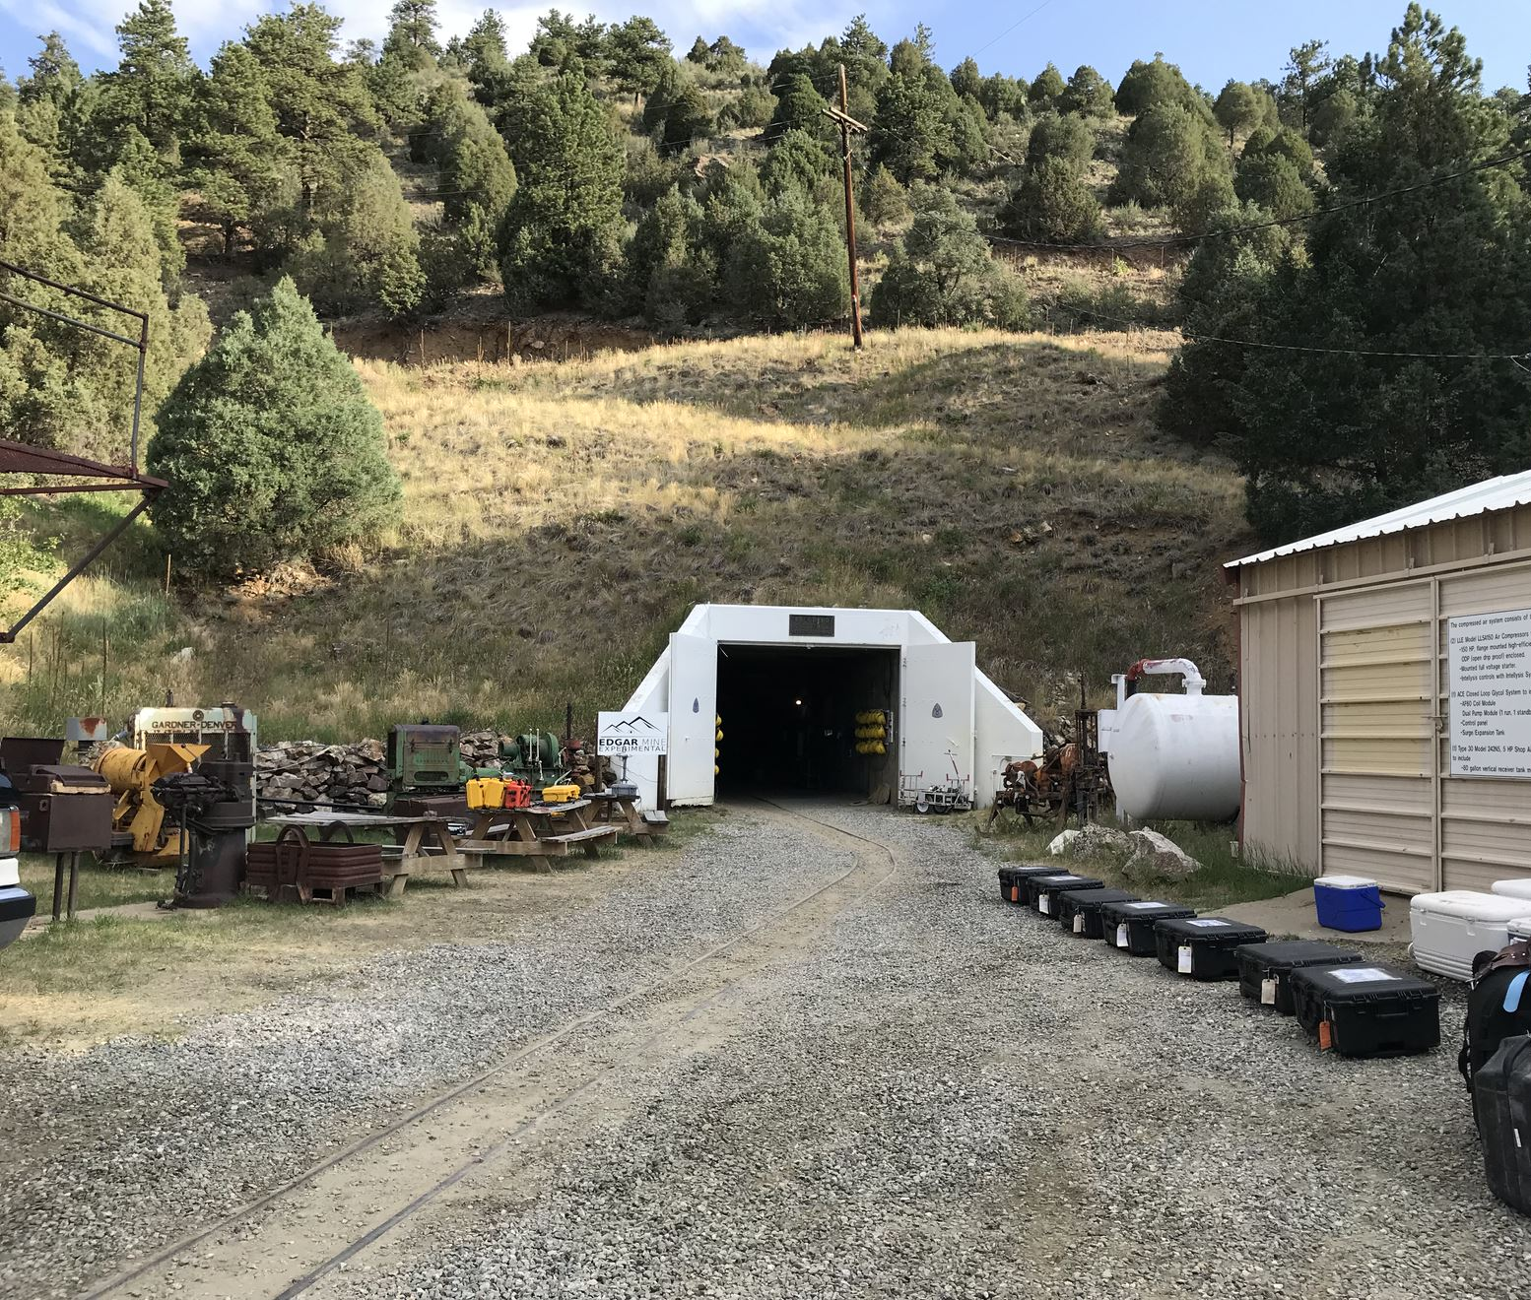
July 12, 2018:
Morning visit to the Colorado School of Mines’ Edgar Experimental Mine in Idaho Springs, Colorado

Slide 7
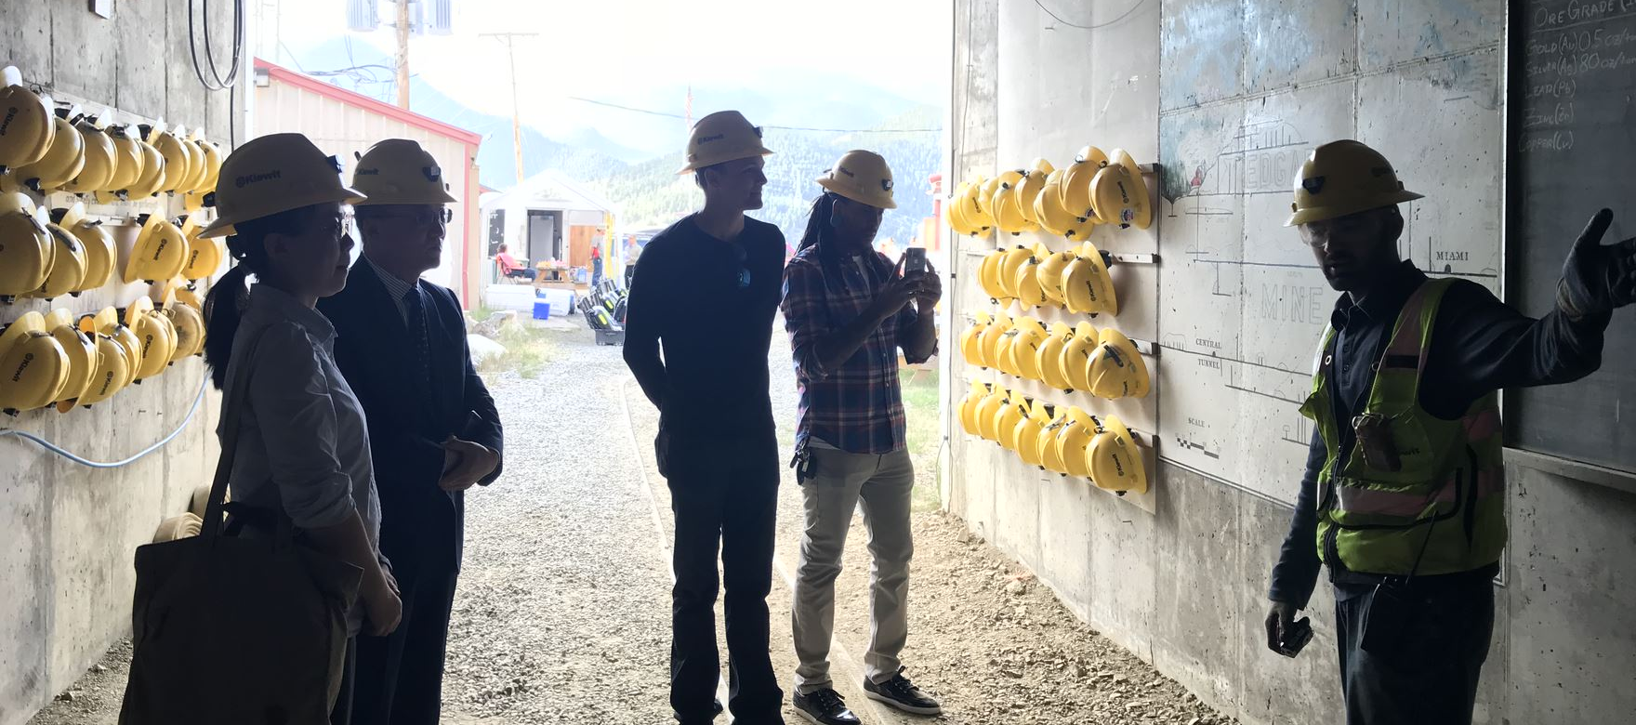
July 12, 2018: Entering the Edgar Mine

Slide 8
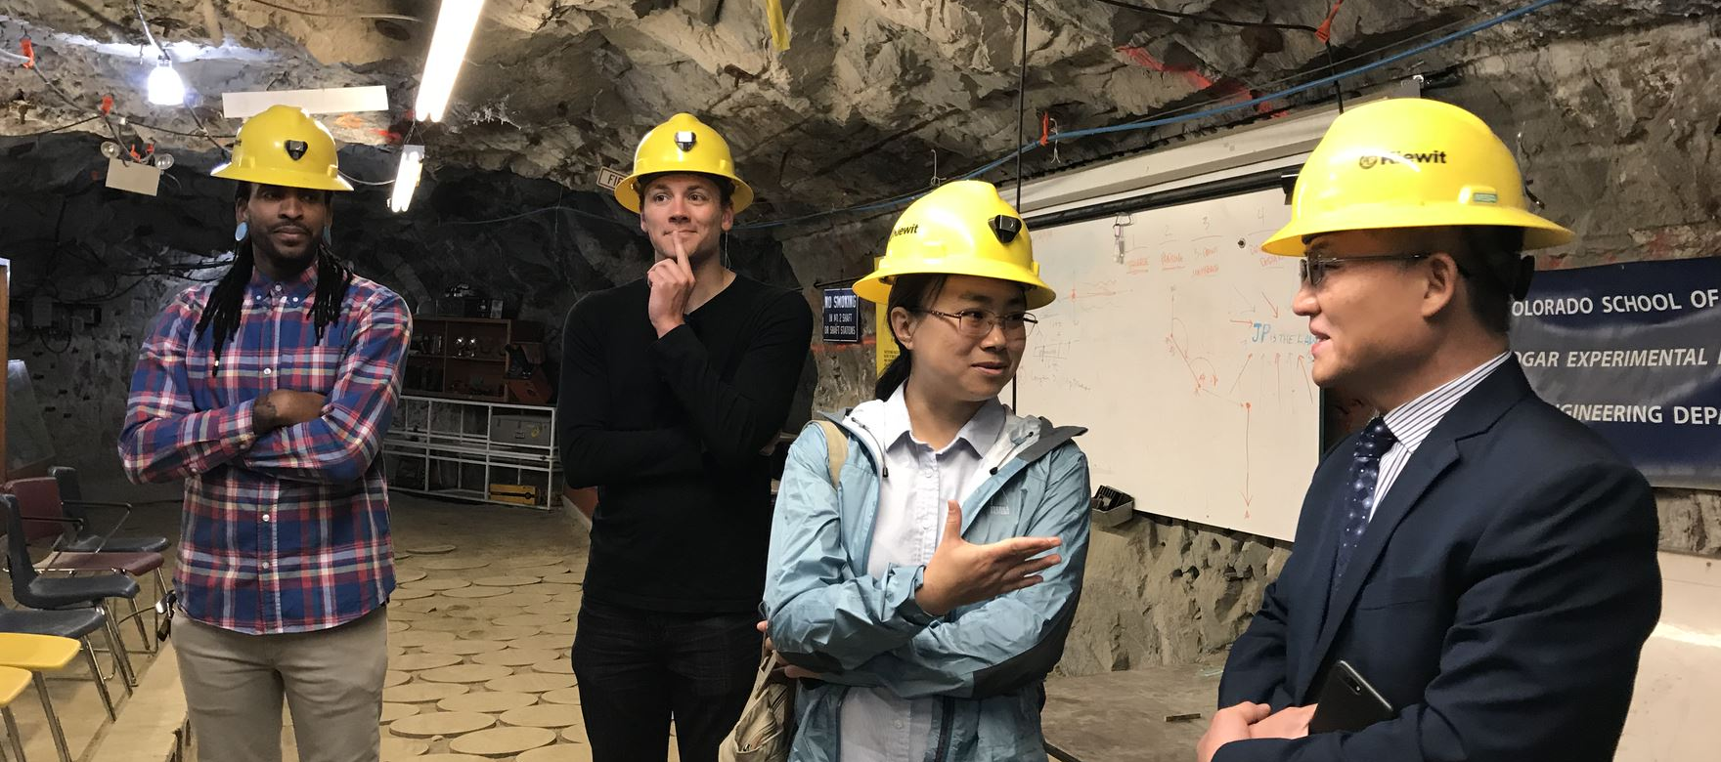
July 12, 2018: Touring the Edgar Mine

Slide 9
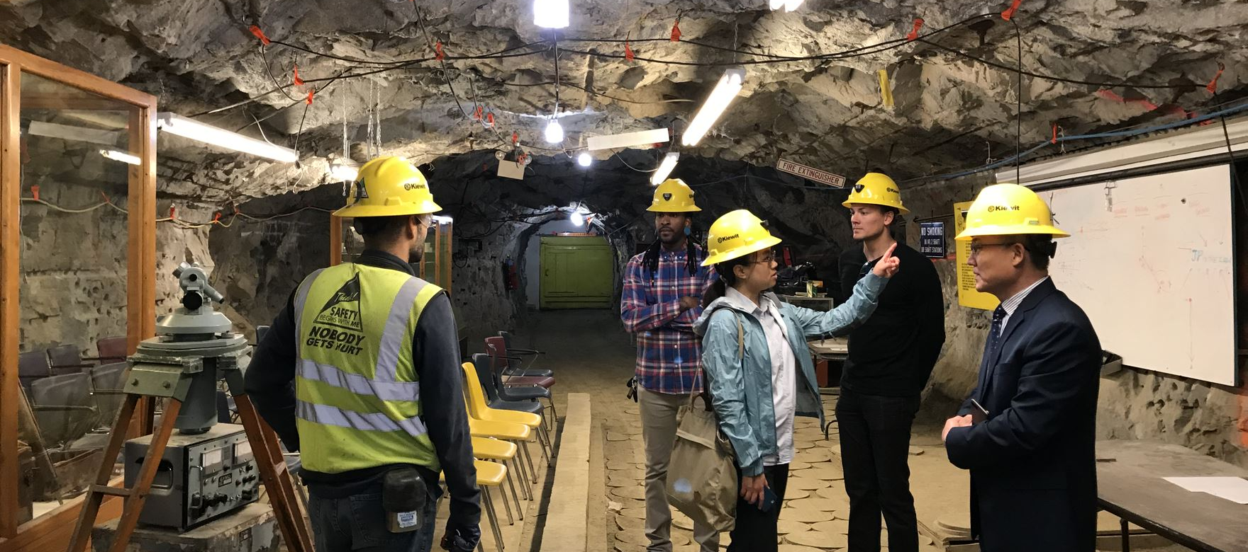
July 12, 2018: Touring the Edgar Mine

Slide 10
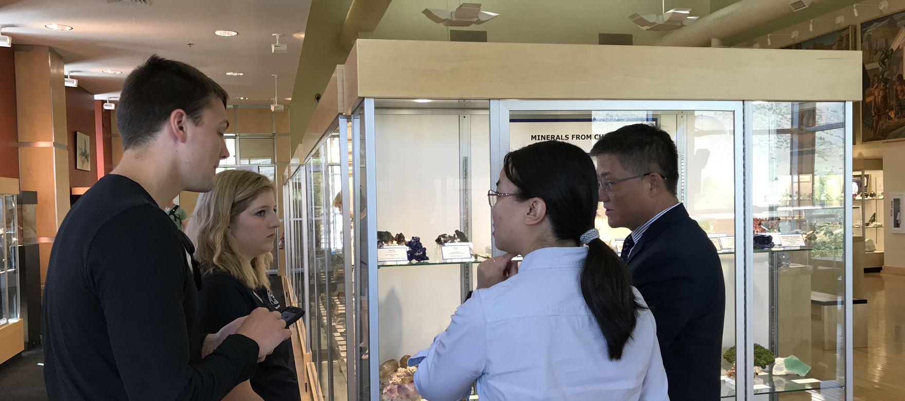
July 12, 2018: Touring the Mines Museum of Earth Science

Slide 11
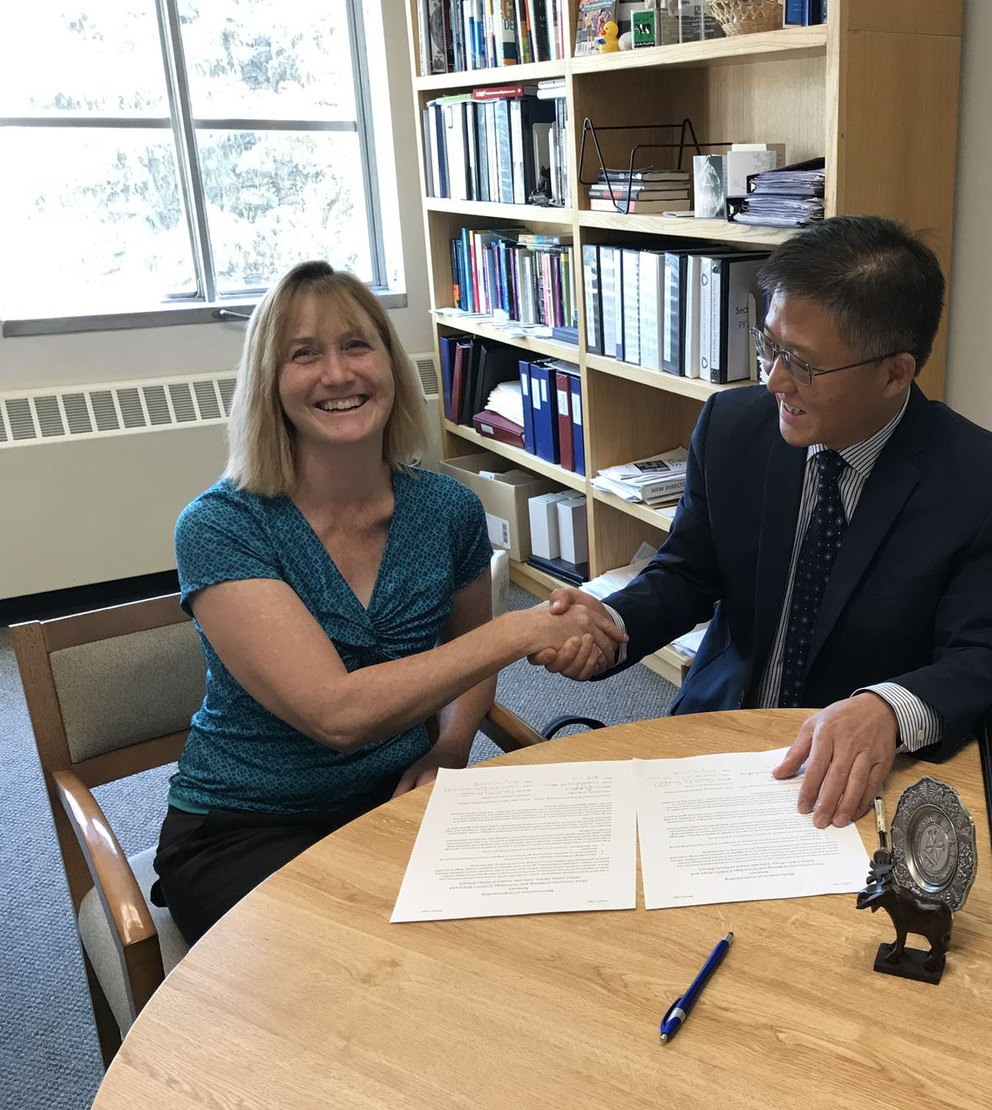
July 12, 2018:
Working on the sister library memorandum of understanding

Slide 12
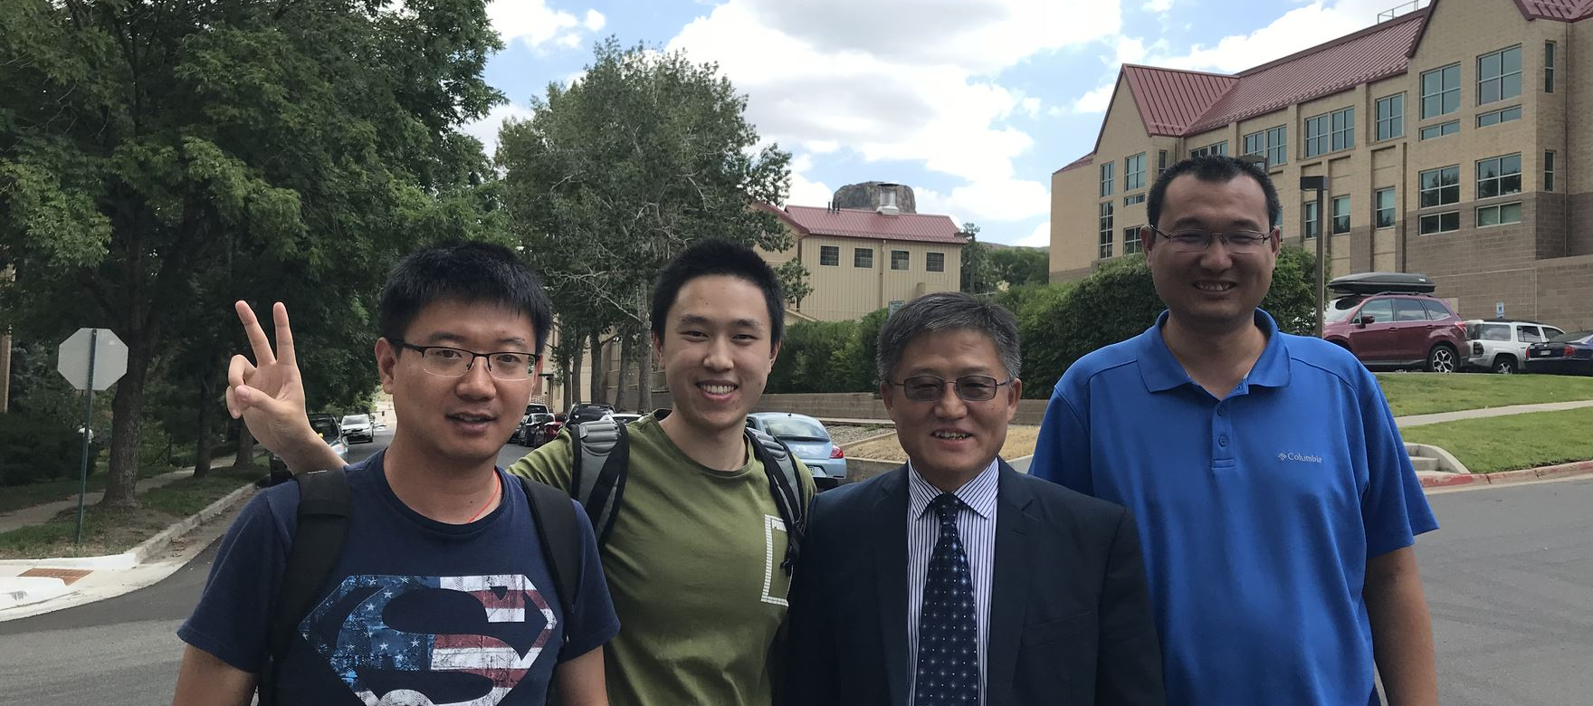
July 12, 2018: Meeting Chinese students attending Mines

Slide 13
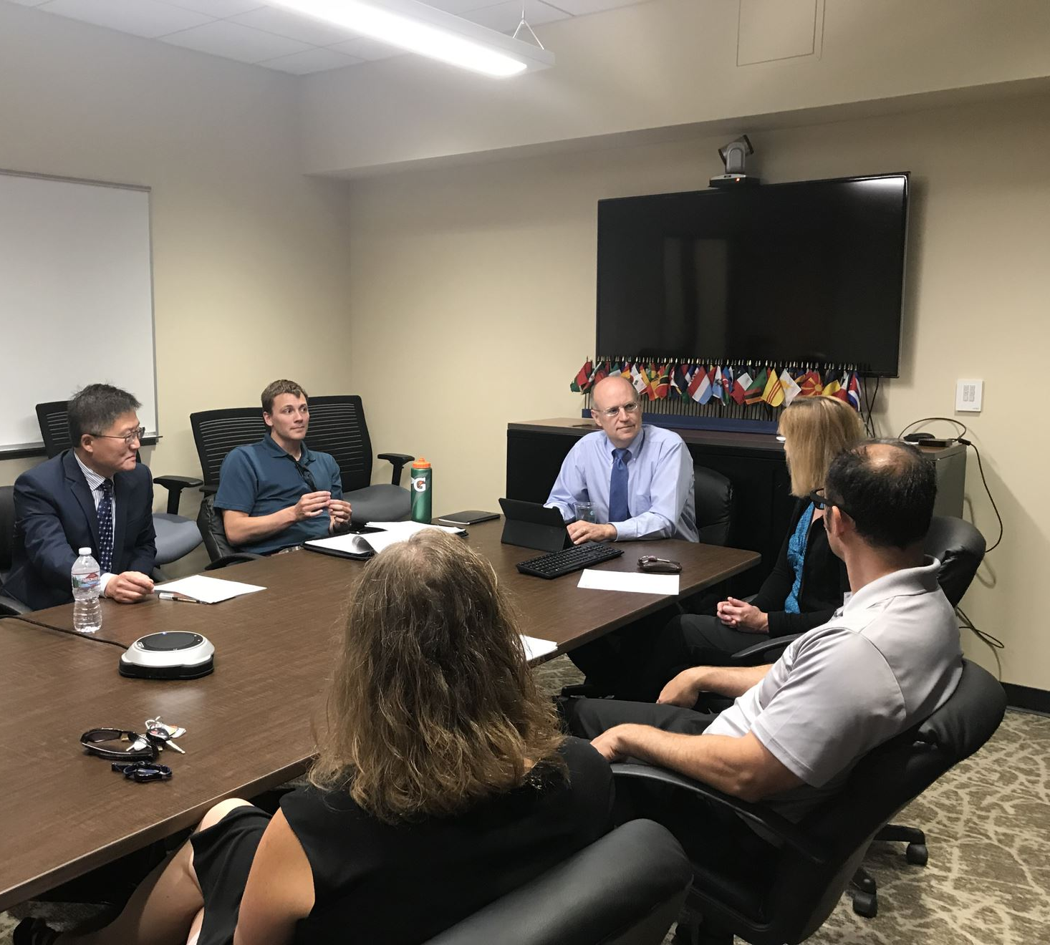
July 12, 2018: Meeting with the Mines Assistant Provost for International Affairs

Slide 14
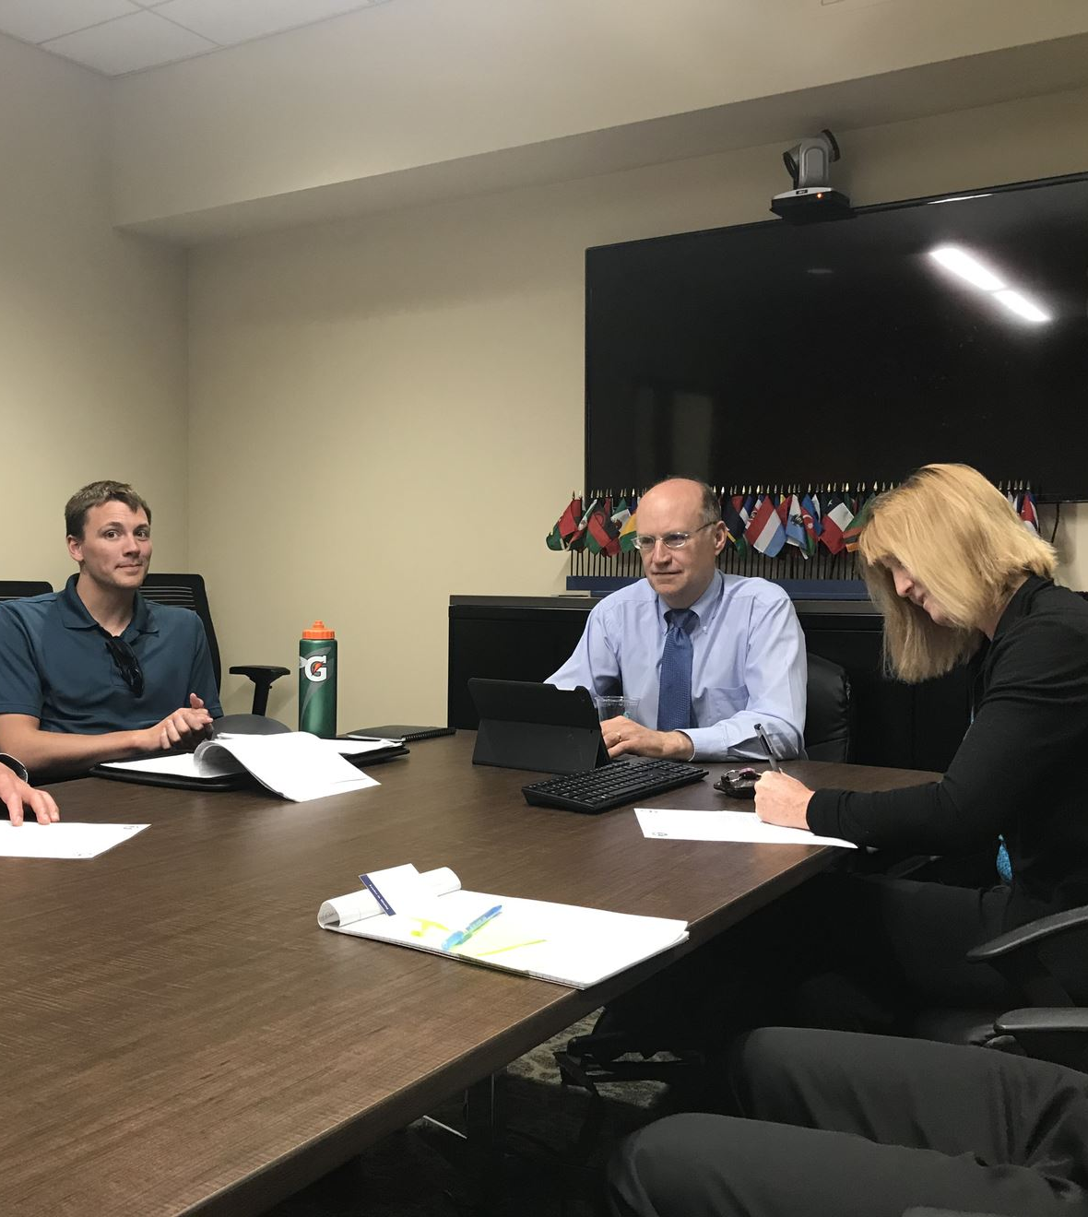
July 12, 2018: Signing a Sister Libraries memorandum of understanding

Slide 15
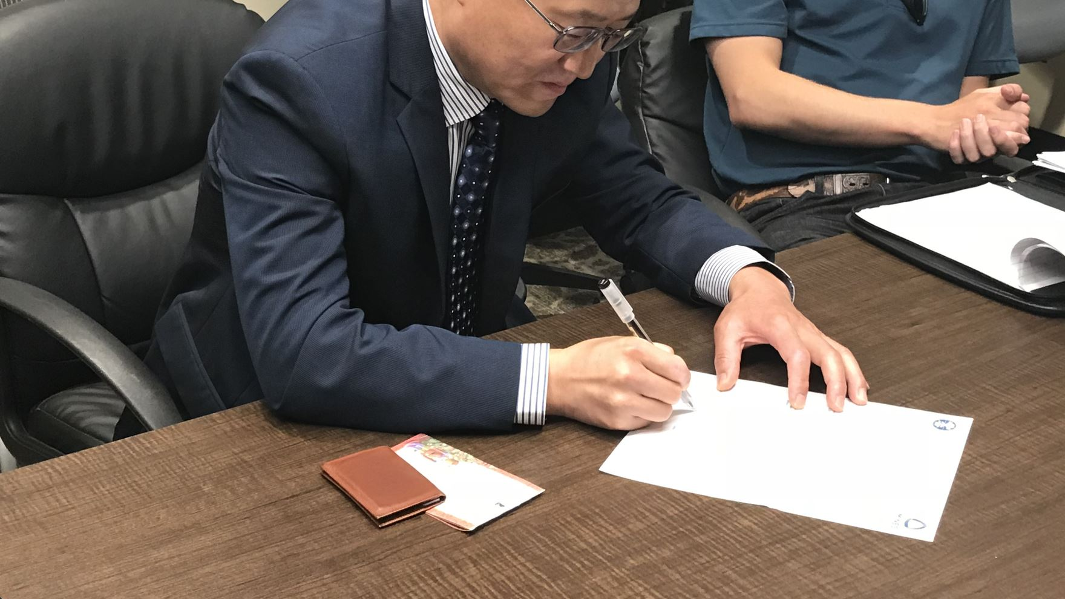

Slide 16
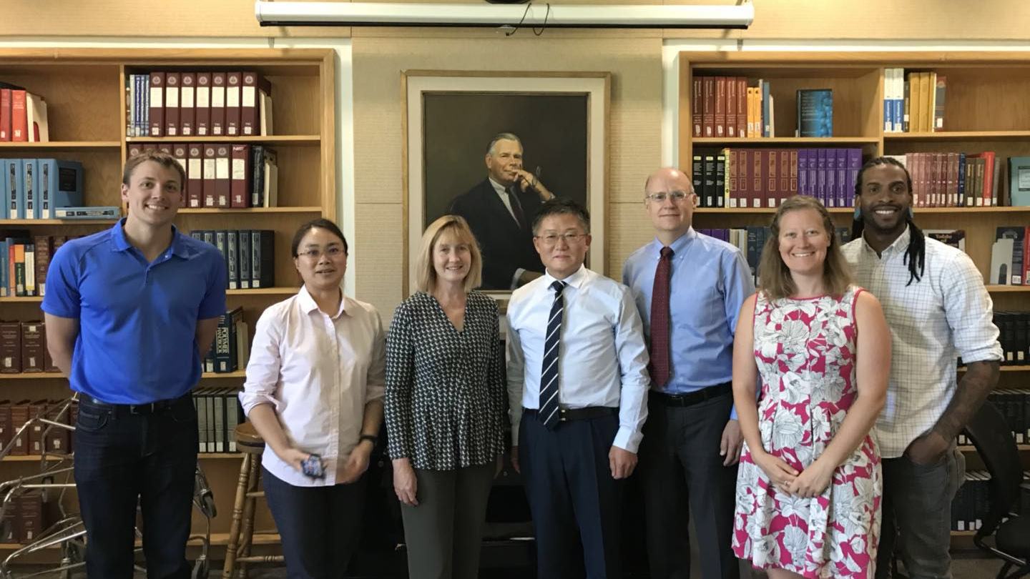

Slide 17
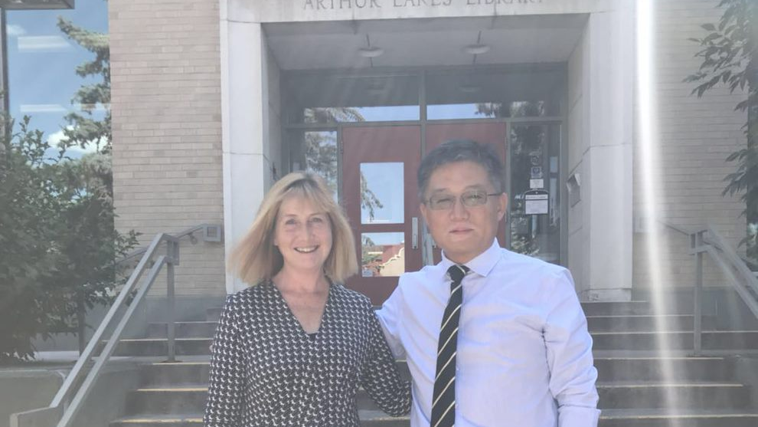

Slide 18
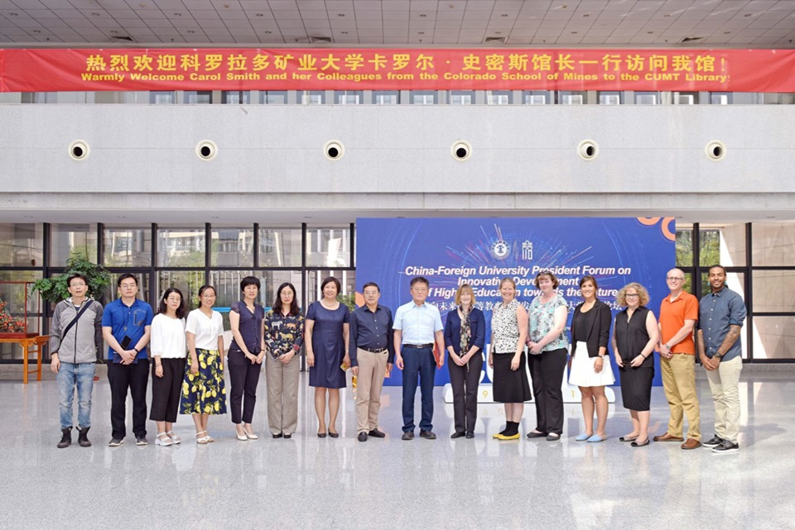
Mines Librarians at China U. of Mining and Technology in Xuzhou – May 2019

