Slide 1
Introduction to Sister Cities
Connect globally. Thrive Locally.

Slide 2
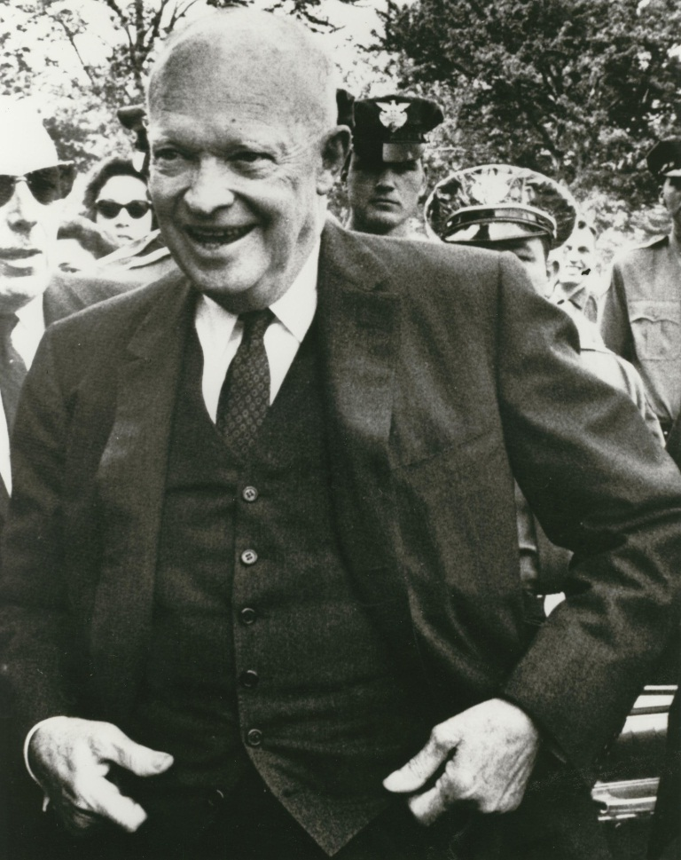
What is Sister Cities International?
Founded in 1956, Sister Cities International is a nonprofit citizen diplomacy network that creates and strengthens partnerships between U.S. and international communities. We strive to build global cooperation at the municipal level, promote cultural understanding and stimulate economic development.

Slide 3
History of Sister Cities International
Launched by President Eisenhower, SCI arose out of post WWII environment, hence the large number of partnerships in Germany, Japan, Italy, France
Initially proposed as a “People-to-People” citizen diplomacy initiative
While originally a part of the National League of Cities, SCI became a separate, non-profit corporation in 1967 due to tremendous growth and popularity of the U.S. program
Notes:
Although underwent changes, Eisenhower’s goals have remained the basis of SCI

Slide 4
What is Citizen Diplomacy?
Citizen Diplomacy is the concept that the individual has the right, even the responsibility, to help shape U.S. foreign relations 'one handshake at a time.' Citizen diplomats can be students, teachers, athletes, artists, business people, humanitarians, adventurers or tourists. They are motivated by a responsibility to engage with the rest of the world in a meaningful, mutually beneficial dialogue. (US Council on Citizen Diplomacy)

Slide 5
What is a Sister City?
A sister city, county or state relationship is a broad-based, officially approved, long-term partnership between two communities, counties or states in two countries.
Sister city partnerships have the potential to carry out the widest possible diversity of activities of any international program, including every type of municipal, business, professional, educational and cultural exchange or project.
Notes:
Only formal requirement is that mayors/elected officials sign an agreement
That being said, successful partnerships rely on more than just a paper agreement
Sister city programs have a great degree of versatility and flexibility

Slide 6
How do sister city relationships begin?
There is no one path to developing a sister city
  Can be through the meeting of two mayors, or community members taking the lead and organizing a sister city committee and requesting an official partnership

Slide 7
How do sister city relationships begin?
Many trends and motivators can lead to relationships
  Examples are similarities in culture, history, economy, geography
    Some relationships begin based on sharing the same name!
Current trends are for partnerships based on shared industries/economic development, as well as partnerships based on new immigrant communities

Slide 8
How do sister city relationships begin?
SCI also offers a Matchmaking Process through the City Connection Marketplace
  https://sistercities.org/membership/member-services/city-connection-marketplace/
Cities can fill out a survey with their city information and preferences in terms of a sister city relationship
  SCI will then assist in providing a city match
Notes:
The City Connection Marketplace also lists different cities in the US and Globally that have filled out surveys and are actively looking for partnerships
Cities and local programs are ones that ultimately decide whether or not to partner, and under what circumstances they will partner;
SCI can assist in building partnerships, by helping troubleshoot, explain the process, assist in narrowing down possible partners, reaching out on cities’ behalf, and utilizing our network
Partnership provided by SCI is not guaranteed upon filling form

Slide 9
How do relationships become formalized?
After two cities connect, the cities then draw up an agreement
Each agreement will vary based on what the two cities have agreed upon wanting in their partnership
The highest elected official from each city then signs the agreement

Slide 10
What do these relationships do?
Cultural Exchange
  Arts, music, traditions, customs, performances
Youth and Education
  Study abroad, virtual exchanges, learning opportunities, leadership building
Developing Communities
  Municipal and technical exchanges, best practices, policy exchanges, staff development
Economic Partnerships
  Trade delegations, business incubation, import/export assistance
Notes:
Cities can set their own agendas and decide what they feel is best for their specific partnership

Slide 11
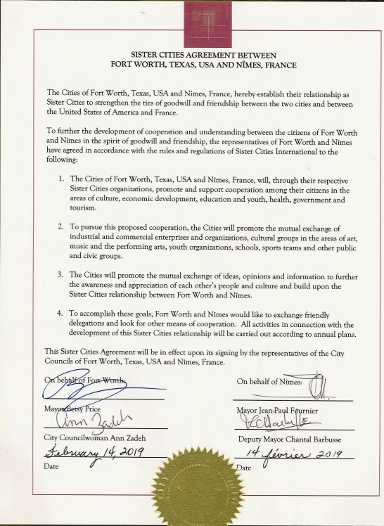
Example of Sister City Relationship
Sister City Agreement between Fort Worth, Texas and Nîmes, France

Slide 12

Libraries and Literacy Campaign

Slide 13

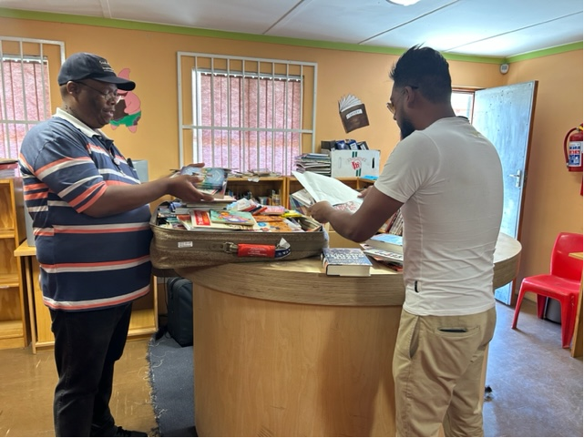
Libraries and Literacy Campaign
Delivered over 5,000 books to school libraries in Langa Township.

Slide 14
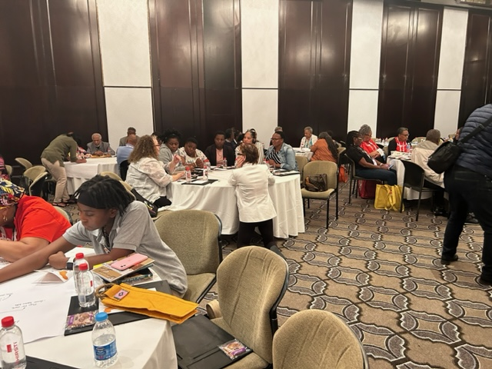
Libraries and Literacy Campaign
Brainstorming session to determine “next steps”

Slide 15
For more information contact us at info@sistercities.org or visit us online at www.sistercities.org

