Slide 1
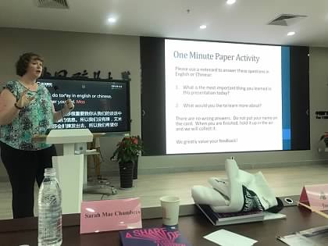
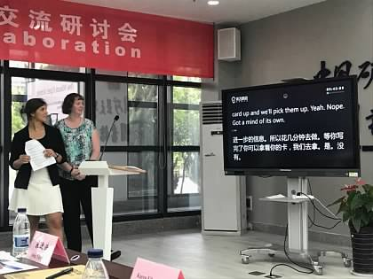
My Role
Standards-Based Information Literacy at the Colorado School of Mines

Slide 2
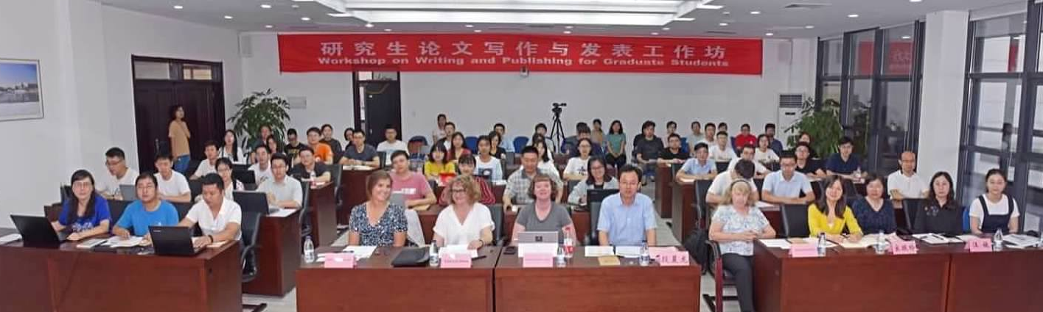
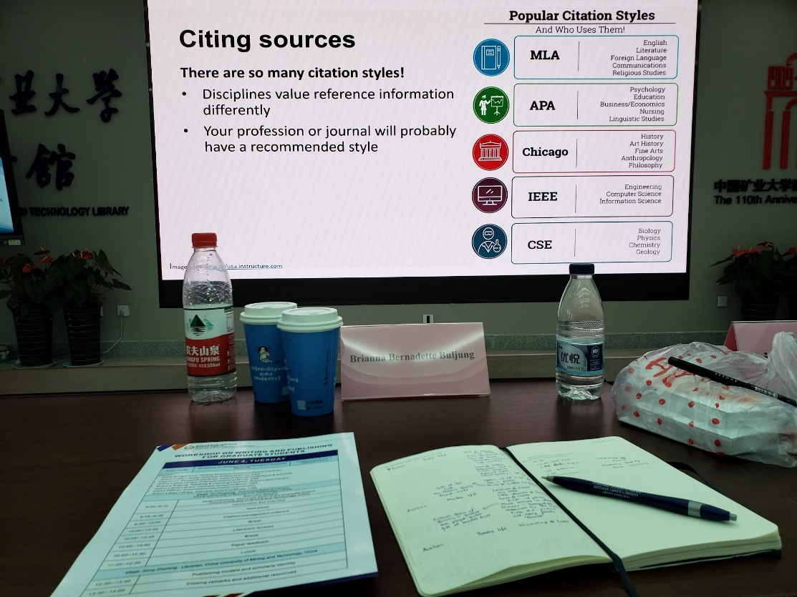
Graduate Workshop
Bongiovanni, E., Buljung, B., Dunn, L., & Pfiffner, K. (2020). From Golden to Xuzhou: Teaching a graduate student workshop in China. College & Research Libraries News, 81(9), 454. doi: https://doi.org/10.5860/crln.81.9.454

Slide 3
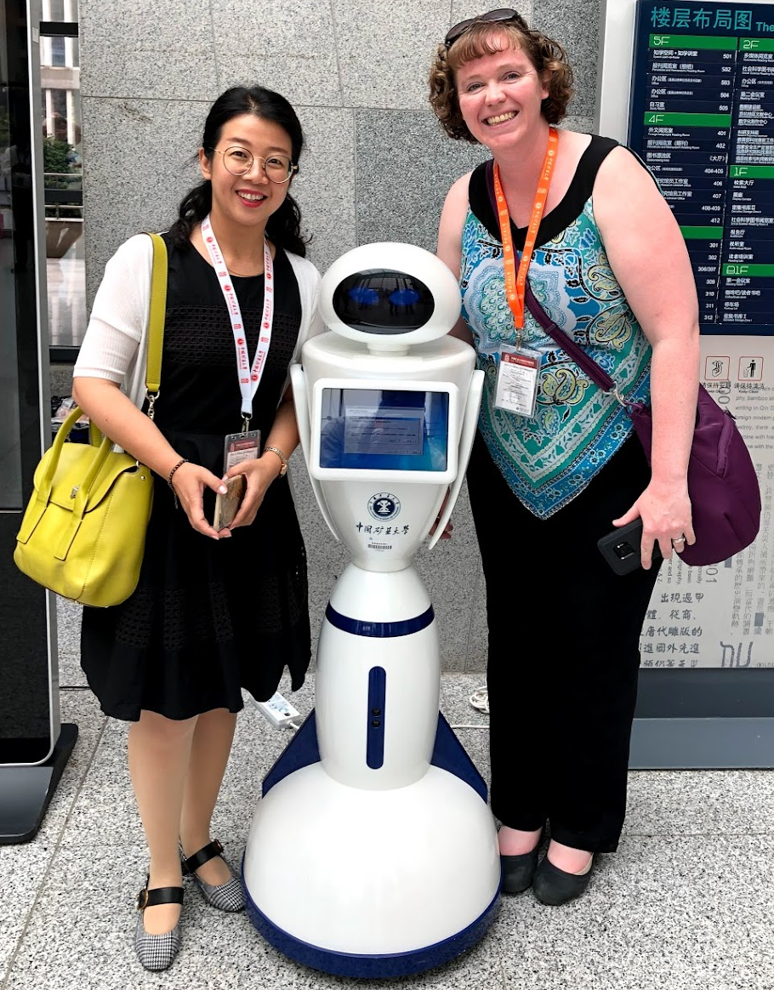
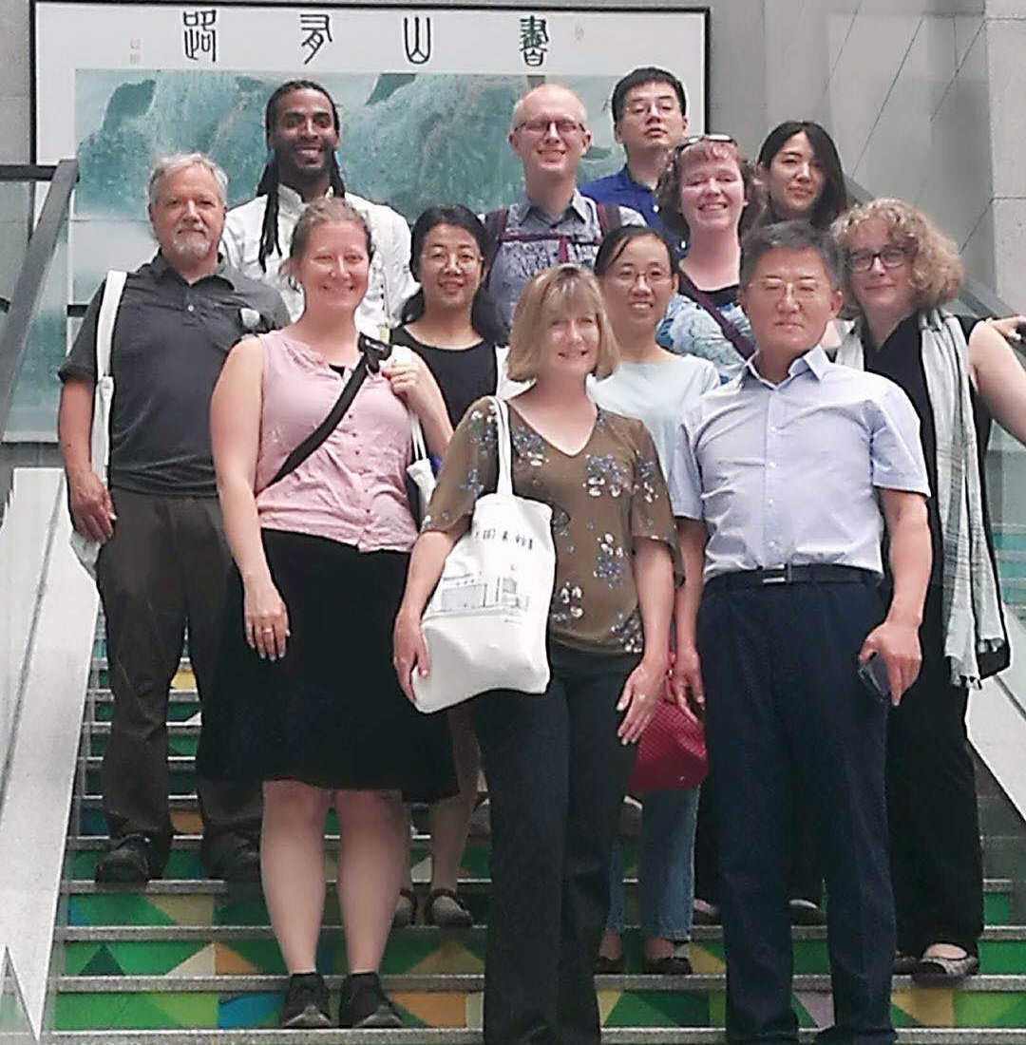
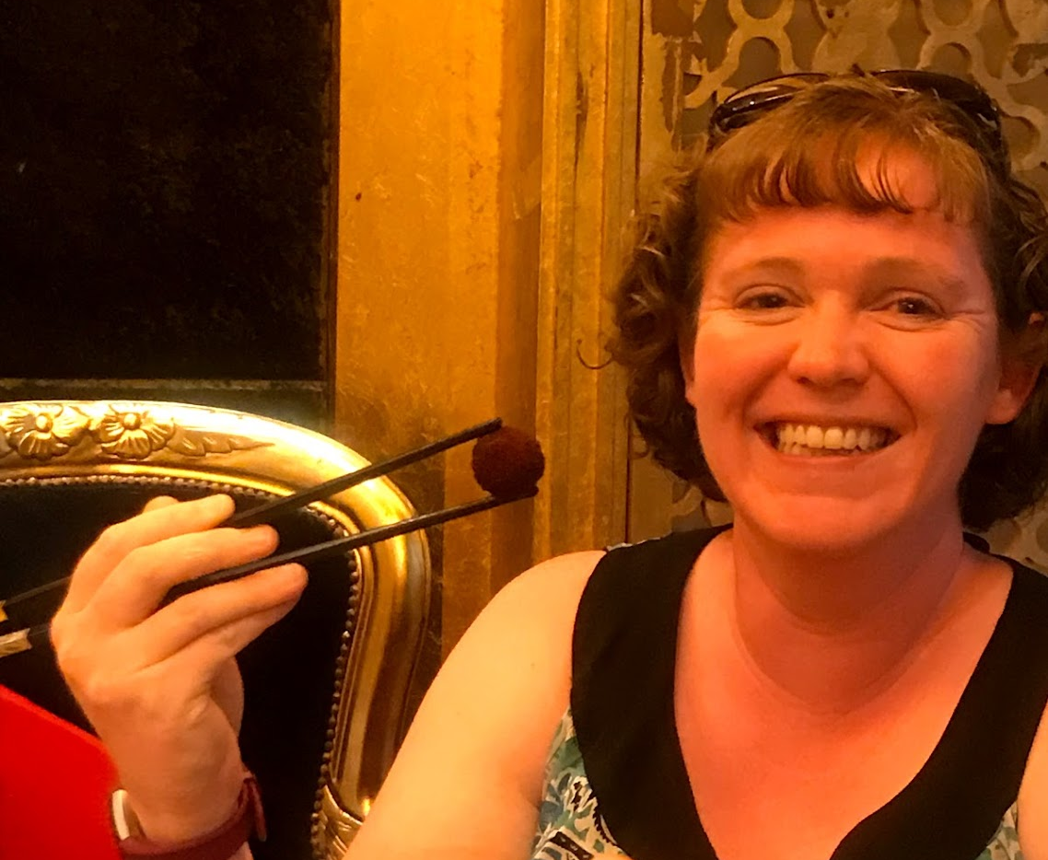
Lessons Learned

