Slide 1
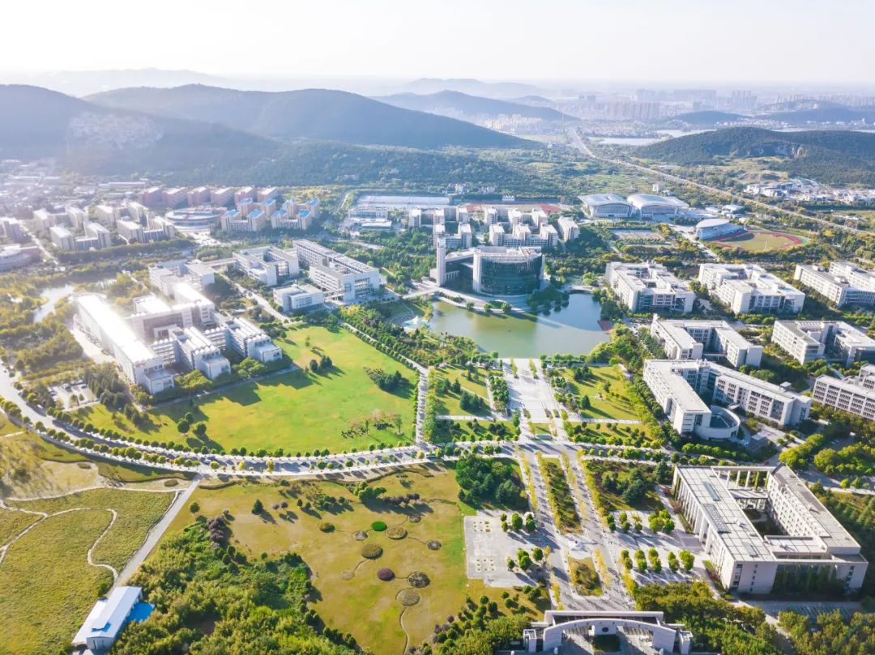

We are better together
Panelist -Better Together: The Power of Global Library Connections
2023
China University of Mining and Technology Library
Xu Shujuan

Slide 2
what I did and what I gained
01
About research data management service
CONTENTS
02
Historical connection between Mines and CUMT
03
Impression

Slide 3
1. About research data management service
I learned about the research data management services of Colorado School of Mines and University of Northern Colorado and University of Colorado Boulder during my visiting period.
university | guide | who | what | partner | how
Mines | Library web-research guides-RDM | scholarship communication librarian | RDM life circle, mainly in RDP,sharing | IT, Office research administration | Workshop, face to face Consultations
UNC | Library web-research guides-RDM | Library Research Services | More work on data sharing and teaching | IT | Workshop(online&face-to-face) Youtube Mooc
CU-Boulder | Library web-research-Data Services | Data Services & Scholarly Communication | training, ci, data management, and digital scholarship | center for research data &digital scholarship(CRDD) | Consultations, workshop

Slide 4
1. About research data management service
I found that the research data management services of three libraries are provided according to the needs of researchers and the service capacity of the library, but there is no uniform service mode. However, they regard the consulting and training of research data management as an important part of their research data management services. By holding workshops and providing consulting services, they are committed to improving the data literacy of university researchers. On this basis, some suggestions and ideas on how to develop research data management services in CUMT are put forward.

Slide 5
1. About research data management service
Some suggestions and ideas on how to develop research data management services in CUMT：
The portal of research data management service is set on the homepage of the library to provide knowledge, software, platforms, tools and policies of domestic and foreign data services, and push this information to teachers, researchers and graduate students.
To offer data management courses for graduate students or to integrate data management knowledge into information literacy courses.
Conduct data literacy training for new faculty.
Improve librarians' data literacy and train data librarians.

Slide 6
2. Historical connection between Mines and CUMT
During my visit to the Arthur Lakes library, I also collected some materials about Chinese students who studied in the university before 1935. Some of them taught in China University of Mining and Technology after returning to China. They brought the advanced university-running ideas and experience of Colorado School of Mines to CUMT.

Slide 7
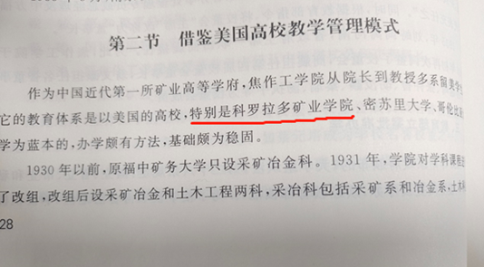
2. Historical connection between Mines and CUMT
Section II Reference the teaching management mode of American universities
As the first mining higher education institution in modern China, The dean and professor of Tsiaotso Engineering College were mostly students studying in the United States. Its education system is based on American universities, especially Colorado School of Mines, University of Missouri, and Columbia University. It has quite a method and a solid foundation.
——《The brief history of China University of Mining and Technology 》
——《中国矿业大学简史》

Slide 8
2. Historical connection between Mines and CUMT
Name （Chinese Name） | Status; CSM Degree and Date Awarded* | Catalog Edition | Origin | Post in CUMT | Start and end time
Ho, Chieh （何杰） | Student, 1913 | 1910, 1912 | CHINA Poo Ting Foo | Vice President（Beijing Institute of Mining and Technology） | 1956～1979
Wang, Shao-ying （王绍瀛） | Student, 1913 | 1910, 1912 | CHINA Canton | Professor（Beijing Institute of Mining and Technology） | 1952-1958
Lee, Y. C. [Yu-Ching] （李余庆/李善棠） | Student, 1921 | 1919-21 | CHINA HONAN Hiangcheng | President（Fu Chung Mining College） | 1926.7～1928.11
Chang, C. L. [Ching Lien] （张清涟） | Student, 1921 | 1919-20 | CHINA HONAN Nanyang | President（Tsiaotso Engineering College） | 1933.7～1938.7 1946.8～1950.4
Jen, T. Y. [Tien Yuan] （任殿元） | Student, 1921 | 1919-21 | CHINA NONAN Nanyang | dean （Mining and metallurgy Department,Tsiaotso Engineering College） | 1931-1938

Slide 9
3. Impression
During my visit, the Arthur Lakes library staff gave me a lot of guidance and help in research proposal and data collection. Thanks for Carol! Thanks for Emily! Thank you all very much! Although the visiting time is only three months, I gained a lot.
Research data management service is one of the service directions for research university libraries to provide scientific research support. This service involves more factors and is more difficult than other services that libraries have carried out. Therefore, university libraries at home and abroad need to coordinate all stakeholders, and there is still a lot of work to explore and carry out.

Slide 10
3. Impression
The story of Colorado School of Mines and China University of Mining and Technology started very early, and there are still many stories to be mined and memorized. This work will continue to strengthen the connection between sisiter libraries, and even promote the cooperation in digital humanities.
I strongly agree with University librarian Carol's emphasis on international library undertakings and the great work she has done. I believe that our sister libraries cooperation will be integrated into the international library undertakings system.
Finally, more importantly, we have become good friends , lifelong friends.

Slide 11

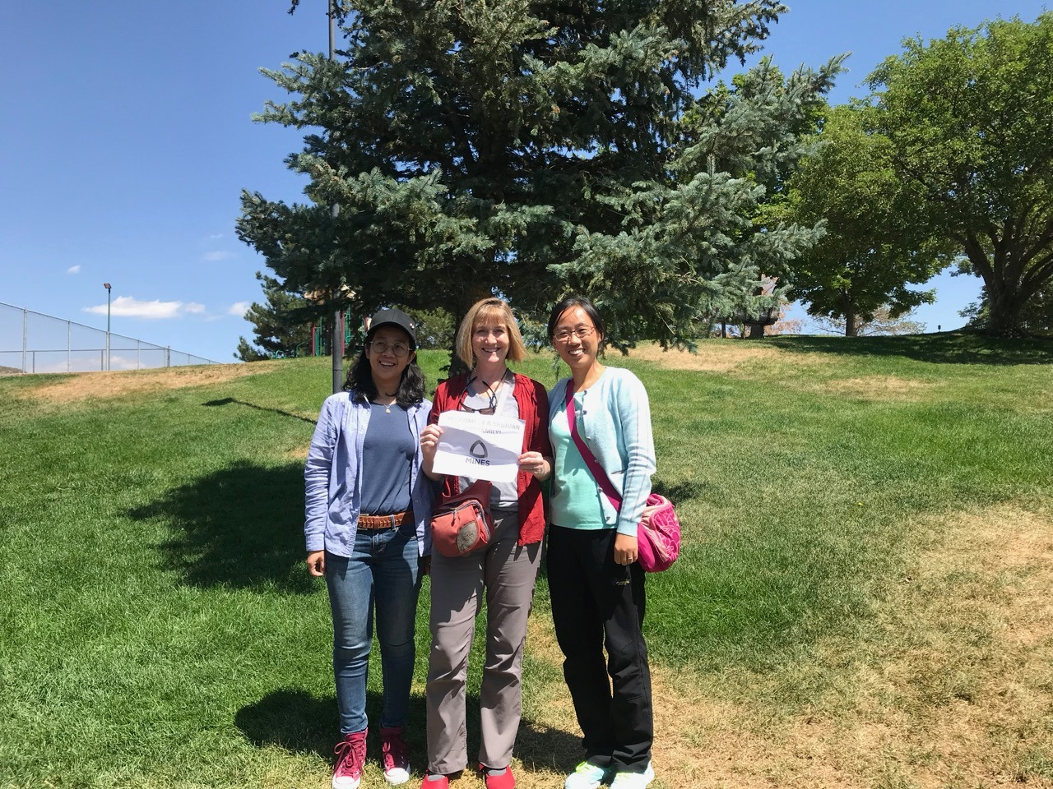
3. Impression

Slide 12
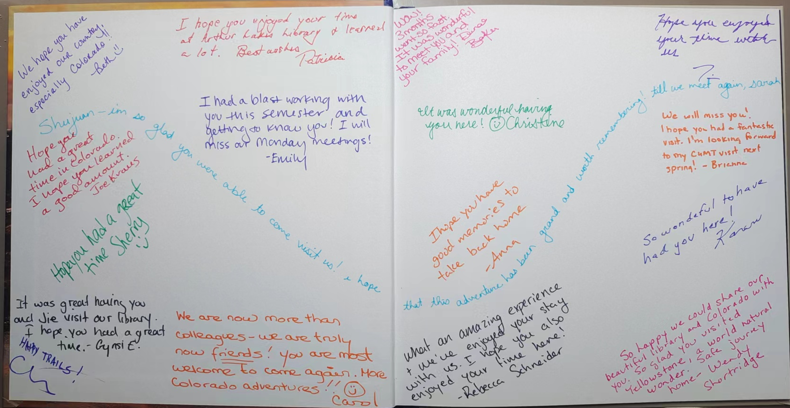
3. Impression

Slide 13

Thanks.
We are better together!
Xu Shujuan
xushujuan@cumt.edu.cn
THANKS
China University of Mining and Technology Library

