Slide 1
Nazarbayev University Library and Partnership with Foreign Libraries
Tolkyn Jangulova
Head of the Digitization Office
Nazarbayev University Library
tolkyn.jangulova@nu.edu.kz
March, 2023

Slide 2
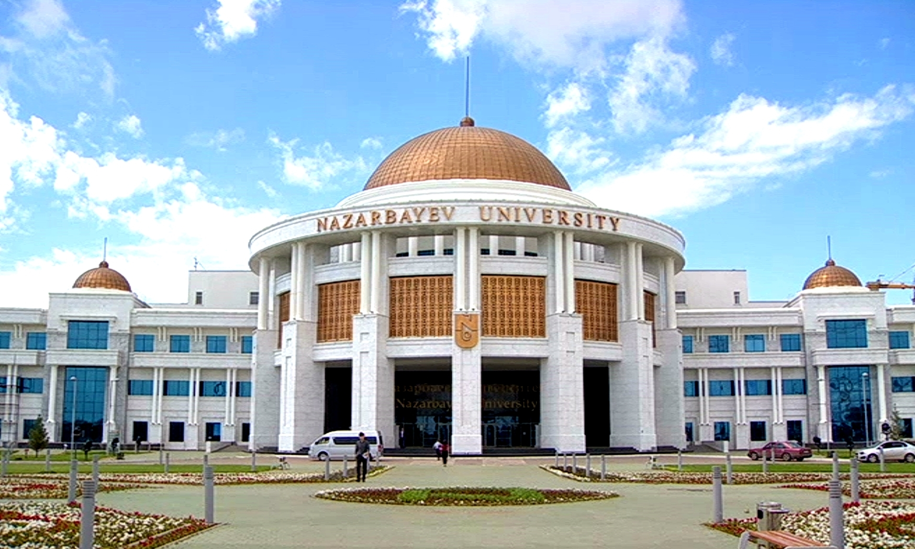
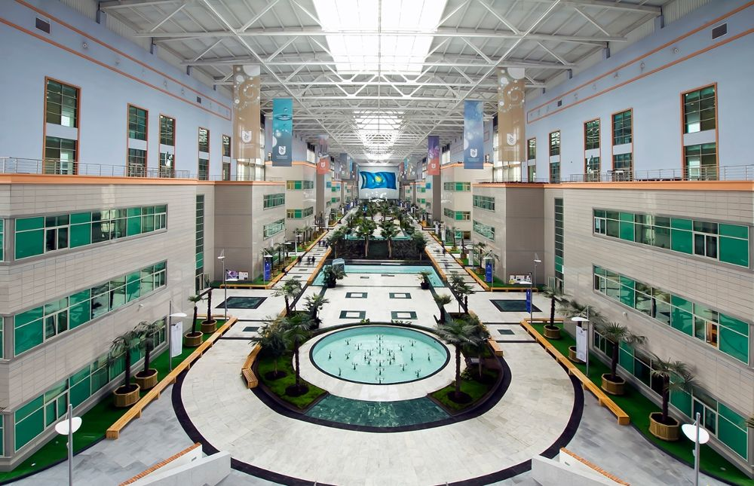
Quick factors about Nazarbayev University
Nazarbayev University was founded by the First President of the Republic of Kazakhstan in 2010 as the country’s flagship institution for academics and researchers to collaborate.
Total number of students – 6365
Undergraduate students - 4249
Graduate students - 1467
Foundation students - 649
NU faculty and teaching community consists of 521 full-time faculty. Our diverse faculty hails from 58 countries.
https://nu.edu.kz

Slide 3
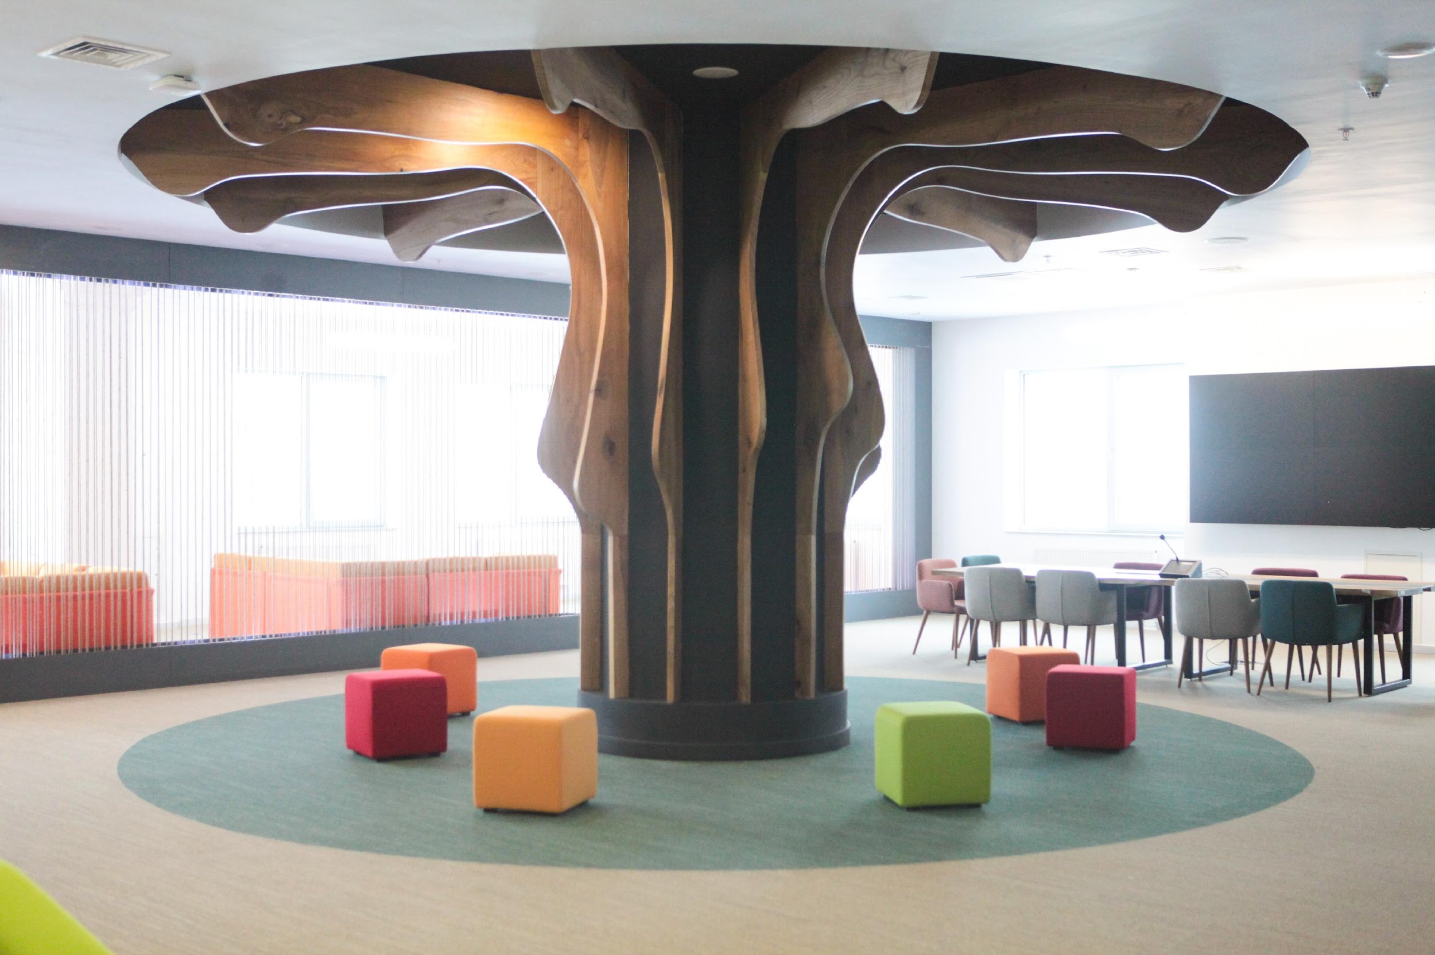


Nazarbayev University Library
In 2010 - the Opening of NU Library.
The arrival of the first 200 books for collection.
NU library in 2023
Print Books – 189,410
E-books (perpetual access) – 41,641
Publications in NU Repository – 6050
Database Subscriptions – 114
Registered Users – 8466
https://library.nu.edu.kz

Slide 4




Nazarbayev University Library
NU Library Partners:
University of Wisconsin-Madison Libraries (USA)
University of Pittsburgh Health Sciences Library (USA)
Duke Fuqua School of Business University Ford Library (USA)
Colorado School of Mines (USA)
Warwick University Library (UK)
Library of Congress
IFLA Document Delivery and Resource Sharing Section Standing Committee

Slide 5

Partner: University of Wisconsin – Madison
Contract on a fee-based form:
Consultative Workshops
Develop and deliver consultative workshops for NU Library staff.
Conference Participation
Speaker at the annual Kazakhstani librarian conference - Eurasian Academic Libraries Conference (EALC)
Wisconsin TechSearch (WTS) / Interlibrary Loan (ILL)
Delivery of e-documents requested by NU faculty, staff and students
Internship (business trips) of the NU Library staff
To support the Library in improving its operational processes and policies and becoming a leader in outreach and engagement with Kazakhstani libraries

Slide 6
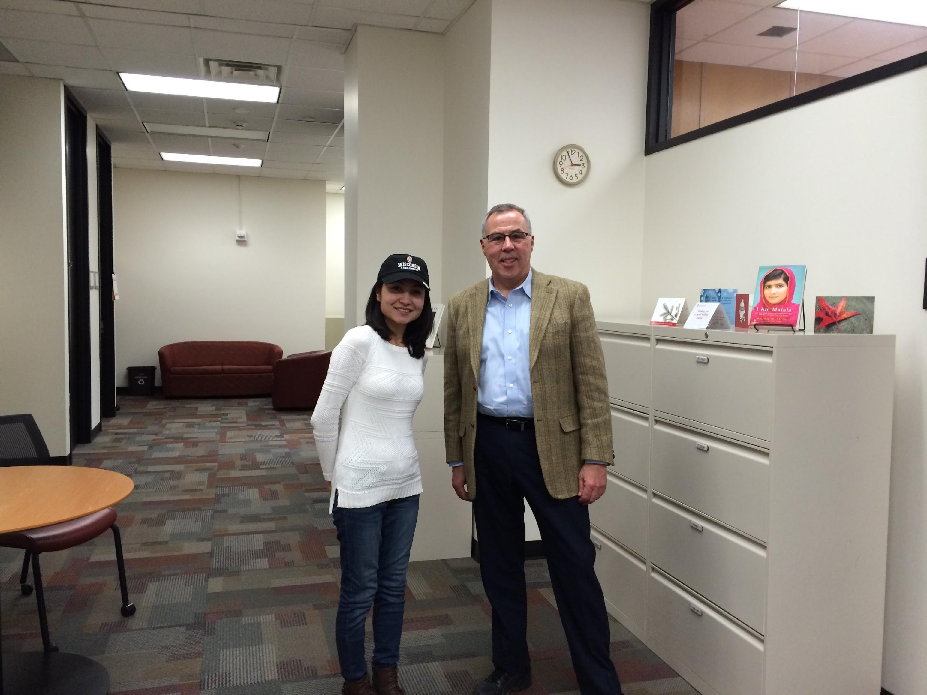
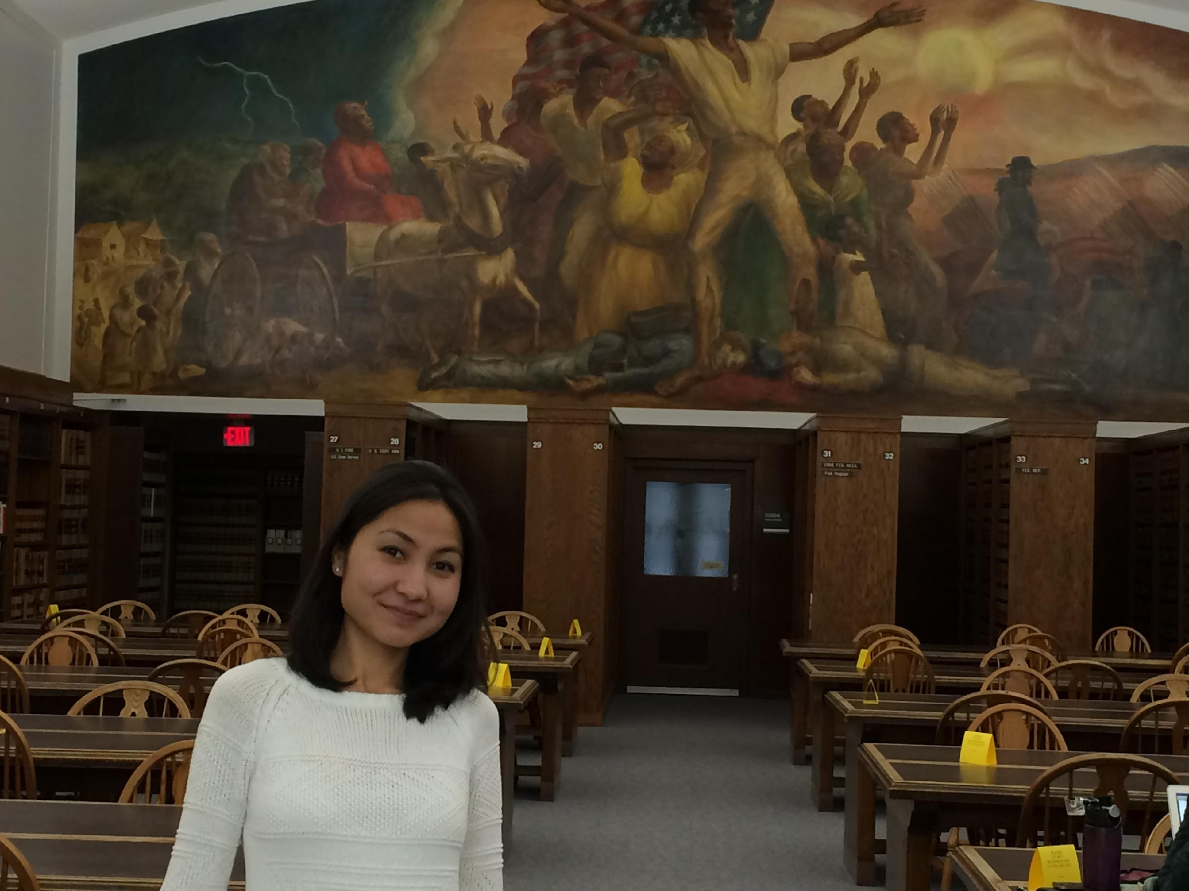
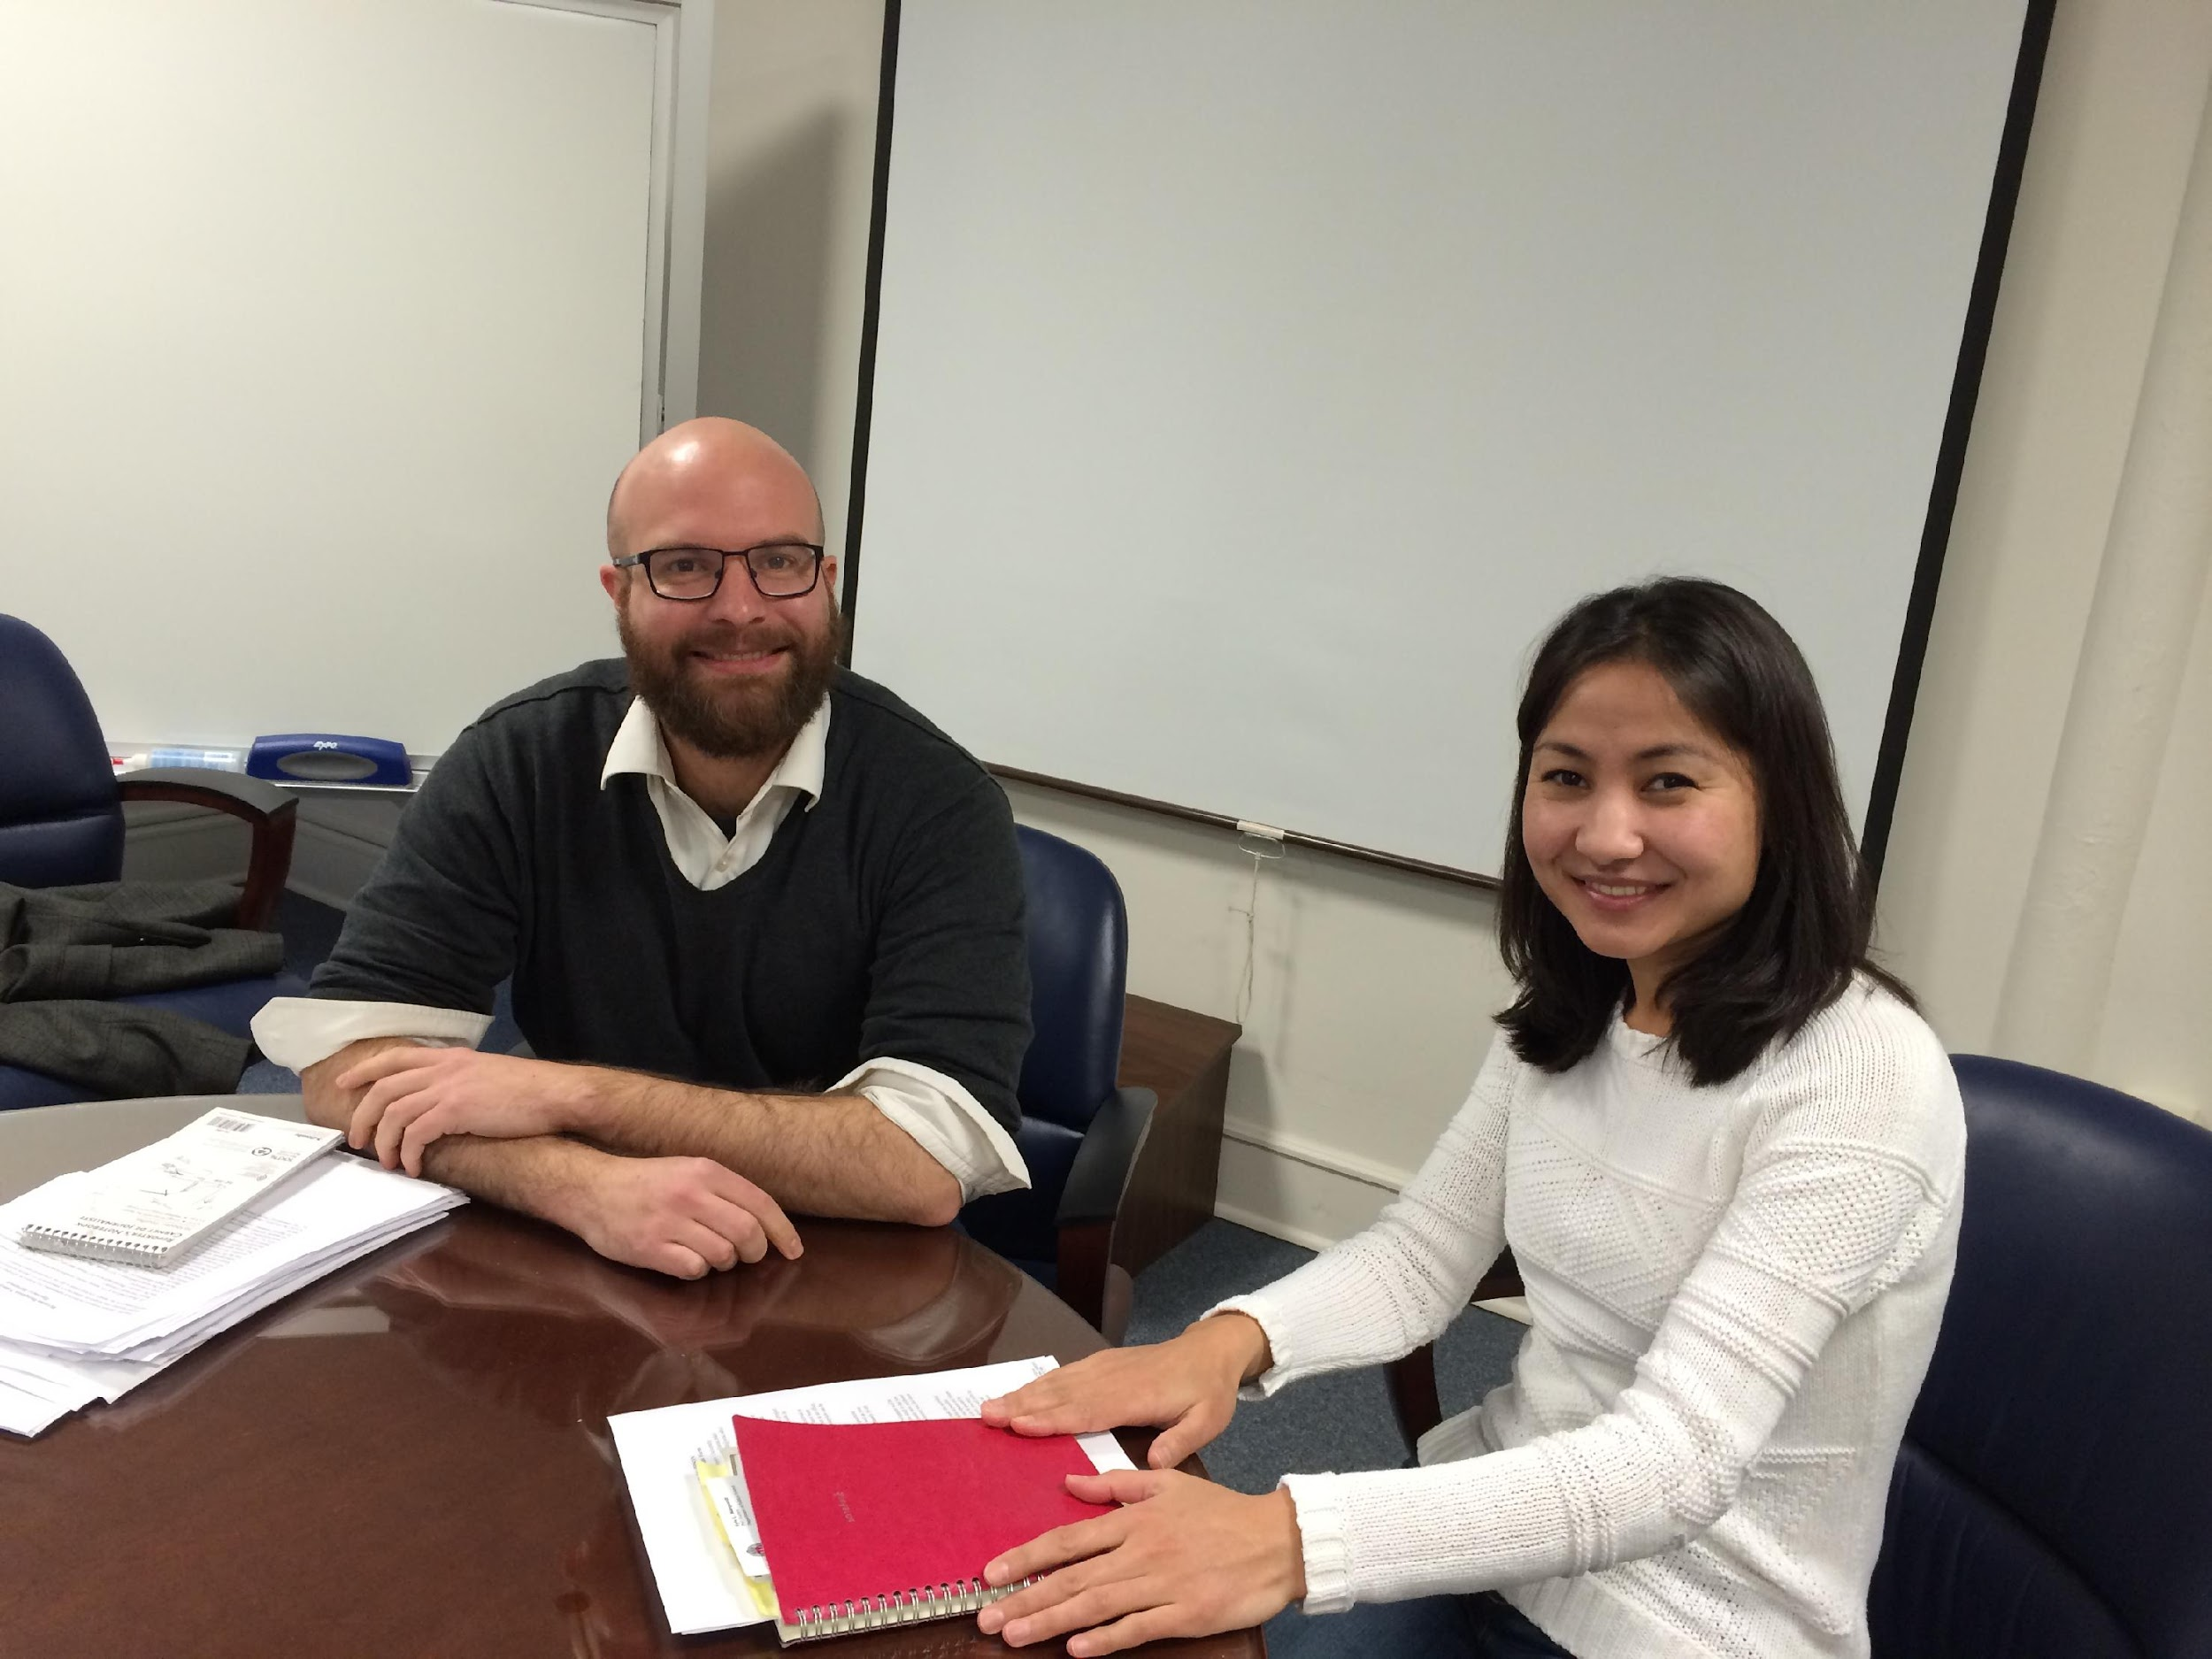
Internship at University Wisconsin - Madison Library
- Internship at University Wisconsin - Madison Library, Digital Collections Center (September – December, 2014)
Main goals:
- development and management the digital collections
- understand the digital project development process
- UW-Madison Institutional Repository
- By the end of the internship to create and develop the Nazarbayev University Institutional Repository.

Slide 7
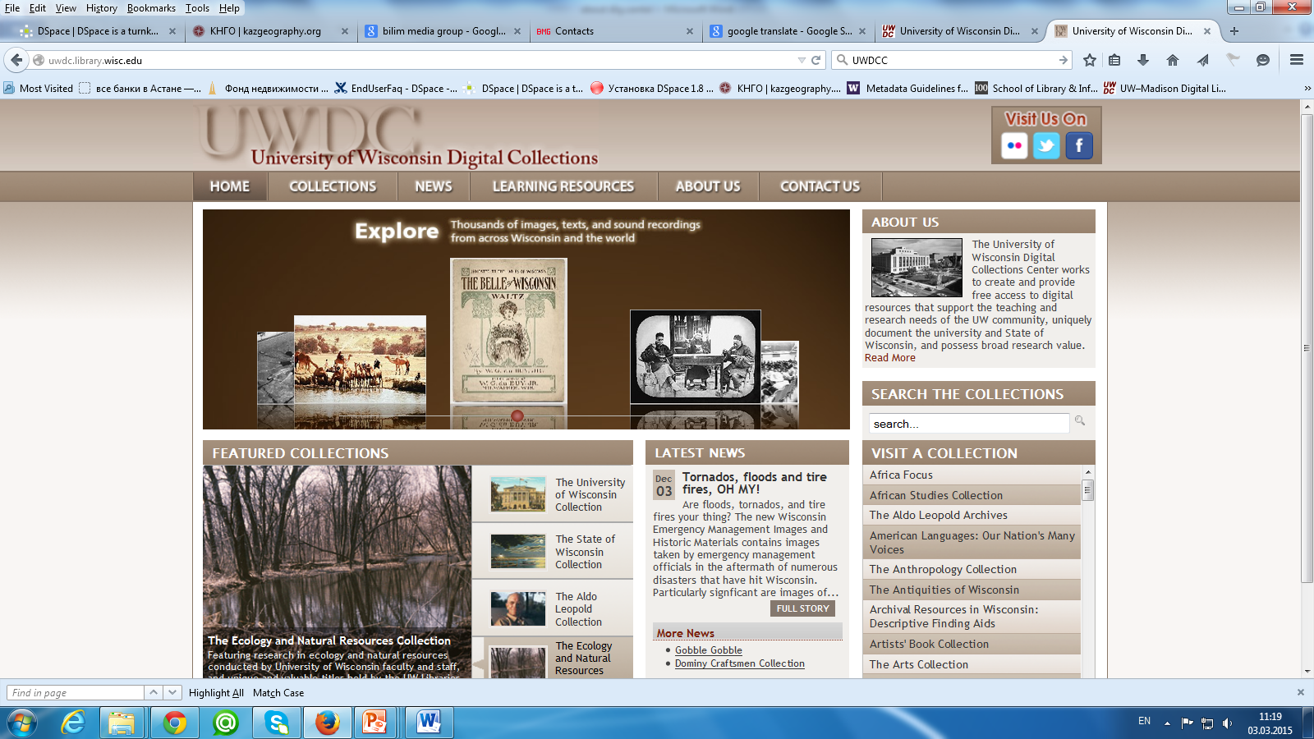
University Wisconsin Digital Collections (UWDC)
Notes:
The University of Wisconsin Digital Collections (UWDC) were established in the summer of 2001

Slide 8
University of Wisconsin Digital Collections (UWDC)
What they do:
Create digital resources to support instruction and research
UWDCC provide over 60 collections about
art, ecology, literature, history, music,
natural resources, science, social sciences,
the State of Wisconsin and the University of Wisconsin.
Resources in the collections are free and publicly accessible online.

Slide 9
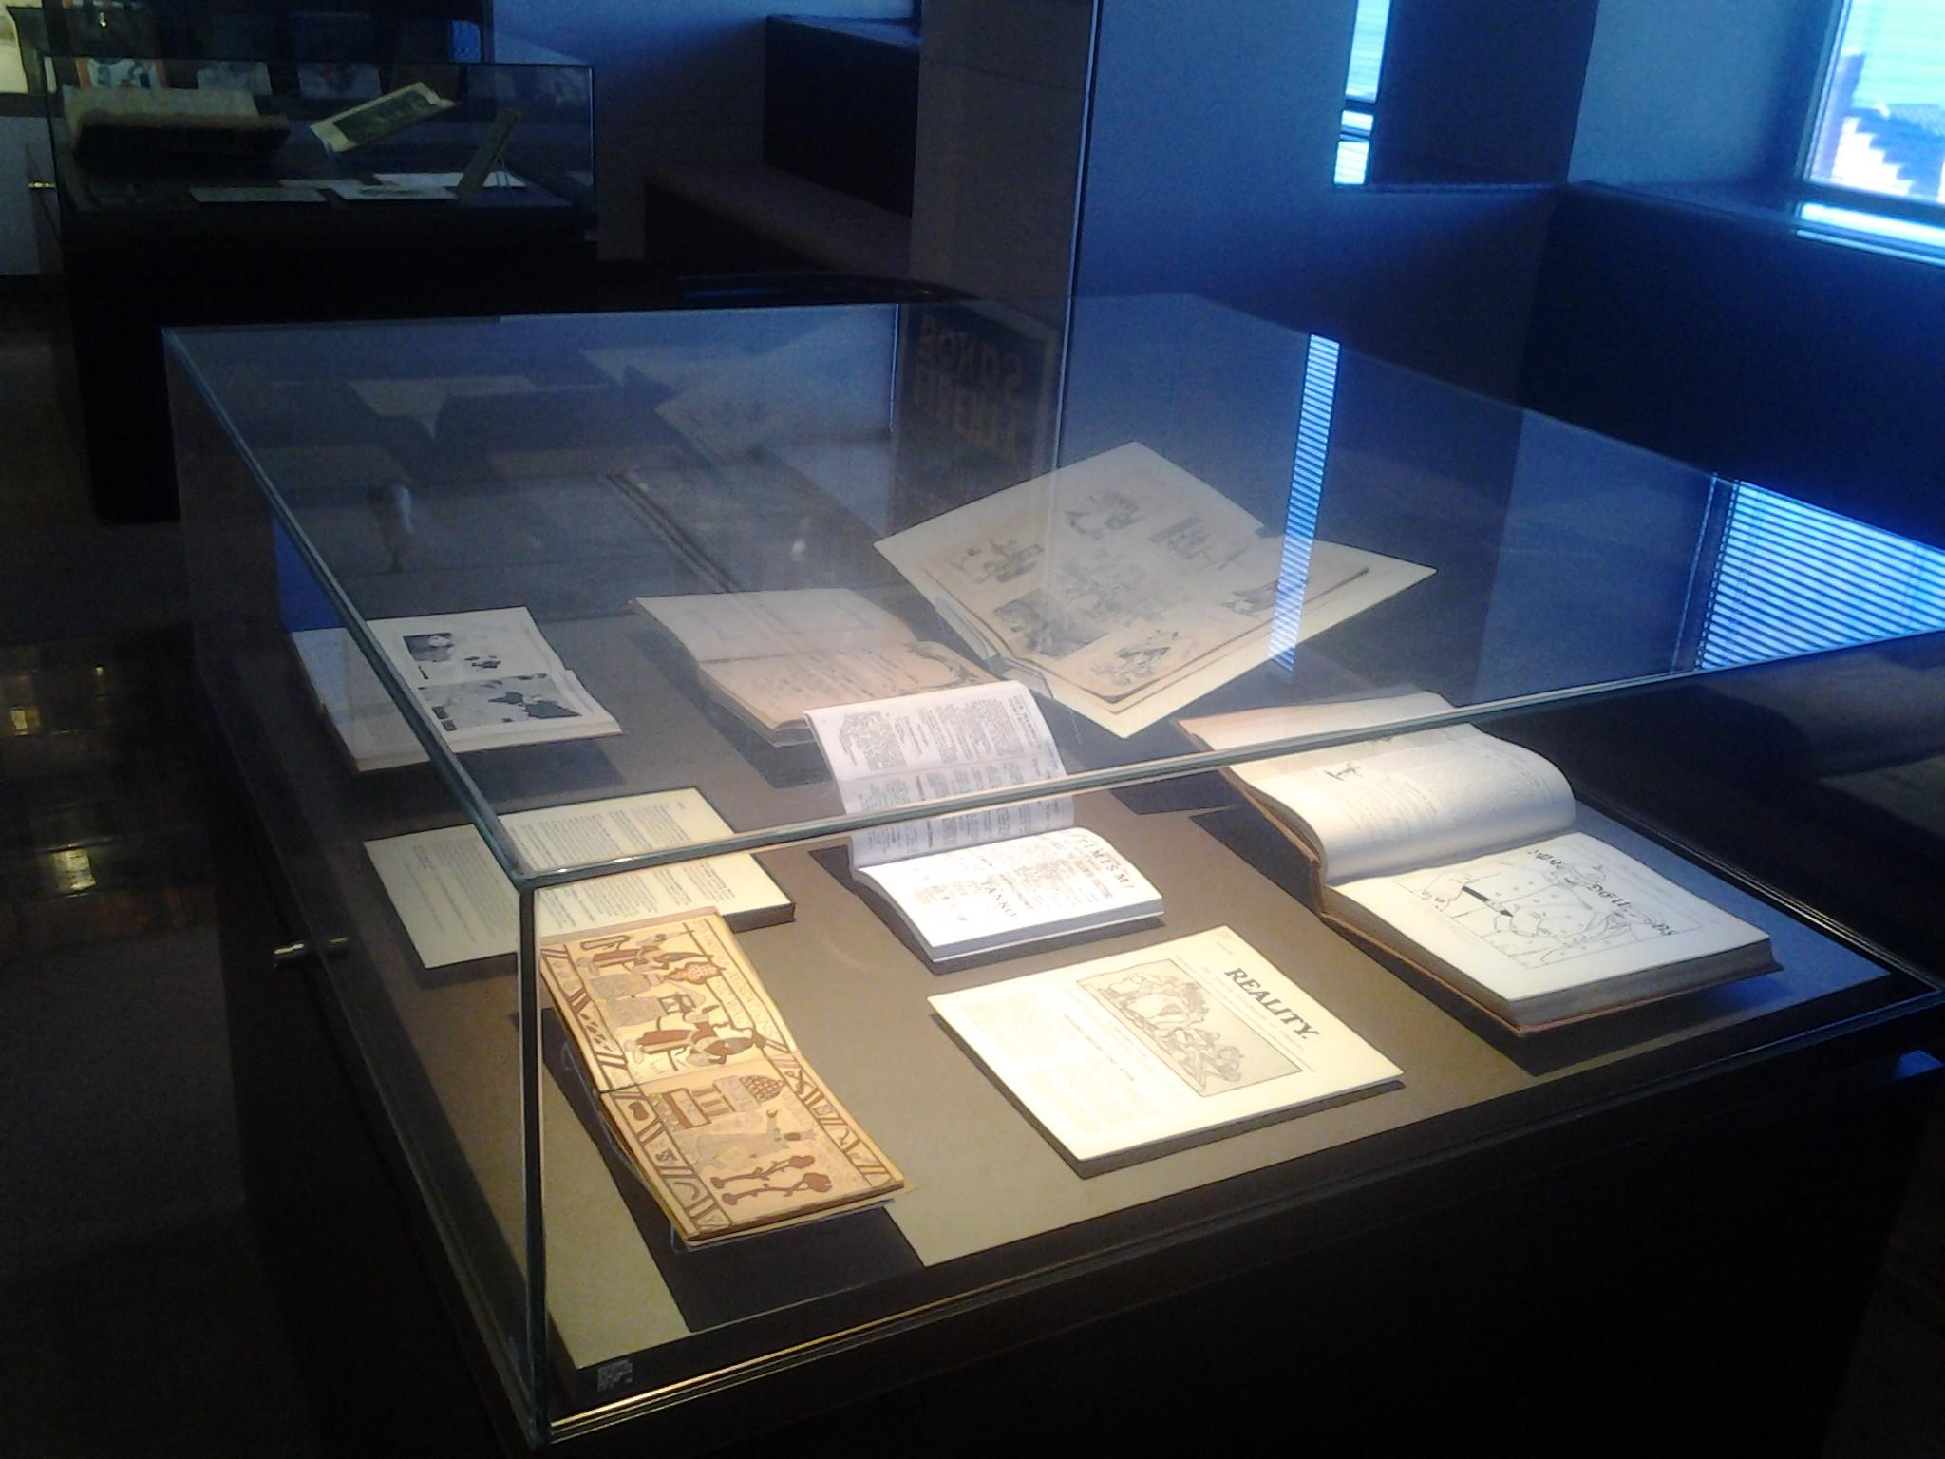
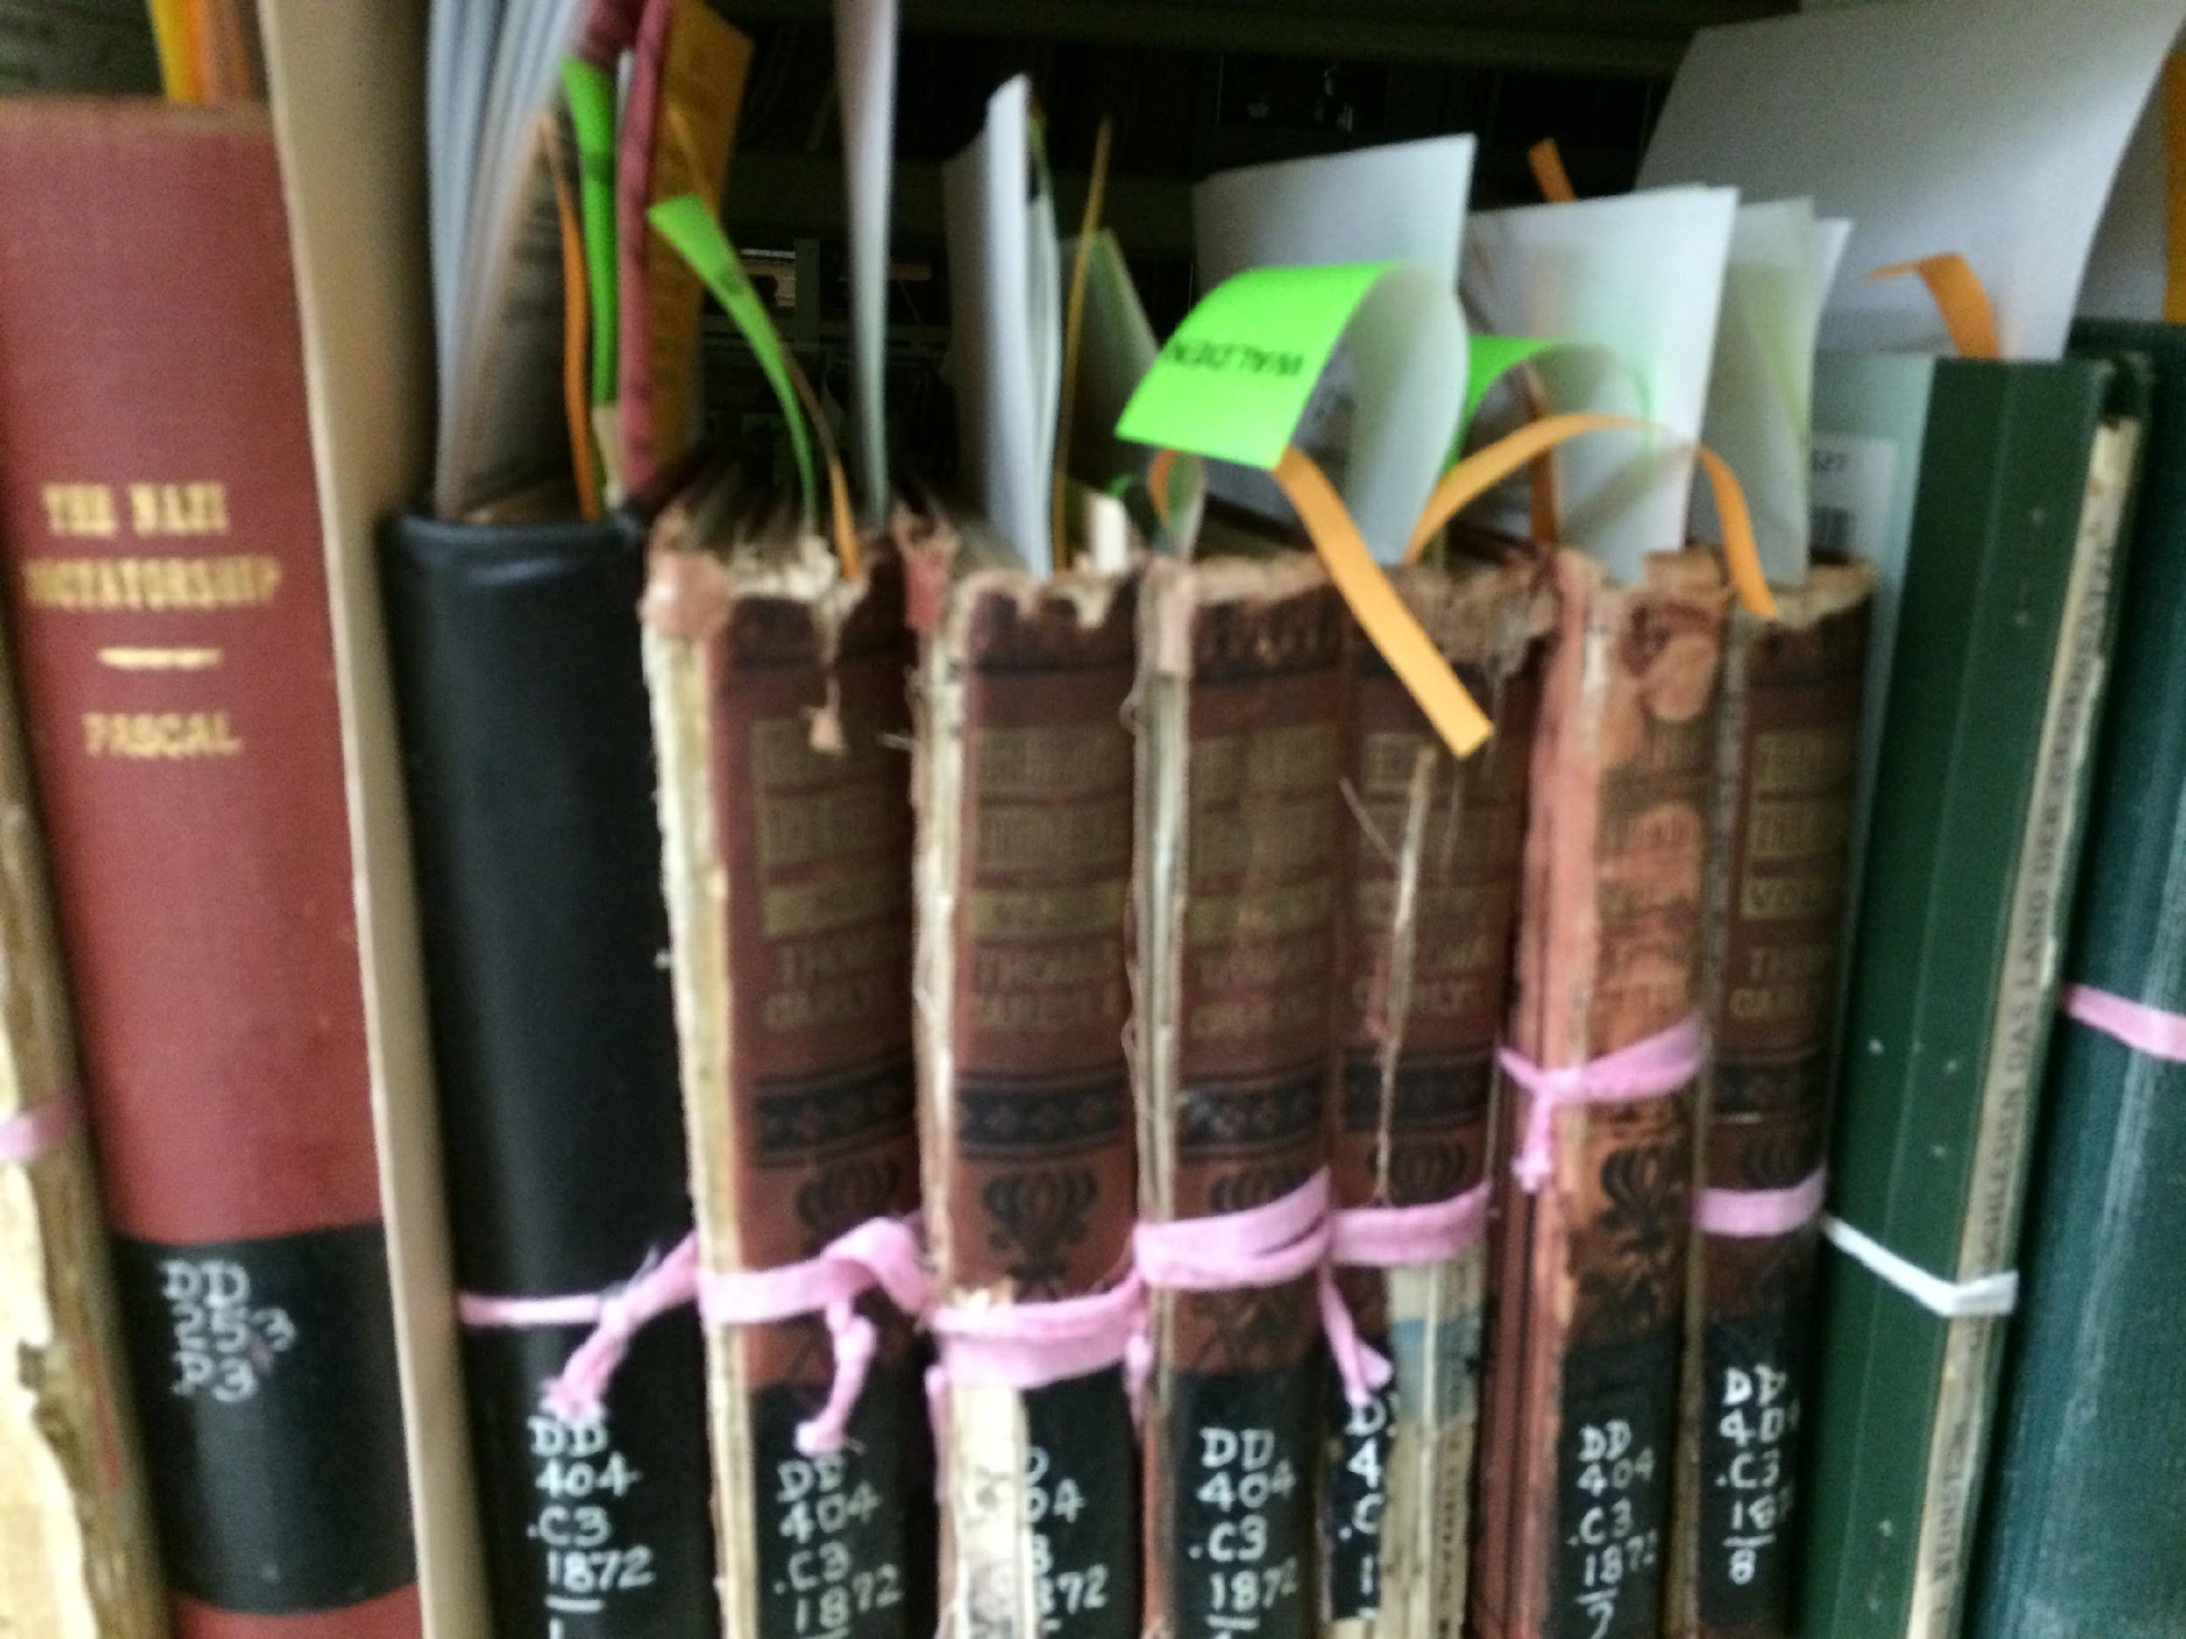
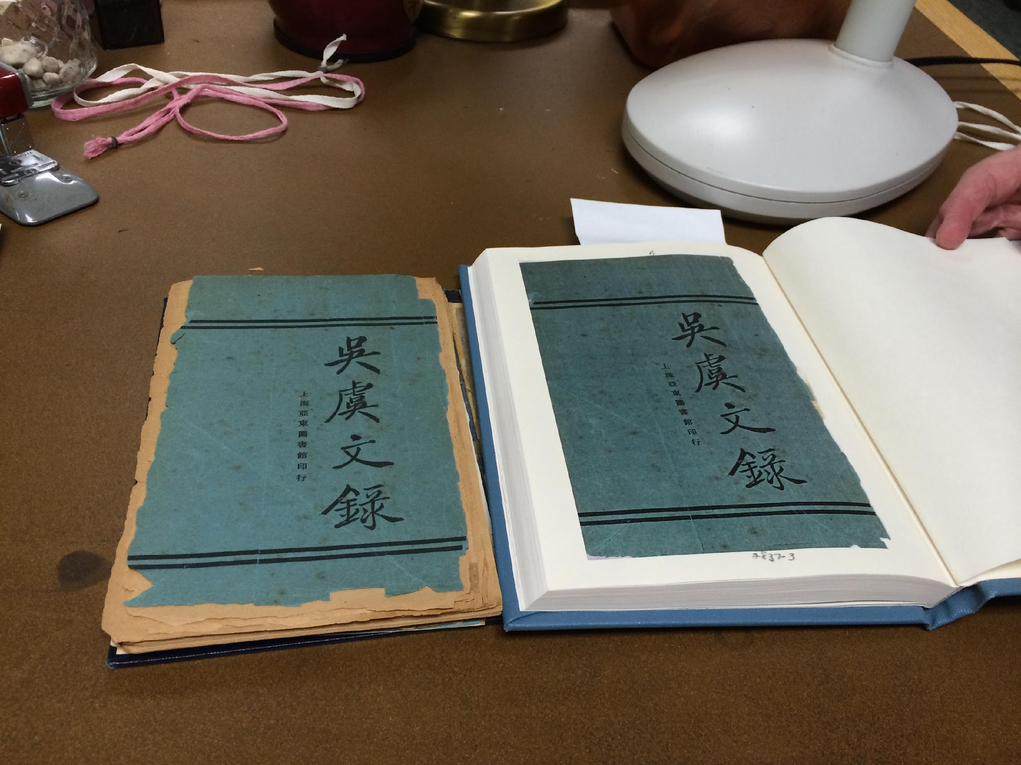
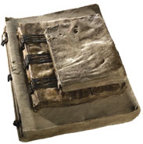
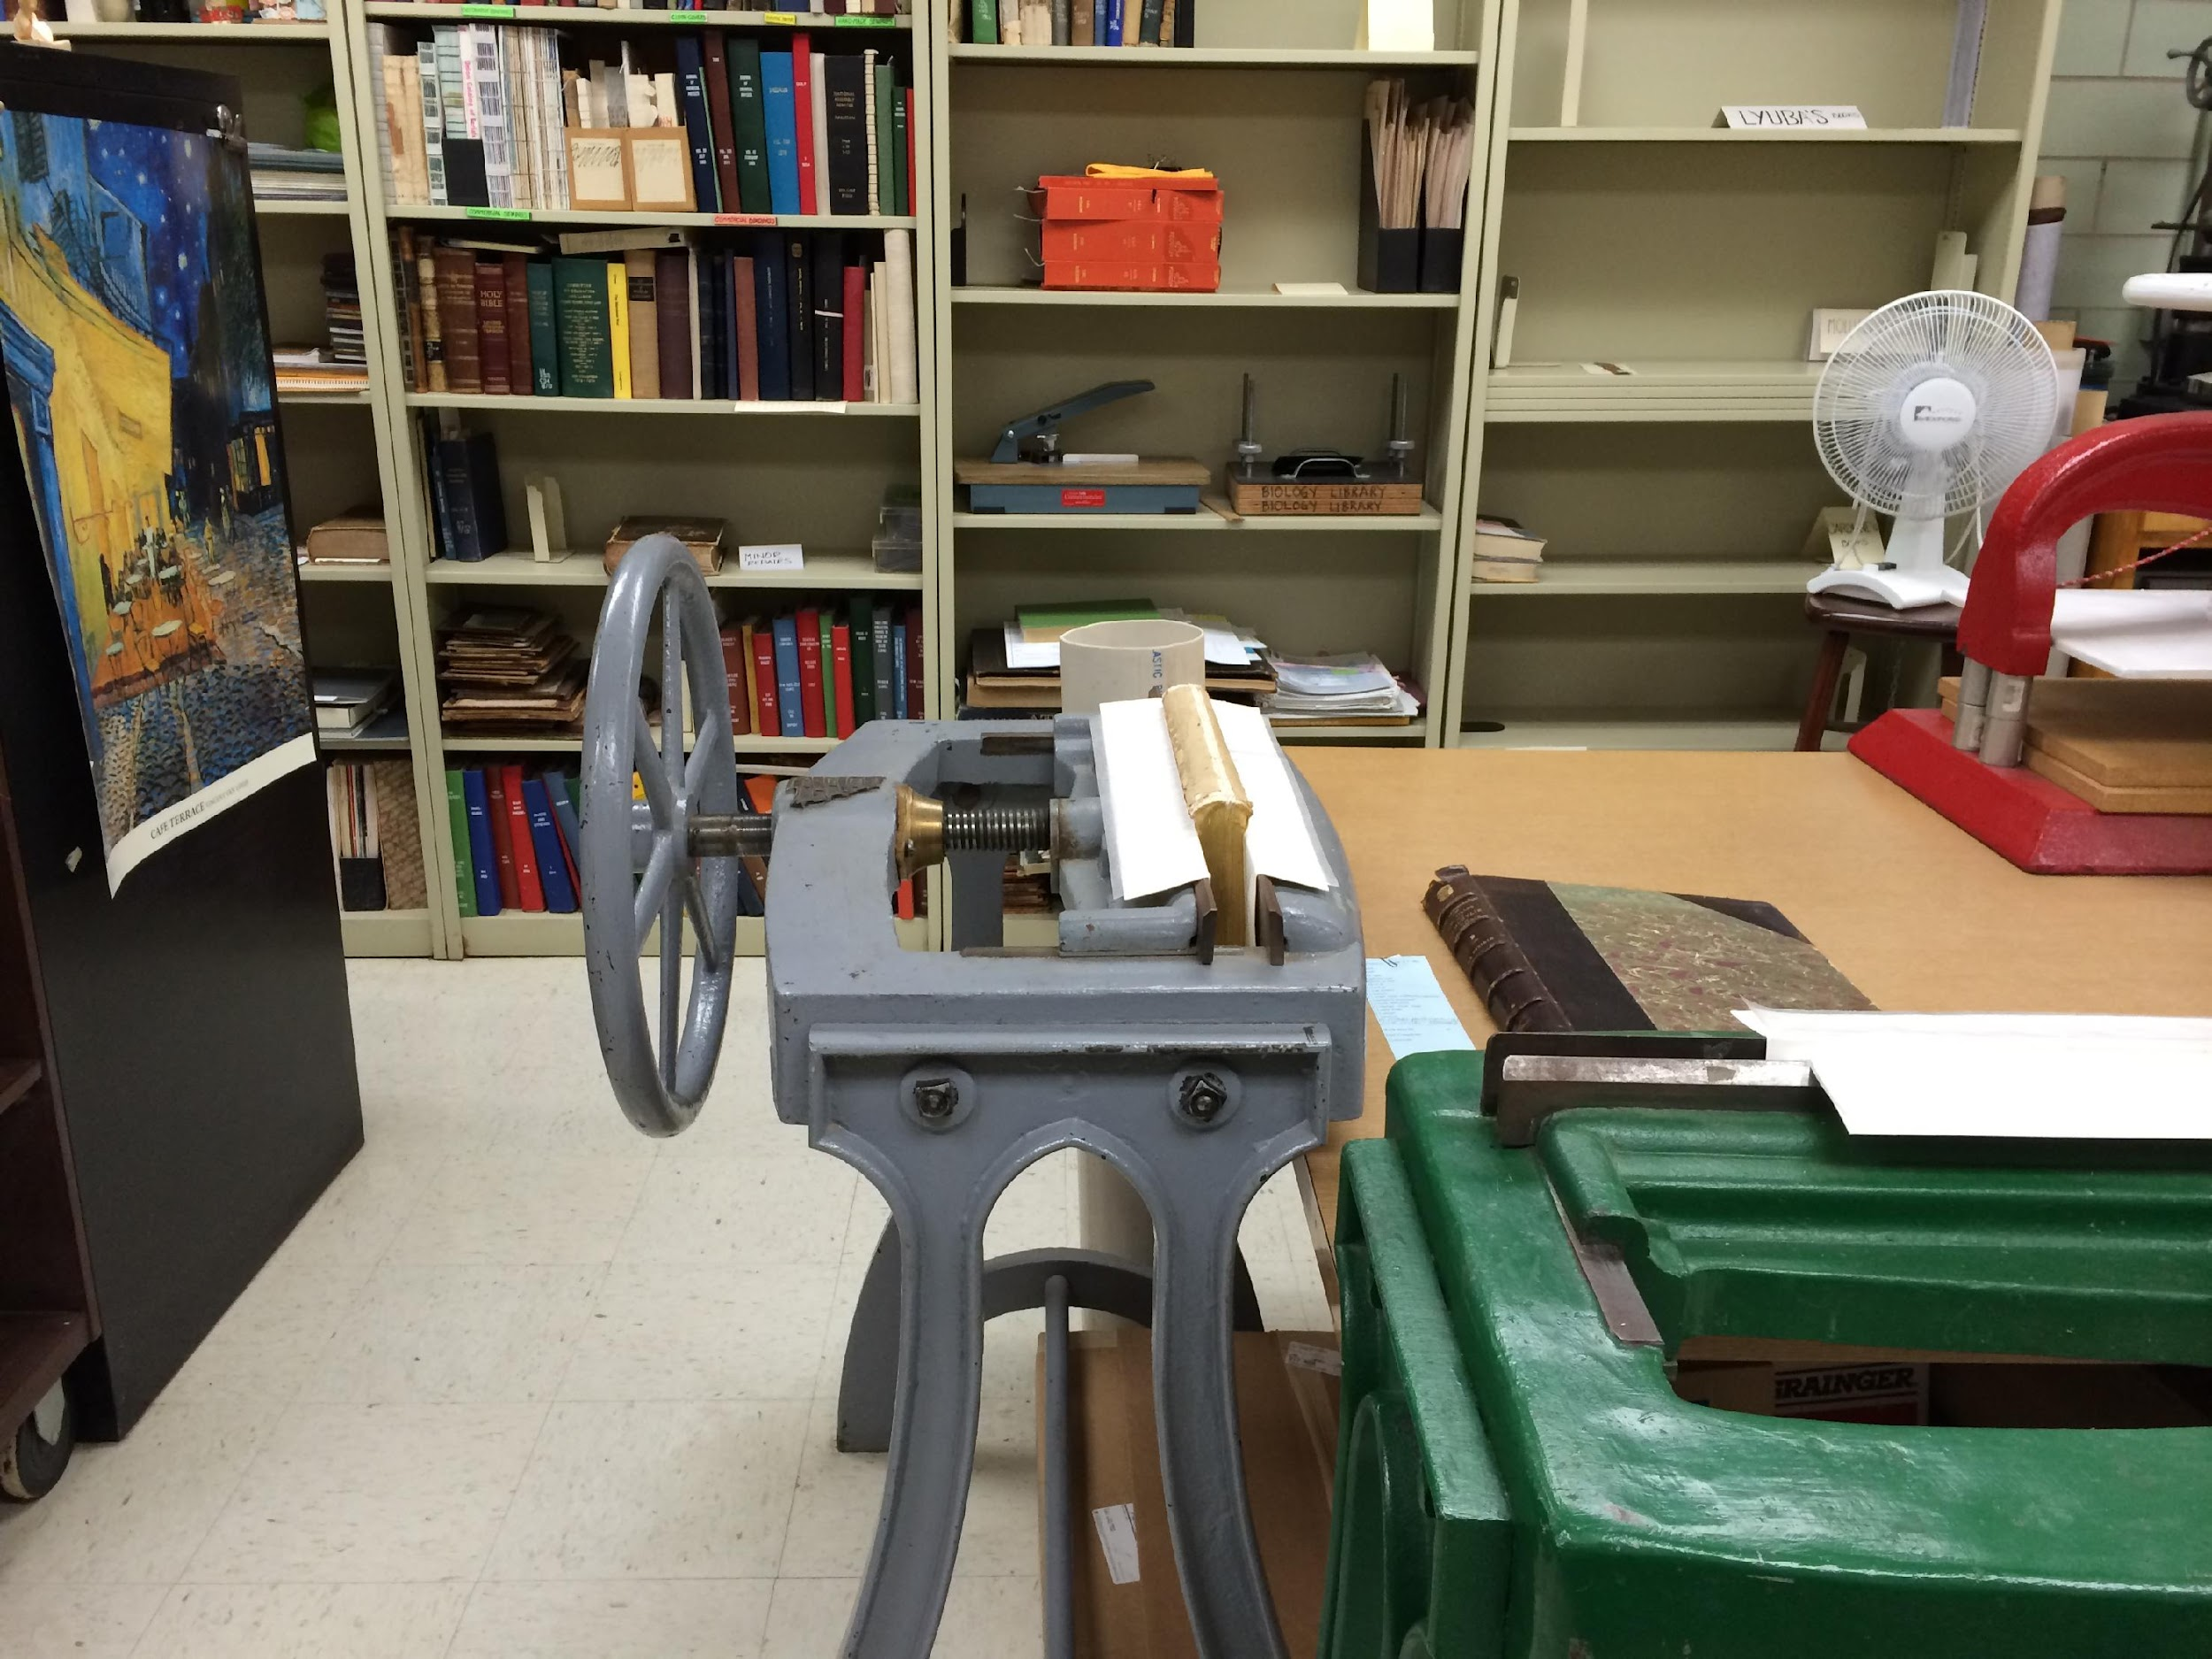
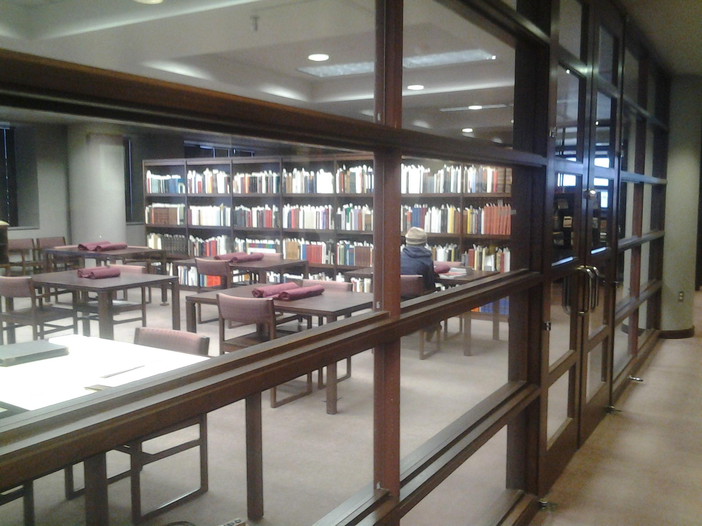
Special Collections
Conservation Laboratory

Slide 10
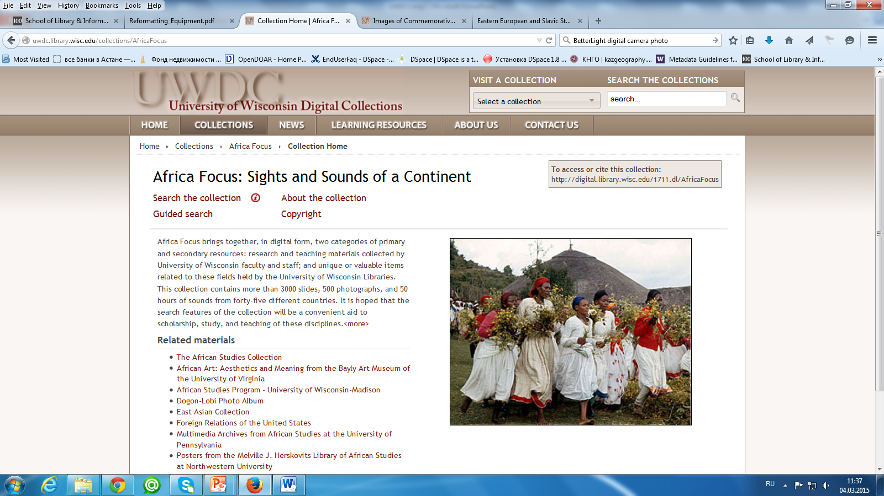
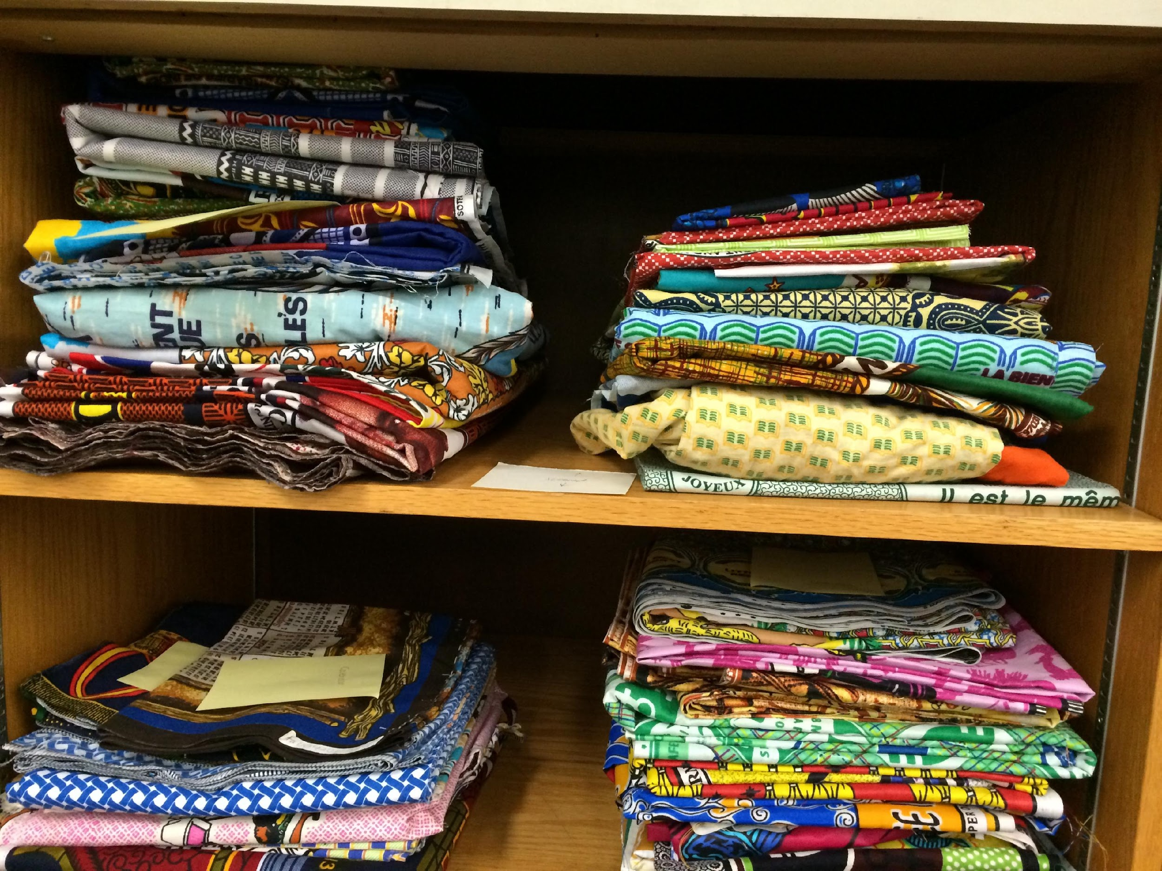
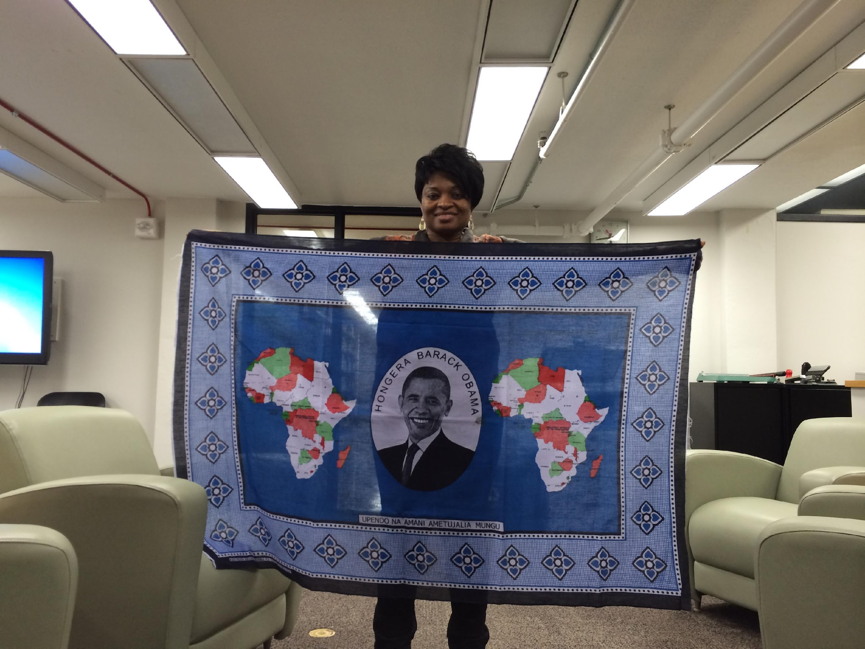
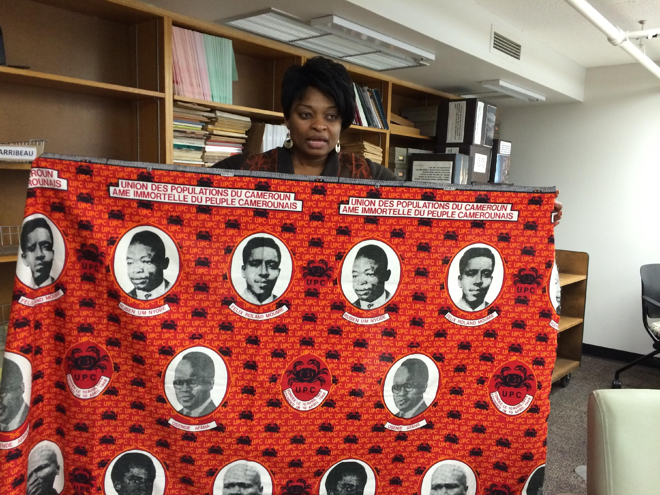
First multi-media project - Africa Focus
This collection contains more than 3000 slides, 500 photographs, and 50 hours of sounds from forty-five different countries.
African Commemorative Fabrics is a collection of machine-made commemorative textiles from various African countries.
This collection provides access to digitized fabrics with images and text of historical, political, religious аnd sociological significance to African societies.

Slide 11
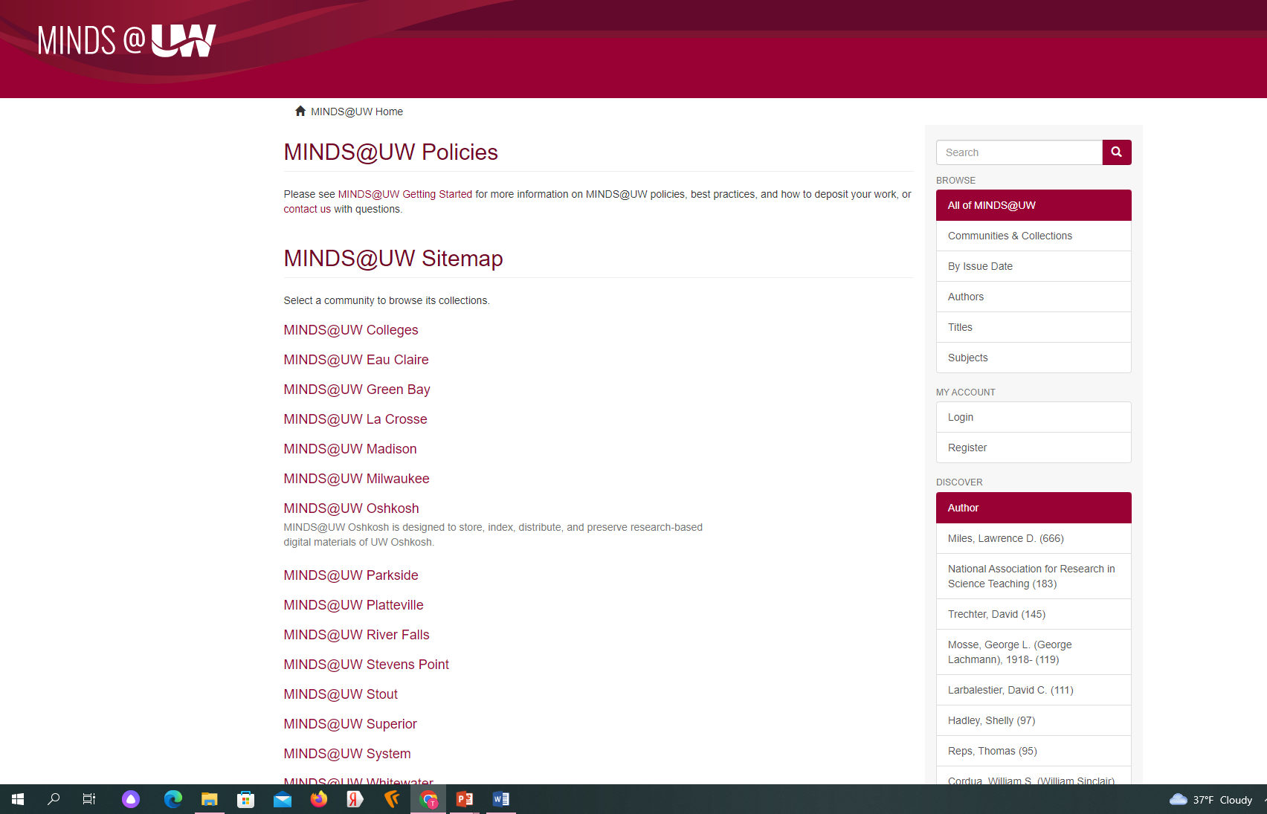
MINDS@UW - Institutional Repository

Slide 12
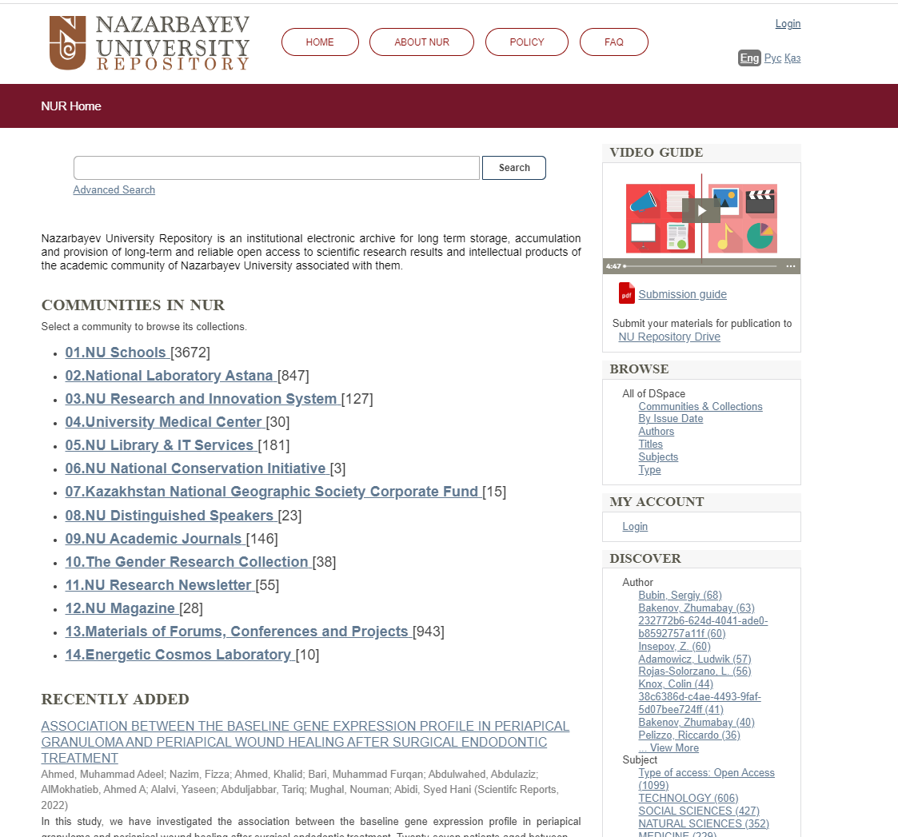
Nazarbayev University Institutional Repository
NU Repository is an institutional electronic archive designed to support main idea of Open Access and perform long term storage, accumulation and provision of long-term and reliable access to scientific research results and intellectual products of the academic community of Nazarbayev University associated with them.
https://nur.nu.edu.kz
In 2014, the Managing Council approved Regulations about Open Access Archives – NU Repository
Currently the total number of items – 6050
The Result of the internship was establishment of the NU Repository https://nur.nu.edu.kz/

Slide 13
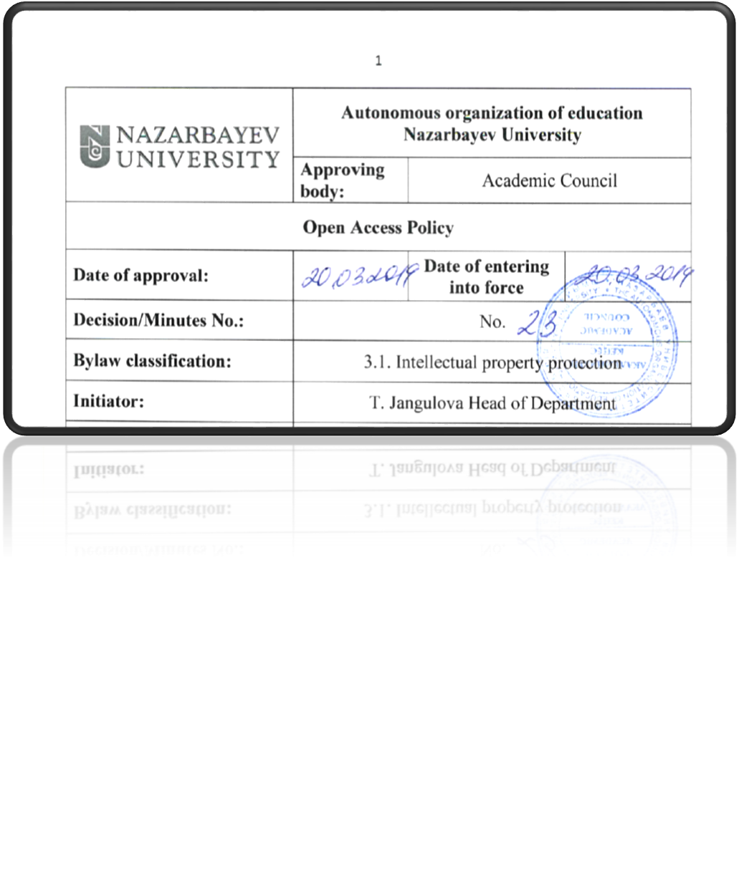
NU Open Access Policy
The NU Academic council approved Open Access Policy, 2019

Slide 14
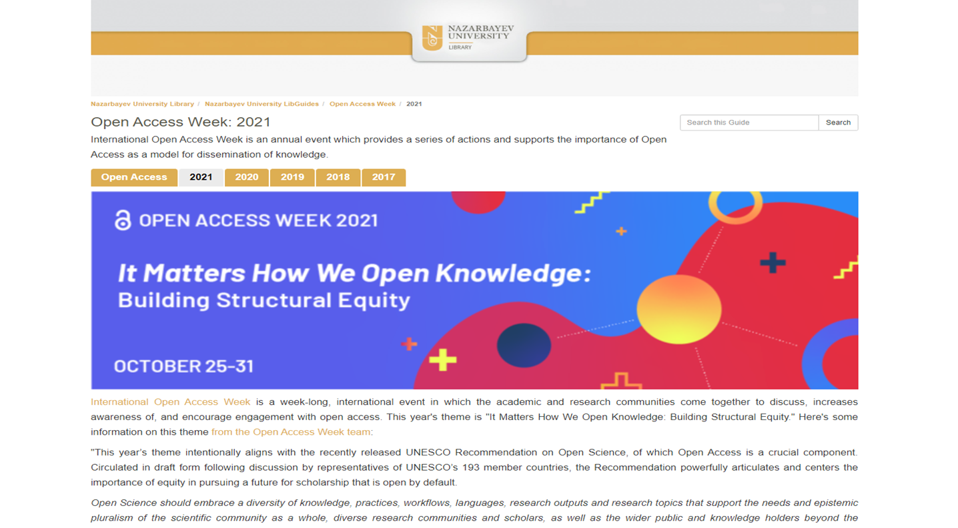
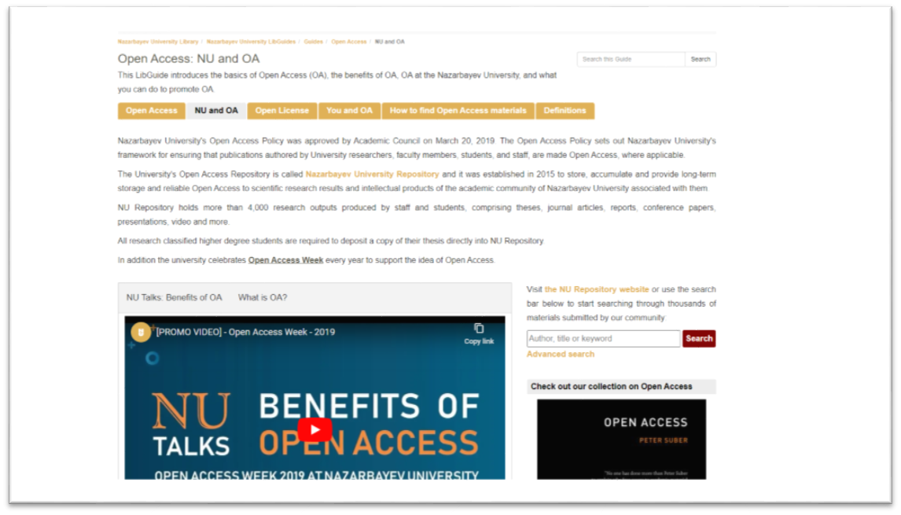
Open Access LibGuide
https://nu.kz.libguides.com/nuoa/nu

Slide 15
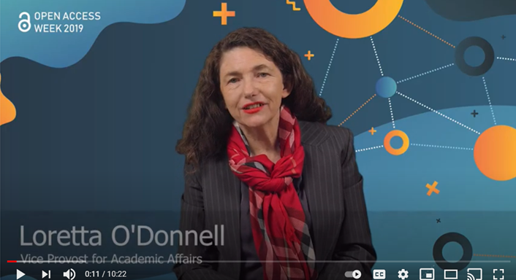
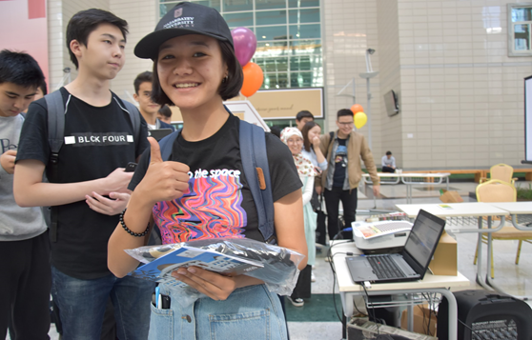

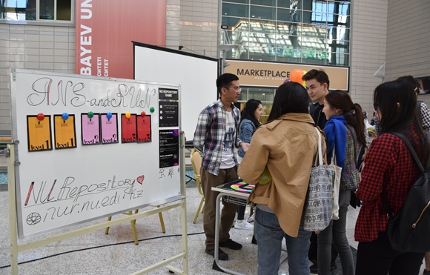
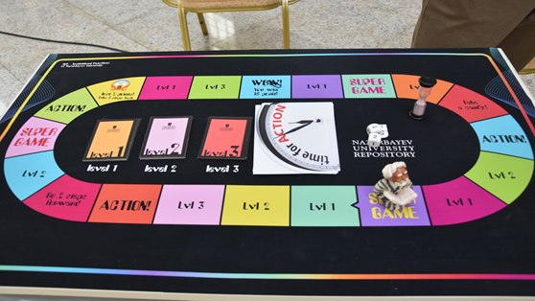
Open Access Week

Slide 16
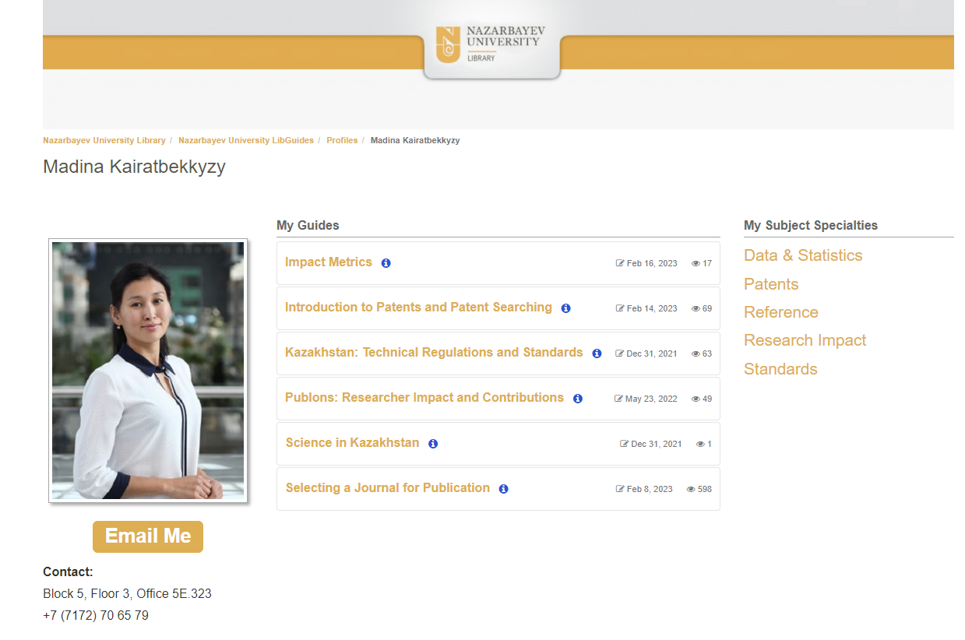
Internship at University Wisconsin - Madison Library
One month internship at UW-Madison, (July, 2013)
- Madina Kairatbekkyzy, Head of Reference Office
- Learned about reference department work
- Functions of the Subject Librarians
- Information Literacy

Slide 17
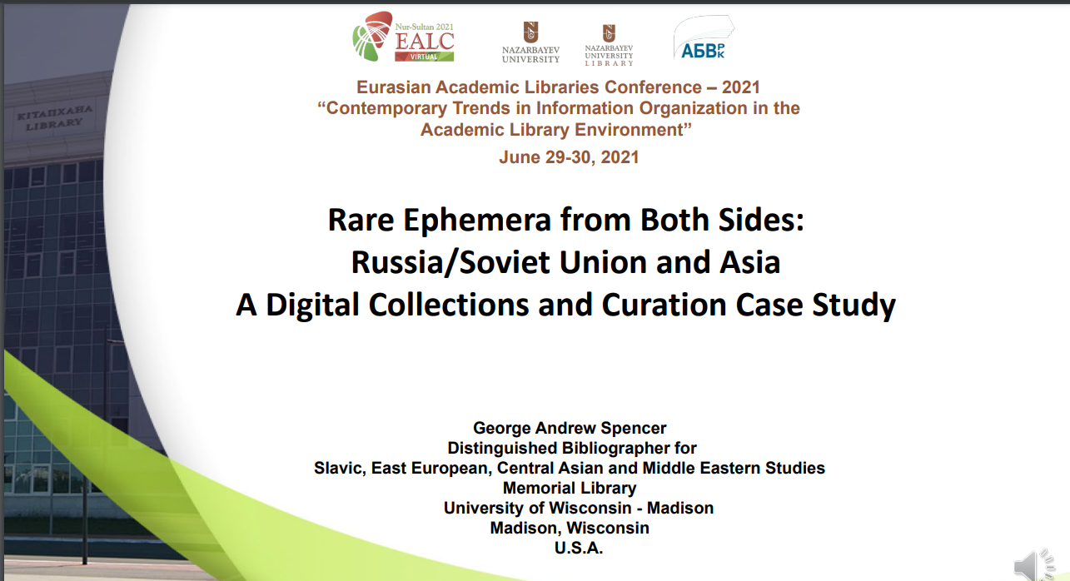
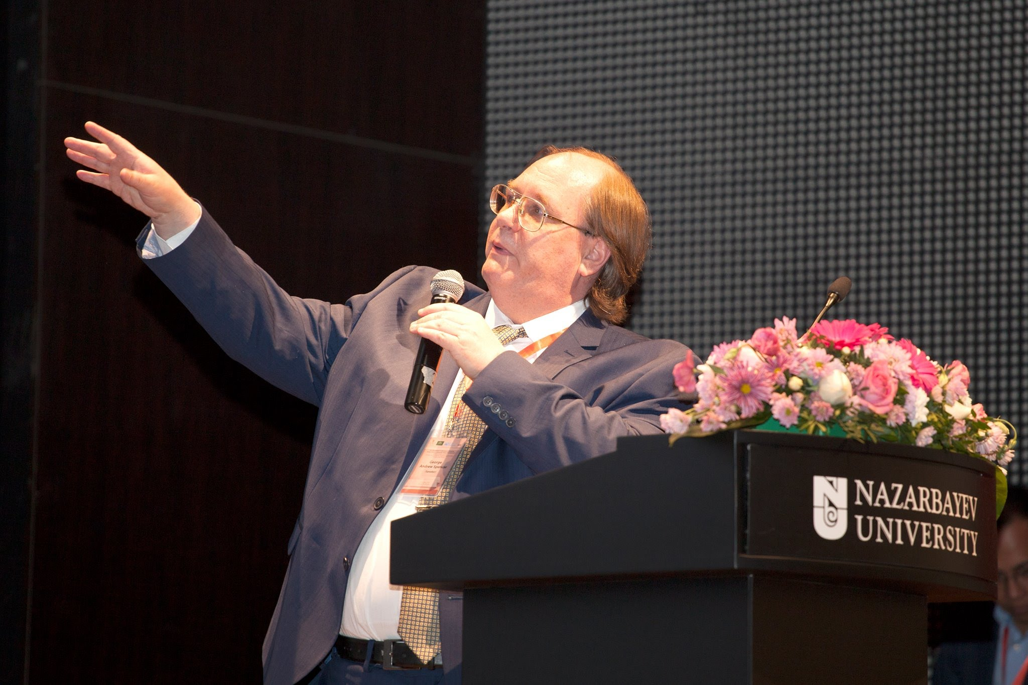
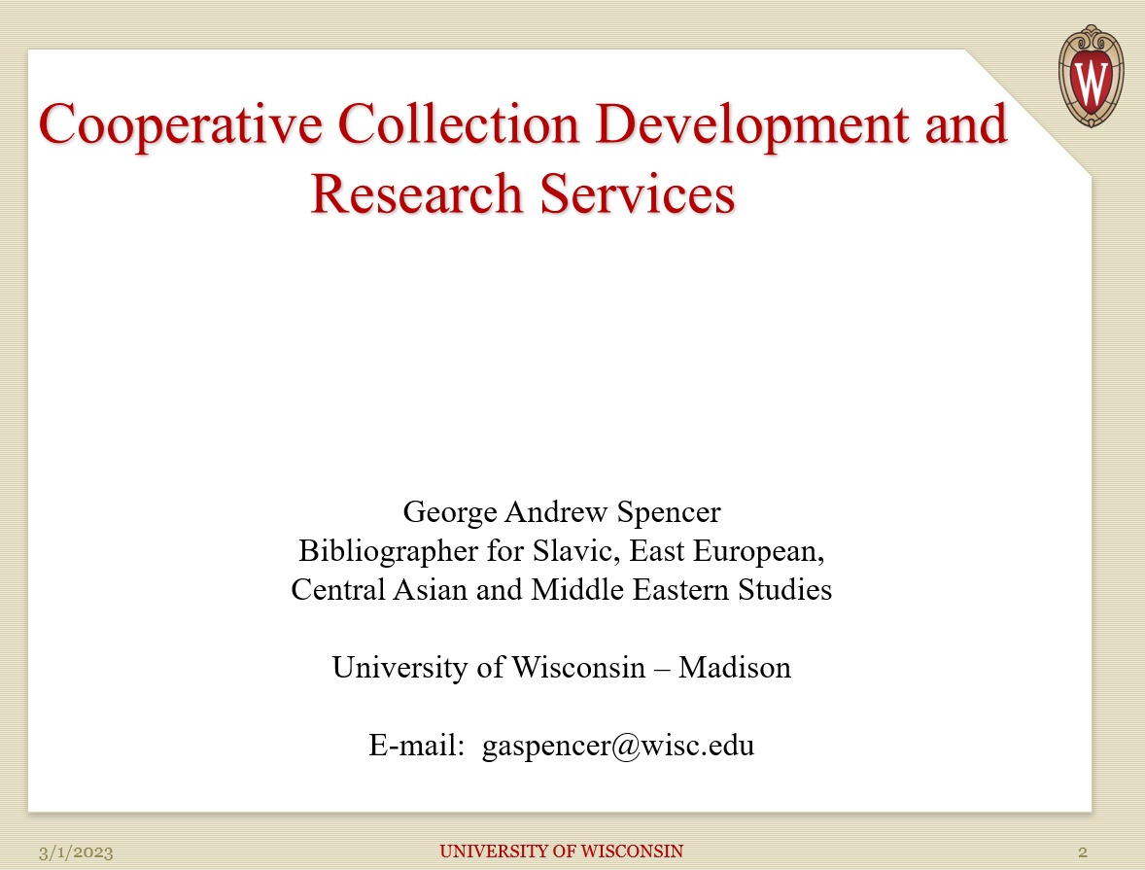
Conference and series of the webinars, UW-Madison, 2018
George Andrew Spencer
Distinguished Bibliographer for
Slavic, East European, Central Asian and Middle Eastern Studies Memorial Library University of Wisconsin - Madison
Conference Participation
Speaker at the annual Kazakhstani librarian conference – EALC-2018

Slide 18
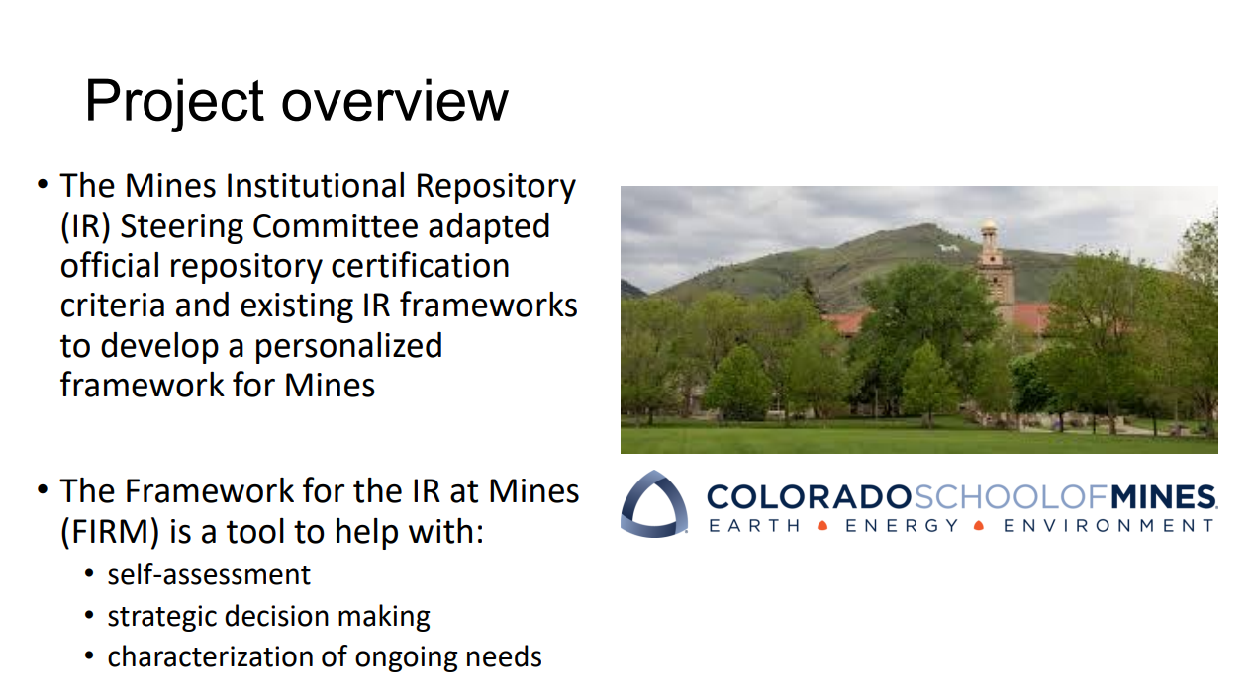
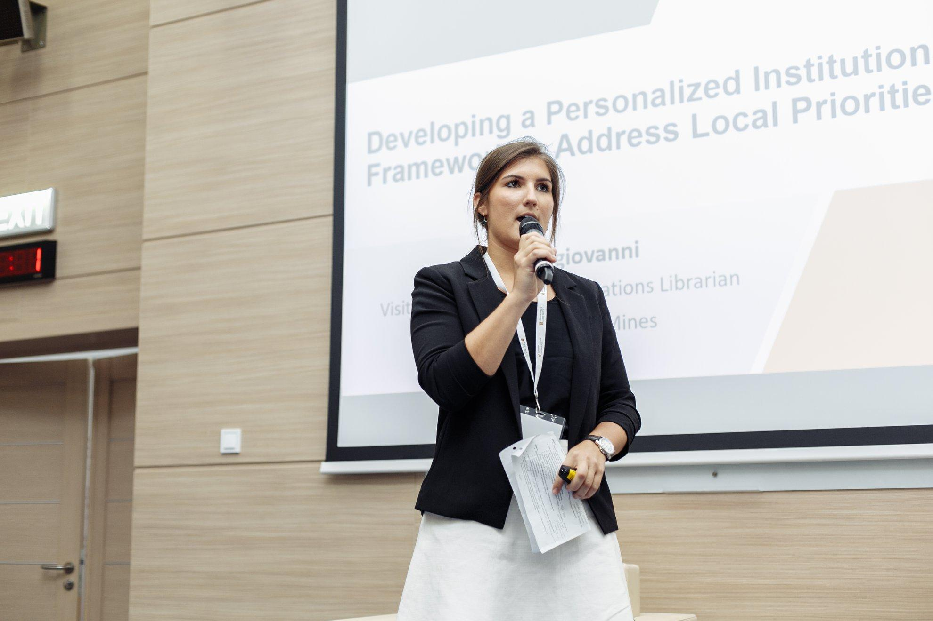
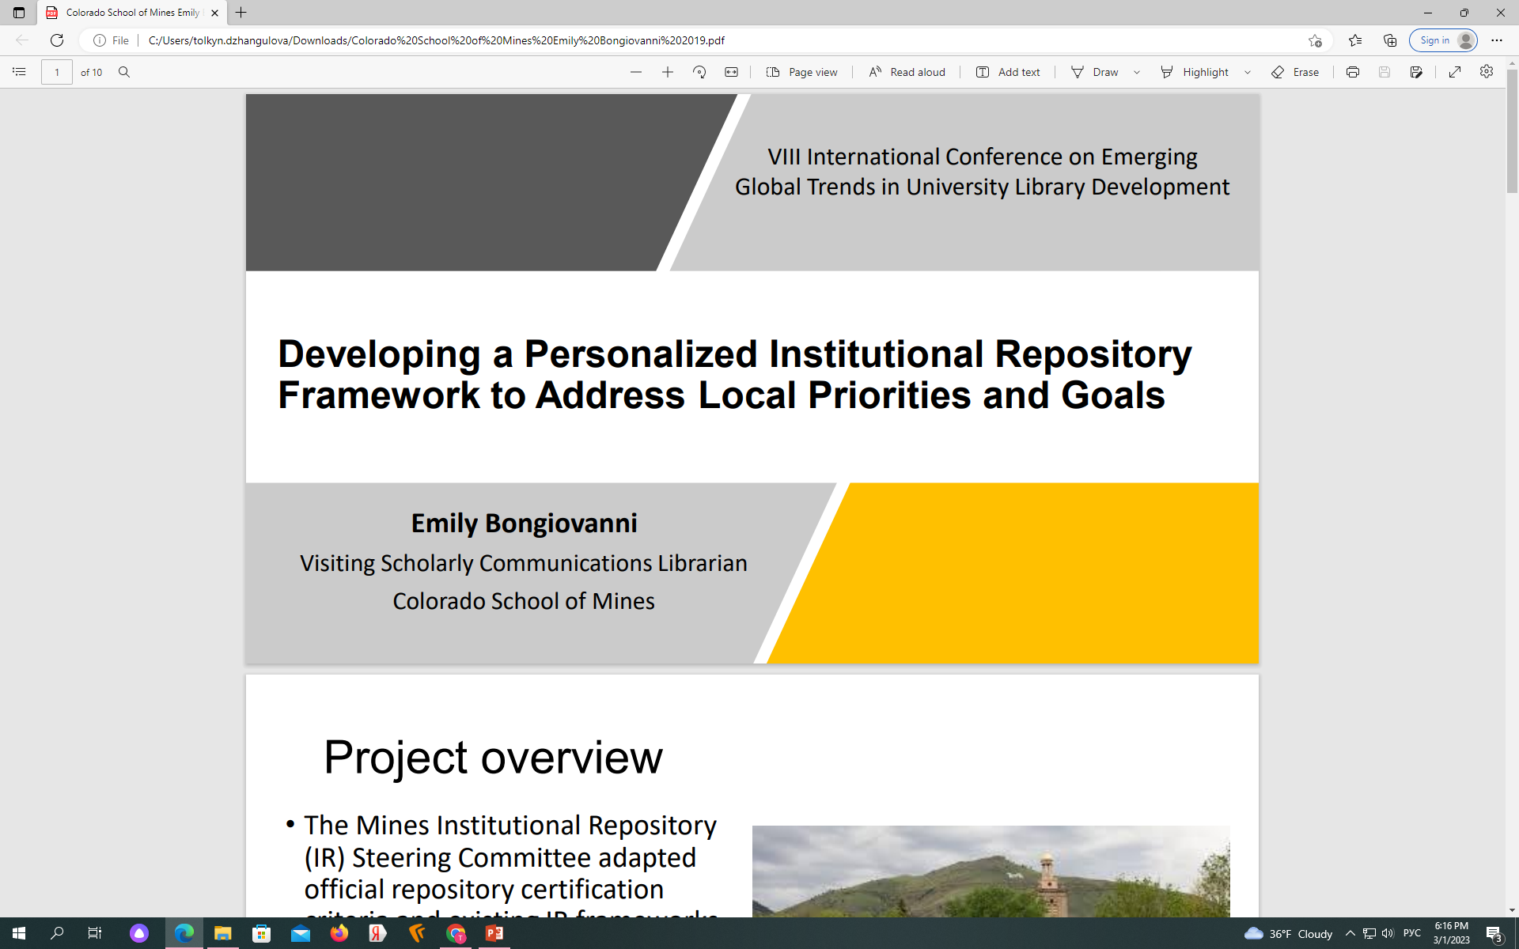
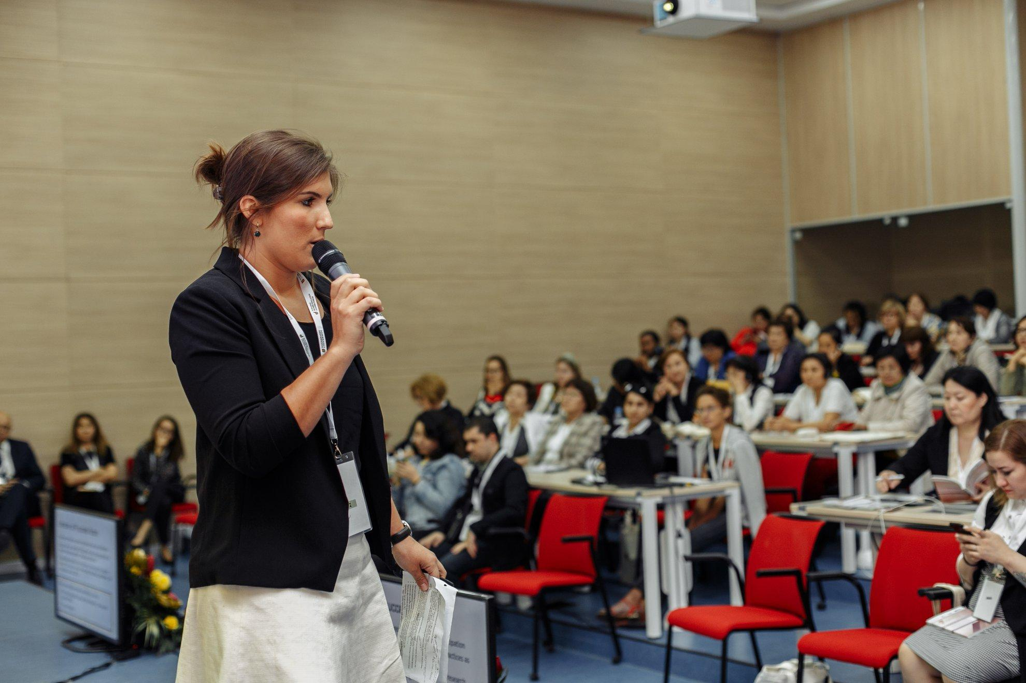
Colorado School of Mines & Arthur Lakes Library,2019
Emily Bongiovanni
Visiting Scholarly Communications Librarian Colorado School of Mines
Conference Participation
VIII International Conference on Emerging
Global Trends in University Library Development, 2019
Notes:
Conference Participation
Speaker at the annual Kazakhstani librarian conference

Slide 19
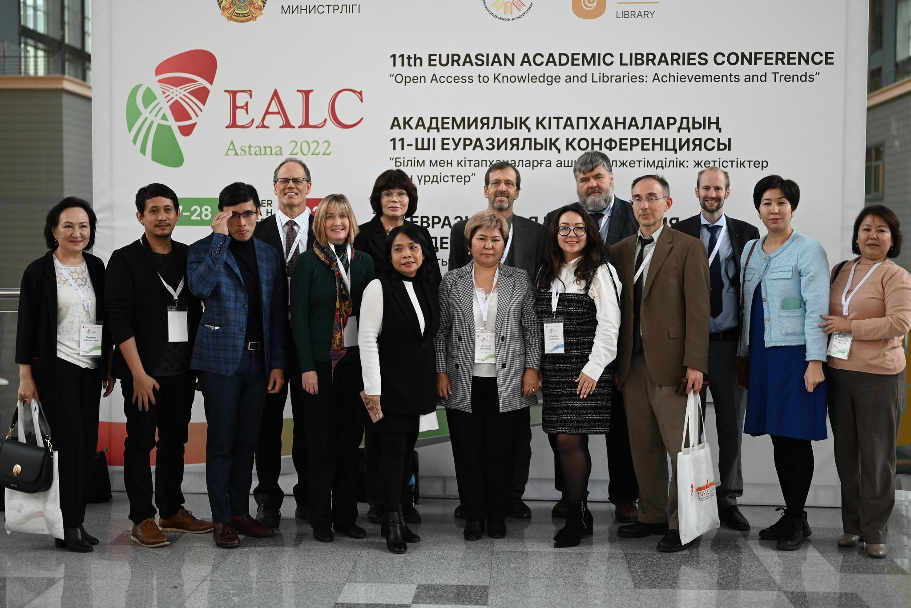
11th Eurasian Academic Libraries Conference
«Open Access to Knowledge and Libraries: Achievements and Trends», 2022

Slide 20
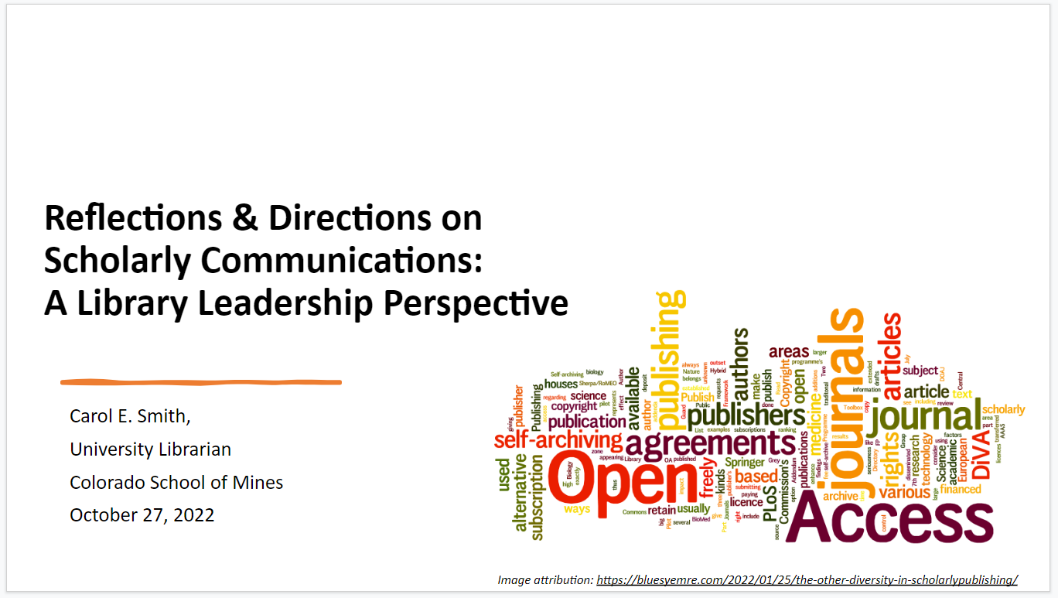
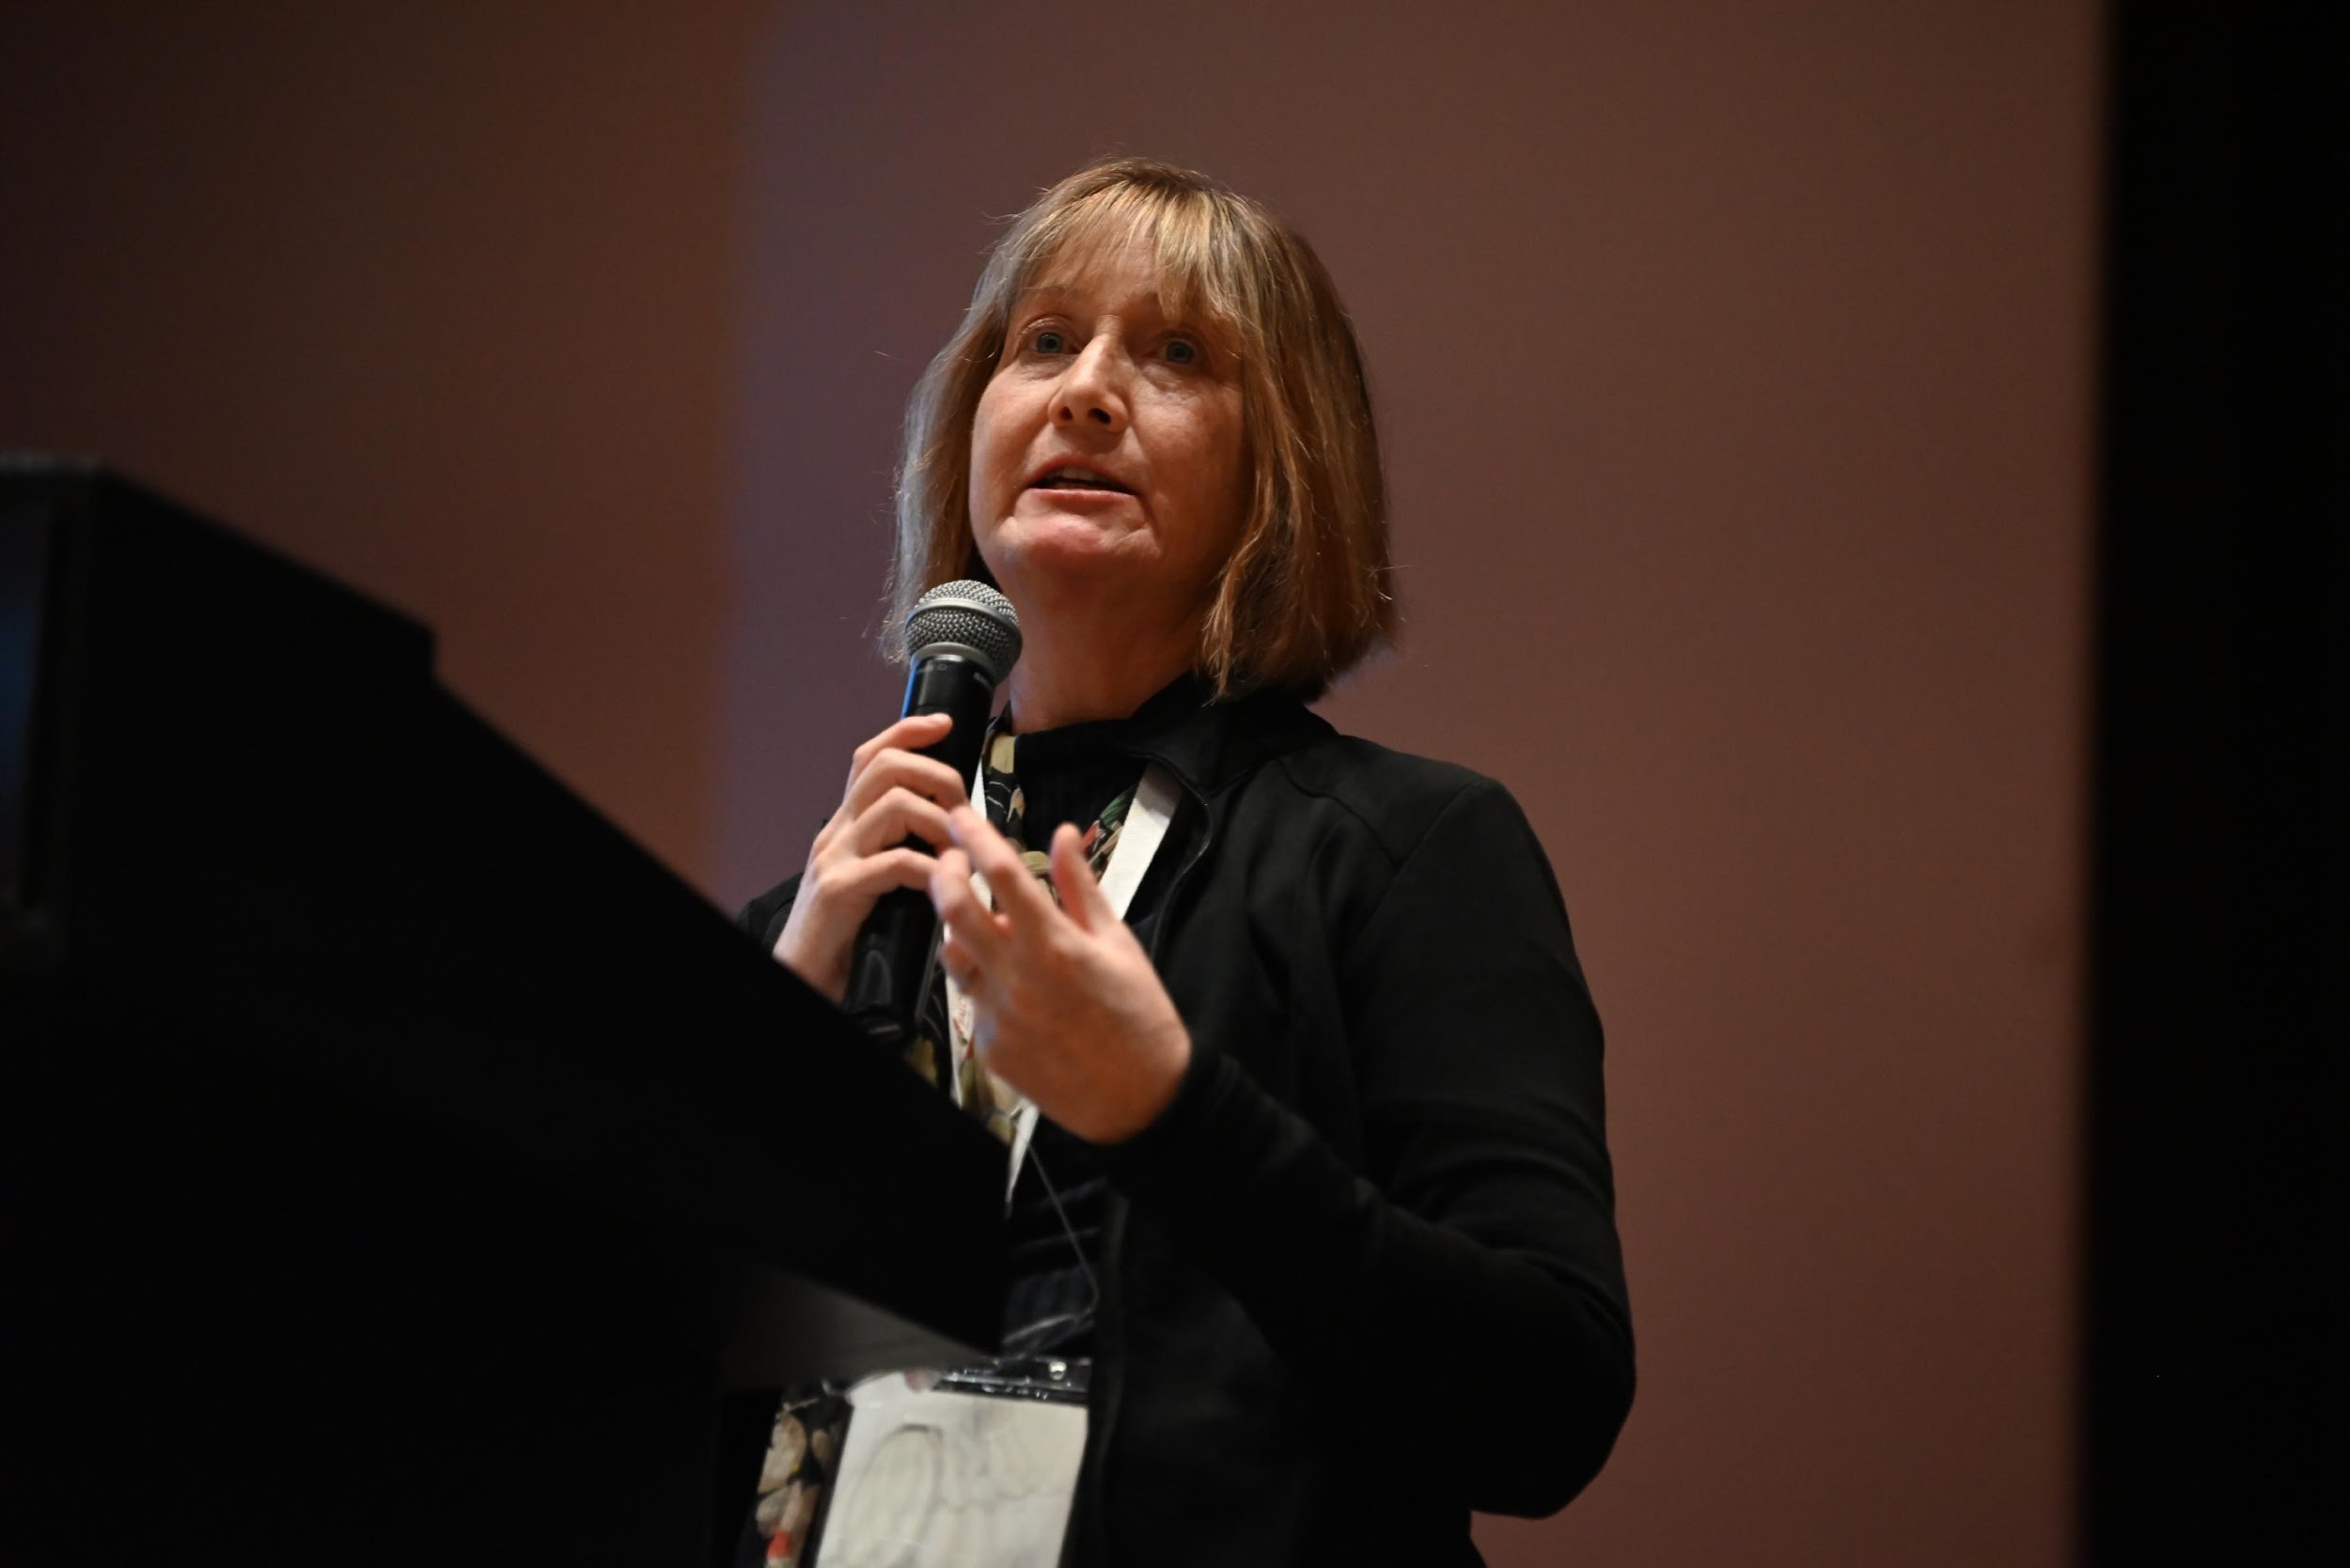
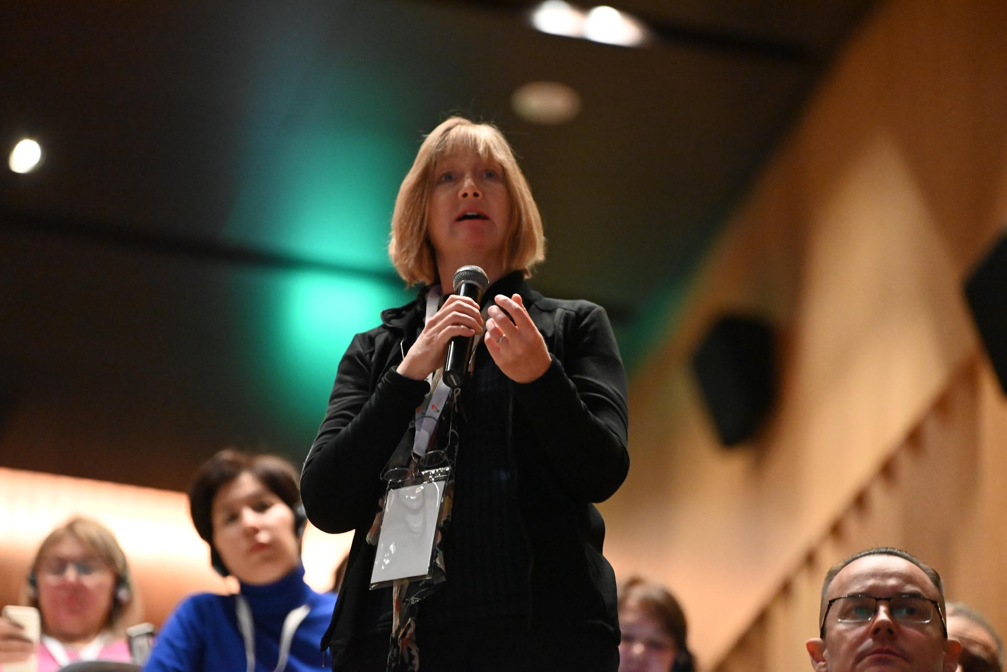
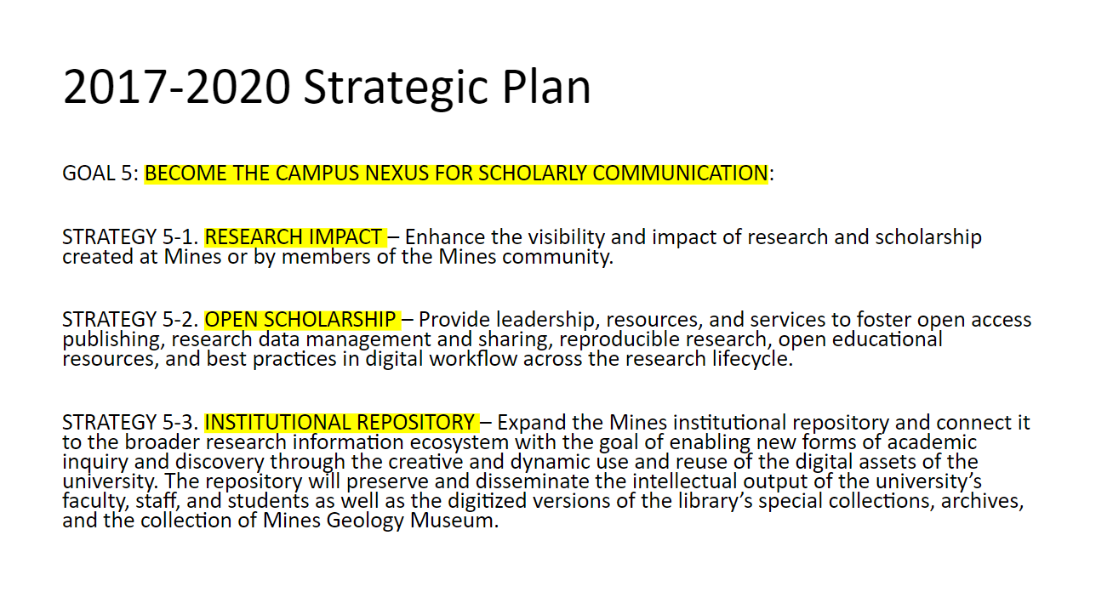
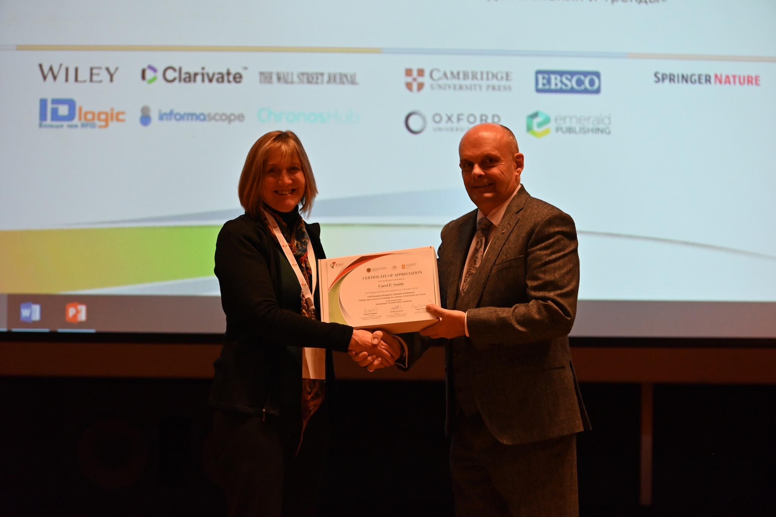
Colorado School of Mines & Arthur Lakes Library, 2022
Carol E. Smith, University Librarian
Colorado School of Mines
Conference Participation EALC-2022

Slide 21
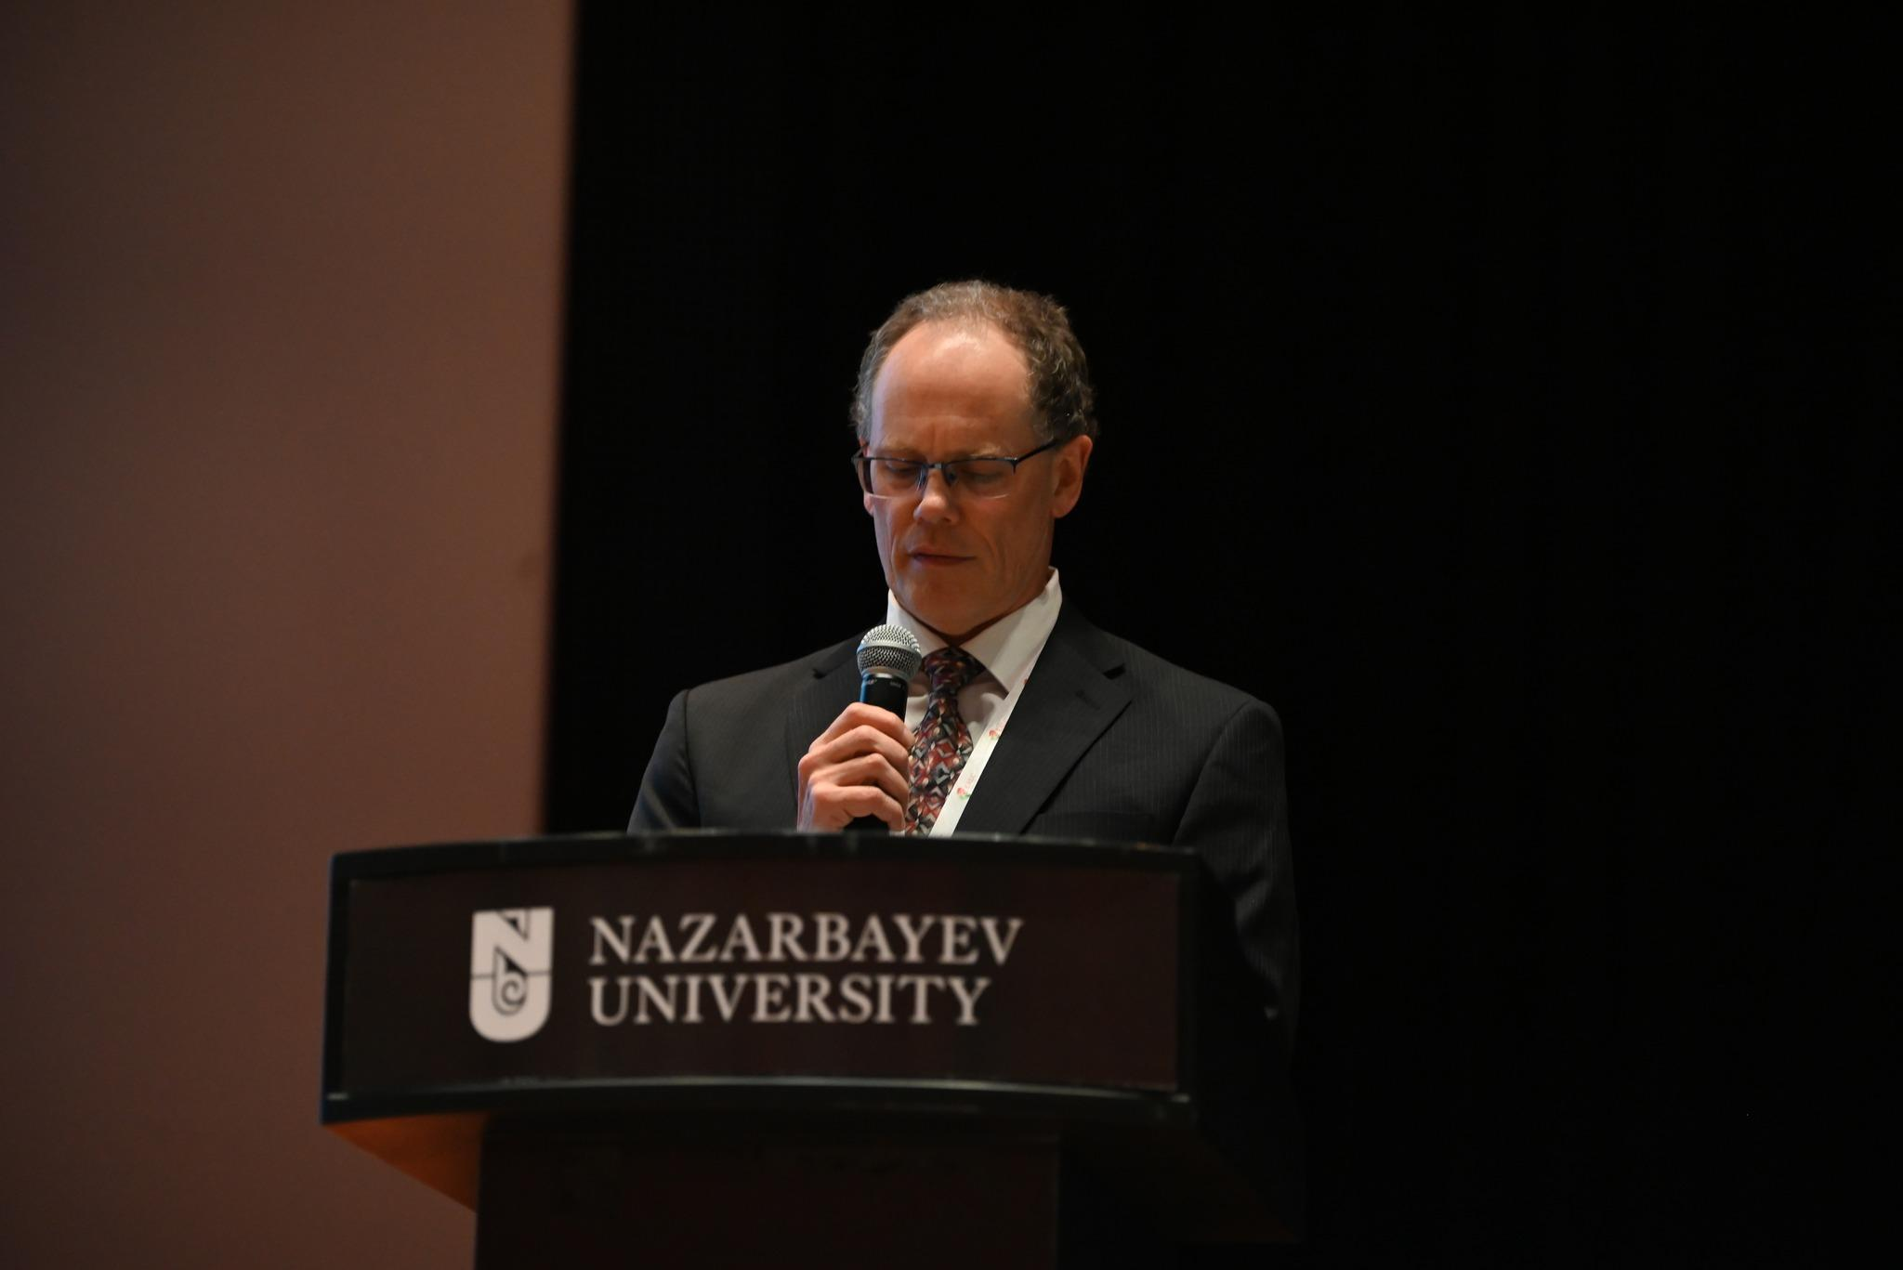
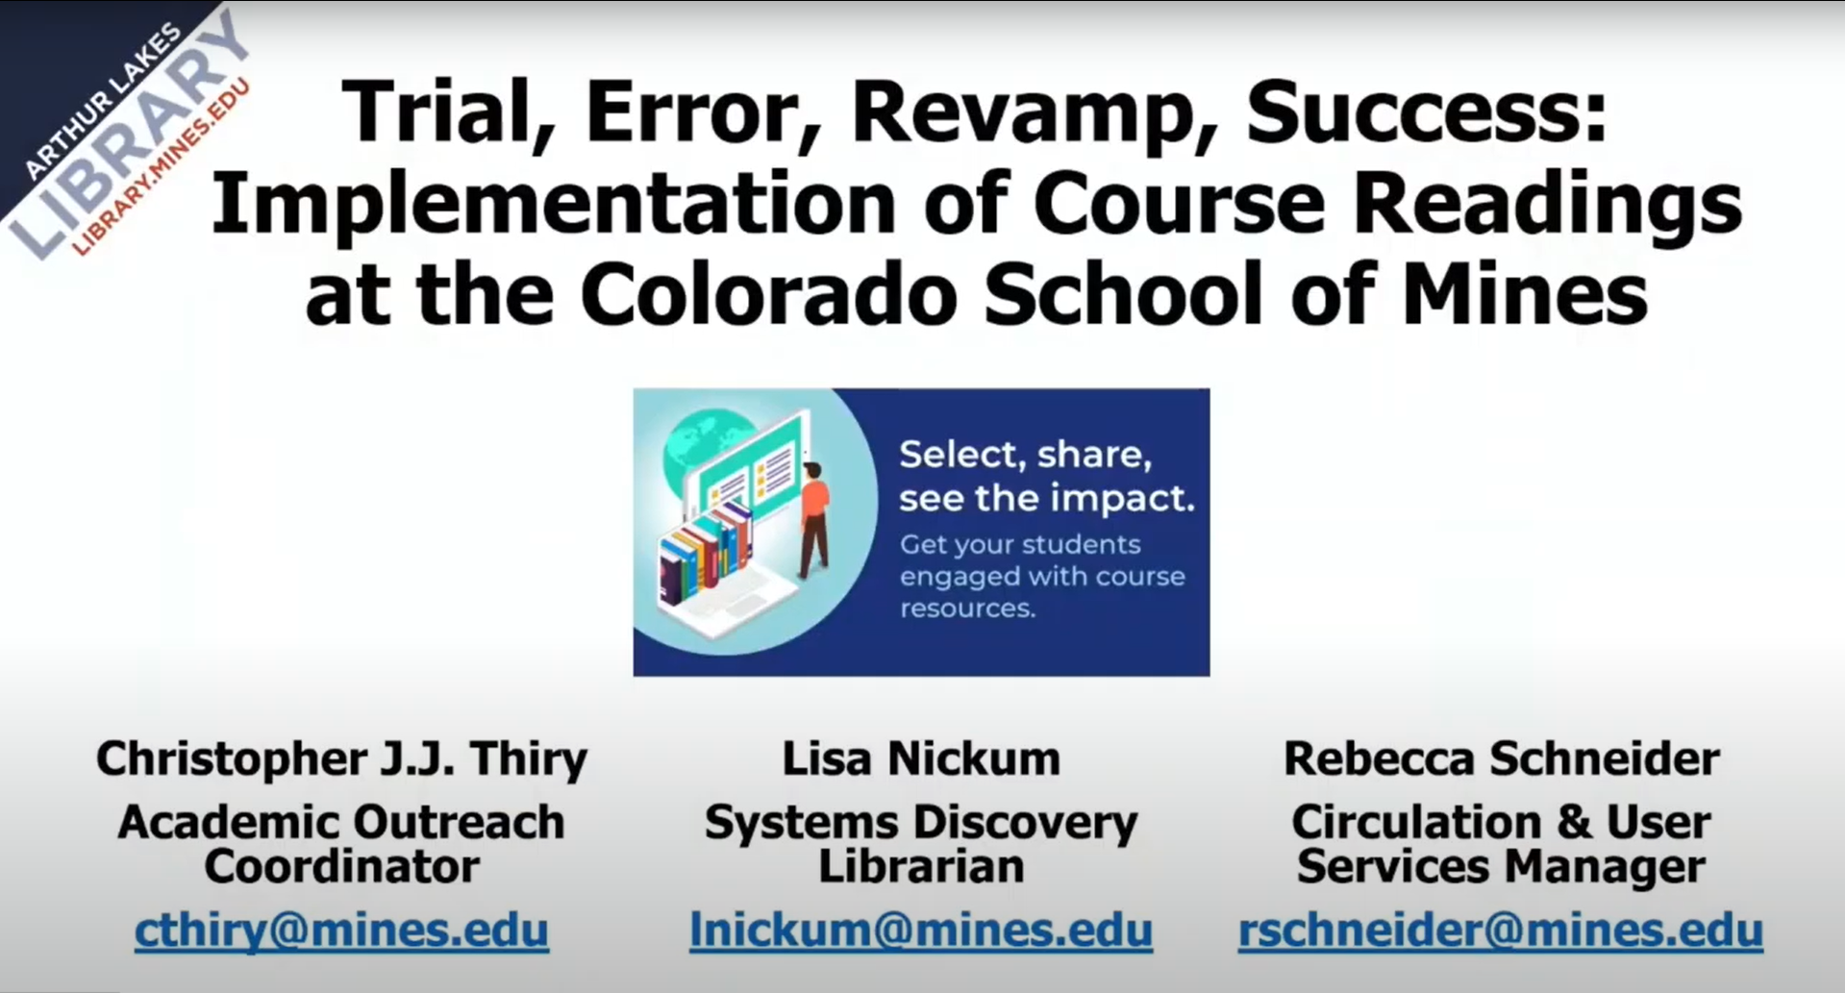
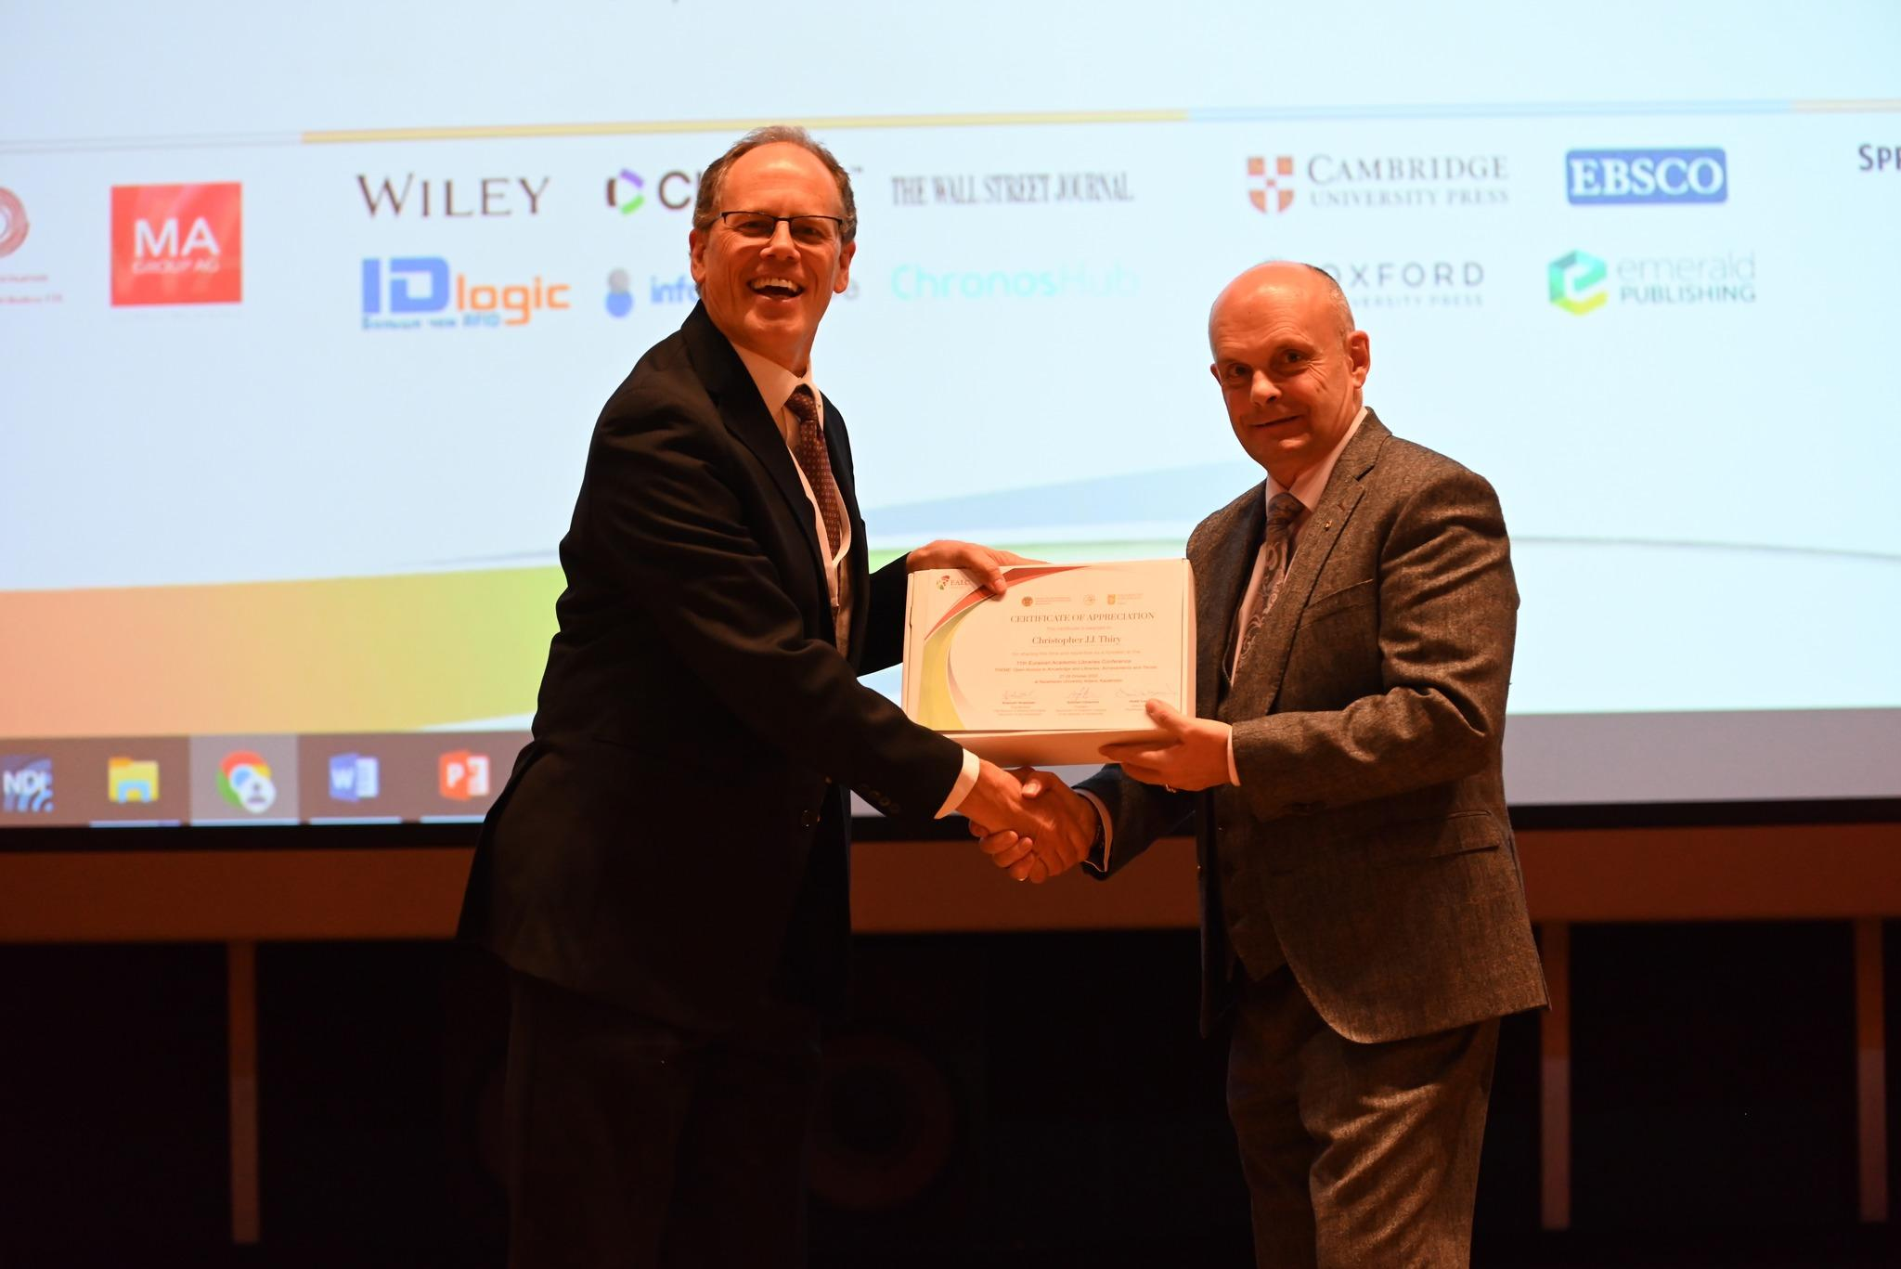
Colorado School of Mines & Arthur Lakes Library
Вставить презент его
Colorado School of Mines
Christopher J.J. Thiry,
Academic Outreach Coordinator
Colorado School of Mines

Slide 22
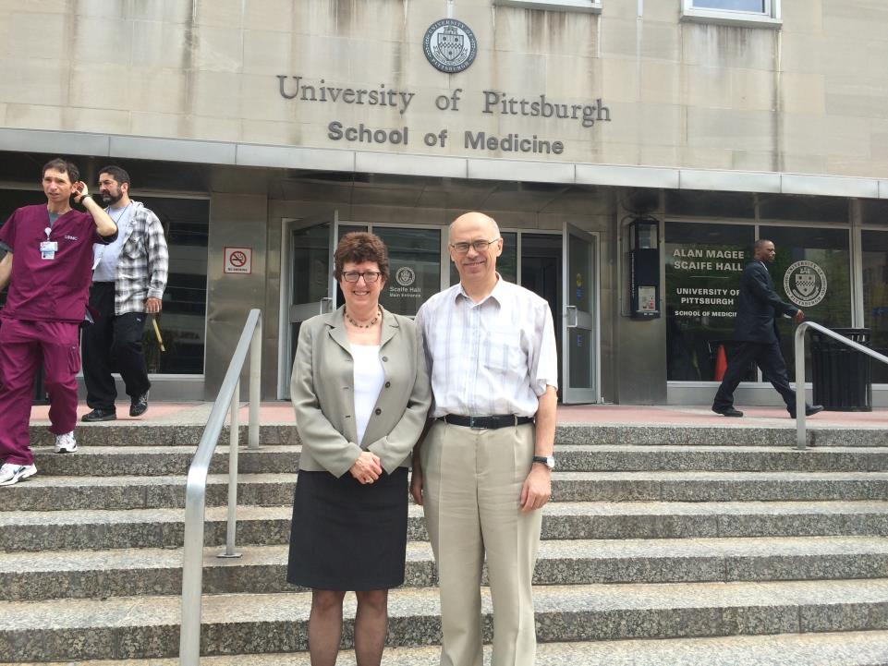
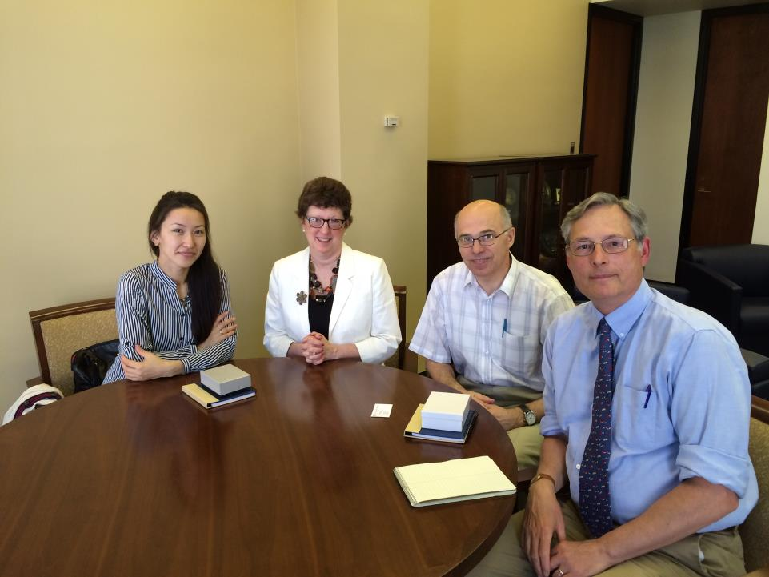
Internship at University of Pittsburgh Library, 2015
Health Science Library System, University of Pittsburgh, USA
In 2015, two NU librarians, Piotr Lapo, the library general manager, and Anar Dautova, one of the subject librarians who is liaison to the school of medicine, visited HSLS.
The goal of the visit was to learn firsthand how an academic health sciences library in the U.S. supports a medical school curriculum.
They met with the library’s leadership team, digital library services, and reference librarians.
Result: establishment of the NUSOM Library with a great medical collections

Slide 23
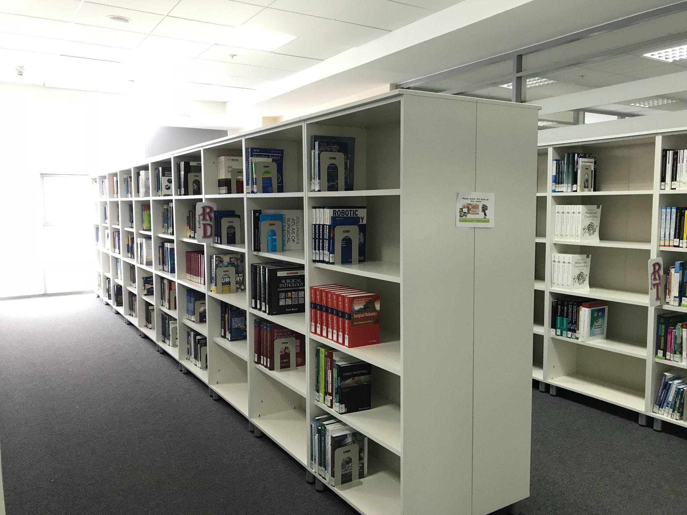
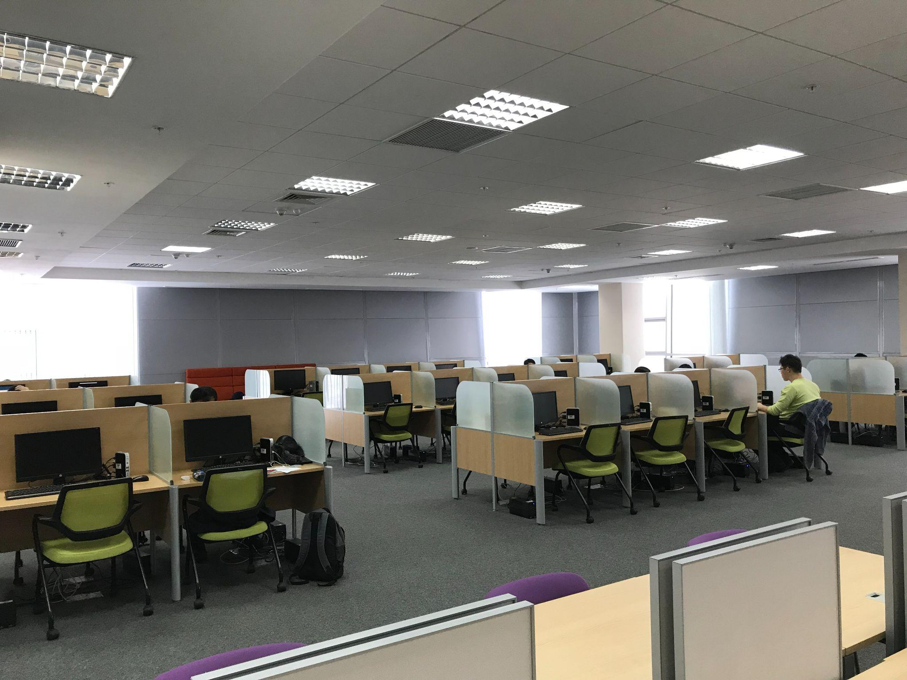
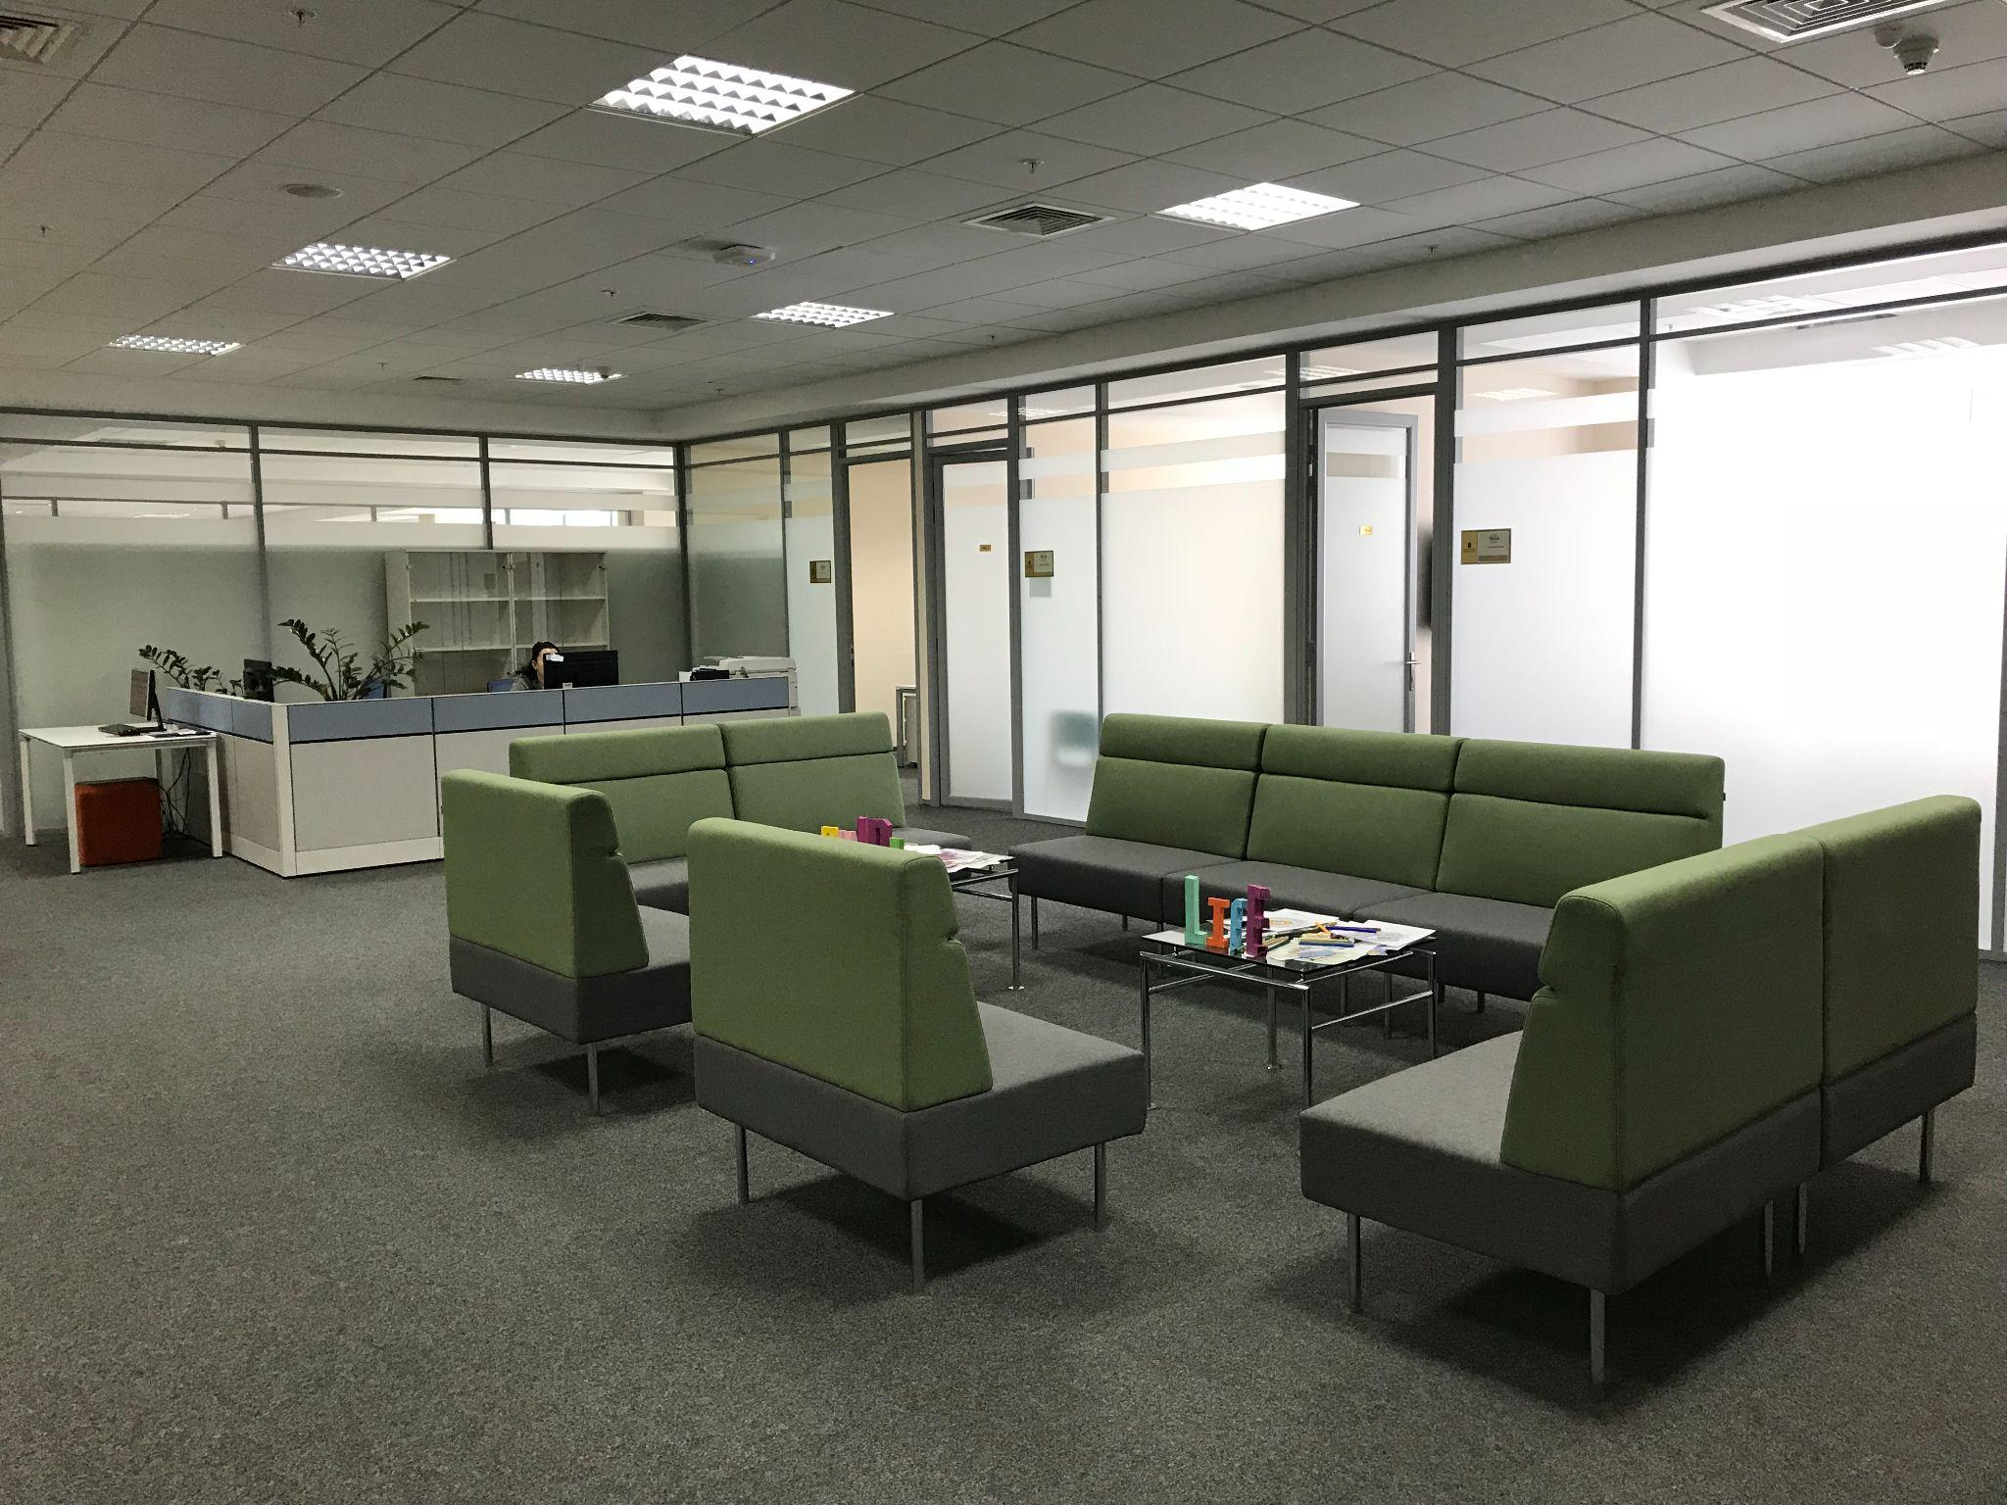
NUSOM Library, 2016
Medicine collection- more than 7000 copies
Subscriptions -41
Seats - 159
Small computer lab for 12 seats
Big computer lab in the Reading room for 48 seats
Room for individual study -1
Room for group study with multimedia system -1

Slide 24
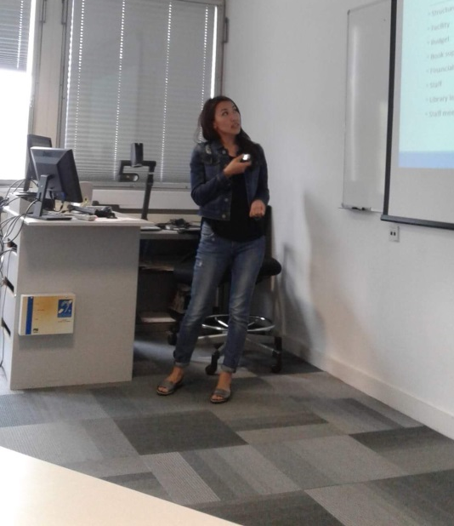
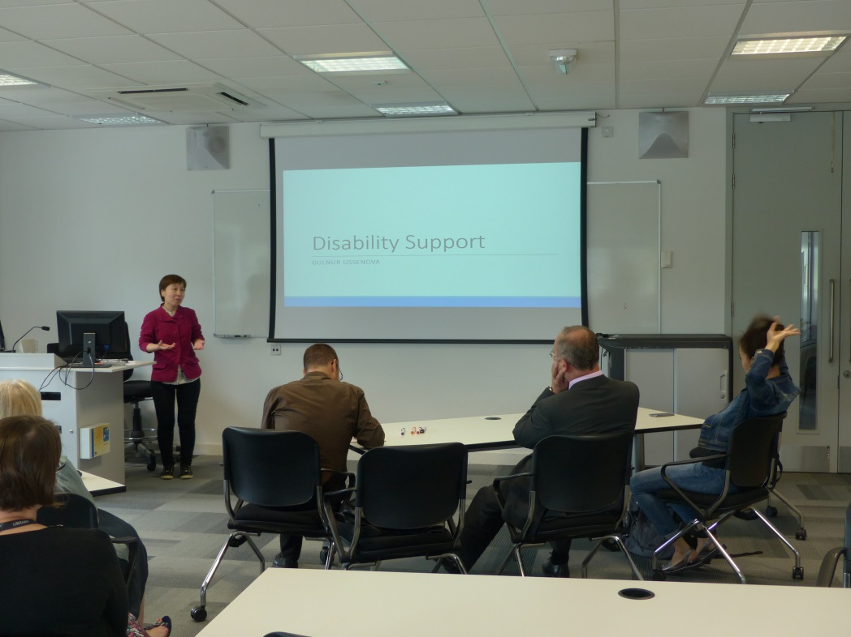

Erasmus program: Warwick University Library
June 17-25, 2017
Research Data Management (Data Management Plan (DMP), Marking Rubrics for DMPs, DMP Tools)
Academic Support: Medicine
Introduction to Scholarly Communication
Assistive Softwares
Embedded skills (Moodle system)
Special Collection and Rare Books
Electronic Access and Resources
Collections Management and Resource Delivery
Anar Dautova – Expert Manager • Patron Services Office, The autonomous organization of education Nazarbayev University
Gulnur Ussenova - Expert Manager • Patron Services Office, The autonomous organization of education Nazarbayev University

Slide 25
The Interlibrary Loan
The Interlibrary Loan (ILL) Document Delivery is a Library service provided to the NU Community in order to obtain unavailable materials at the NU Library from partner libraries.
The main partner institution of the NU Library regarding Document Delivery on a fee-based form is the University of Wisconsin-Madison Libraries.
ILL Partners, delivered in 2022:
University of Wisconsin-Madison Libraries - 231
University of Pittsburgh Health Sciences Library - 62
Duke Fuqua School of Business University Ford Library - 2
IFLA Document Delivery and Resource Sharing Section Standing Committee - 99
Library of Congress - 43

Slide 26
Visit us at
NU Library website: library.nu.edu.kz
NU Repository: nur.nu.edu.kz
NU Library on YouTube: https://www.youtube.com/watch?v=f3IYPoWFWdg

Slide 27
Thank you!

