Slide 1

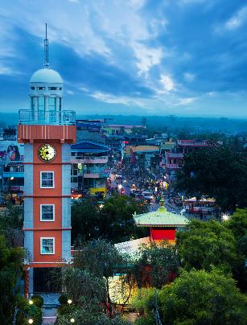
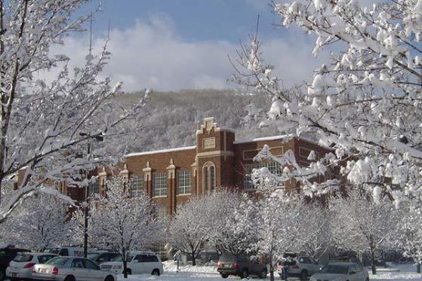
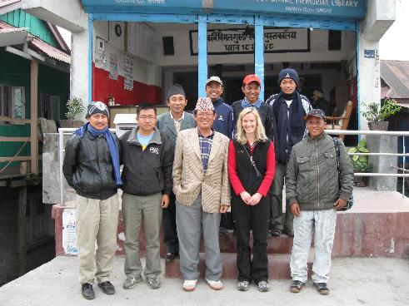
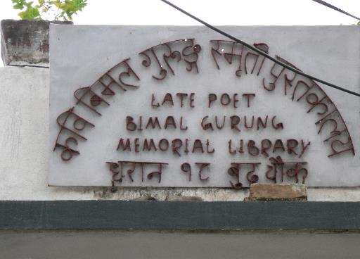
Park City and Bimal Library:
A sister library legacy of a 10th Mountain Division Veteran and Gurkha Soldiers Connection

Slide 2

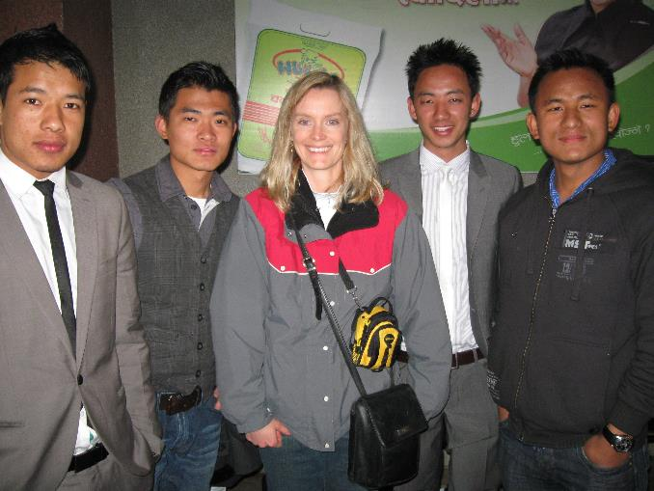
The Park City and Bimal Sister Library Program was inspired by Jim Powell’s reconnection with the Gurkha Soldiers he came to know during WWII. The partnership began on February 9, 2004
Jim Powell, 10 Mountain Division
Gurkha Soldiers and Linda Tillson at Tribhuvan International Airport Kathmandu Nepal – December 2008

Slide 3
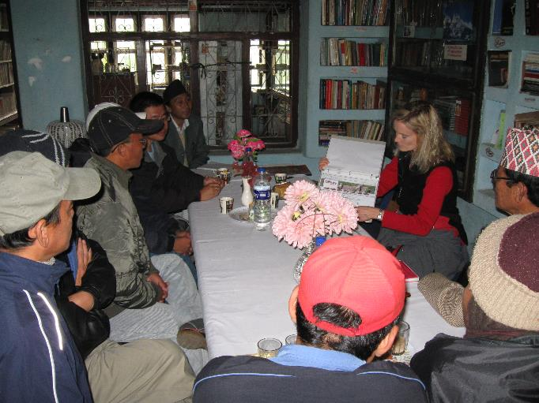
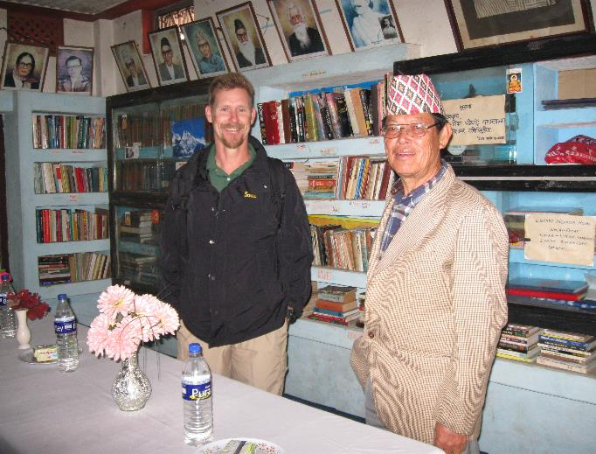
Partnership projects
Park City Library shipped books and other materials to the Bimal Library
Collaborated via e-mail on a variety of library topics in regard to providing services and materials to respective communities
Rohit did one month internship at Park City Library learned about
  Youth & adult programming
  Cataloging practices
  Collection development
  Library management
  Library software
  Circulation procedures
  customer service philosophy
In December 2008 Park City Library Director, Linda Tillson did a site visit to Bimal Library in Dharan, Nepal

Slide 4
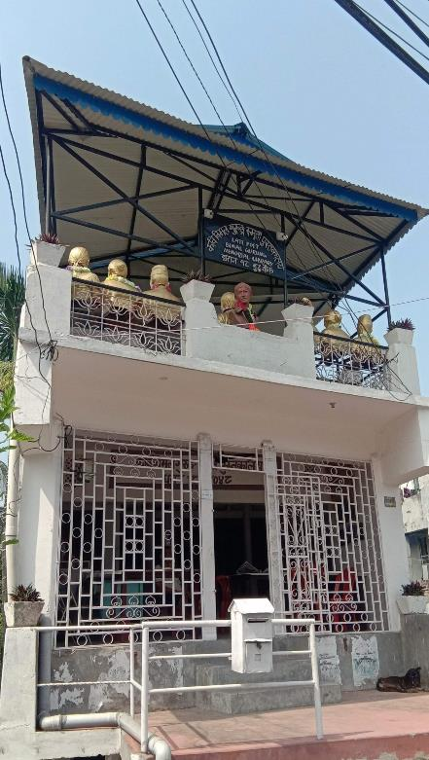
Roof purchased for Bimal Library with funds donated to Park City Friends of the Library

Slide 5
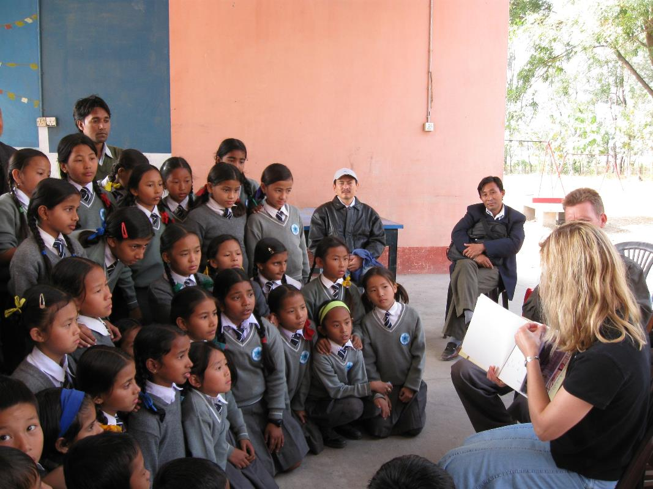
Benefits of Sister Library Partnerships
Promote cultural understanding
Place international emphasis on libraries and the importance of access for all
Heighten awareness of libraries among governments and local officials
Offers new perspectives
Develops lifelong friendships and connections
Create goodwill

Slide 6
Questions & Comments

