Slide 1
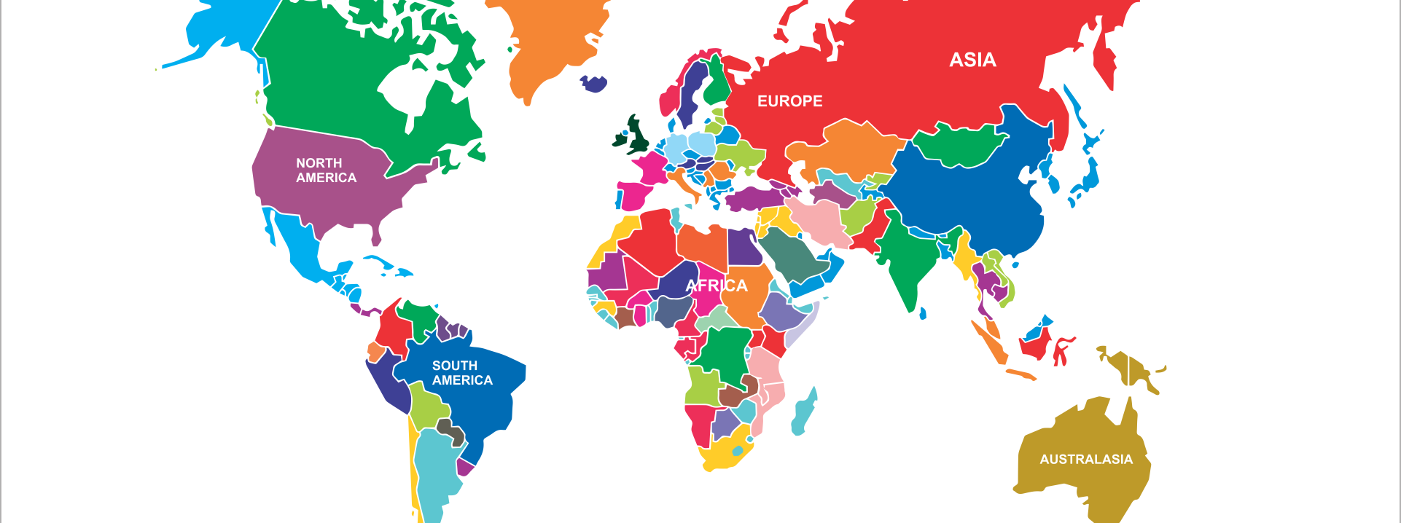



Beyond Borders:
Connecting Globally
International conference:
“Better Together: The Power of Global Library Connections”,
The International Library and Cultural Exchange Interest Group, Colorado Association of Libraries
March 6, 2023 (virtual, 2023 - Monday
Colorado School of Mines
Denver, Colorado, USA
Jesús Lau, PhD
Former Co-Chair, UNESCO MIL Alliance
Professor, Faculty of Pedagogy
Universidad Veracruzana, www.uv.mx, Veracruz Campus
Boca del Río, Veracruz, MEXICO
jlau@uv.mx / jesuslau@gmail.com / www.jesuslau.com.mx
Social and academic networks, jesuslau:
Twitter, FB, Instagram //
Google Scholar, Mendeley, Slideshare, LinkedIn, Wikpedia

Slide 2
Objective
Discuss the benefits and enriching experiences
of making global connections

Slide 3
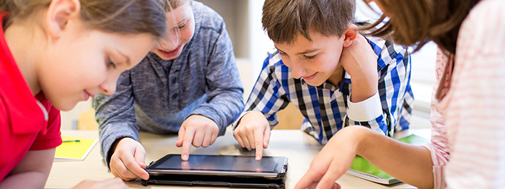
Kid´s Dream:
The World
As a son of an illiterate peasant who used to grow vegetables in a small piece of land:
I used a stick to draw maps on the soil floor before entering elementary school

Slide 4
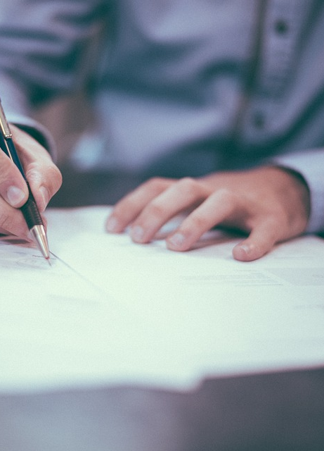
Making Connections
Open a map
Define objectives
Be flexible
One learns from everyone
Esta foto de Autor desconocido está bajo licencia CC BY-SA-NC

Slide 5
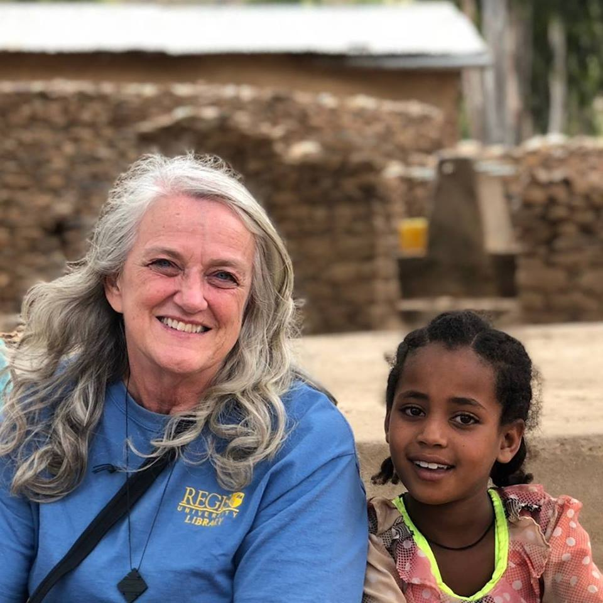
Personal International Beginnings
San Francisco, CA – First classes of English as a Second Language, the world opened up
Denver, Colorado / Library Science Master´s Degree: First flight, air conditioning experience, step on a rug (Met Janet Lee, my host today)
Sheffield, England / Ph.D in Information Studies: Briitish Culture, Discipline,
A great example: Janet Lee – Ethiopia´s experience

Slide 6


Expanded
My own cultural understanding
By experiencing others´:
General culture
Language
Food
Religious
traditions

Slide 7

Binational Experiences:
Transborder Library Forum
Transborder Library Forum: USA and Mexico
North American Free Trade Agreement kick off
Annual Forum held alternatively on both countries
Great colleagues and friends:
Charlene Baldwin: Meeting Management Course
Carol Elliott: Thesis, workshop, English editing
Several other professionals
Esta foto de Autor desconocido está bajo licencia CC BY-NC-ND

Slide 8
Better Together
Personal Parternships/Friendships
(A Selection)
Dorothy McGarry, California, USA // SLA, IFLA
Barbara Ford, IL, USA // ALA, IFLA, Transborder Library Forum
Charles Townley, Las Cruces, New Mexico // Border
Alan Griffiths, Sheffield, United Kingdom // Ph.D. Studies
Evgeny Kuzmin, Moscow, Russia // IFLA
Several others: Africa, Asia, Europe, North and South America, Oceania

Slide 9
Associations: Professional Catwalk Venues
01
02
03
04
Library Associations are great venues to meet international colleagues
Join their international sections or groups, such as ALA – IRRT
Attend international conference session and social events
Be active on social library media
05
Identify your goal and professional niche to be international relevant

Slide 10
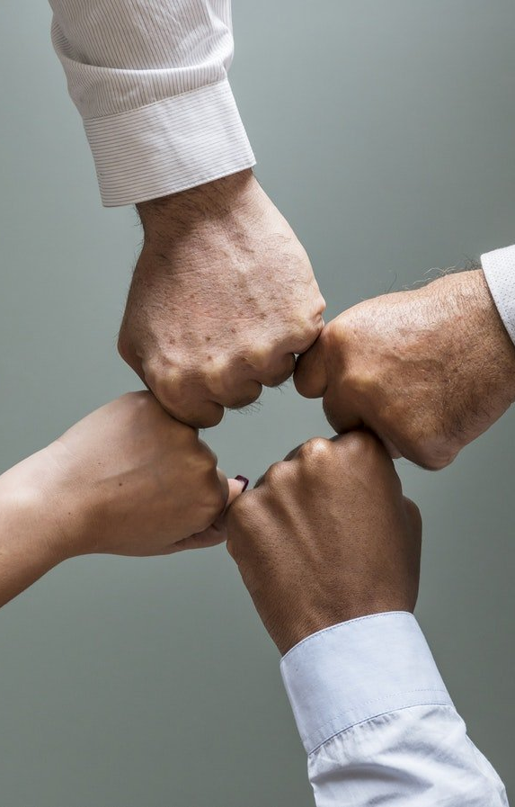
IFLA Experience / Benefits
25 world conferences around the planet (1987 -
First chair – Information Literacy Section
Authored information Literacy Guidelines (13 languages)
Information Literacy International State of the Art Report
International InfoLit resources database
Governing Board member, twice
Esta foto de Autor desconocido está bajo licencia CC BY

Slide 11

American Library Association
Perhaps the oldest ALA remaining Mexican member, 1976
Invited about seven ALA President-Elects to Mexican Library Association conferences (AMBAC): Barbara Ford, Jim Neal, Reforma, Loida Garcia-Febo.
Helped to sign cooperation agreements with AMBAC
Great ALA colleagues who I have worked with in different association endeavours

Slide 12

Special Libraries Association
One of the first (second) foreigners to be part of the Board of Directors
Part of some committees
First foreigner to receive the highest recognition: John Cotton Dana Award
Develop my leadership and management skills

Slide 13
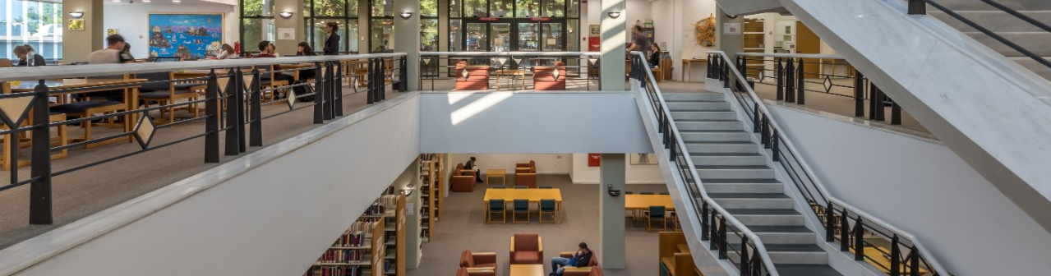
OCLC
First foreigner, former Advisory Council in the 1990´s
A great learning information technology experience (Nancy Allen)
Excellent institutional library benefits: Joined the network and actively participated

Slide 14
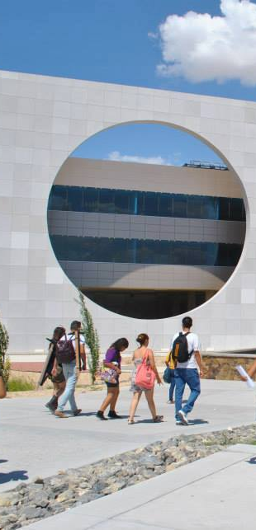
UACJ University Experience
Texas – Chihuahua Border
Background: 12 UACJ Librarians – 240 El Paso Librarians
El Paso Community Collegue – Borrowing Agreement
New Mexico State University – Borrowing Agreement, Collection development
UTEP – Special collections and interlibrary lending
Border Regional Library Association: Librarian of the Year Award

Slide 15
Rewards
Life has been an international journey and
libraries my passport

Slide 16
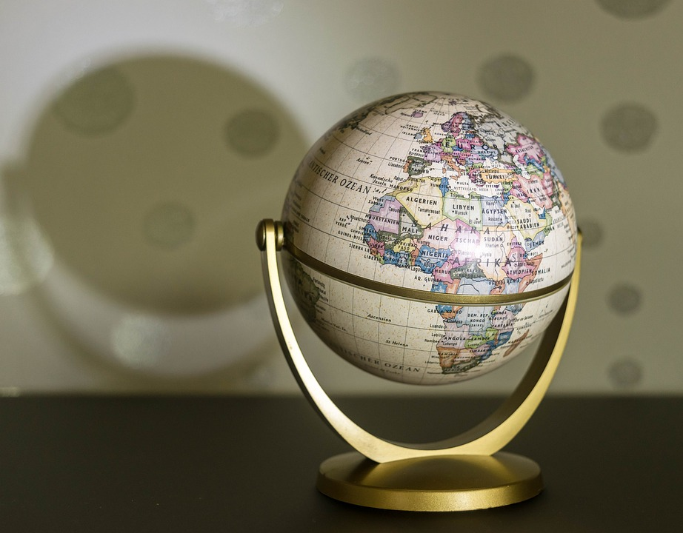
Power of Global Library Connections
Travelled for conferences, workshops or professional stays in:
70 countries

Slide 17
Conclusions
Benefits of partnerships, collaboration, cooperation have great intangible value to your professional development
Understanding of international cultures opens up one´s attitudes and values
Cultivate and harvest international understanding as much as you can
If I were born again, I would be more international and make the world my country, without borders

Slide 18
References
Autonomous University of Ciudad Juárez (UAC): https://www.uacj.mx/
Online Computer Library Center (OCLC): https://www.oclc.org/es/home.html
Special Libraries Association (SLA): https://connect.sla.org/home
American Library Association (ALA): https://www.ala.org/

Slide 19
Thanks!
Presentation will be available in
Slideshare

